Slide 1
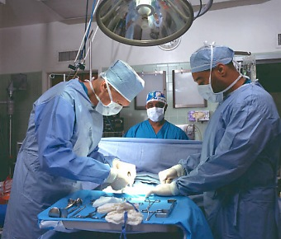
From… the Hospitals social dialogue committee… to the “sharp injuries” EU Directive COM(2009)577
Council Directive implementing the Framework Agreement on prevention from sharp injuries in the hospital and healthcare sector

Slide 2
The hospitals and healthcare sector
Challenges
5 millions workers in Europe
Mobility of patients/Mobility of workers
Safety of patients/Safety of workers
Attractiveness/ Image
New technologies
Demographic trends

Slide 3
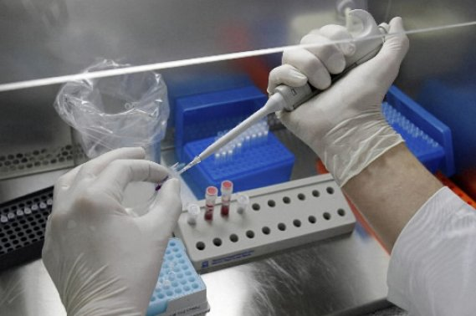
The EU social partners
Employers’ side (cooperation agreement)
HOSPEEM common employers platform issued from CEEP who is a cross- industry EU social partner for public enterprises
HOPE who represents the private dimension of the sector
Employees’ side
EPSU

Slide 4
First results of the SDC
SDC was launched in December 2006.
In parallel, Dublin foundation was requested by F1 to conduct a representativeness study in the sector
in December 2007, adoption of a
“Code of conduct and follow up on Ethical Cross-Border Recruitment and Retention in the Hospital Sector”

Slide 5
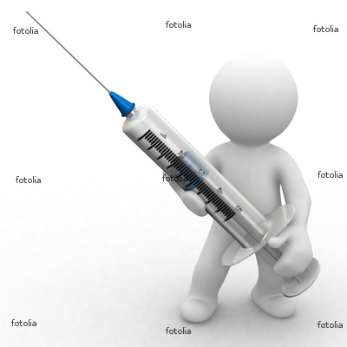
EU Parliament’s concerns (I)
On several occasions the European Parliament has expressed concern at the life-threatening risks to healthcare workers from contaminated sharp instruments, since the existing legislation, in practical terms, does not address the risk arising specifically from work with needles
Under the Lobbying from the pharmaceutical industries wishing to spread safe needle sticks ?

Slide 6
EU Parliament’s concerns (II)
Resolution of 24 February 2005 on promoting health and safety at the workplace, Parliament called for a revision of Directive 2000/54/EC on the protection of workers from risks related to exposure to biological agents at work to address specifically the risk arising from work with needles
On 6 July 2006, Parliament adopted a Resolution on protecting European healthcare workers from blood-borne infections due to needle-stick injuries requesting the Commission to submit a legislative proposal on the basis of Articles 137 and 251 of the EC Treaty for a directive amending Directive 2000/54/EC.

Slide 7
Art. 154 & 155 TFUE
Council
Commission
Social Partners
Consultation (art.154)
No
negotiation
or failure
Negotiation
(art.155)
Opinions
Legislative
process
Extension
procedure
Agreement
implemented
by a Decision
Autonomous
Agreement
– to be
implemented
by social
partners
NATIONAL PROCEDURES
& PRACTICES
LEGISLATION

Slide 8
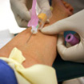
EU social partners’ consultations
Consultations on
“protecting European healthcare workers from blood-borne infections due to needlestick injuries” on 20.12.2006 and 20.12.2007
No real proposal for negotiation from EU SP’s at that time….

Slide 9
Role of the Commission
The Commission has helped to trigger the negotiation process:
Technical Seminar on February 2008
Organised in Brussels with all relevant EU stakeholders: surgeons, doctors, nurses, biologists, professors, F4, DG SANCO …

Slide 10
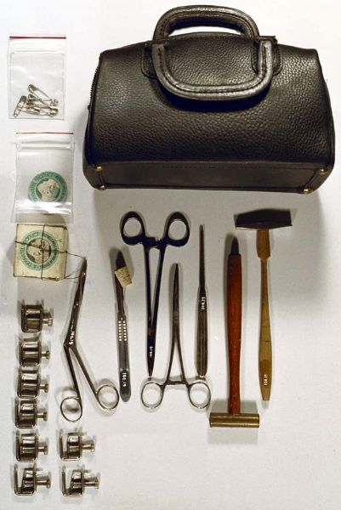
Technical seminar
Showed that needlesticks were one of the causes of injuries amongst others (scalpels, catheters, technical devices, …)

Slide 11
Impact assessment….
….of the Commission draft legislative proposal was rather in favours to adopting tools or common agreement on the issue than to revising the Directive 2000/54/EC on the protection of workers from risks related to exposure to biological agents at work ….

Slide 12
Added value of the negotiation process
EPSU and HOSPEEM informed the Commission of their intention to negotiate a framework agreement on all the causes of injuries in hospitals and healthcare sector (including needlesticks) in November 2008

Slide 13
The Commission has suspended its draft proposal
In January 2009 Commissioner Spidla received EU social partners informing them that they were given 9 months for achieving complete and ambitious agreement otherwise the Commission should resume its proposal

Slide 14
Information to the EU Parliament
On 26 January 2009, prior to entering negotiations, EPSU and HOSPEEM were heard by the EMPL committee of the EU Parliament, which was waiting for a EU regulation on the issue for 5 years…

Slide 15
The negotiation process
8 meetings
The role of the Commission is sensitive:
It has to respect the full autonomy of the negotiators while giving legal advices in view to achieve juridical consistency with exiting EU law (in terms of wording)
Service juridique and/or jurist linguists should be associated to the process with the agreement of SP’s

Slide 16
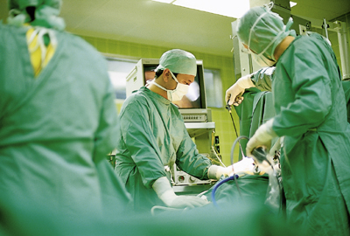
The framework agreement on sharp injuries
Was achieved by EU social partners with the assistance of F1 and F4 in 6 months (Jan/June)
Is complete, technical and ambitious
Addresses the topics of :
Risk assessment
Prevention
Protection
Information, awareness-raising and training of workers
Reporting and follow-up of hazards

Slide 17
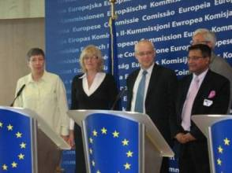
Signature - Press conference
On 17 July 2009, in presence of Commissioner Spidla and Journalists within the framework of a
…Followed by a joint request for implementing the Agreement via an EU directive

Slide 18
The draft proposal Directive
In September 2009, F1 and F4 (under the opinion of F2 and Service juridique) drafted the
Proposal Council Directive implementing the Framework Agreement on prevention from sharp injuries in the hospital and healthcare sector concluded by HOSPEEM and EPSU,
Adopted by the College on 26 October 2009, just before the “affaires courantes” period due to the expiration of Commission Barroso I ( 1st November 2009)

Slide 19
The proposal Directive
Ist Examination under the Swedish Presidency by the Working Party on Social Questions of the Council of the European Union
Under the Spanish Presidency, the Commission was questioned on the following issues:
Scope of the agreement, purpose, definitions, technical provisions (recapping), representativeness of the EU social partners
As regards the highly technical nature of certain questions, the Commission suggested that the WPSQ should invite the EU social partners who negotiated the agreement

Slide 20
The proposal Directive
On 25 January 2010, EPSU and HOSPEEM Secretaries general, with their technical advisers (doctors and dentists), were heard and called for drafting common clarifications to be annexed to the minutes of the Council
This common document was established on 4 February 2010
In the meantime, the EU parliament adopted a Resolution supporting the adoption by the council of the Directive

Slide 21
The EU Directive
On 8 march 2010, at a meeting of the Council in charge of Employment, Social Policy, Health and Consumer Affairs, the Council adopted the principle of the Directive
The Directive will protect around 5 millions workers in the hospitals and healthcare sector in Europe

Slide 22
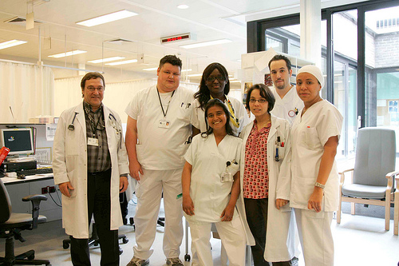
Conclusions
The EU social partners
Have showed their expertise
Are “co-legislators” in social matters
Have widened the scope of the envisaged regulation
Are fully recognised by the Council who decided to annex their common clarifications to its minutes in order to facilitate the directive implementation in the Member States

