Slide 1
International Labour Standards on Minimum Wages and Wage Negotiations in the Europe and Central Asia Region: Role of Unions
Rafael Peels, Senior Specialist in Workers’ Activities (ACTRAV) International Labour Organization (ILO)
International Seminar of Trade Union Economists on Wage Setting and Objectives in Eastern Europe and Central Asia
(Armenia, 15-16 October 2018)
Notes:
Good morning colleagues and friends,
Let me start by thanking the colleagues for organizing this event:
Confederation of TU of Armenia
ITUC
ILO: both SKILLS and ACTRAV
I am here on behalf of ACTRAV, the bureau for workers’ activities, of the International Labour Organisation.
This is also reflected in my presentation of today:
An institutional perspective, that is the ILO, with its core functions, such as standard setting and supervision. In other words, the ILO has developed ILS on this issue
A tripartite perspective, which is the DNA of the ILO … and which reflects a joint understanding among governments, employers and workers
With particular emphasis on the interest in workers and workers’ organizations (as representing the bureau for workers’ activities)
Will liaise with the other issues that will be discussed in the other panels:
such as GSCs, living wages, skills or public procurement, gender equality

Slide 2
WHY should we have this discussion ?
… at the heart of our lives
… political, economic, identity
… key role for unions
… the very reason of the ILO …
… level playing field
… “provision of an adequate living wage” as well as “the recognition of the principle of equal remuneration for work of equal value”
Notes:
Relevant and Timely
Pay the bills
Press (Political):
TUs, ETUC and ITUC campaigns
Win and lose elections on the issue
Economic:
Wages do not exist in a vacuum, but in an economic reality, which is often harsh, and based on international competition
Key in ILS on the issue
Identity:
Conditions for a life in dignity for workers and their families
Political economy:
fair share of the fruits of progress : role of unions
If you contribute as worker to progress, seems acceptable that as worker you participate in the benefits of this progress
The very reason of the ILO
Everyone play by the same rules - level playing field
Race to the bottom, based on workers’ rights and conditions
Wages
Living wage
Equal pay

Slide 3
Structure
Trends
International labour standards
… and outcomes of the ILO supervisory system
Roles of unions
… minimum wages and wage negotiations
Conclusions and the way forward

Slide 4
Trends : Introduction
Persistent uncertainty in the global economy …
… raises concerns about the ability of the economy to address
Global unemployment
High levels of vulnerable employment
Working poverty …
Notes:
- briefly, some overall trends: global, but also for countries in the region, and with regard to some particular issues …
- Global economic growth: 3.6% in 2017;
The total number of unemployed is expected to remain stable - above 192 million;
The number of workers in vulnerable forms of employment (own-account workers and contributing family workers) is likely to increase in the years to come.
In 2017, around 42 per cent of workers (or 1.4 billion) worldwide are estimated to be in vulnerable forms of employment,
while this share is expected to remain particularly high in developing countries, at above 76 per cent;
In 2017, working poverty remained widespread.
In developing countries, the number of people in extreme working poverty is expected to exceed 114 million in 2018, or 40 per cent of all employed people.

Slide 5
Trends : Gender inequality
Lower labour force participation rates …
Women in vulnerable employment …
… important gender pay gap
… inadequate access to social protection
Notes:
Today, women are less likely to participate in the labour market, facing a global gender gap in participation of over 26 percent.
Also less likely to find employment: global unemployment rate of women is higher than that of men.
Once in employment, women face restricted access to quality employment …
Women are over-represented in informal employment in developing countries
Vulnerable forms of employment are consistently higher for women
women are found to earn, on average, 20 per cent less than men
Vertical and horizontal discrimination (lower level jobs and sectoral segregation)
And as a consequence limited access to social protection, etc.

Slide 6
Gender gap … (hourly wages ; number of selected economies)
Source: ILO Global Wage Report 2016/2017
Notes:
- What we see on the figure is gender pay gap in hourly wages, including some of the countries of the region
- Azerbaijan, Georgia or Russia, Ukraine, Armenia: 20-45%

Slide 7
Male/female representation in wage distribution…
Source: ILO Global Wage Report 2016/2017
Notes:
Russia: Wage distribution from lower to higher wages and the representation of men and women therein
Women are in grey
Overrepresentation of women in the lower deciles of the wage distribution and underrepresentation in the upper deciles

Slide 8
The gender wage gap among the top occupational categories and among the top 1 per cent of earners …
Source: ILO Global Wage Report 2016/2017
Notes:
- Similar idea as the previous slide: gender pay gap in the wage distribution, having a look at the highest-paid occupational categories, compared to the overall gender wage gap?
At the left-hand side, you see that the gender wage gap among CEOs in the population is about 40 per cent – twice as high as the overall gender pay gap, which is about 20 per cent
So, higher wage gap in the better paid jobs
Within the top 1 per cent (right-hand side), the gender pay gap reaches about 45 per cent overall
Having a look at CEO’s: within the top 1 per cent, male CEOs earn twice as much as their female counterparts

Slide 9
Trends : Wages
In a nutshell …
… modest real wage growth
… increasing wage inequality
… wages do not follow improvements in labour productivity
Notes:
real wage growth has fallen from 1.6 per cent in 2012 to 0.9 per cent in 2015
during recent decades wage inequality has increased in many countries around the world
E.g. in most countries wages climb gradually across most of the wage distribution and then jump sharply for the top 10 per cent
wage growth in recent decades has lagged behind the growth of labour productivity, leading to a fall in the labour share of GDP

Slide 10
Annual average global real wage growth …
Source: ILO Global Wage Report 2016/2017
Notes:
Overall: modest real wage growth
We are not at pre-crisis levels
However, China has been responsible for the most significant part of this wage growth

Slide 11
Annual average real wage growth by region …
Source: ILO Global Wage Report 2016/2017
Notes:
In Eastern Europe real wages declined significantly in 2015 following the slowdown observed in 2013–14
To a large extent this reflects the drop in real wages observed in the Russian Federation and Ukraine
In Central and Western Asia estimates show that after a strong recovery from the crisis in 2010 and 2011, wage growth has since gradually slowed down.

Slide 12
In many countries there has been an increase in wage inequality …
Source: OECD Earnings Database
Notes:
What we see on the graph is that in the past 15 years, there has been an increase in the gap between the top and the bottom of the wage scale, which means that inequality increased …

Slide 13
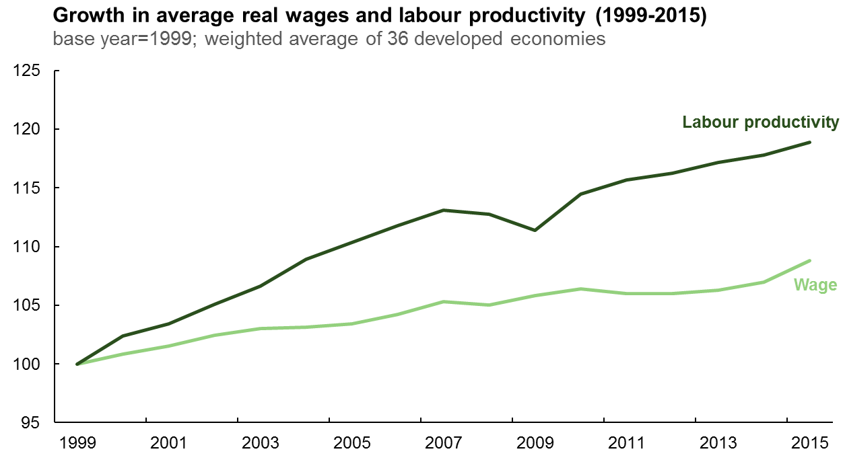
Real wages growth has lagged behind the growth of labour productivity …
Source: ILO Global Wage Report 2016/2017
Notes:
What this graph shows is that in the past 15 years for a group of 36 developed economies,
… growth in real wages has been lagging behind growth of labour productivity
… and accordingly a decreasing labour share, which is expressed, in the part of the total income allocated to labour compared to capital
(Wage adjusted productivity (ETUI))
1. labour productivity: added value per unit of labour
2. labour cost
3. wage adjusted labour productivity : how much value added is produced by a unit measure of labour costs

Slide 14
Inflation by region …
Source: ILO Global Wage Report 2016/2017
Notes:
High levels of inflation which has serious impact on real wage growth, as it erodes the value of wages
In the Commonwealth of Independent States (CIS), high levels of inflation
Importance of Russia
(Oil prices, economic sanctions, etc. ?)

Slide 15
Relative wage distribution in Russian Federation
Source: ILO Global Wage Report 2016/2017
Notes:
The figure shows the wage distribution in Russia, that is, it compares the lower wages with the higher wages
While wages climb gradually across most of the deciles, they jump sharply for the top 10 per cent and especially for the top 1 per cent of highest-paid workers
In other words, in Russia, the best paid gain more than 60 times the worst paid

Slide 16
Proportion of workers covered by collective bargaining …
Source: ILO, 2013
Notes:
CB coverage
Employees and employment (broader understanding of employment relationships – own account)
Large variation among countries
Context/tradition
Russia – Armenia – Ukraine – Kazakstan
Russia: around 20% CB coverage
Armenia: 15-25%, so probably high level of informal economy
Ukraine: 40-50%
Kazakstan: 50-75%
Method (only if asked):
The figure shows CB rate as a proportion of total employment and total employees
the difference between both is explained by the existence of the informal sector, i.e. own-account workers, which are not included under employees (only formal employment), however are included under employment
Therefore the CB coverage is higher for employees only as they have more chance to be covered compared to self-employed

Slide 17
Bargaining coverage and union density rates
Source: ILO, 2013
Notes:
Russia – Armenia – Kazakstan - …
CB is one of the core activities of TUs, so one may expect CB coverage to be higher when trade union density is higher …
… We see that CB and TU density generally go together …
… however, not always : institutional framework (extension of CBA vis-à-vis company-level bargaining)

Slide 18
International Labour Standards … … on Minimum Wages
The Minimum Wage Fixing Machinery Convention, 1928 (No. 26) and Recommendation, 1928 (No. 30)
Standards for particular categories of workers and sectors
The Minimum Wage Fixing Convention, 1970 (No. 131) and Recommendation, 1970 (No. 135)
broad scope of application
adjust from time to time
full consultation with social partners and independent experts
take into account the needs of workers and their families, as well as economic factors;
ensure effective application
Notes:
Representation of women in wage negotiation bodies (R30) in female dominated sectors
- Maritime, domestic, hotel workers
C131, most up to date:
All workers (vulnerable workers, such as non-standard forms of employment: temporary, agency, migrant and posted workers, etc.)
Regular adjustment (cost of living changes, but also economic environment)
Full consultation (METHOD) – in design and operation
Two main pillars: needs of workers and their families; as well as economic factors : balanced approach
Living wage - Cost of living (food, housing, education, etc.) vis-à-vis poverty line
Inequality - General level of wages and relative living standards of others
De facto application (e.g. labour inspection, …)

Slide 19
International Labour Standards … … on Equal Pay
Equal Remuneration Convention (C100) and Recommendation (R90)
Addresses the issue of equal pay for work of equal value, including the role of wage setting mechanisms and unions
Fundamental convention
Highlight consultation of the social partners in the establishment of gender-neutral job evaluations and classifications

Slide 20
International Labour Standards … … on Collective Bargaining
Freedom of Association and Protection of the Right to Organise Convention, 1948 (No. 87) and the Right to Organise and Collective Bargaining Convention, 1949 (No. 98)
… Fundamental, Enabling and Human Rights
Collective Bargaining Convention, 1981 (No. 154) and Recommendation, 1981 (No. 163)
… Whom, What, How
Notes:
Fundamental: irrespective of level of development, only for being a member of the ILO
Enabling: necessary condition for others (you need to have FoA to be able to enter into a genuine negotiation process)
Human (FoA) – Universal Declaration of HR
C154 – up-to-date instrument and key reference
Clarifies what is CB, who can participate in it, with which purpose, and what are the rules of the game

Slide 21
International Labour Standards … … Ratification
 | C26 | C131 | C154 | C87 | C98 | C100
Armenia | x | x | x | x | x | x
Azerbaijan |  | x | X | x | x | x
Belarus | x |  | x | x | x | x
Georgia |  |  |  | x | x | x
Kazakhstan | x |  |  | x | x | x
Kyrgyzstan |  | x | x | x | x | x
Russian Federation |  |  | x | x | x | x
Tajikistan |  |  |  | x | x | x
Turkmenistan |  |  |  | x | x | x
Ukraine |  | x | x | x | x | x
Uzbekistan |  |  | x | x | x | x

Slide 22
Outcomes of the ILO Supervisory Mechanism … … minimum wage setting and collective negotiations in the region
The absence or establishment of, or progress towards, a minimum wage
Armenia, Azerbaijan, Georgia, Uzbekistan, Kyrgyzstan, …
(Limited) role of social partners in wage setting (e.g. composition of wage board, economic and social committee, right of “other worker representatives” to bargain collectively, etc.)
Armenia, Azerbaijan, Belarus, Georgia, Uzbekistan, Kyrgyzstan, Russian Federation, Ukraine, …
- Adequacy of minimum wage and factors that are taken into account to establish minimum wage (e.g. poverty reduction, cost of living, economic needs, regular readjustment, etc.)
Belarus, Armenia, Azerbaijan, Kyrgyzstan, Ukraine, …

Slide 23
Outcomes of the ILO Supervisory Mechanism … … minimum wage setting and collective negotiations in the region
Coverage of minimum wages (e.g. informal economy, public employees, armed forces, etc.)
Armenia, Uzbekistan, Belarus, …
Enforcement (e.g. labour inspection, existing institutions, penalties, court decisions, pay slips, payment at regular intervals, workers’ claims, etc.)
Belarus, Armenia, Kyrgyzstan, …
Access to reliable data for effective wage setting (e.g. tripartite body, company-level data, number of collective agreements, employees covered, etc.)
Russian Federation, Kyrgyzstan, Armenia, …

Slide 24
Outcomes of the ILO Supervisory Mechanism … … Freedom of Association in the region
Right of workers and employers, without distinction whatsoever, to establish and join organizations (e.g. self-employed, informal economy, prison staff, military and police, judges, etc.)
Armenia, Kazakhstan, Ukraine, ...
Right to establish organizations without previous authorization and right of these organizations to organize their administration and activities in full freedom (e.g. right to strike, including in public service)
Armenia, Azerbaijan, Belarus, Georgia, Kazakhstan, Kyrgyzstan, Russian Federation, Tajikistan, Turkmenistan, Ukraine, …
Membership requirements (e.g. SMEs, higher-level organizations, trade union monopoly, etc.)
Georgia, Kazakhstan, Turkmenistan, …

Slide 25
Outcomes of the ILO Supervisory Mechanism … … Role of unions in wage setting for equal pay
the need for the principle of equal remuneration for men and women for work of equal value to be fully reflected in wage setting on minimum wages and through collective bargaining
incorporate the issue of equal remuneration for men and women for work of equal value on the agenda of specialized equality or diversity bodies, and bi- and tripartite wage bargaining and consultation bodies
apply gender-neutral criteria in the setting of wages and extent the coverage of minimum wages and collective agreements to ensure coverage of female dominated sectors and groups of vulnerable workers
raise awareness and address underlying causes of pay differentials
improved access to information on pay differentials

Slide 26
Role of Trade Unions … … four scenarios for the Future of Trade Unions
Gradual extinction ...
Dualization …
Replacement …
Renewal …
Source: J. Visser, forthcoming
Notes:
Gradual extinction
- through decreasing rates of unionization and trade unions becoming powerless in shaping the newly emerging labour markets.
Dualization
- unions will fight their corner and hang on to where they are currently strong, that is, in the public sector and social services, large firms, standard employment, skilled workers in industry and logistics, etc.
Replacement
- Unions will gradually give way to other forms of social action and representation, such as productivity boards, works councils, ethical codes, law firms and mediating agencies, and other forms of civil society action and representation.
Renewal
- Unions will find ways to expand beyond their current membership base, and represent women, youngsters and workers in the increasingly unstable workforce. This is without doubt the most desired scenario, and many examples exist where this is actually taking place, for instance by organizing seasonal and part-time workers, freelancers, taxi drivers in the platform economy, etc. Moreover, many examples exist of innovative practices of trade union action, such as union involvement in labour rights’ due diligence of MNEs; the incorporation of gender clauses in collective agreements; or living wage campaigns; to name but a few.

Slide 27
Conclusions and the way forward …
Strong, independent and representative trade unions are key …
Adequacy of wages …
Wage inequality …
Economic upgrading, skills anticipation and development ... and political economy
Social protection …
Fiscal policy … and the declining labour share
Globalized economy and innovative practices

Slide 28
What about your experiences ??

