Slide 1
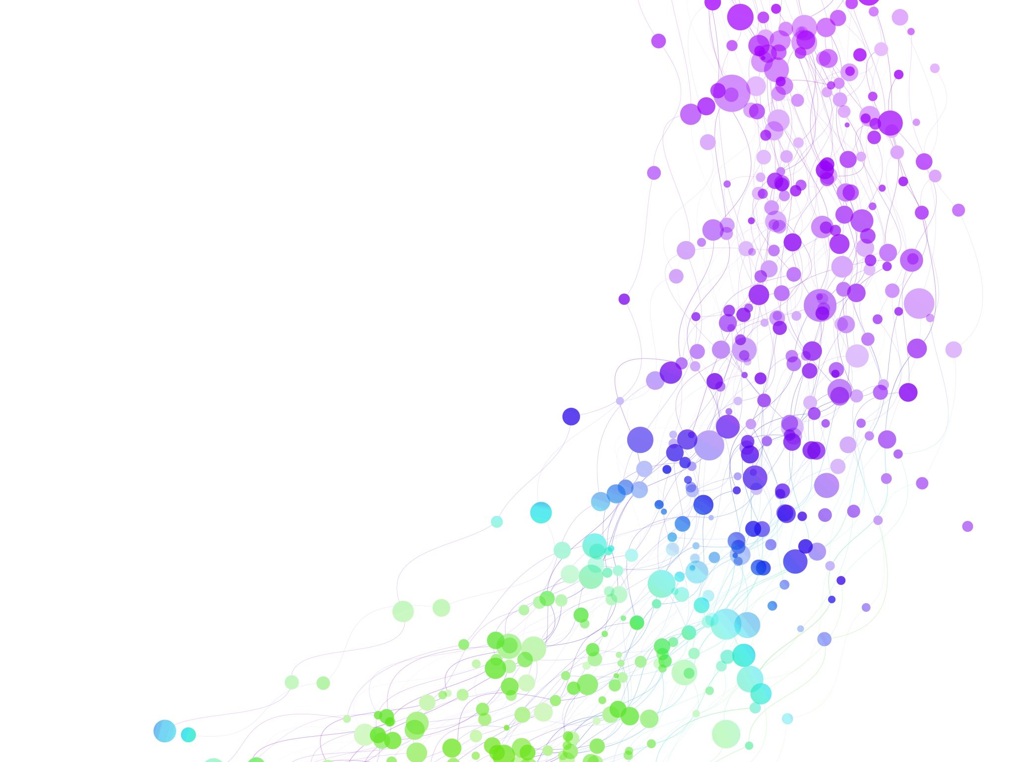
PERC ILO Trade Union Economic experts meeting
For Trade Unions from the Western Balkans, Ukraine, Moldova, and Georgia
8-9 June 2023, Belgrade Serbia
The state of the labour market following the onset of the recent pandemics and war
Bruno S. Sergi

Slide 2
Labour markets before and after the pandemics

Slide 3
Number of employees worldwide. In 2022 there were estimated to be approximately 3.32 billion people employed worldwide, compared with 2.28 billion people in 1991 - an increase of around 1.04 billion people. There was a fall in global employment between 2019 and 2020 when the number of employed people fell from 3.3 billion to 3.19 billion, likely due to the sudden economic shock caused by the Coronavirus pandemic.
4
Note(s): Worldwide; 1991 to 2022
Source(s): ILO

Slide 4
From 2000 to 2020, the global employment-to-population ratio decreased steadily, with a significant drop in 2020 following the COVID-19 pandemic. Since then, the ratio increased slightly, estimated to reach 55.84 percent in 2022. North America was the region with the highest employment rate worldwide in 2022.
Note(s): Worldwide; 2000 to 2022; 15 years and older
Source(s): ILO

Slide 5
Estimated employment-to-population ratio worldwide in 2022, by region. In 2022, the employment-to-population ratio worldwide was estimated to be approximately 55.8%, indicating that just over half of the global working age population were employed. Northern America had the highest employment-to-population ratio, at 58.8%, with Europe and Central Asia having the lowest at 53.9%.
Empoyment-to-population-ratio
6
Note(s): Worldwide; 2022
Source(s): ILO

Slide 6
Estimated employment-to-population ratio worldwide in 2022, by gender
Since 2000, employment-to-population ratio worldwide was constantly significantly higher among men than among women. Whereas more than two thirds of men were estimated to be employed worldwide in 2022, only around 44 percent of women were the same. Moreover, employment rates among both genders fell over the time period.
7
Note(s): Worldwide; 2022; 15 years and older
Source(s): ILO

Slide 7
Countries with the lowest employment-to-population ratio in 2021. In 2021, the Palestinian Territories had the lowest employment-to-population ratio worldwide at less than 32%. Iraq had the second lowest ratio, whereas Morocco, South Africa, and Moldova all had just below 40%. On the other hand, Qatar had the highest labor force participation rate.
Income level
13
Note(s): Worldwide; 2021; 15 years and older
Source(s): ILO

Slide 8


20 countries with the highest foreign-born labor force worldwide in 2021 (in millions)
The United States was, by far, the country with the highest number of foreigners in its workforce in 2021 with nearly 29 million foreign-born citizens in the workforce. Germany had the second highest foreign labor force at nearly eight million, followed by the United Kingdom. A high number of the countries on the list are EU members.
Number of foreign-born workers in millions
8
Note(s): Worldwide; 2021*; Includes both part-time and full-time employees; * The most recent value varies from country to country, reference year is put in brackets. Read more
Source(s): ILO

Slide 9
Global unemployment rate from 2003 to 2022 (as a share of the total labor force)
The unemployment rate in the World decreased by 0.4 percentage points in 2022 in comparison to the previous year. In total, the unemployment rate declined to 5.77% in 2022. Over the observed period, the unemployment rate has been subject to fluctuation.
9
Note(s): 2003 to 2022
Source(s): World Bank

Slide 10
Unemployment rate in the EU in January 2023 (seasonally adjusted)
The statistic reflects the seasonally adjusted unemployment rate in member states of the European Union in January 2023. The seasonally adjusted unemployment rate in Spain in January 2023 was 13%.
Note(s): EU; * as of December 2022.
Unemployment rate
24
Source(s): Eurostat

Slide 11

Average salaries in selected countries worldwide as of June 2021 (in U.S. dollars).
The average salaries in Germany amounted to 49,876 U.S. dollars. In the United States, this figures was 55,522 U.S. dollars. Among the selected countries, the highest wages were reported in Australia, with 83,910 U.S. dollars.
Reported in job ads.
Average salary in U.S. dollars
10
Source(s): Adzuna

Slide 12
Average annual wages for selected European countries in 2021 (in U.S. dollars)
Luxembourg had the highest average annual wage in Europe in 2021, at approximately 75 thousand U.S. dollars, compared with Slovakia, which had an average annual salary of just over 24.7 thousand U.S dollars a year, the lowest among the countries provided in this statistic.
Average annual wages in USD
37
Source(s): OECD

Slide 13
Number of employees worldwide in 2020, by region and sector (in millions)
The sector employing the largest number of people was the services sector for most of the presented regions in 2020. Only in Southern, South-Eastern Asia and the Pacific as well as Sub-Saharan Africa the agriculture industry was the main employer. In 2020, 270.3 million people in Southern Asia worked in the agriculture sector.
Number of employed people in millions
15
Source(s): ILO

Slide 15
2
Annual GDP growth projections for the U.S., U.K., Germany and Eastern Europe from 2010 to 2027*
Note(s): Europe, United States; 2010 to 2021
Further information regarding this statistic can be found on page 8.
Source(s): IMF; Statista; ID 369266

Slide 16
2
Real GDP growth in Central and Eastern Europe and Central Asia from 2019 to 2024, by subregion
Note(s): Asia, CEE; 2019 to 2021
Further information regarding this statistic can be found on page 8.
Source(s): World Bank; ID 1337207

Slide 17
Youth unemployment rate in selected world regions in 2000 to 2020
Globally, the youth unemployment rate (of those aged 15-24 years) fluctuated between 13 and 15.5 percent in each year between 2000 and 2019, before it rose above 17 percent in 2020 due to the Covid-19 pandemic.
Broken down by global region, however, there was much more variation. The Arab World was the region with the highest rate of youth unemployment in each year of the previous two decades, while East Asia and the Pacific generally had the lowest youth unemployment rate.
27
Source(s): World Bank

Slide 18
Youth unemployment rate of G20 countries in 2021
The youth unemployment rate of South Africa was around 64 percent in 2021, the highest of any G20 country. Brazil followed with a youth unemployment rate of close to 32 percent. In contrast, Japan's youth unemployment rate was the lowest at roughly four and a half percent.
Note: 15-24 years old
Youth unemploymet rate
28
Source(s): World Bank

Slide 19
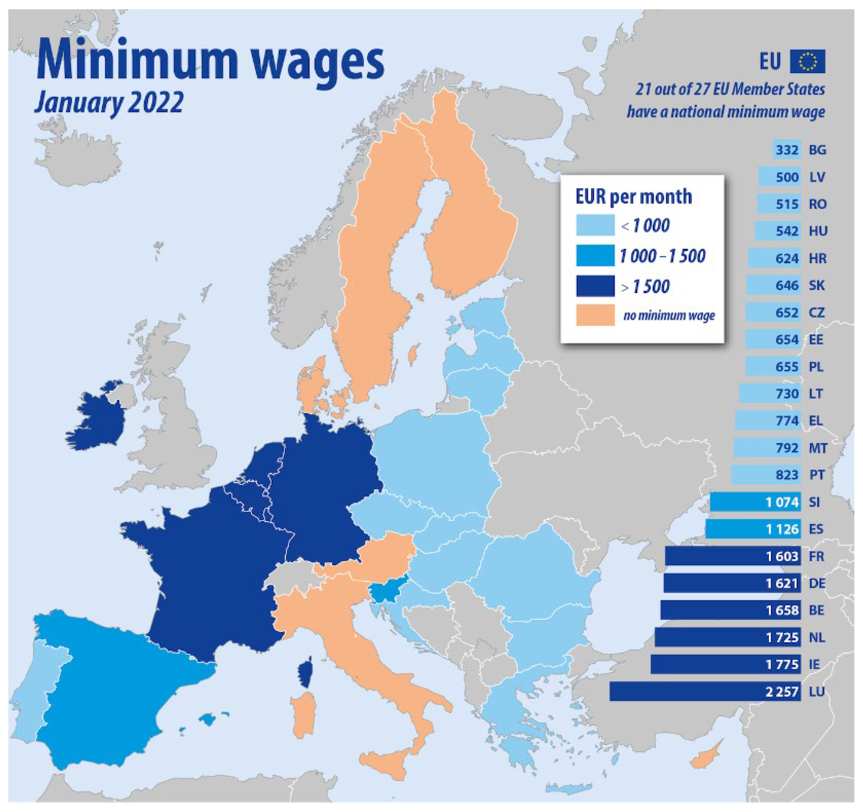
Labor cost lower than Western European Countries

Slide 20
Worldwide real wage growth forecast by country in Q1 2023.
Hungary was forecast to have the highest salary increase in the first quarter of 2023 of the 37 countries included. The salary increase in the European country was forecast to reach 15 percent. Serbia and Bosnia and Herzegovina followed behind. On the other hand, the Czech Republic was forecast to have a real wage decrease of 4.4 percent, with North Macedonia and Slovakia estimated to have a decrease of 3.6 percent.
Note(s): Worldwide; December 2022, unless other stated; *Data from September 2022. **Data from January 2023. ***Data from November 2022. ****Data from February 2023. *****Data from January 2022.
Wage growth - inflation rate
Country
33
Source(s): Trading Economics

Slide 21
Number of employees worldwide from 1991 to 2021, by broad sector (in millions)
In 2021 there were estimated to be approximately 866.3 million people employed worldwide in agriculture, compared with 1.64 billion people in services, and 753 million people in industry.
14
Source(s): ILO

Slide 22
2
Forecast of the number of internet users in Eastern Europe from 2013 to 2028 (in millions)
Note(s): Europe; 2013-2028; All values are estimates.
Further information regarding this statistic can be found on page 8.
Source(s): Statista; ID 1144544

Slide 23
The 20 countries with the highest unemployment rate in 2021
Countries with the highest unemployment rate 2021
Unemployment rate
20
Description: In 2021, South Africa had the highest unemployment rate in the world, at 34 percent. Of the 10 countries with the highest unemployment rates, eight were in Sub-Saharan Africa. Read more
Note(s): Worldwide
Source(s): CIA

Slide 24
Quarterly unemployment rates in developed and emerging countries from Q2 2017 to Q3 2022
Quarterly unemployment rates in developed and emerging countries 2017-2022.
From the second quarter of 2017, Brazil was the country with the highest unemployment rates. However, it has been decreasing constantly since the second quarter of 2021, dropping below eight percent in the last quarter of 2022. In the same quarter, Japan had the lowest unemployment rate of the countries included.
21
Source(s): Brazilian Institute of Geography and Statistics; MOHRSS; OECD

Slide 25
The statistic shows the unemployment rate in selected world regions between 2016 and 2021. In 2021, the unemployment rate in the Arab World was estimated to have been at 11.69%.
Unemployment rate
22
Source(s): World Bank

Slide 26
Breakdown of unemployment rates in G20 countries.
As of October 2022, South Africa had the highest unemployment rate among the 19 countries that are members of the G20. The unemployment rate in South Africa stood at 34.6 percent that year, followed by Turkey with an unemployment rate of 10.8 percent. On the other hand, Japan had the lowest unemployment rate at just 2.6 percent.
Unemployment rate
23
Source(s): IMF

Slide 27
Number of unemployed persons worldwide from 1991 to 2021 (in millions)
Between 2019 and 2020, the number of unemployed people worldwide increased from 191.93 million to 235.21 million, the biggest annual increase in unemployment in this provided time period. In 2021, the number of people unemployed decreased down to 216 million.
25
Note(s): Worldwide; * Preliminary estimates. **Projections. Values have been rounded. Projections for 2022 taken from the World Employment and Social Outlook: Trends 2021 report Read more
Source(s): ILO

Slide 28
Average real salary growth globally 2006-2019. The average real wages worldwide saw an increase every year since 2006. In 2007, salaries increased by 3.2 percent, which was the highest value in the past years. According to the forecast for 2019, the average wages were expected to grow by two percent in that year.
32
Note(s): Worldwide; 2006 to 2019; *Estimate. Read more
Source(s): ILO

Slide 29
20 countries with the highest average monthly salaries of employees worldwide in 2021 (in PPP U.S. dollars)
Belgium had the highest average monthly salary of employees in the world in 2021 in terms of Purchasing Power Parities (PPP), which takes the average cost of living in a country into account. Germany followed in second, with France in third. Notably, the Palestinian Territories had the sixth highest average monthly salaries of employees in the world.
Purchasing Power Parities 2017 U.S. dollars
34
Note(s): Worldwide; 2021*; Employees; * The most recent value of each country varies, the base-year is shown in brackets. The source adds the following information: "This series is based on the 13th ICLS definitions. For time series comparability, [...] Read more
Source(s): ILO

Slide 30
20 countries with the lowest average monthly salaries of employees worldwide in 2021 (in PPP U.S. dollars)
As of 2021, Hungary had the lowest average monthly salary of employees in the world in terms of Purchasing Power Parities (PPP), which takes the average cost of living in a country into account. Zimbabwe had the second lowest average wages, with Ethiopia in third. Of the 20 countries with the lowest average salaries in the world, 18 were located in Africa. On the other hand, Belgium had the highest average monthly salaries of employees.
Purchasing Power Parities 2017 U.S. dollars
35
Note(s): Worldwide; 2021*; Employees; * The most recent value of each country varies, the base-year is shown in brackets. The source adds the following information: "This series is based on the 13th ICLS definitions. For time series comparability, [...] Read more
Source(s): ILO

Slide 31
Average salaries of software developers worldwide as of early 2022, by role (in 1,000 U.S. dollars)
Average software developer remuneration globally 2022, by role. Senior Executive is the highest-earning software development job worldwide as 2022, with the average annual salary amounting to around 117,126 U.S. dollars. Engineering manager and site reliability engineer are the other developer jobs with high salaries.
Average salary in thousand U.S. dollars
29
Note(s): Worldwide; May 11, 2022 to June 1, 2022; 37,546 respondents; Software developers
Source(s): Stack Overflow

Slide 32
Average salary earned by cybersecurity professionals worldwide in 2022, by level of education (in U.S. dollars)
Average salary in the cybersecurity industry worldwide 2022, by educational level. In 2022, the highest average salary in the cybersecurity sector was paid to professionals who completed a doctoral/post-doctoral level of education. However, professionals who only graduated high school earned approximately 128 thousand U.S. dollars.
30
Note(s): Worldwide; May to June 2022; 3,757 respondents; Cybersecurity professionals
Source(s): ISC2

Slide 33
Median salary earned by cybersecurity professionals in 2022, by region (in U.S. dollars)
Median salary in the cybersecurity industry 2022, by region
31
Description: In 2022, highest median salary in the cybersecurity industry was paid in North America and amounted to 134,800 U.S. dollars. By contrast, median cybersecurity wages in Latin America slightly exceeded 22.1 thousand U.S dollars Read more
Note(s): Worldwide; May to June 2022; 3,757 respondents; Cybersecurity professionals
Source(s): ISC2

Slide 34
Analysis of the sector structure of the companies making greenfield investments in the region:
investing companies from the software and IT services sector account for the highest share of greenfield projects in CESEE, increasing in 2022 in all subregions;
in the CIS and Ukraine, investing companies from this sector accounted for almost half of all the greenfield projects in January-August 2022 (however, projects announced by supporting software and IT services companies are small);
CIS and Ukraine, FDI inflows have performed mainly poorly.
Kazakhstan and Moldova, which have a relatively stable political situation, managed to increase their FDI inflows slightly in Q2 2022, primarily on the back of reinvested earnings.
Source: https://wiiw.ac.at/economic-and-social-impacts-of-fdi-in-central-east-and-southeast-europe-dlp-6407.pdf

Slide 35
Information technology (IT) spending forecast worldwide from 2012 to 2023, by segment (in billion U.S. dollars)
The global information technology (IT) spending on devices, including PCs, tablets, mobile phones, printers, as well as data center systems, enterprise software, and communications services came to 4.26 trillion U.S. dollars in 2021. Global IT spending is expected to increase to around 4.43 trillion U.S. dollars in 2022 and 4.66 trillion U.S. dollars in 2023.
4
Note(s): Worldwide; 2012 to 2021; * Forecast Read more
Source(s): Gartner

Slide 36
Share of enterprises that expect their IT budget to increase in the next 12 months as of 2022, by sector
Nearly 60 percent of respondents working in power and utilities companies in 2022, expected their IT budget to increase over the next twelve months. On the other hand, only 38 percent of respondents from the governmental sector expected their IT budget to increase in the upcoming twelve months.
Expect IT budget increase
5
Note(s): Worldwide; July 20 to October 10, 2022; 1,785 respondents; Digital leaders across 82 countries
Source(s): Cionet; Harvey Nash; NashTech

Slide 37
Most important measures taken by global companies in order to create a positive work culture in 2022
In 2022, the main measures taken by companies worldwide in an effort to create a positive work culture was to implement flexible work arrangements so employees can work remotely, and flexible work hours. At the same time, 18 percent of respondents stated that their company had instituted robust parental leave policies.
Share of respondents
7
Note(s): Worldwide; May to June 2022; 11,525 respondents; Cybersecurity professionals on cybersecurity teams
Source(s): ISC2

Slide 38
Main impact experienced by cybersecurity professionals as a result of the war in Ukraine in 2022
In 2022, the main impact experienced by companies worldwide as a result of the war in Ukraine was increased focus on business continuity and resiliency. At the same time, 22 percent of respondents faced an increase in cyber security attacks either on their company or on third party partners and suppliers.
Share of respondents
8
Note(s): Worldwide; May to June 2022; 11,779 respondents; Cybersecurity professionals
Source(s): ISC2

Slide 39
Which skills would you like to acquire in 2023?
The most in-demand tech skill by recruiters in 2023 was by far web development, while the tech skill that developers wanted to acquire the most in 2023 was also web development, along with skills related to artificial intelligence, machine learning and deep learning. Game development skills ranked third among people's preferences.
Share of respondents
10
Note(s): Worldwide; 2022; 18,200*; Developers from 131 countries and recruiters from 98 countries
Source(s): CoderPad; CodinGame

Slide 40
Cybersecurity workforce gap worldwide in 2022, by region (in 1,000s)
The Asia-Pacific region witnessed the largest cybersecurity workforce gap in 2022, as over two million IT security professionals were still needed in the most populous continent at that time. Globally, a cybersecurity workforce gap of around 3.4 million needed to be filled.
16
Note(s): Worldwide, North America, Europe, APAC, LAC; 2022
Source(s): ISC2

Slide 41
Number of cybersecurity professionals needed worldwide in 2022, by country
In 2022, there were over one million cybersecurity professionals needed in China and over half a million in India. Overall, employers worldwide are struggling to find qualified and skilled professionals to fill cybersecurity roles.
Number of cybersecurity professionals needed
17
Source(s): ISC2

Slide 42
Size of cybersecurity workforce worldwide in 2022, by country
The number of professionals working in the cybersecurity industry was estimated to be over 1.2 million in the United States in 2022. The number of cybersecurity professionals globally stood at 4.6 million, up from 4.1 million in 2021. Cybersecurity refers to the practice of protecting computer information systems, hardware, networks, and data from cyberattacks. As awareness of cyber threats is rising, so is the size of the global cybersecurity market.
Number of professionals
20
Note(s): Worldwide; 2022
Source(s): ISC2

Slide 43
Most difficult cybersecurity roles to fill worldwide in 2022
The majority of the respondents stated that their company found it the most difficult to hire individuals for cloud security positions in 2022. Other cybersecurity jobs that were considered hard to fill worldwide were related to security operations, network security, and software development security.
Share of respondents
22
Note(s): Worldwide; 2022; 1,223 respondents; IT and cybersecurity decision-makers
Source(s): Fortinet

Slide 44
Which skills would you like to hire for in 2023?
The most demanded tech skill by recruiters in 2023 was web development. It was followed by DevOps and database software. At the same time, over 16 percent of recruiters were looking to hire people with cyber security skills.
Share of respondents
25
Note(s): Worldwide; 2022; 18,200*; Developers from 131 countries and recruiters from 98 countries
Source(s): CoderPad; CodinGame

Slide 45
Distribution of tech jobs that are hard to fill from 2020 to 2022, by country
In September 2022, Belgium and the Netherlands' share of tech jobs that were characterized as hard to fill in relation to total tech jobs was at 56 percent. A job position that is hard to fill is defined as a job that remained for more than sixty days on the relevant job posting site Indeed.com without finding a suitable candidate. By contrast, for the United Kingdom, the share of tech jobs that were hard to fill was below 40 percent.
Share of tech jobs
34
Note(s): Worldwide; 2020 to 2022
Source(s): Atomico; Indeed; Orrick; Slush

Slide 46
Planned changes to investment in IT staffing worldwide in 2022
Organizations had to reconsider their investments in IT employees as a result of the pandemic and the resignations that followed. In 2022, investment in the upskilling of existing employees was at the top, followed by remote workers and re-skilling of existing employees.
Share of respondents
38
Note(s): Worldwide; 2022; 501 respondents; Executives and high-level managers in IT with visibility into their organizations' overall IT budgets. Organizations with at least 2,000 employees.
Source(s): Flexera Software

Slide 47
Analysis of the sector structure of the companies making greenfield investments in the region:
investing companies from the software and IT services sector account for the highest share of greenfield projects in CESEE, increasing in 2022 in all subregions;
in the CIS and Ukraine, investing companies from this sector accounted for almost half of all the greenfield projects in January-August 2022 (however, projects announced by supporting software and IT services companies are small);
CIS and Ukraine, FDI inflows have performed mainly poorly.
Kazakhstan and Moldova managed to increase their FDI inflows slightly in Q2 2022, primarily on the back of reinvested earnings.
Source: https://wiiw.ac.at/economic-and-social-impacts-of-fdi-in-central-east-and-southeast-europe-dlp-6407.pdf

Slide 48

The future of employment in developing countries

Slide 49
The future of employment
Developing and enhancing human skills and capabilities through education, learning and meaningful work are key drivers of economic success, of individual well-being and societal cohesion.
The past decade of technological advancement, especially as AI technologies continue to advance, has also brought about the looming possibility of mass job displacement, untenable skills shortages and a competing claim to the unique nature of human intelligence now challenged by artificial intelligence.
The coming decade will require purposeful leadership to arrive at a future of work that fulfils human potential and creates broadly shared prosperity.
Source: WEF

Slide 50
The recent launch of ChatGPT stirs up fears about the impact of deep learning artificial intelligence on our economic future, especially on labor market. Will AI replace white collar jobs en masse?
Harvard Professor Joseph Fuller:
"ONCE COMPANIES LEARN HOW TO EXPLOIT GENERATIVE AI, WE CAN ANTICIPATE RAPID RESTRUCTURING AT MANY COMPANIES THAT INVOLVE SUBSTANTIAL CUTS IN WHITE-COLLAR STAFF.”
Harvard Professor Iavor Bojinov:
"AUTOMATING THESE TASKS WILL ENABLE KNOWLEDGE WORKERS TO CONCENTRATE ON VALUE-ADDING ACTIVITIES WHERE HUMAN EXPERTISE IS INDISPENSABLE"

Slide 51
Goldman Sachs economists predict AI like ChatGPT will replace as many as 300 million full-time white-collar jobs.
Goldman Sachs economists have warned that the latest wave of artificial intelligence, which has spawned platforms such as ChatGPT, could lead to the automation of up to 300 million full-time jobs worldwide.
They estimate that around two-thirds of current jobs in the United States and Europe are exposed to some level of AI automation, and up to a quarter of all work could be done entirely by AI.
The impact of this automation is expected to be more significant in advanced economies than in emerging markets, with white-collar workers deemed more vulnerable than manual laborers.
Administrative workers and lawyers are predicted to be the most affected, while physically demanding or outdoor occupations, such as construction and repair work, are expected to see little effect.
Overall, Goldman Sachs predicts that about 18% of work globally could be computerized.
Source: https://www.cnn.com/2023/03/29/tech/chatgpt-ai-automation-jobs-impact-intl-hnk/index.html#:~:text=300%20million%20jobs%20could%20be%20affected%20by,of%20AI%2C%20says%20Goldman%20Sachs&text=As%20many%20as%20300%20million,according%20to%20Goldman%20Sachs%20economists.

Slide 52
Goldman Sachs economists predict AI like ChatGPT will replace as many as 300 million full-time white-collar jobs.
The impact of AI on the labor market can affect both developed and developing countries alike, but the consequences are not equally distributed.
Larger and more affluent countries may have the means to mitigate any negative effects. Nonetheless, AI can also offer opportunities for job creation, increased productivity, and economic growth in developing countries.
AI can automate tedious and repetitive tasks, allowing human workers to focus on more sophisticated and imaginative work. It can also be leveraged to improve public services, such as healthcare and education, leading to better health outcomes, higher education standards, and increased economic well-being.
Source: https://www.cnn.com/2023/03/29/tech/chatgpt-ai-automation-jobs-impact-intl-hnk/index.html#:~:text=300%20million%20jobs%20could%20be%20affected%20by,of%20AI%2C%20says%20Goldman%20Sachs&text=As%20many%20as%20300%20million,according%20to%20Goldman%20Sachs%20economists.

Slide 53
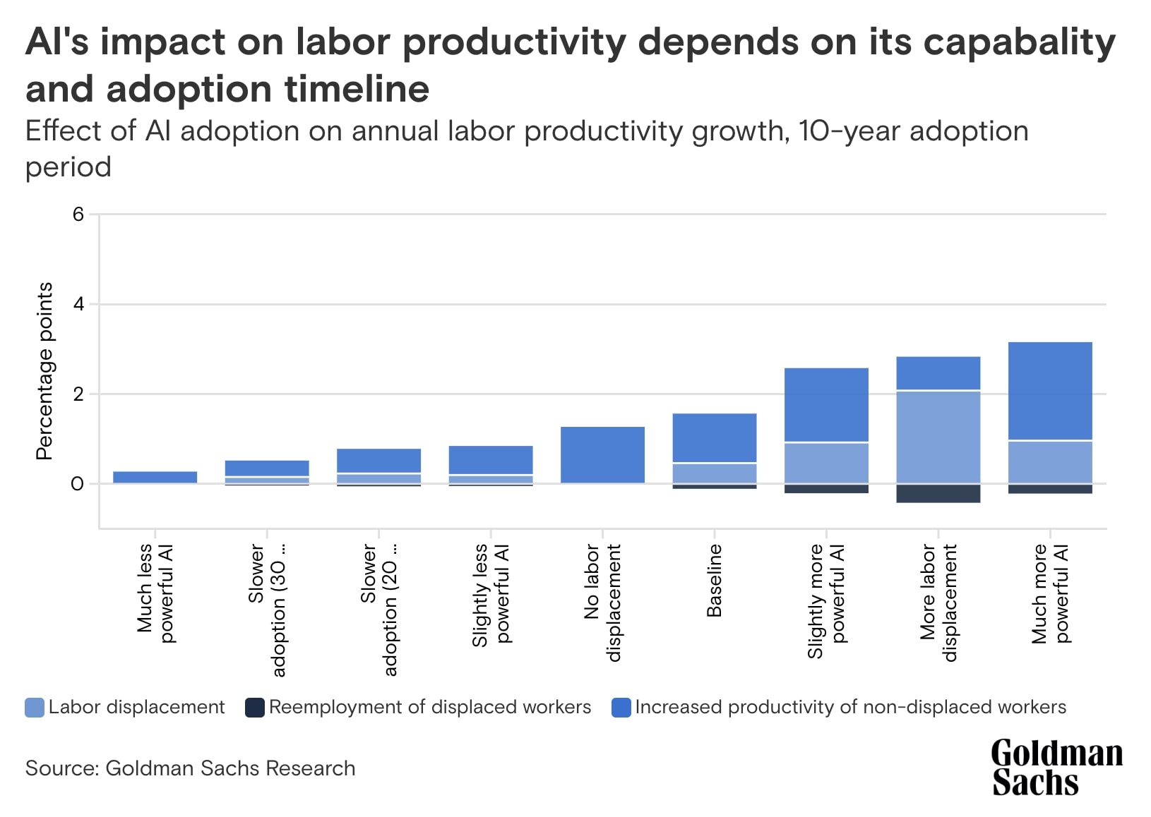
Better AI will significantly enhance labor productivity, but that also means AI to replace human employment

Slide 54
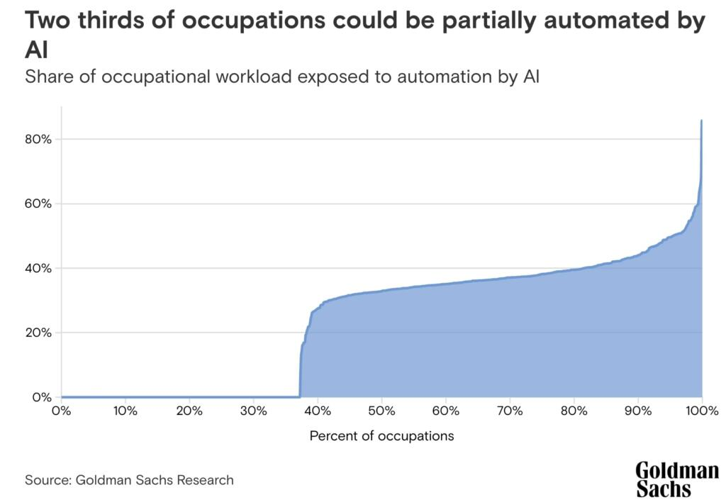

Slide 55
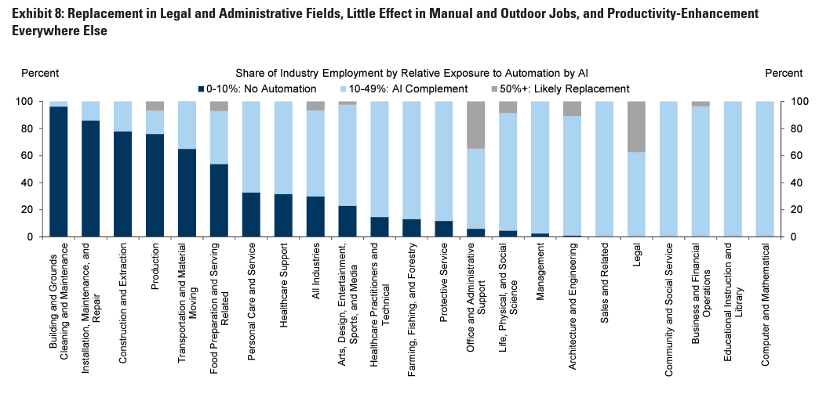
Goldman Sachs

Slide 56

Technologies likely to be adopted by 2025 (by share of companies surveyed)
Source: WEF

Slide 57
Does education prepare for skills in both developed and developing countries?
Almost half of the young people surveyed in both developed and developing economies feel they don’t have the right skills, according to the World Economic Forum’s Davos Labs Youth Recovery Plan 2021.
Source: https://www3.weforum.org/docs/WEF_Davos_Lab_Youth_Recovery_Plan_2021.pdf

Slide 58
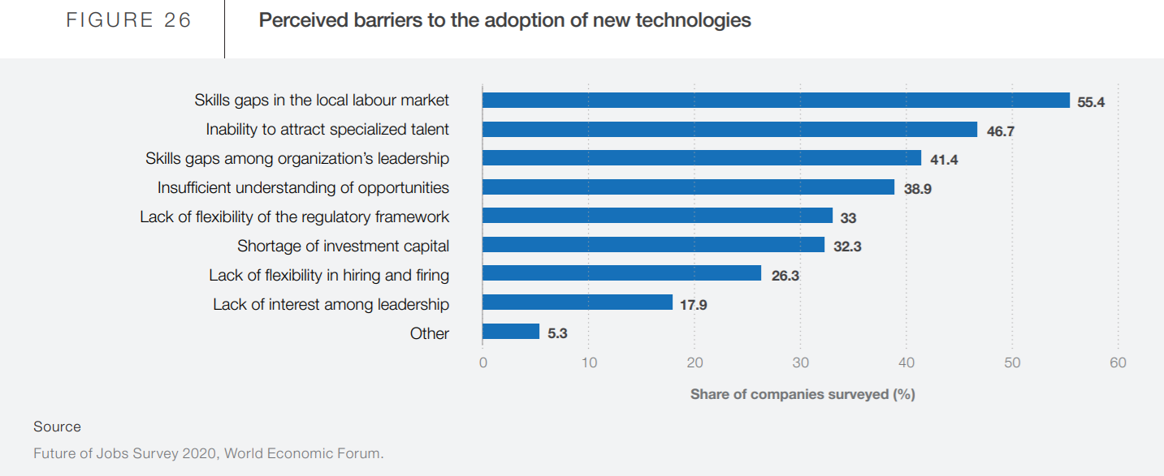
Source: WEF

Slide 59
Skill mismatch and overeducation in transition economies
Substantial skill shortages coexist with overeducation, affecting both young and old workers.
Research at World of Labor did an analysis on the pros and cons of this issue, and the impact to transitional economies.
Source: https://wol.iza.org/uploads/articles/224/pdfs/skill-mismatch-and-overeducation-in-transition-economies.one-pager.pdf?v=1

Slide 60
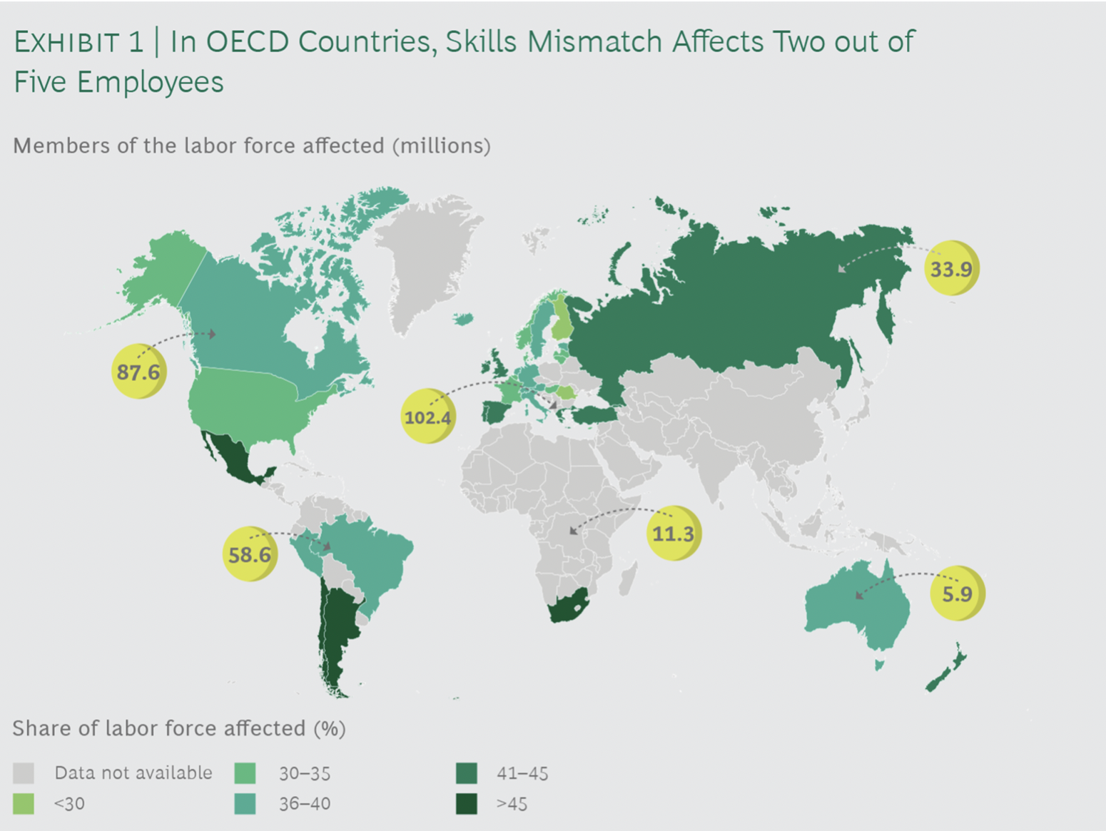
Ongoing technological change and market transformations require flexible thinking, quick and continuous learning, and mobility.
The problem is as a result of ineffective, the skill demand of the economic sector doesn’t always meet by the education system.

Slide 61

An Empirical Analysis.
The labour share and income inequality in post-Soviet countries
(with S. Balashova and S. Ratner)

Slide 62
Motivation
Labour compensation in GDP is chosen to be one of the indicators to measure a progress in achieving one of the goals of Sustainable Development (indicator 10-4-1).
Although labour compensation in GDP was roughly constant during the XX century, in the XXI century the declining labour share of income was observed in some countries especially in the USA and other advanced economies.
It causes the mounting concern about the rising inequality (Piketty, 2014). This concern has increased during the COVID-19 pandemic.

Slide 63
Average Gini coefficient of pre-tax national income in 17 CESEE economies during 1990s, 2000s and 2010s

Slide 64
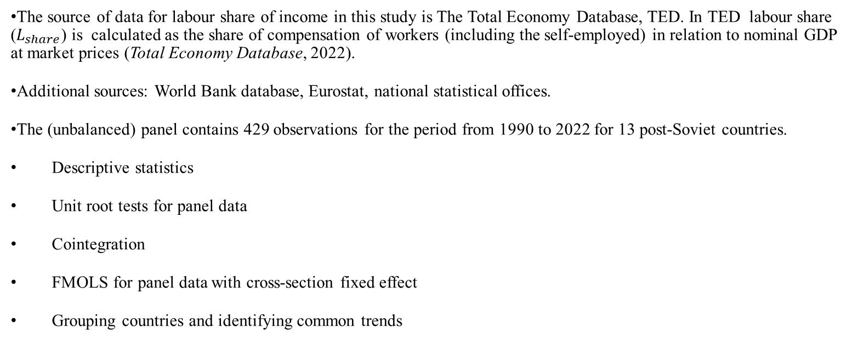
Methodology
The source of data for labour share of income in this study is The Total Economy Database, TED. In TED labour share ($L_{share}$) is calculated as the share of compensation of workers (including the self-employed) in relation to nominal GDP at market prices (Total Economy Database, 2022).
Additional sources: World Bank database, Eurostat, national statistical offices.
The (unbalanced) panel contains 429 observations for the period from 1990 to 2022 for 13 post-Soviet countries.
Descriptive statistics
Unit root tests for panel data
Cointegration
FMOLS for panel data with cross-section fixed effect
Grouping countries and identifying common trends

Slide 65



GINI Index Box-Plot
Russia – the highest level of inequality
Ukraine and Belarus – the lowest level of inequality

Slide 66




Labour Share of Income
Armenia, Kazakhstan, Kyrgyz Republic and Moldova –downward stochastic trends

Slide 67
Association between Labour Share and Gini Index
Negative correlation only in Estonia and Latvia

Slide 68
Labour Share vs Inequality
Globalisation
Economic growth → Labour Share decline
New technologies
redistribution of income through taxation → Inequality decline

Slide 69
Example of Estonia, Latvia, Lithuania

Slide 70
Research hypothesis
Gini Index, Labout Share, GDP growth and Government efficiency are cointegrated
Data:
Moving average of Gini Index (World Bank database)
Moving average of Labour share (TED database)
GDP growth (World Bank database)
Government efficiency (World Bank database)

Slide 71
Methods
Test for cointegration for panel data
Panel Fully Modified Least Squares
Residual diagnostics

Slide 72
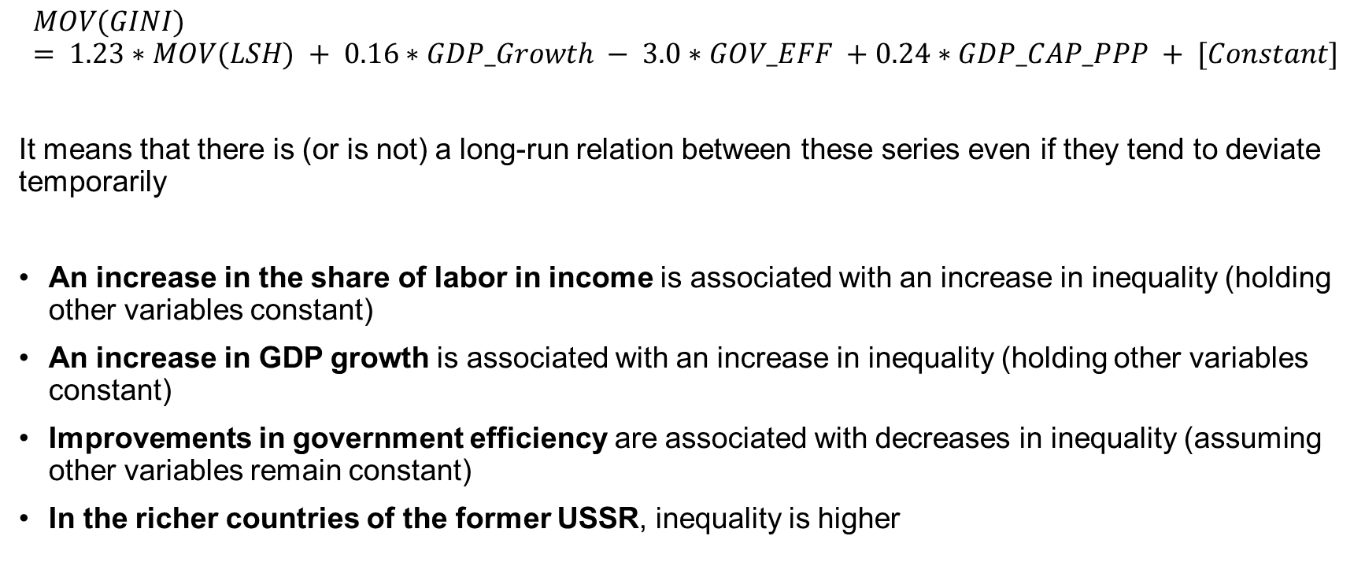
Cointegration equation
$$MOV(GINI) = 1.23∗MOV(LSH) + 0.16∗GDP_Growth − 3.0∗GOV_EFF +0.24∗GDP_CAP_PPP + [Constant]$$
It means that there is (or is not) a long-run relation between these series even if they tend to deviate temporarily
An increase in the share of labor in income is associated with an increase in inequality (holding other variables constant)
An increase in GDP growth is associated with an increase in inequality (holding other variables constant)
Improvements in government efficiency are associated with decreases in inequality (assuming other variables remain constant)
In the richer countries of the former USSR, inequality is higher

Slide 73
Inequality Ranking - Case of Serbia
Inequality Ranking | Country | Bottom 50% | Top 20% | Top 1%
1 | South Africa | 5.48 | 66.20 | 22.00
…
71 | United States | 13.31 | 45.46 | 18.76
…
82 | China | 14.36 | 41.66 | 14.00
…
121 | Russian Federation | 16.82 | 46.43 | 21.45
…
126 | Serbia | 17.75 | 66.23 | 10.85
…
169 | Czech Republic | 25.48 | 28.57 | 10.04
Source: World Inequality Report 2022

Slide 74
Consequences of COVID-19
Further shift in the distribution of income towards an increase of the share of low-income households.
The Decile Dispersion Ratio which presents the ratio of the average income of the richest 10 percent (the 90th percentile) by that of the poorest 10 percent (the 10th percentile) has declined rather sharply in 2020 compared to previous periods.
This does not mean that the incomes of the poor have increased, but rather that in 2020 the richest lost more of their income.

Slide 75

Thank you for your attention.
bsergi@unime.it

