Slide 1
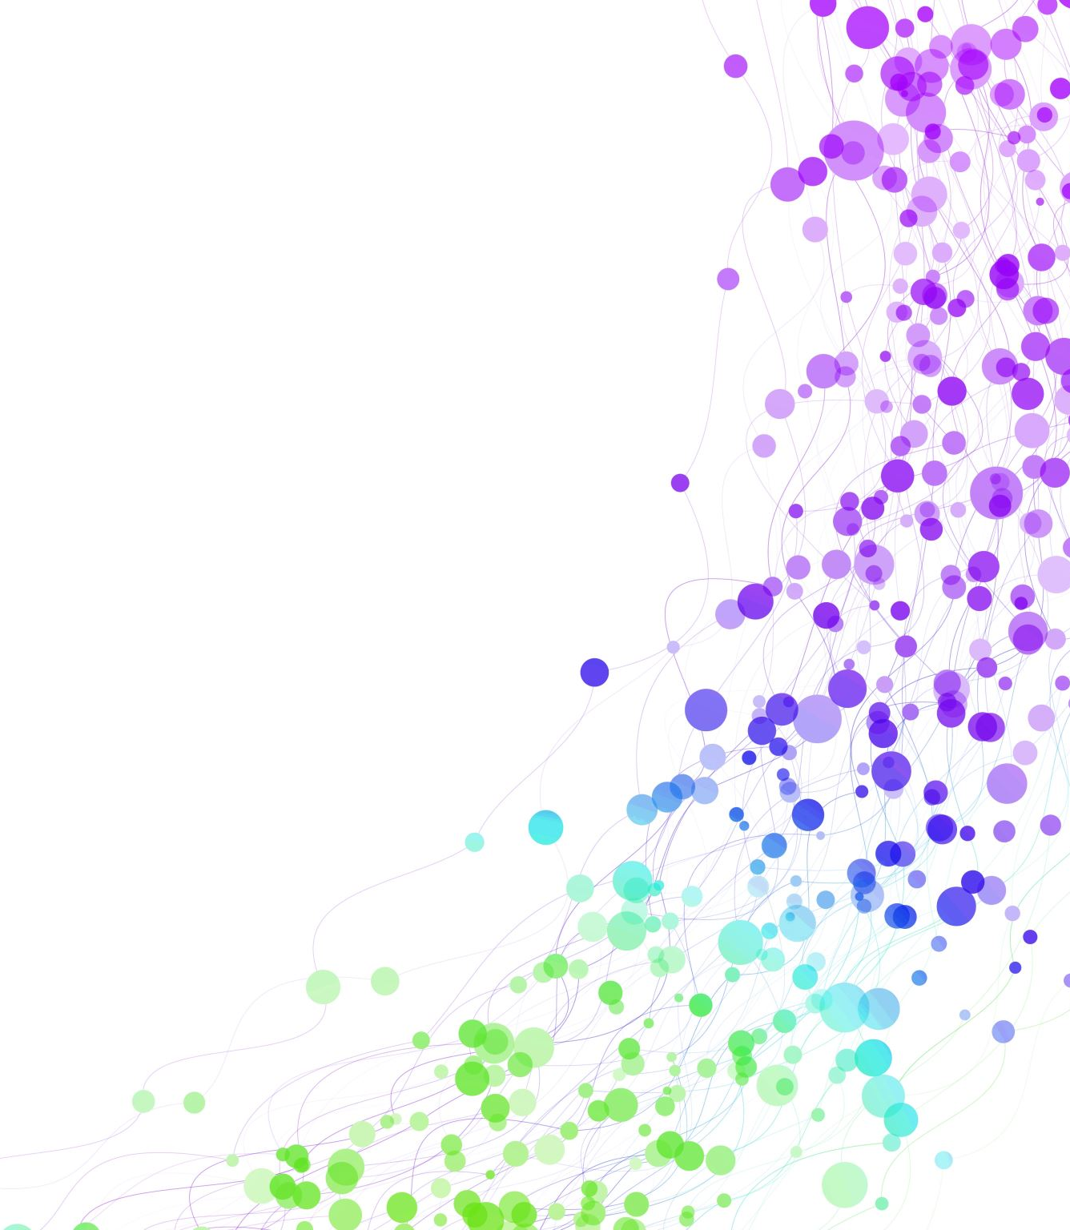
PERC ILO Trade Union Economic experts meeting
For Trade Unions from the Western Balkans, Ukraine, Moldova, and Georgia
8-9 June 2023, Belgrade Serbia
To join the EU soon, and what does that mean?
Bruno S. Sergi

Slide 2
The transformation of CEEC economies
Ukraine and the EU
Towards an enlarged EU? 27 + 9?
34 years of transition and the recent pandemics and war in Ukraine
Outflow of human capital
Sizable trade and investment links
Degree of institutional quality and institutional and governance standards
The role of FDI and export in the convergence of CEECs to Western Europe

Slide 3
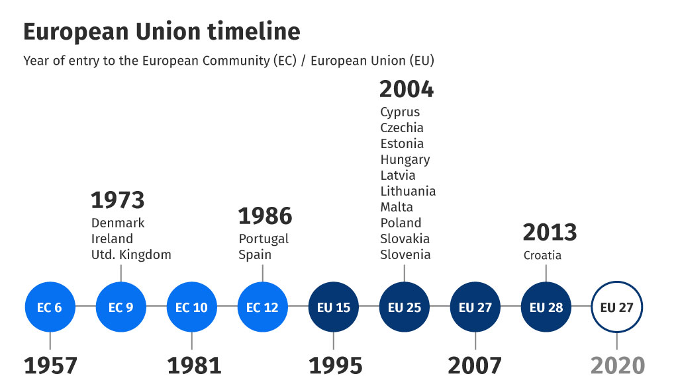
May 1, 2004 – 10 new countries joined the EU: Cyprus, Malta, and 8 Central and Eastern European countries: Czechia, Estonia, Hungary, Latvia, Lithuania, Poland, Slovakia, and Slovenia.
This step finally ended the division created by the cold war and entering the new era of convergent with the East and Central Europe countries.

Slide 4
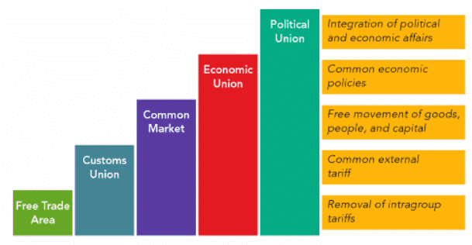
Different stage of regional integration

Slide 5
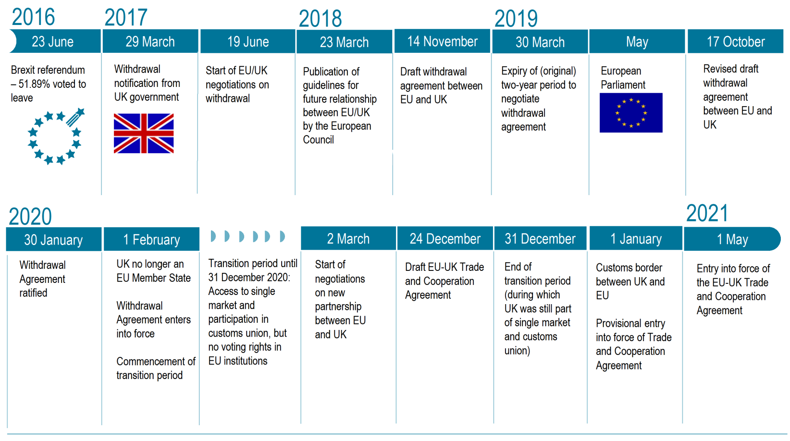
BREXIT
On January 31, 2020, the UK formally withdrawal from the European Union since its membership in 1973.

Slide 6
For the past 30 years, the CEECs economic transition and integration with the EU involved a gradual removal of barriers to trade and international capital flows.
Gradually, CEEC economies have become the manufacturing backbone of the European economy, due to their tight integration with regional and global value chains, a high degree of vertical specialization in the production of intermediate good.
Exports from CEEC economies have more than doubled relative to GDP through the last two decades.
These countries have increased their domestic value added in their products and exports across all categories during 1995–2008. The increase in knowledge-intensive manufacturing sectors, namely machinery and transport equipment, was spectacular. Between 1995 and 2008, exports from these niche sectors multiplied many times over in these countries.

Slide 7
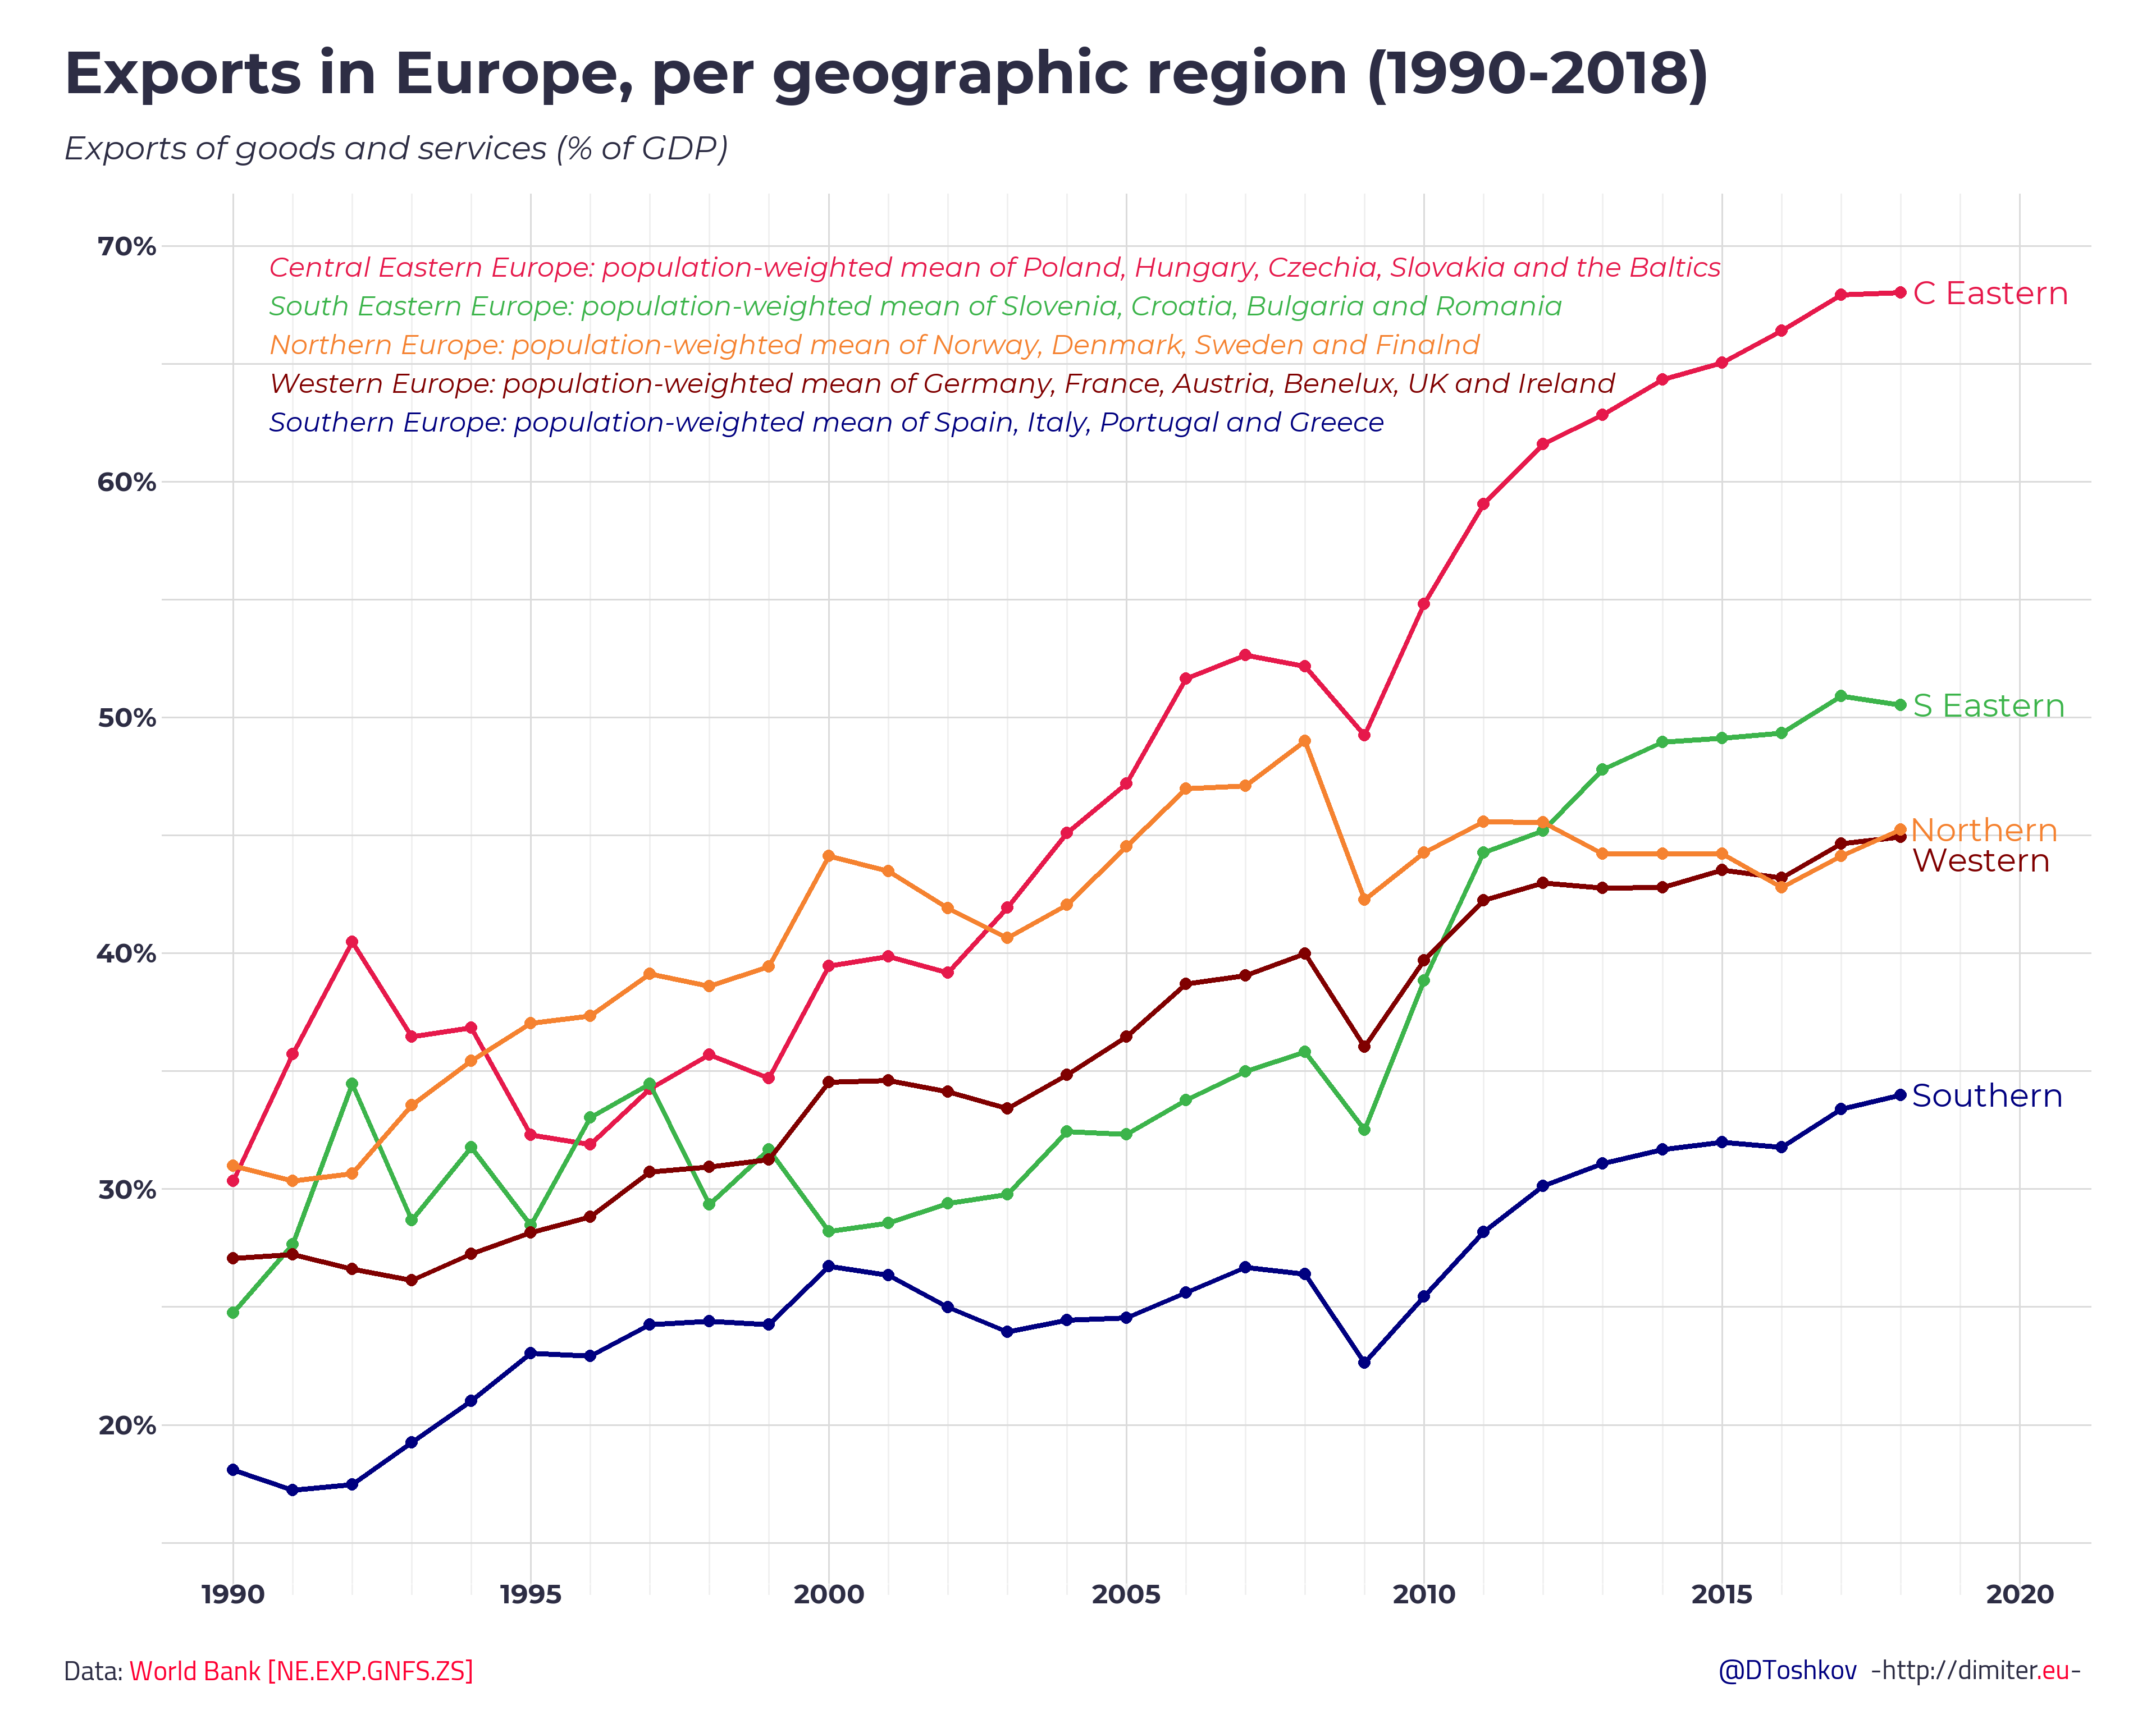
Source: http://dimiter.eu/Visualizations_files/CEE.html

Slide 8
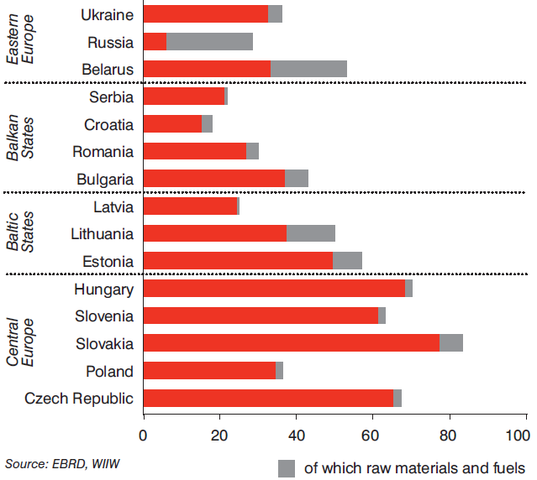
Export dependence in CEE, in % of GDP in 2018
8

Slide 9
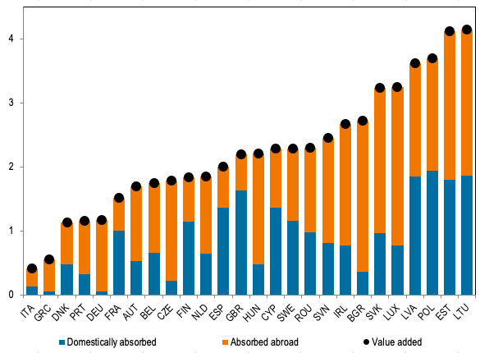
Exports contributed to GDP—1995 and 2014
Value added growth and its components for European countries, average between 1995 and 2014 (%)
The role of exports and vertical specialization was substantial for period between 1995 and 2014.
The role of exports over this period varied across Europe. On one hand, in the CEEC economies that converged over time to the EU15, exports were dominant. The average share of exports in overall economic growth in Slovakia, Hungary, and Czechia were 87%, 78%, and 70%, respectively (see figure).
On the other hand, in the West the contribution of exports to growth was much lower: 34% in France, 26% in the UK and 32% in Spain. Only in Germany were exports a predominant growth component.
The average annual export contribution to the GDP growth in Poland was 1.8 percentage points. Considering the average annual GDP growth over that period was 3.7%, exports were responsible for around half of GDP growth.
https://cepr.org/voxeu/columns/export-led-growth-central-and-eastern-europe

Slide 10
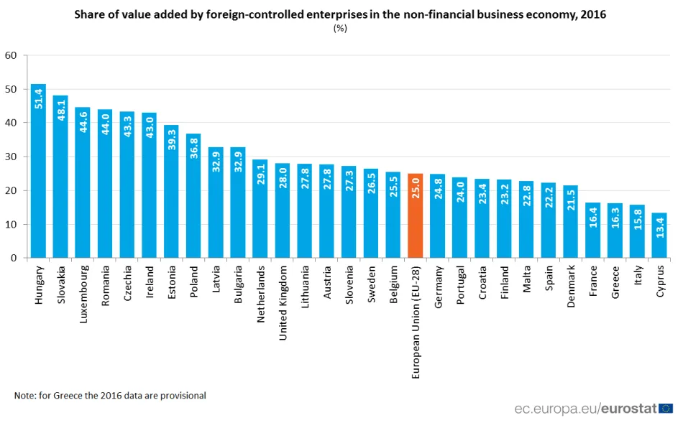
Multinational affiliates make up varying but very significant shares of these economies.

Slide 11
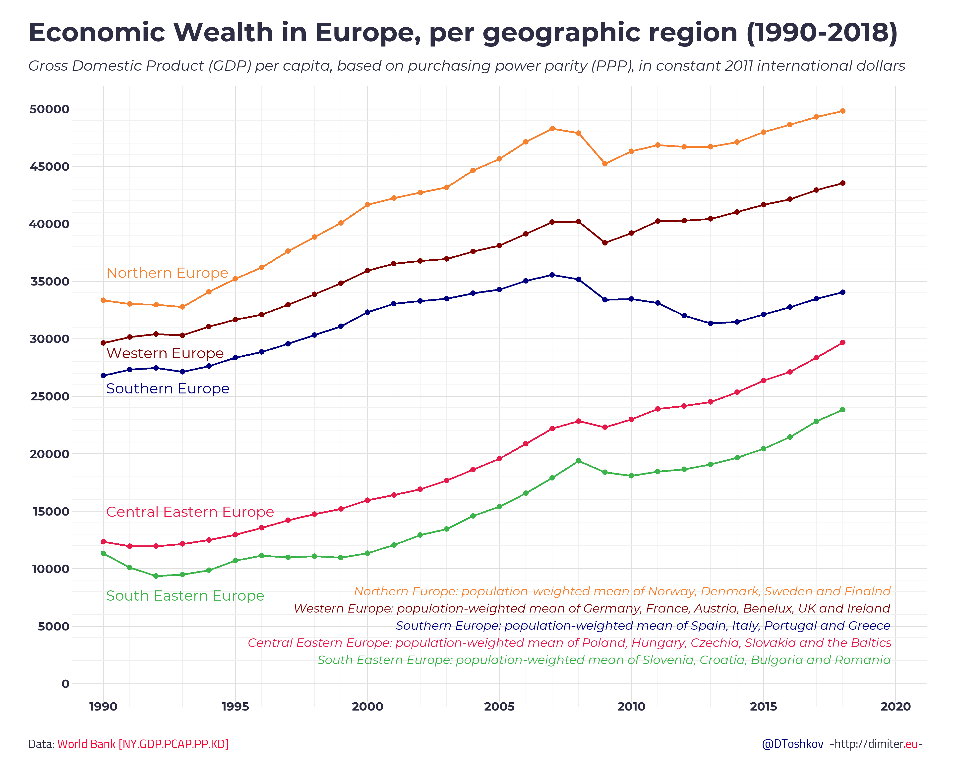
Growth of wealth in prior to the pandemic

Slide 12
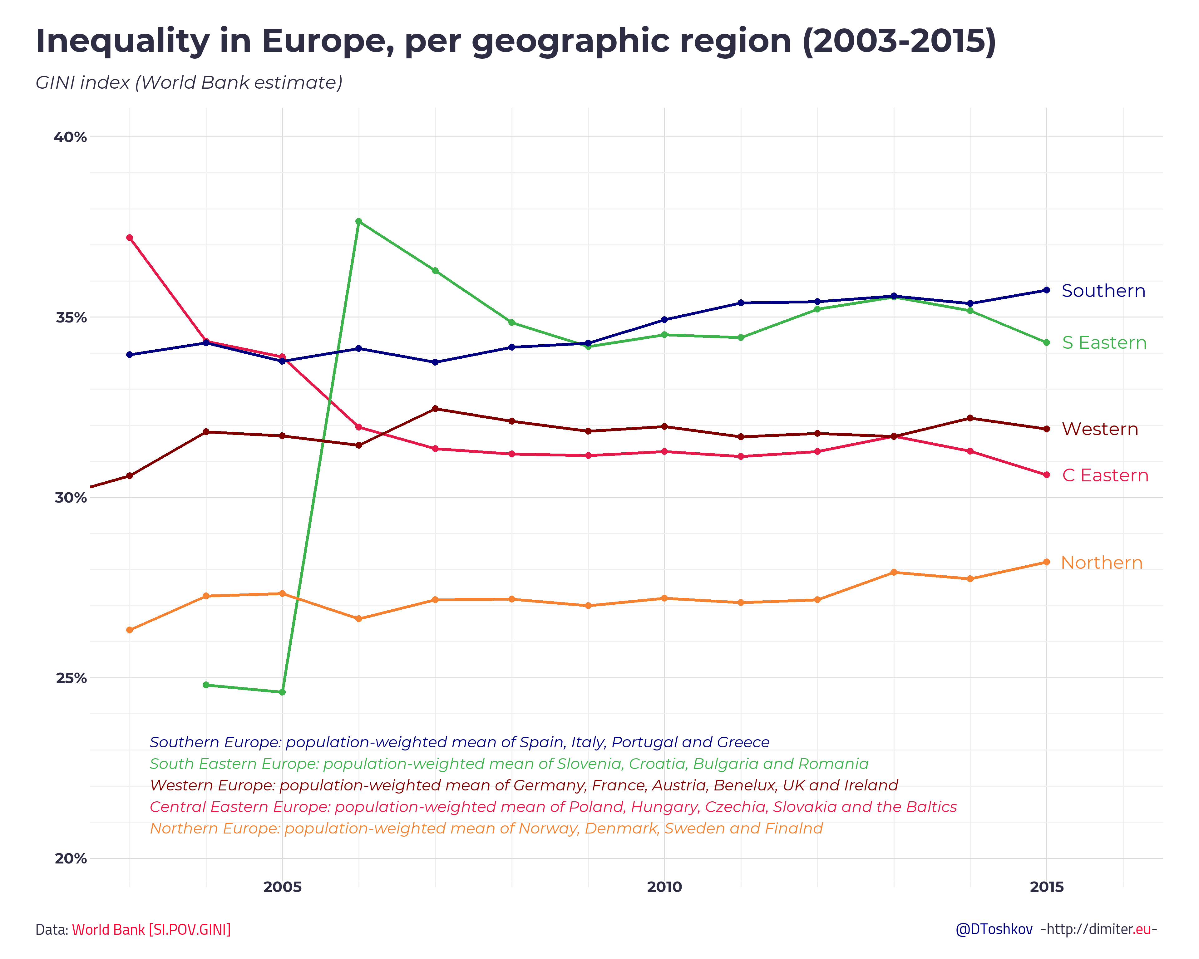
Source: http://dimiter.eu/Visualizations_files/CEE.html

Slide 13
Wealth inequality from transition
Income inequality grew radically in Eastern Europe during the transition to market economies.
In some countries, growing gap in wealth with a minority of the population harvesting most of the economic fruits.
In some successor states of the Soviet Union and Yugoslavia, the resulting inequality has been particularly strong. One country stands out in this respect: resource-rich Russia. The top 1 percent of Russian income earners received 20.2 percent of all incomes.
It should also be noted that a large portion of national wealth was transferred to citizens in a rather equitable way through privatization of housing to tenants at below-market prices. For example, homeownership rates between 1980 and 2010 grew from 26% to 86% in Estonia, from 36% to 81% in Poland, from 53% to 79% in Czechia, from 69% to 78% in Slovenia, and from 71% to 90% in Hungary. Thus, growing homeownership rates could play a mitigating role in increasing inequality.
Source: https://www.econstor.eu/bitstream/10419/260730/1/iza-wol-496.pdf

Slide 14
Obstacles on the Road of Further Convergence
Fragmented markets.
Language and cultural differences, institutional differences.
Limited availability and acceptance of financing mechanisms.
Some countries can access more financial resources, while others can’t.
Less mature market governance practices:
  Example: Corruption in some nations.
Brain drain.
CEE is renowned for its technical expertise, due mainly to the popularity of studying engineering—an educational background shared by many of the world’s most successful entrepreneurs and businesspeople. It is a concern whereby many of the most talented engineers leave the region to pursue advanced studies or higher-paid, more entrepreneurial opportunities abroad.

Slide 15
Outflow of human capital from CESEE countries – 1990-2012

Slide 16
The outflow of human capital from CESEE countries affects local economies' growth prospects since those left are younger and better educated.
Sources: OECD International Migration Database, Eurostat, World Bank World Development Indicators, and IMF staff calculations.

Slide 17
Human capital outflow
Emigrants have generally been younger than the populations they left behind.
Emigrants’ education levels tended to be higher than their home country averages.

Slide 18
Outward migration has significantly reduced population growth. https://population.un.org/wpp/Graphs/DemographicProfiles/Line/923
Serbia: https://population.un.org/wpp/Graphs/DemographicProfiles/Line/688
Bosnia and Herzegovina: https://population.un.org/wpp/Graphs/DemographicProfiles/Line/70
Sources: OECD International Migration Database, Eurostat, World Bank World Development Indicators, and IMF staff calculations.

Slide 19
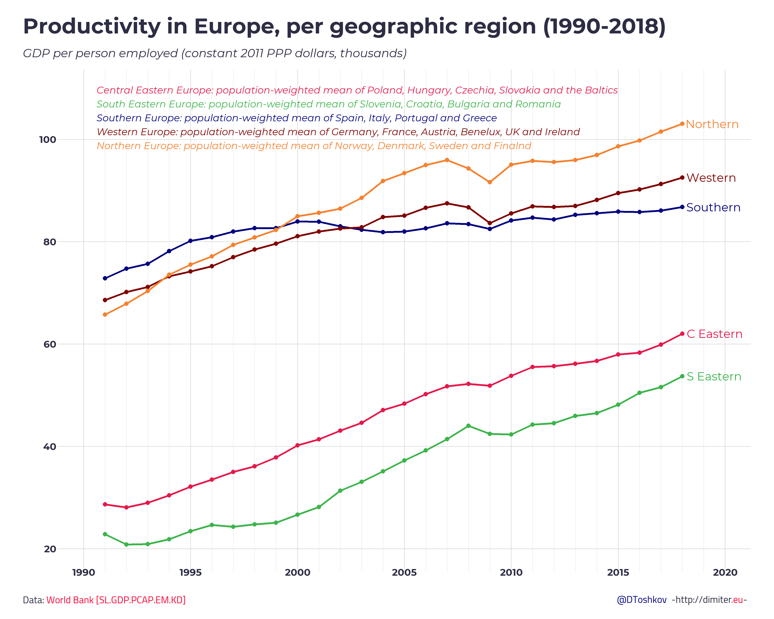
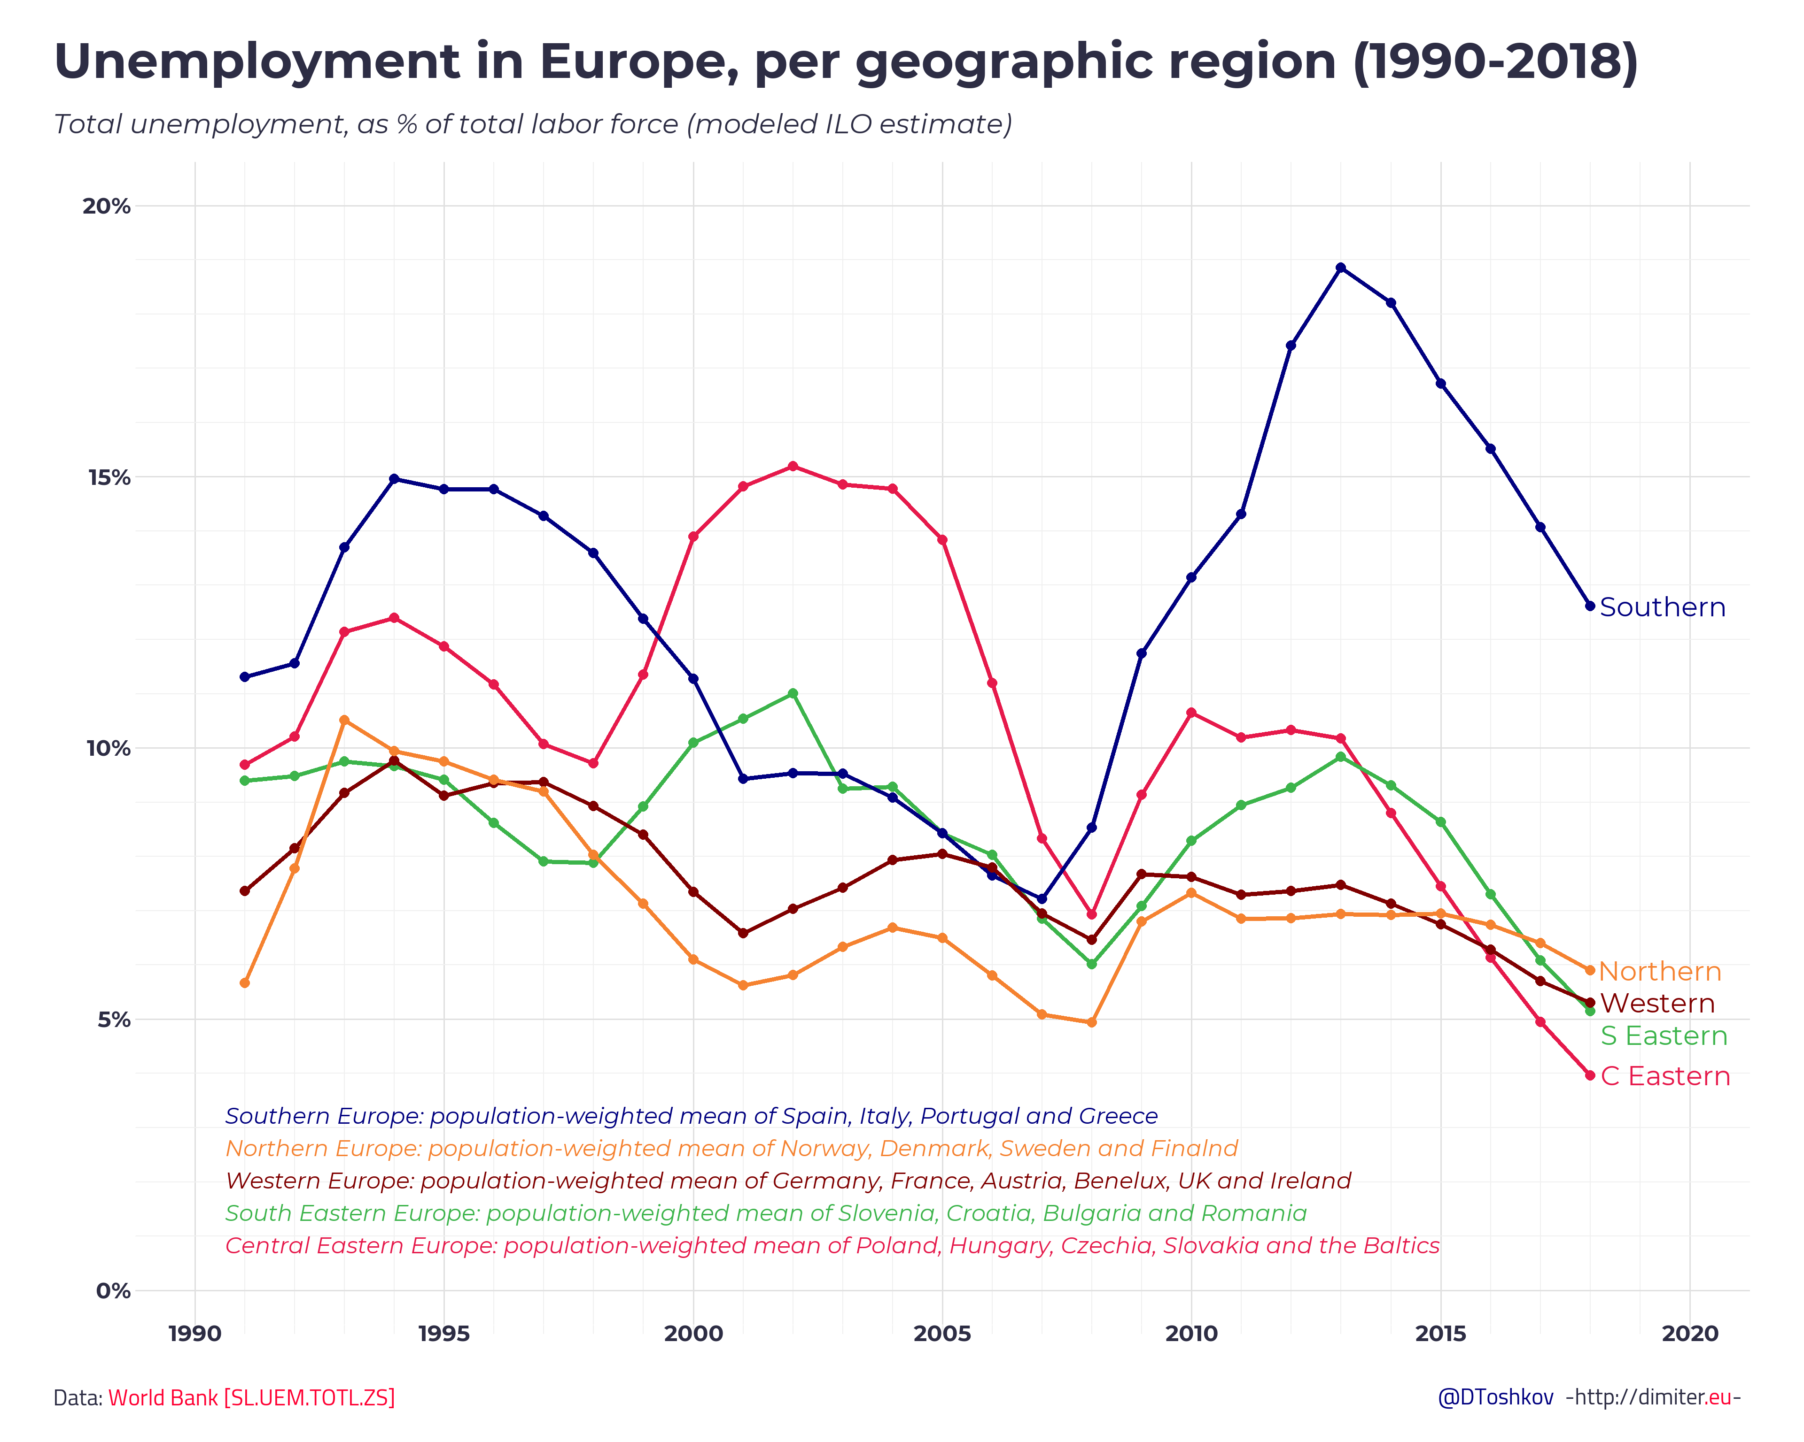
Source: http://dimiter.eu/Visualizations_files/CEE.html

Slide 20
34 years of integration
Source: http://dimiter.eu/Visualizations_files/CEE.html

Slide 21
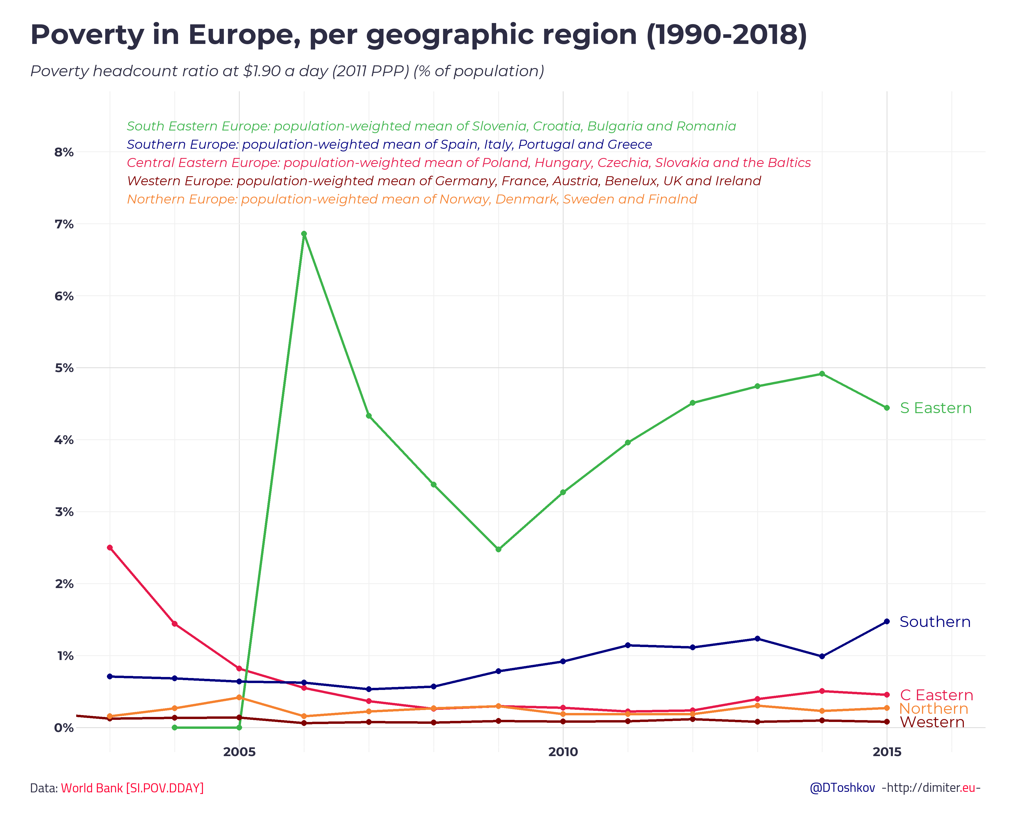
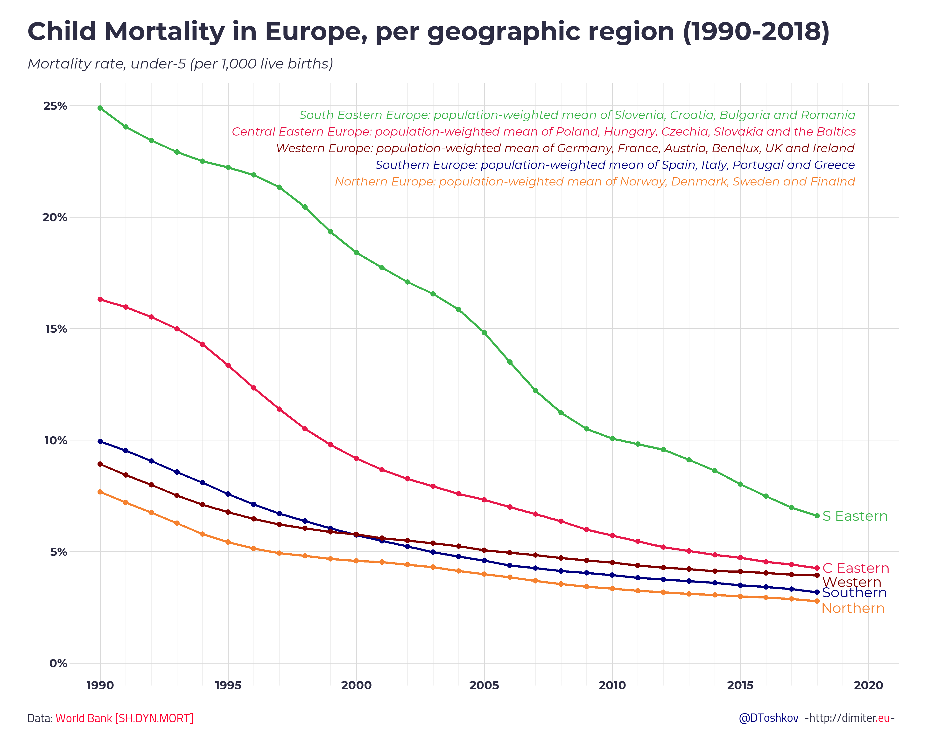
34 years of integration
Source: http://dimiter.eu/Visualizations_files/CEE.html

Slide 22
Integration and income convergence
Integration has contributed to solid convergence of incomes.
The average GDP per capita across emerging Europe relative to advanced economies in Europe rose by about 50% between 1995 and 2013.
Sizable trade and investment links with western Europe were critical to the growth and convergence progress that brought emerging Europe’s income levels to just under half of those in their advanced economy neighbors.
The lack of complete income convergence is often coupled with a low degree of institutional quality, the institutional and governance standards that facilitate the economic growth of a country and make it more resilient to shocks.
Source: https://www.imf.org/external/pubs/ft/fandd/2014/03/moghadam.htm

Slide 23
2
Contribution of Central and Eastern European countries to GDP of the EU: Poland had the most significant contribution to the EU's GDP among countries from the CEE region. Four percent of the EU's GDP was generated by this country in 2021.
Share
Note(s): CEE; 2020 to 2021
Further information regarding this statistic can be found on page 8.
Source(s): Eurostat; ID 1303466

Slide 24
From the Collapse of the Former Soviet Bloc onward.

Slide 25
Why are nations in CEE referred to as transitional economies?
Transition is very different from development:
    Development is the process of turning a less complex economy into a more complex one
    Transition can be likened to changing the organism from one type to another. Transition thus involves studying the creation of markets and governing institutions; hence, it should interest all economists.

Slide 26
Political and Economic Integration
Accelerating and sustaining convergence in the region will require further efforts to enhance institutional quality and innovation, reinvigorate investment, address the adverse impact of population aging, and support these countries' long-term growth prospects and real convergence.

Slide 27
Common Features of Transition Economies at the Beginning of Transition.
Dominated by state ownership before transition.
Small private sector share—FSU <10%, CEE <20%.
The state controlled foreign trade.
High level of secondary school enrollment; unlike developing countries, transition economies invested relatively highly in education.
Financial system was outdated. Many of the Eastern Europe banking sectors resembled the old-fashioned banks of the 19th century. The main balance sheet items were short-term loans and deposits.

Slide 28
Country | EU Membership Official Status | Population 2023 | Real GDP per capital, PPP, 2021, in $ | GDP PPP as a percentage of the EU average
Euro Area |  |  |  | European Union GDP per capita for 2021 was $48,480
Slovenia | Member since 2004; in the euro since 2007 | 2,078,938 | 40036 | 82.6%
Slovakia | Member since 2004; in the euro since 2009 | 5,459,642 | 31498 | 64.97%
Estonia | Member since 2004; in the euro since 2011 | 1,326,535 | 38718 | 79.8%
Latvia | Member since 2004; in the euro since 2014 | 1,886,198 | 32081 | 66%
Lithuania | Member since 2004; in the euro since 2015 | 2,722,289 | 39306 | 81%
Croatia Non-Euro area | Member since 2013 | 4,105,267 | 31636 | 65%
Czech Republic | Member since 2004 | 10,708,981 | 40741 | 84%
Hungary | Member since 2004 | 9,660,351 | 33593 | 69%
Poland | Member since 2004 | 37,846,611 | 34916 | 72%
Bulgaria | Member since 2007 | 6,948,445 | 24398 | 50%
Romania | Member since 2007 | 19,237,691 | 30777 | 63%

Slide 29
Country | EU Membership Official Status | Population 2023 | Real GDP per capital, 2021, in $ | Real GDP as a percentage of the EU average
Albania | Candidate since June 2014 (the EU held its first intergovernmental conference with Albania in July 2022) | 2,877,797 | 14519 | 29%
North Macedonia | Candidate since December 2005 (the start of negotiations was officially launched on July 19, 2022) | 2,083,374 | 16464 | 33%
Montenegro | Candidate since December 2010 (negotiations opened in June 2012) | 628,066 | 20602 | 42%
Serbia | Candidate since March 2012 (negotiations opened in January 2014) | 8,737,371 | 19831 | 40%
Bosnia and Herzegovina Kosovo | Potential candidate (applied for EU membership in February 2016) Potential candidate | 3,280,819 1,873 (2020) | 15667 13056 (2021, World Bank) | 27% 32%
Ukraine | Ukraine applied for EU membership in February 2022 and was granted EU candidate status in June 2022. | 43,733,762 (2020) | 12944 | 26%
ENVR E-172: CASE STUDIES IN DEVELOPMENT ECONOMICS

Slide 30
Political and Economic Integration
CEECs are not uniform.
The region has significant variation and fragmentation.
CEE countries also differ in governance, institutional strength, and business climates.
Total population: 291,857,761 as of March 3, 2023

Slide 31
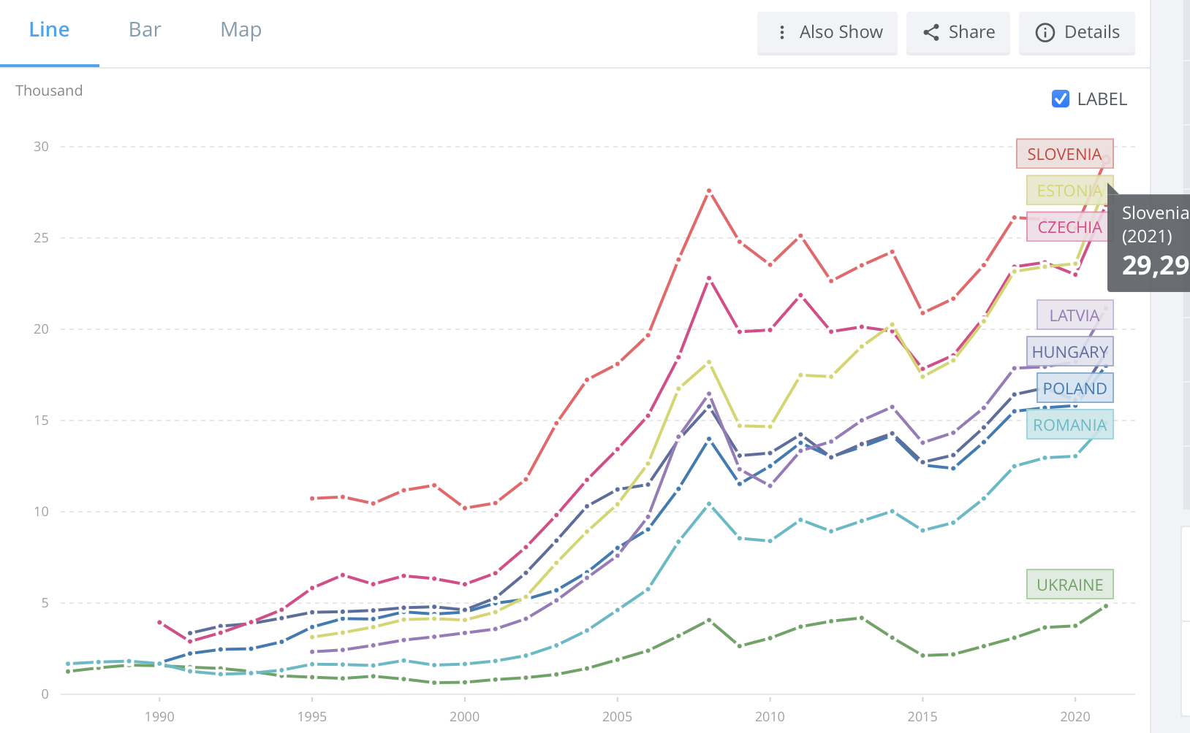
The Revival of Eastern Europe

Slide 32
Real money on the ground matters.
High investment rates appear essential for convergence towards the higher-income EU economies.
While investment was booming in most CESEE economies before 2008, domestic saving rates were not sufficient to finance investment expenditures.
Large saving gaps (i.e., the differences between domestic saving and investment rates relative to GDP) constituted a common characteristic of CESEE countries. These gaps were large in south-eastern Europe, including in those economies that are currently EU candidates and potential candidates, and in the Baltic countries, where in some cases saving gaps exceeded 10 percentage points.
Source: https://www.ecb.europa.eu/pub/pdf/other/ecb.ebart201803_01.en.pdf

Slide 34
Average annual FDI inflows in 17 CESEE economies during 1990s, 2010s and 2020s (% of GDP)
Source: https://wiiw.ac.at/economic-and-social-impacts-of-fdi-in-central-east-and-southeast-europe-dlp-6407.pdf

Slide 35
The Role of Germany in Central Europe.
The emergence of a German–central European supply chain is a good example of successful economic integration.
Since the 1990s, the Czech Republic, Hungary, Poland, and the Slovak Republic have emerged as major manufacturing satellites—particularly in the automobile industry—of a production system with Germany at its hub.
The evolution of this export-oriented system was spurred by large labor cost differentials, geographic proximity, and historical and cultural affinities and supported by large flows of FDI from Germany.

Slide 36
The Role of Germany
By 2020, German enterprises had invested no less than 109 billion euros in the 17 countries (Albania, Bosnia and Herzegovina, Bulgaria, Croatia, Czechia, Estonia, Hungary, Kosovo, Latvia, Lithuania, Montenegro, North Macedonia, Poland, Romania, Serbia, Slovakia, Slovenia), and Austrian companies as much as 76 billion.
Source: “Economic and Social Impacts of FDI in Central, East and Southeast Europe”(https://wiiw.ac.at/p-6407.html)

Slide 37
German’s production possibility frontier has expanded.
The supply chain benefits Germany by allowing it to produce and export goods from neighboring countries where labor cost is more competitive
Meanwhile, in the supply chain they have received significant technology transfers, enabling particularly rapid income convergence.
Rapid export led growth in these countries has been tilted in favor of knowledge-intensive sectors.
The supply chain is driving greater demand for skilled labor and creating opportunities for countries to move up the value chain over time.

Slide 38
The Model of Dependency Economy in Central and Eastern Europe
The driver for economic growth comes from FDI and lower labour costs.
Many domestically owned businesses failed, facing FDI competition.
A domestic development plan with a policy that does not support an active role from the state (vs. East Asia).
Much slower economic growth when FDI inflow slows.
MNCs have brought upgrading to the CEECs, leaving technological levels somewhat behind West Europe.

Slide 39
2
Total value of M&A deals in Eastern Europe from 1995 to 2021* (in billion euros)
Note(s): CEE; 1995 to 2021
Further information regarding this statistic can be found on page 8.
Source(s): Institute for Mergers, Acquisitions and Alliances (IMAA); ID 912942

Slide 41
In many of the EU-CEE countries and in the West Balkans, more greenfield projects were announced.
The fastest increase occurring in Montenegro (where the five projects announced in January-August 2022 meant a 400% increase over the same period last year), Serbia (100% increase), Croatia (92%) and Latvia (88%).
The number of greenfield projects fell year-on-year only in Hungary (-44%), Estonia (-33%), Czechia (-17%), Slovakia (-10%), and Bosnia and Herzegovina (-10%).
A significant decline in greenfield investment projects in the CIS and Ukraine.
Russia experienced a slump of 91% decline year-on-year Jan.-Aug 2021 – Jan.- Aug. 2022 in in the number of greenfield projects.
Turkey and Russia stand out as the countries where logistics and sales & marketing became relatively more important in the structure of greenfield investment projects.
Source: https://wiiw.ac.at/economic-and-social-impacts-of-fdi-in-central-east-and-southeast-europe-dlp-6407.pdf

Slide 42
Analysis of the sector structure of the companies making greenfield investments in the region:
investing companies from the software and IT services sector account for the highest share of greenfield projects in CESEE, increasing in 2022 in all subregions;
in the CIS and Ukraine, investing companies from this sector accounted for almost half of all the greenfield projects in January-August 2022 (however, projects announced by supporting software and IT services companies are small);
CIS and Ukraine, FDI inflows have performed mainly poorly.
Kazakhstan and Moldova managed to increase their FDI inflows slightly in Q2 2022, primarily on the back of reinvested earnings.
Source: https://wiiw.ac.at/economic-and-social-impacts-of-fdi-in-central-east-and-southeast-europe-dlp-6407.pdf

Slide 43
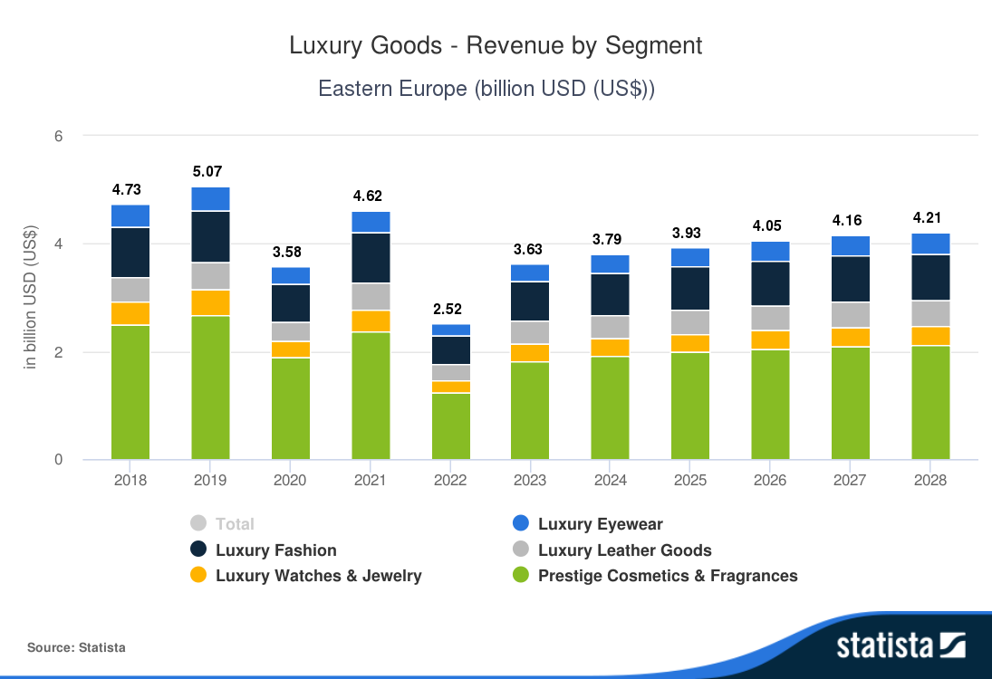
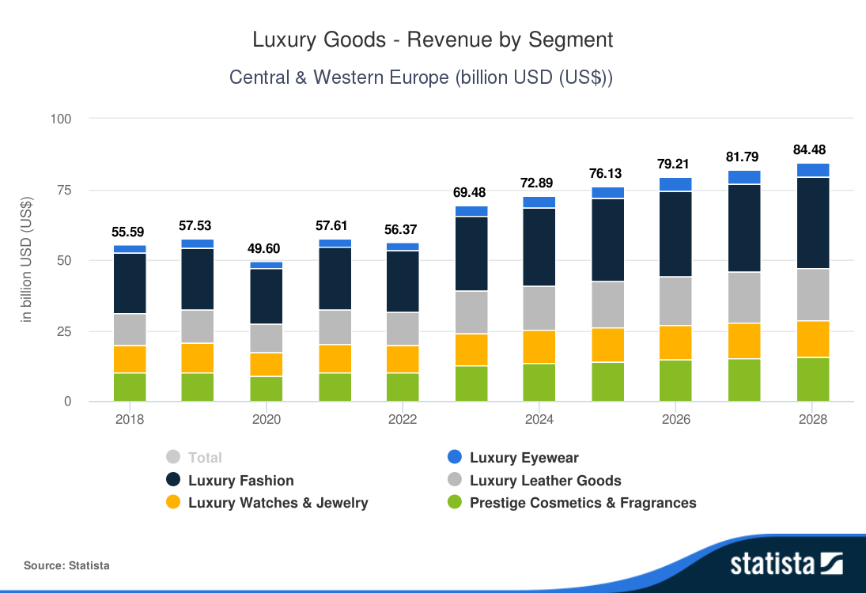

2

Slide 44
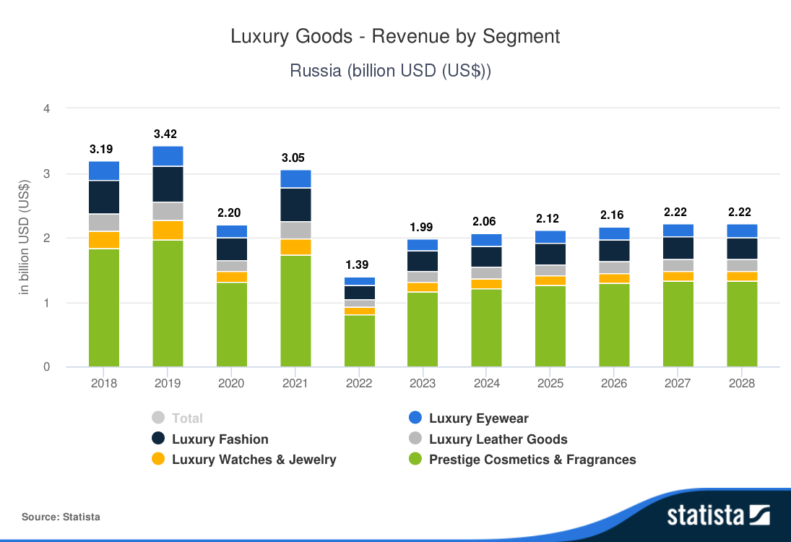
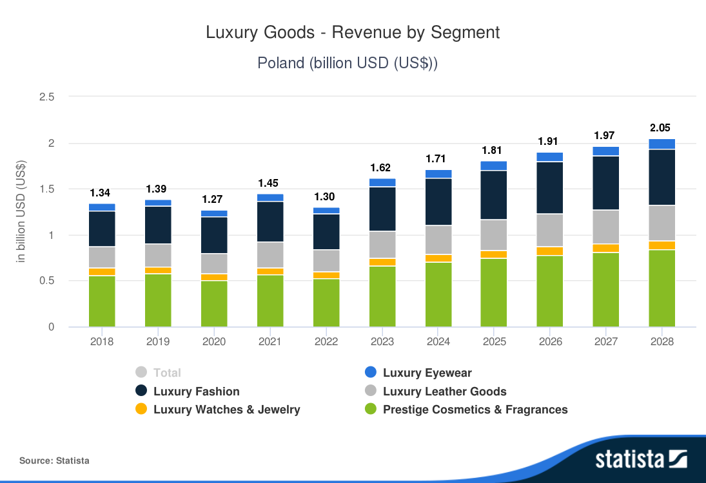
2

Slide 45
2
Growth in hotel room supply in selected Central and Eastern European cities from 2015 to 2023
Note(s): Bulgaria, Czechia, Hungary, Poland, Romania, Slovakia, CEE; 2015 to 2020
Further information regarding this statistic can be found on page 8.
Source(s): Cushman & Wakefield; ID 1148165

Slide 46
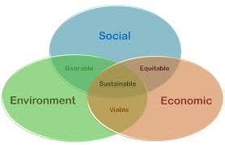
What is Sustainable Development? Current decisions should not impair the prospects for maintaining or improving future living standards!
Sustainable development is an approach that will permit continuing improvements in the quality of life with a lower intensity of resource use, leaving for future generations an undiminished or even enhanced stock of natural resources and other assets.

Slide 47
Triple bottom line
Mohan Munasinghe – three approaches
Economic: Maximize income while maintaining a constant or increasing stock of capital
Environment: Maintaining resilience and robustness of biological and physical systems
Socio-cultural: Maintaining the stability of social and cultural systems
Sustainability
Social
Environmental
Economic

Slide 48
UNEP: Integrating the Three Dimensions of Sustainable Development: Economic aspect
Leave no one behind and provide a life of dignity for all.
  The poor, vulnerable and marginalized groups need opportunities for sustainable livelihoods and should be ensured of a minimum level of social and environmental protection. People living in extreme poverty must be enabled to achieve a life of dignity. Innovative and green technologies can simultaneously increase employment, foster better use of science and traditional knowledge, upscale provision of basic services, and at the same time protect the environment.

Slide 49
2. Achieve greater prosperity in an inclusive manner within the capacity of the earth’s life support system
  Future prosperity will require that economic growth no longer degrades the environment.
  We need to change the production systems, employment patterns, and technologies in every country.
  Sustainable consumption is not necessarily about consuming less, it is about consuming better—what we buy and how we live in an intelligent, safe, and environmentally sustainable way.
  Sustainable consumption can yield a variety of interlinked economic, social, and health benefits, including greater access to markets, social innovation, job creation, among others.
UNEP: Integrating the Three Dimensions of Sustainable Development: Environmental aspect

Slide 50
  3. Increase capital to achieve greater resilience and secure future generations’ livelihoods
  Investment in natural capital, social capital (i.e., knowledge, societal systems), and resource efficient economic capital (i.e., infrastructure and production capacities) will sustain long-term development.
  Waste management, resource efficiency, ecosystem restoration and cleaning of our water-ways expands our resources and opportunities for employment and livelihoods.
UNEP: Integrating the Three Dimensions of Sustainable Development:
Social aspect

Slide 51
The Environmental Performance Index is produced jointly by Yale University and Columbia University.
The Environmental Performance Index ranks countries’ performance on high-priority environmental issues in two areas:
- protection of human health and
- protection of ecosystems.

Slide 52

EPI Measuring Framework: https://epi.yale.edu/epi-results/2022/component/epi
The EPI uses a hierarchical framework to compare and understand environmental performance for 180 countries and provide a gauge of how close countries are to established environmental policy goals.
40 performance indicators are grouped within 11 issue categories.
The EPI groups indicators within issue categories, issue categories within policy objectives, and policy objectives within the overall index.

Slide 53
A Comprehensive Environmental Index
Yale has created the Environmental Performance Index, which combines data on sustainability issues and assigns each country a single score.
This index provides a detailed breakdown of environmental concerns, such as air quality, water and sanitation, biodiversity and habitat, and climate and energy.
The EPI evaluates countries based on their performance in these areas, with each indicator weighted according to its importance to each country's environmental goals.

Slide 54
2022 EPI rank, score, and regional rank (REG) for 180 countries.

Slide 56
The 2020 EPI score shows a positive correlation between EPI score and GDP per capita

Slide 57
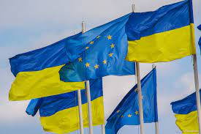
Ukraine and the EU

Slide 58
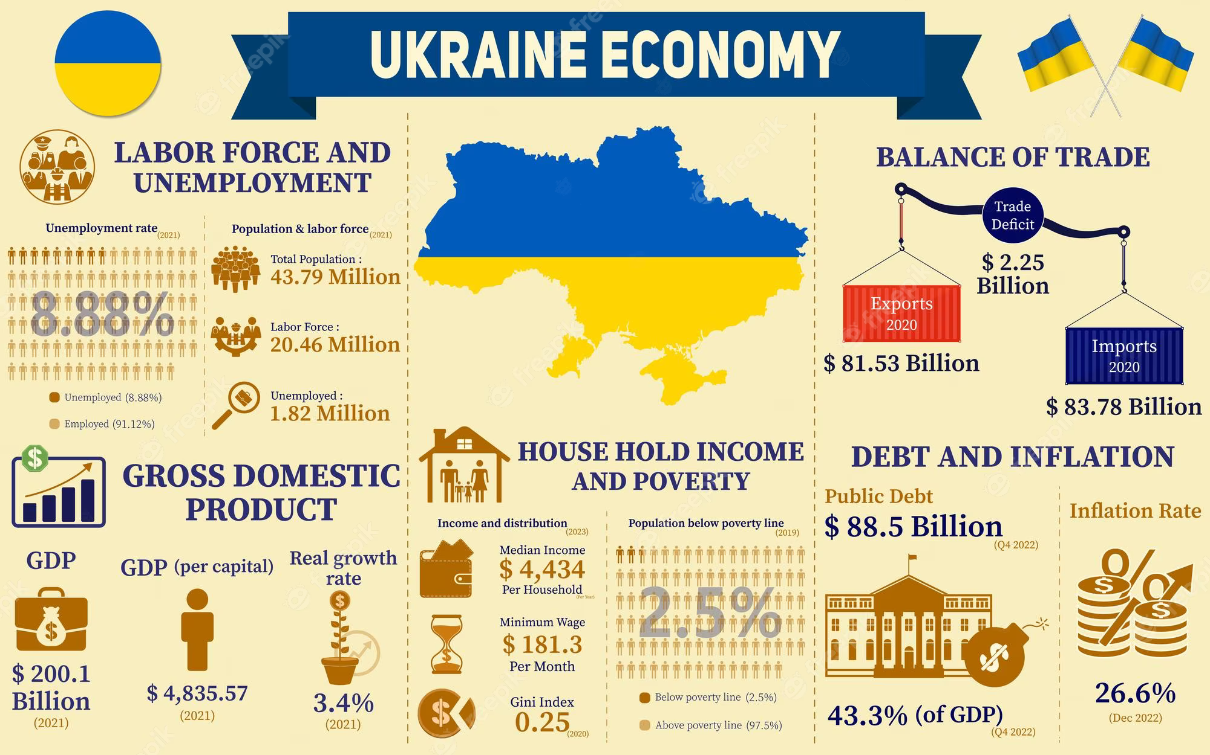
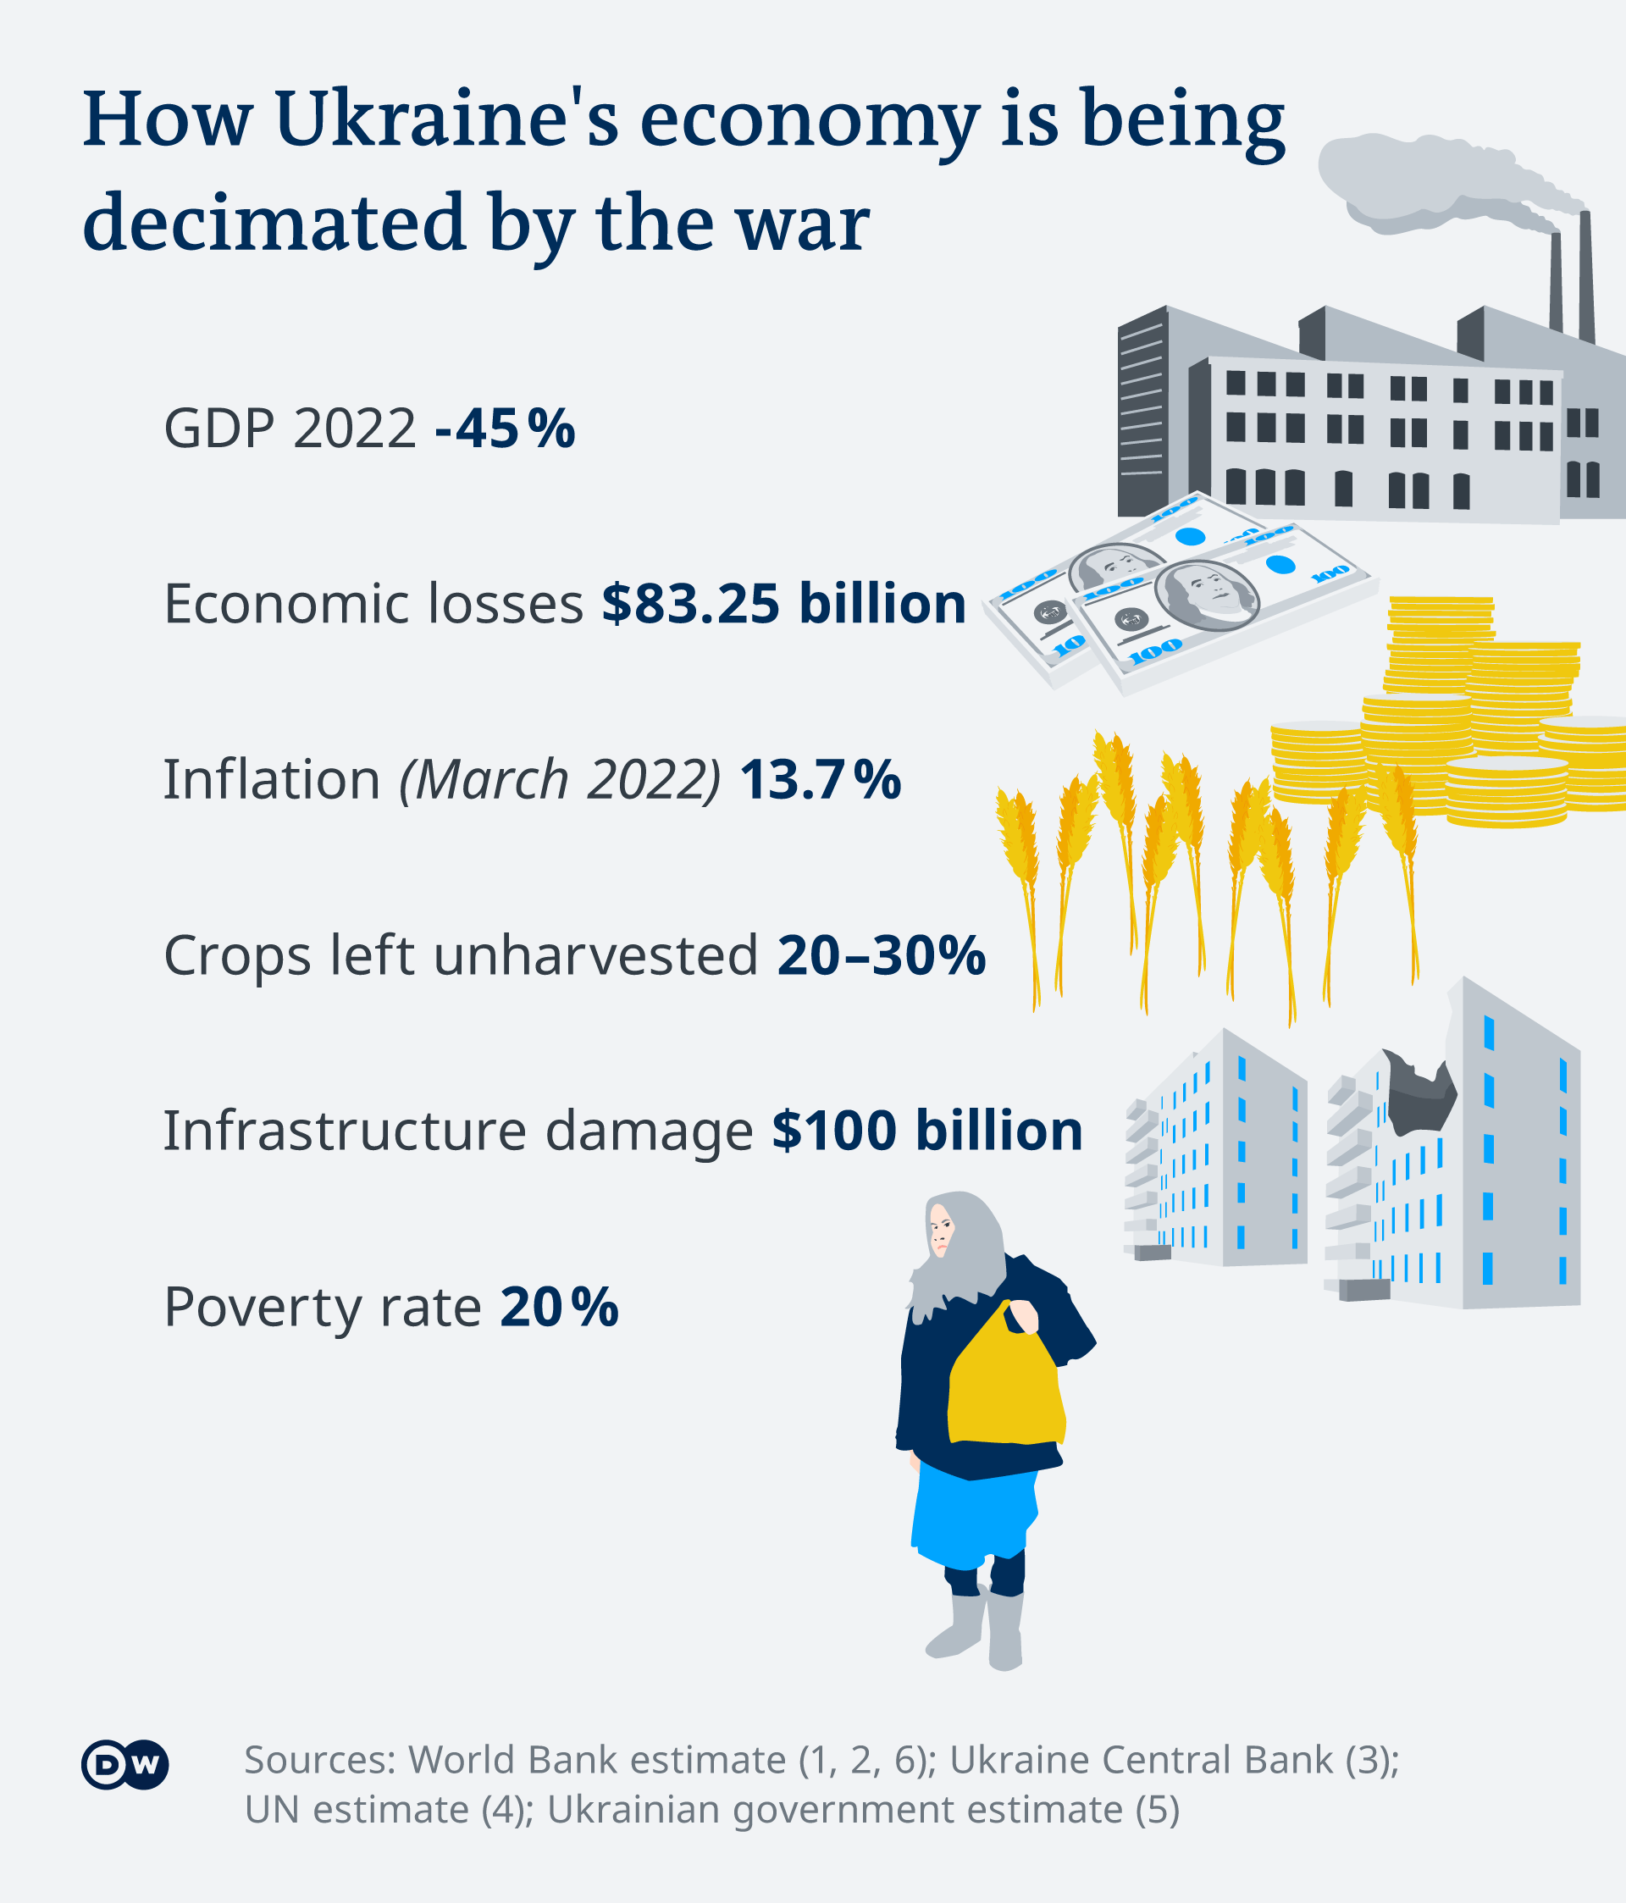
Ukraine
A country positions on strategic geographical location, at the gates of Europe, Russia and Asia, has abundant mineral resource and the most fertile black soil on earth.
A country with well educated workforce, heavy industrial legacy dates back to the Soviet era.

Slide 59
Deep and Comprehensive Free Trade Area (DCFTA)
The Association Agreement, including a Deep and Comprehensive Free Trade Area (DCFTA) between the EU and Ukraine, was negotiated between 2007 and 2011 and signed on March 21 and June 27, 2014.
The DCFTA has been provisionally applied since 1 January 2016. The Association Agreement (AA) formally entered into force on 1 September 2017 following ratification by all EU Member States.
The Association Agreement is the main tool for bringing Ukraine and the EU closer together: it promotes deeper political ties, stronger economic links, and respect for common values.

Slide 60
Trade
The EU is Ukraine's largest trading partner, accounting for 39.5% of its trade in 2021. Ukraine is the EU's 15th biggest trading partner, accounting for around 1.2% of the EU's total trade. Total trade between the EU and Ukraine reached almost €52.4 billion in 2021, almost doubling since the entry into force of the DCFTA in 2016.
Ukraine's exports to the EU amounted to €24.1 billion in 2021, a considerable increase of more than 47% compared to 2020.
Ukraine's main exports to the EU are iron and steel (20.8% of total exports), ores, stag and ash (12.5%), animal and vegetable fats and oils (8.5%) – notably sunflower seed oil, electrical machinery (7.8%) and cereals (7.3%).
The EU's exports to Ukraine amounted to €28.3 billion in 2021 and have increased by 22.4% since 2020.
The EU's main exports to Ukraine are machinery (14.8% of all exports), transport equipment and vehicles (10.2%), mineral fuels (9.4%), electrical machinery (9.3%), and pharmaceutical products (5.9%).
https://policy.trade.ec.europa.eu/eu-trade-relationships-country-and-region/countries-and-regions/ukraine_en

Slide 61
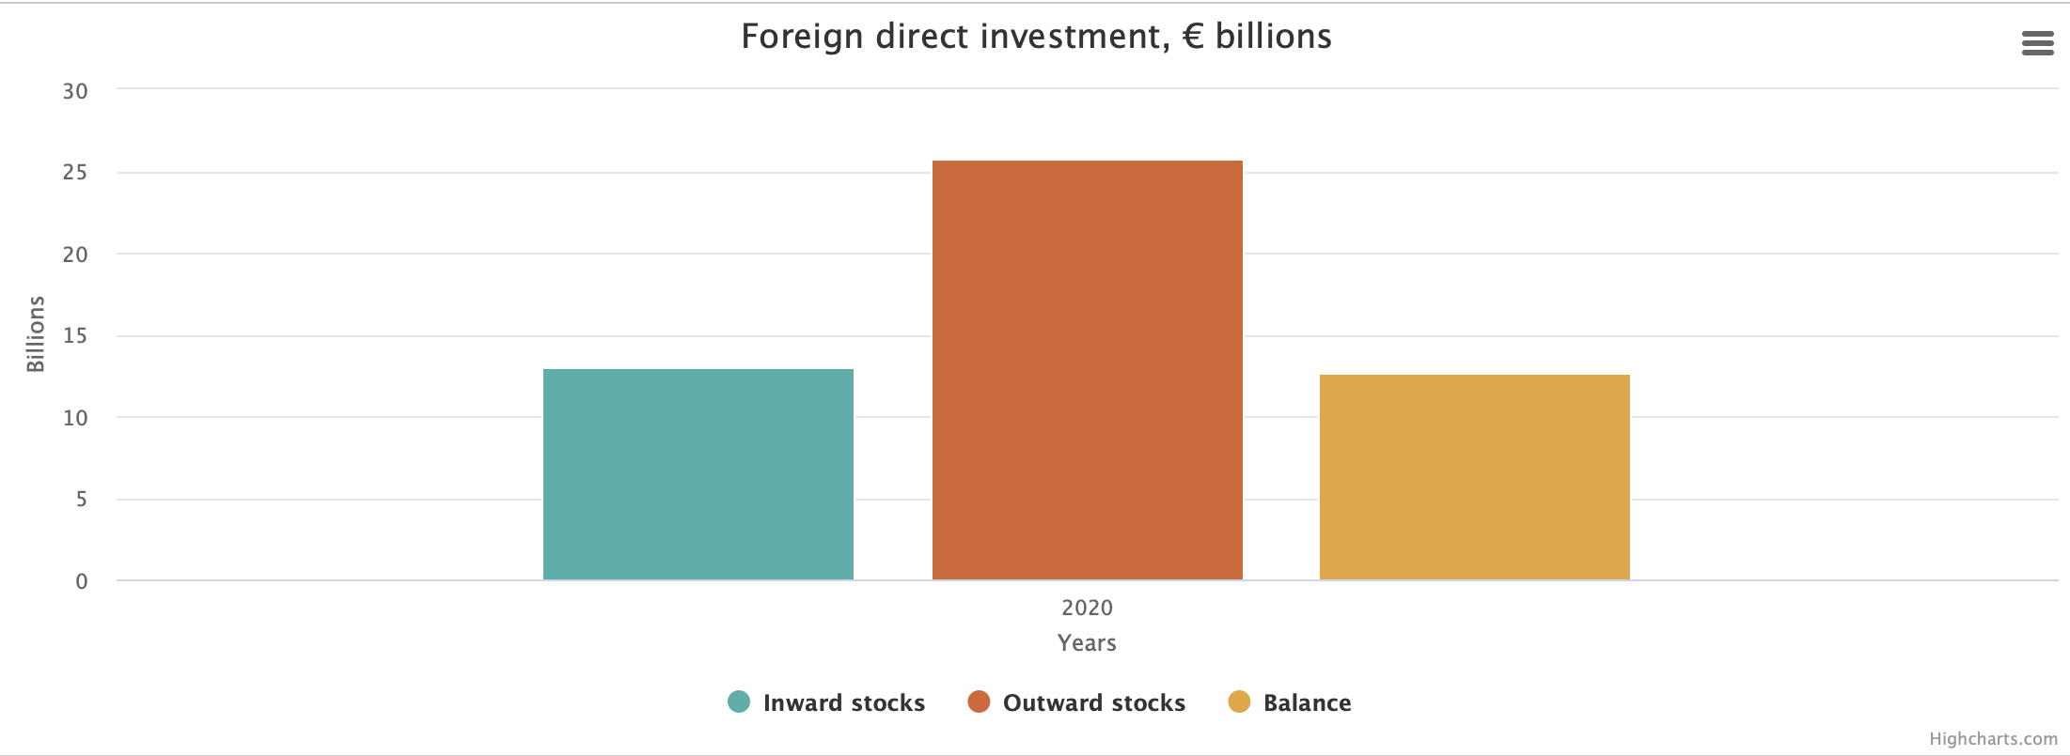
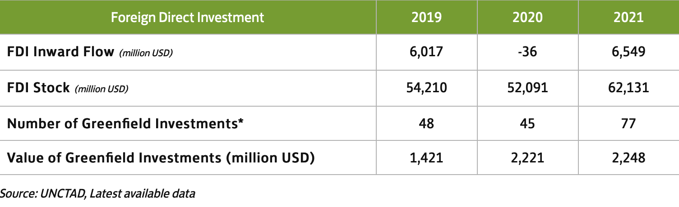
FDI to Ukraine
FDI flows to Ukraine increased to US$ 6.5 billion in 2021.
The stock of FDI was about US$ 62 billion in 2021.
Multinational companies hold assets in steel, information and communication technology, pharmaceuticals, and agricultural commodities.
Arcelor Mittal was the largest investor, with assets of US$ 6.5 billion.
Source: UNCTAD

Slide 62
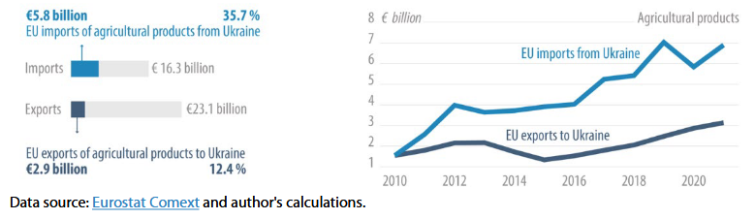
Before the War, the EU trade in goods with Ukraine was growing

Slide 63
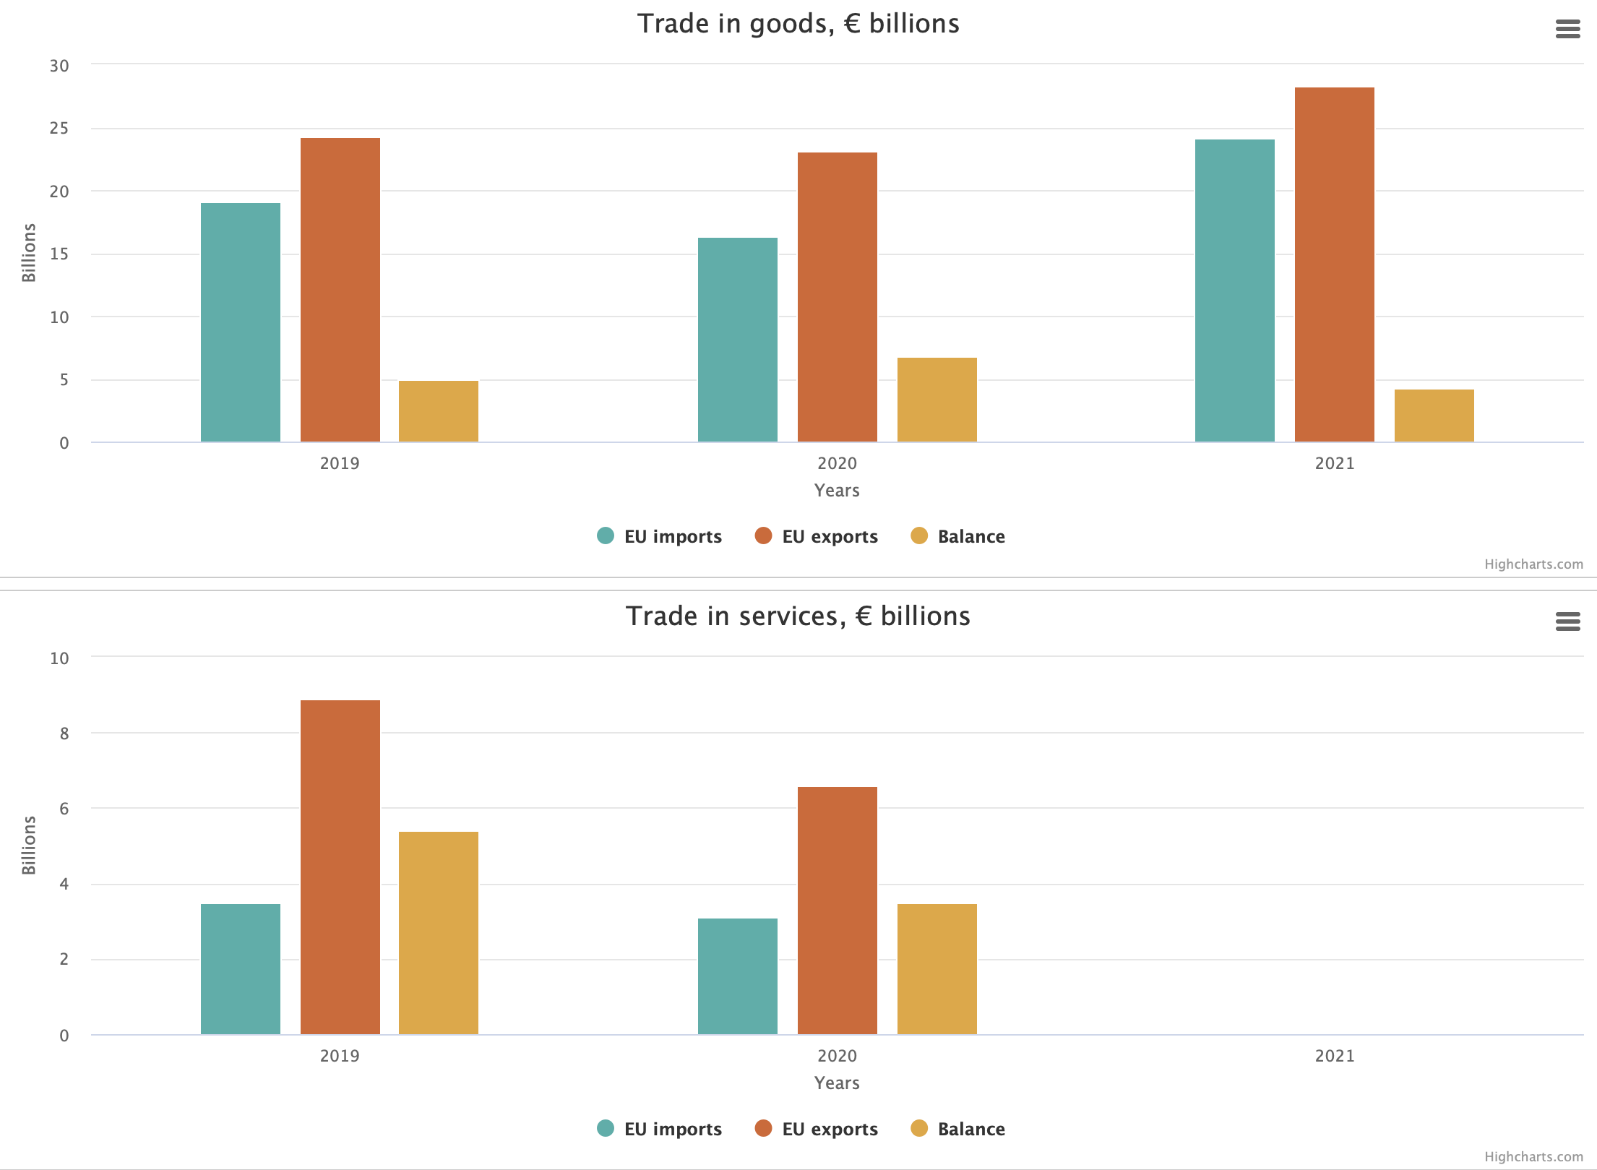

Slide 64
The EU and Ukraine
The AA/DCFTA (the Association Agreement/Deep and Comprehensive Free Trade Area)to bring Ukraine and the EU closer together: it promotes deeper political ties, stronger economic links and the respect for common values.
This aims to boost trade in goods and services between the EU and Ukraine by gradually cutting tariffs and bringing Ukraine's rules in line with those of the EU in certain industrial sectors and agricultural products.
To better integrate with the EU market, Ukraine is aligning its legislation to the EU's norms and standards for industrial and agri-food products.
Ukraine is also approximating its legislation to the EU's in trade-related areas such as:
  Competition
  Technical barriers to trade (TBT)
  Sanitary and phytosanitary (SPS)
  Customs and trade facilitation
  Protection of intellectual property rights

Slide 65
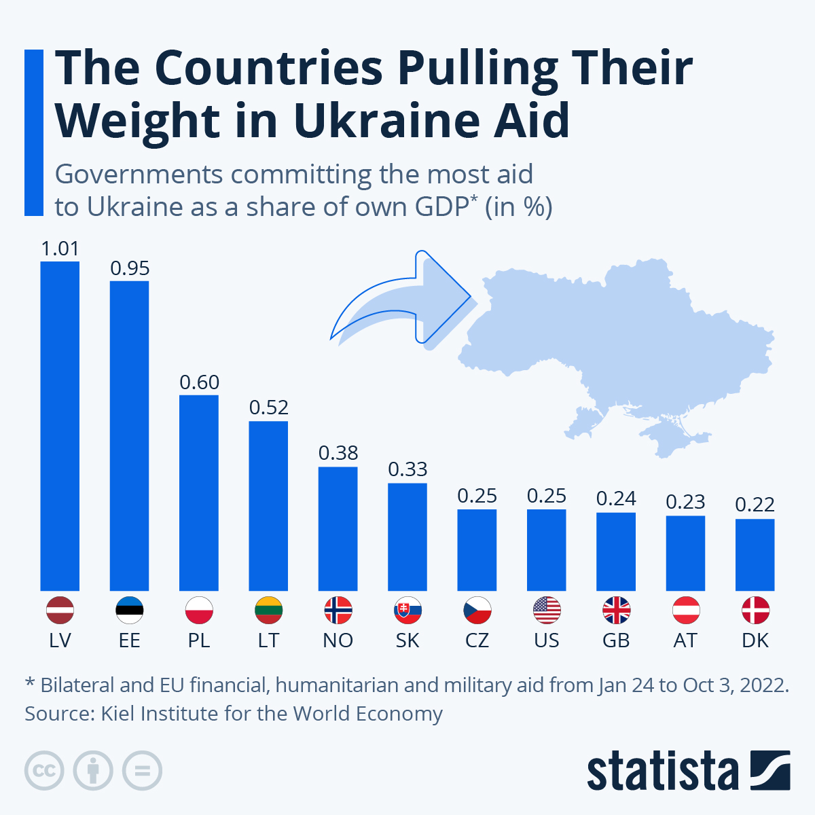
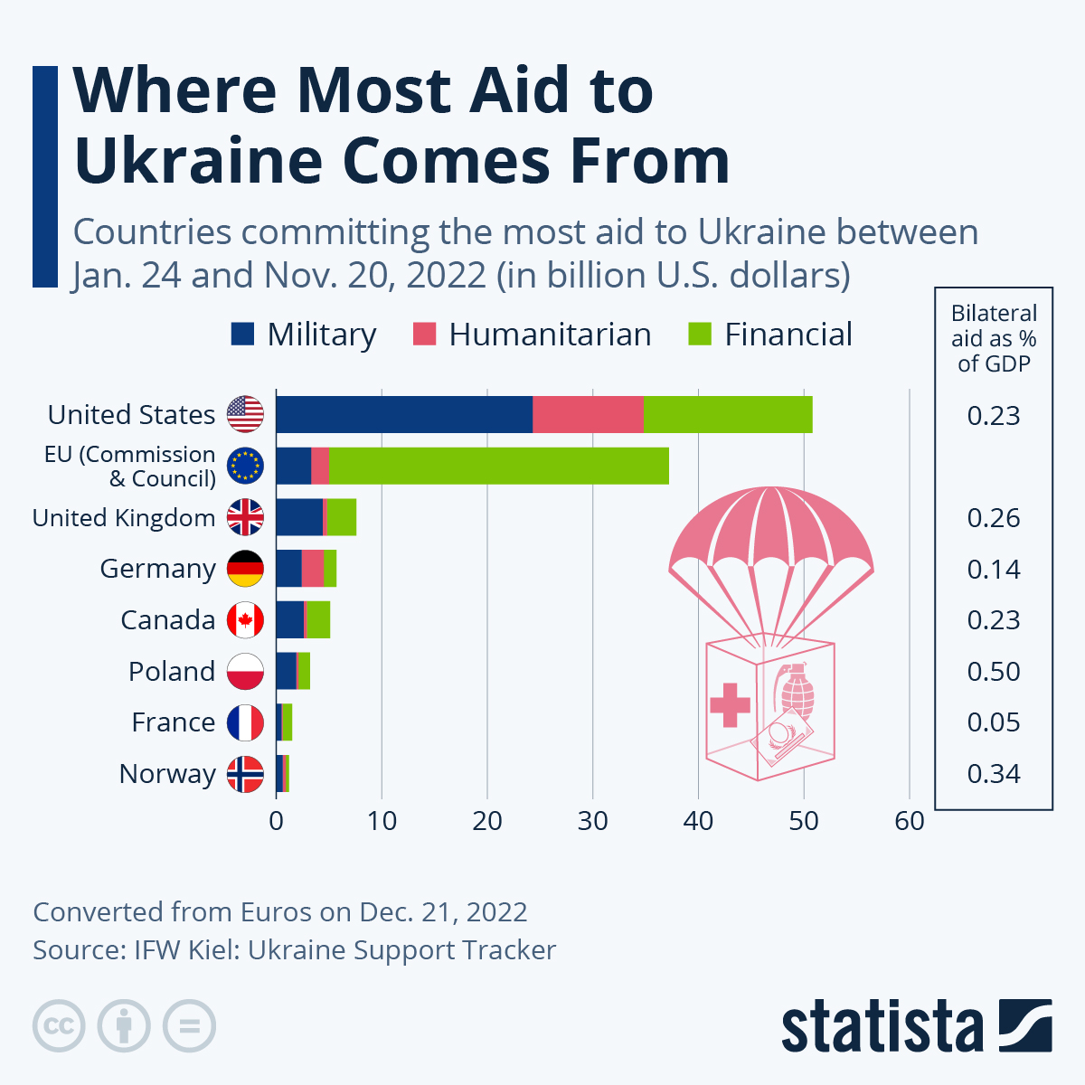

Slide 66

Thank you for your attention.
bsergi@unime.it

