Slide 1
The European Investment Bank
The EU bank
1

Slide 2
The European Investment Bank at a glance
EU’s long-term lending bank set up in 1958 by the Treaty of Rome
Natural financing partner for the EU institutions
Providing finance and expertise for sound and sustainable investment projects
Shareholders: 28 EU Member States
AAA-rated and strong capital base
Governance
Board of Governors – EU Finance Ministers
Board of Directors – Members States, European Commission & External Action Service
Management Committee – EIB´s executive body
2

Slide 3
The European Investment Bank at a glance
Largest multilateral lender and borrower in the world
Raise our funds on the international capital markets
Pass on favourable borrowing conditions to clients
More than 400 projects each year in over 160 countries
Some 90% of lending is inside the EU
Headquartered in Luxembourg and some 30 local offices
Around 2 000 staff:
Not only finance professionals, but also engineers, sector economists and socio-environmental experts
More than 50 years of experience in financing projects
3

Slide 4
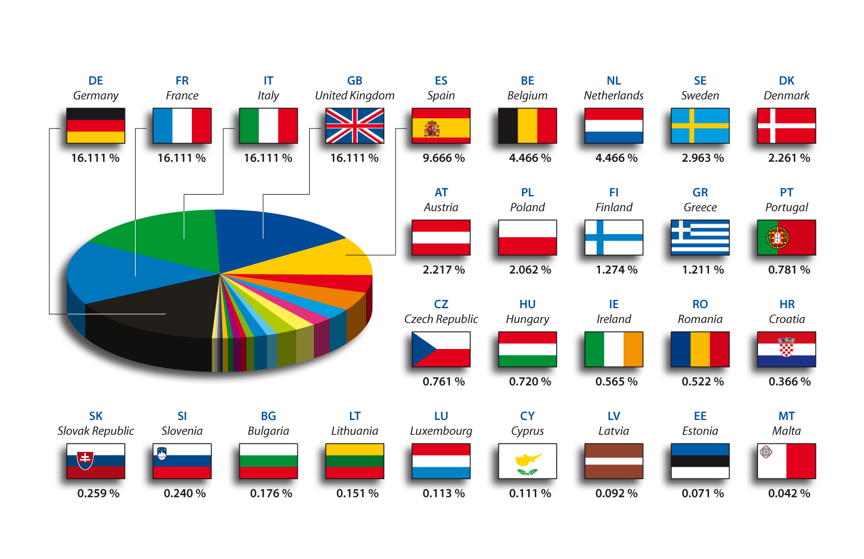
The EIB: capital breakdown at 1st July 2013
4

Slide 5
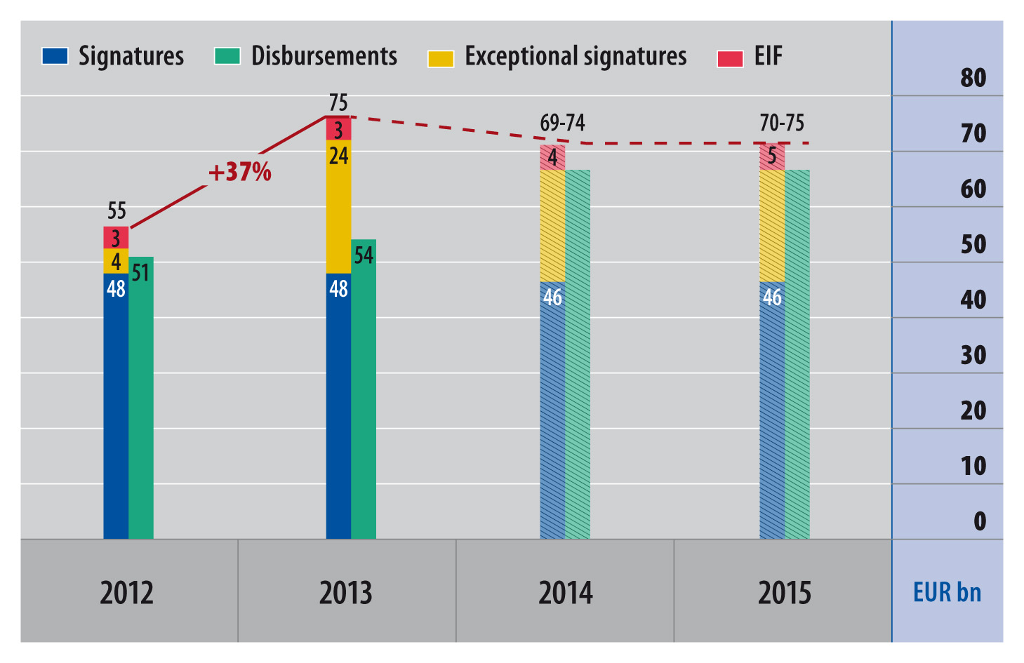
Signatures and disbursements
European Investment Bank Group
5
Notes:
5

Slide 6
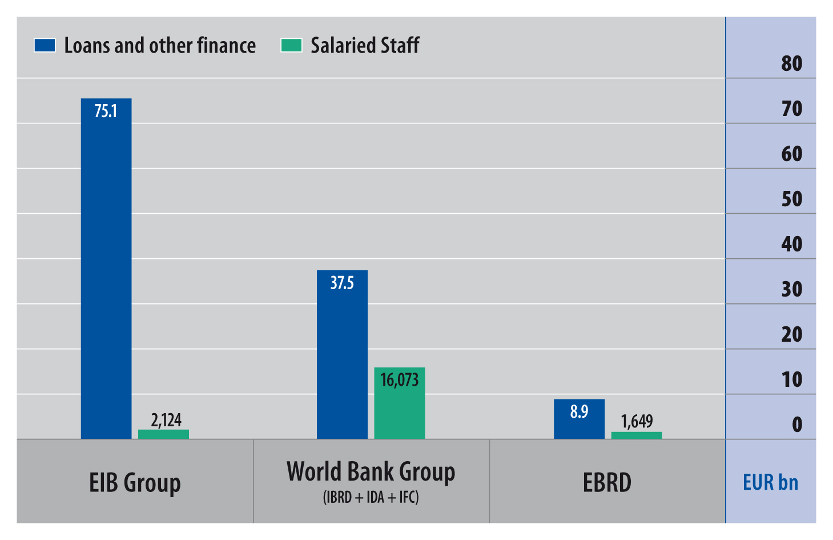
2012/2013 - Total lending and staffing
Peer group of MDBs

Slide 7
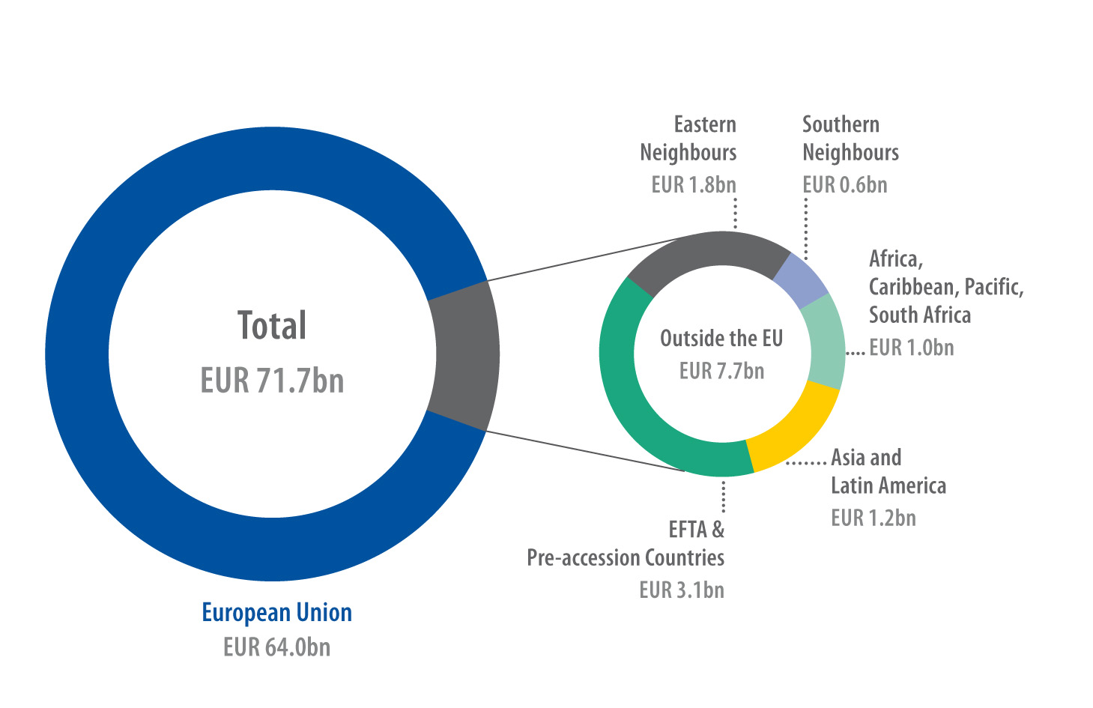
Lending (EIB signatures) in 2013
European Investment Bank Group
7
Notes:
7

Slide 8
Benefits of an EIB loan
Benefits of low cost of funding passed on to clients:
Large amounts
Broad range of currencies
Long maturities
Attractive interest rates
Catalyst for participation of other banking or financial partners

Slide 9
Project Requirements
Project requirements:
Meet at least one of the EIB’s objectives
Be technically sound
Be financially viable
Show an acceptable economic return
Comply with environmental and social standards
Comply with procurement regulations

Slide 10
The EIB: Supporting EU policy goals
Sustainable growth and jobs in Europe
Innovation and skills
Trans-European Networks
Sustainable, competitive and secure energy
Financing smaller businesses (SMEs, mid-caps)
Economic and social cohesion
Special support for economically weaker regions
Helping regions absorb EU funds
Environmental sustainability
Climate action
Sustainable transport
10

Slide 11
The EIB: underpinning EU external priorities
Local private sector development
Social and economic infrastructure
Climate action
Regional integration
Natural partner of the European Commission and the European External Action Service
11

Slide 12
The EIB outside the EU
Pre-Accession countries
Candidate Countries: Iceland, Former Yugoslav Republic of Macedonia, Montenegro and Turkey
Potential Candidate Countries – Western Balkans
EFTA countries (Iceland, Liechtenstein, Norway and Switzerland)
European Neighbourhood
To the South: Mediterranean Neighbours
To the East: Eastern Neighbours and Russia
Partner countries
Africa, Caribbean and Pacific
South Africa
Asia (and Central Asia)
Latin America
12

Slide 13
The EIB in the Eastern Partnership countries
Objectives
The main goal of the Eastern Partnership is to create the necessary conditions to accelerate political association and further economic integration between the European Union and interested partner countries.
Support to private sector, including both lending to SMEs through financial intermediaries and direct lending,
Transport
Energy and Environment
Municipal infrastructure
Agro-industry and rural development
Education and Research

Slide 14
The EIB in the Eastern Partnership countries
Particular investment needs in infrastructure sector
Very large investment needs across all sectors and in particular the energy, transport and municipal sectors;
Legacy of over-sized systems, poor control, financially unsustainable entities, inadequate maintenance and under-investment;
Infrastructure quality is low against global and regional benchmarks;
Priority areas include: transport connections with European networks; pan-European energy markets; low carbon projects; environmental projects of common interest.

Slide 15
Eastern Partnership Technical Assistance Trust Fund
Aims to enhance the quality and development impact of the EIB operations in the Eastern Partnership Countries
The fund fills critical gaps for the development and implementation of investment projects by providing financing for:
feasibility and other studies for the preparation of investment projects
institutional and legal assessments
environmental and social impact assessments
project management and/or promoter support throughout the project implementation process
studies to identify investment needs and priorities as well as activities addressing institutional issues and capacity building.

Slide 16
The EIB in pre-accession countries
Objectives
Support to private sector, including both lending to SMEs through financial intermediaries and direct lending,
Infrastructure
Climate action
Under the the Western Balkans Investment Framework, focus lies on investments boosting jobs and growth and promoting connectivity in the region.

Slide 17
Transparency at the EIB
Transparency practices
Subject to EU legislation on transparency and access to information
EIB Transparency Policy states “presumption of disclosure”, i.e. all information held by EIB is in principle subject to disclosure
De facto all environmental and social information is disclosed
Besides disclosure (upon request), EIB publishes (pro-actively) environmental and social information about its activities, policies, practices on its website
Since October 2014, EIB is reporting to the standard of the International Aid Transparency (IATI) Initiative
17

Slide 18
Transparency at the EIB
Transparency about environmental and social impact
We summarise our environmental and social assessments and make these available via a public register; aim it to also provide information about social and environmental issues related to post completion and monitoring
Non-financial analysts in the Bank carry out technical, environmental and social assessments, and these aspects receive the same weighting as financial considerations

Slide 19
Stakeholder engagement at the EIB
Engagement practices
We aim at ensuring inclusive process when setting policies and standards that affect environment and social issues
We regularly consult on them publicly and broadly
We publish feedback on draft/suggestions from stakeholders
We make them available on our website
Examples:
Recent reviews Transport and Energy Lending criteria, Environmental and Social Handbook
On-going consultation on Transparency Policy
Up-coming consultation on climate action

Slide 20
Stakeholder engagement at the EIB
Engagement practices continued:
Annual Seminar between Civil Society and EIB Board of Directors
Thematic EIB Workshops with CSOs (2-3 per year, mainly in Brussels)
Attendance to events organised by CSOs
Meetings/Conference calls with local CSOs on specific projects
Meetings with CSOs and EIB staff on specific topics/sectors
Answering NGO requests/correspondence
Dedicated Civil Society Unit in Luxembourg

Slide 21
Thank you!
More information at: www.eib.org
info@eib.org
Tél. : +352 4379-22000
21

