Slide 1
Involvement of the Georgian Trade Unions Confederation in ITUC-'s campaign "COUNT US IN”
Eteri Matureli
GTUC vice-president, GTUC women committee president, member of PERC women committee
Brussels 2015

Slide 3
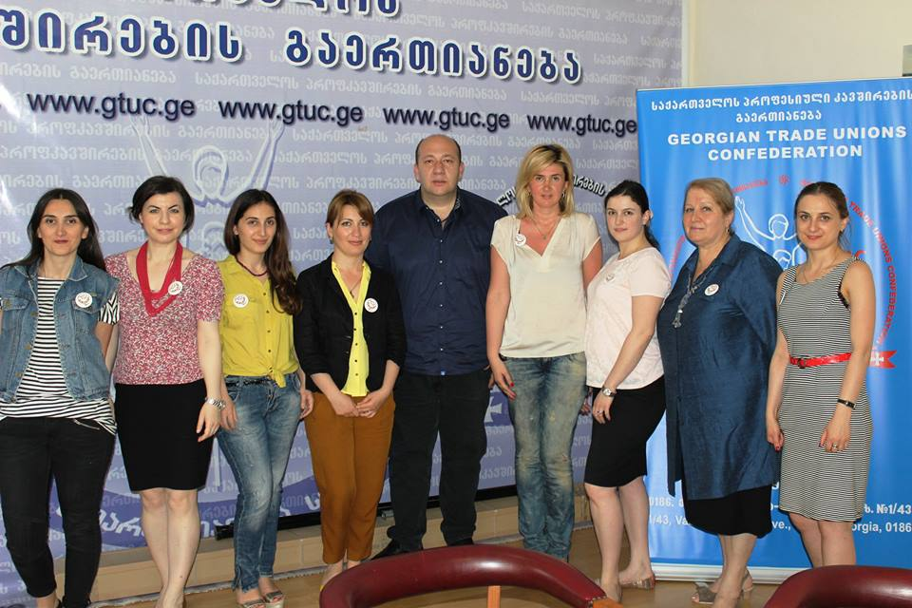
3rd of April 2015, the Georgian Trade Unions Confederation passed an accession resolution of the ITUC campaign "COUNT US IN“.
It was noted in the resolution, that the GTUC endorsed the ITUC campaign and approved its implementation.

Slide 5
PERC saummer school

Slide 6
Statistics
Currently 59.4% of the total number of the GTUC members are women; 4 out of 25 union board members are women (16%); 1 out of 2 vice presidents is a woman, (50%).
The GTUC has 22 affiliates out of which three presidents are women.

Slide 7
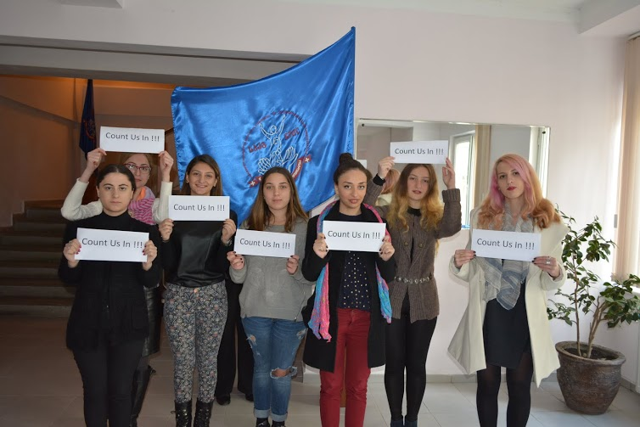
We have a good starting situation at the level of elective primary trade union organisations where 59.4% are women.

Slide 10
The board of the GTUC approved the action plan that was developed by the women’s committee to implement the campaign:
I – Information campaigns about the importance of the “COUNT US IN” campaign with our affiliates. 2015-2018
II – COUNT US IN” Campaign leaflet content preparation and distribution 2015-2016
III – Meetings at the level of primary organisations 2015-2017
IV – Meetings of the collegiate bodies of the affiliated organisations (22 affiliates) and participation in the work of their respective action plan 2015-2016
V Training course on the topic: "Strengthening women's representation in trade unions and reinforcement of their positions in trade union documents (statutes, regulations, instructions) 2015-2016-2017

Slide 12
The board of the GTUC approved the action plan that was developed by the women’s committee to implement the campaign:
VI – Participation in the work of ordinary congresses of the GTUC affiliates and supporting and promoting for inclusion campaign demands in the congress resolutions 2016-2017
VII – Meeting with elected women members of collegial bodies of trade unions. (at various levels) 2016
VIII – Incentive measures for women's activities. /Entire campaign period/
IX – Special conference for trade union women members. “COUNT US IN” 2017
X – Increased representation of women in preparation of the XIII congress of the Georgian Trade Unions Confederations. 2017
XI - COUNT US IN” – Accompanied campaign “Get Active in Trade Unions” /Entire campaign period/

Slide 13
Thanks for your attention

