Slide 1
Fiscal reforms that fall flat? The effects of regressive tax and social security reforms in Eastern Europe
30 September 2022
Evelyn Astor
Economic and Social Policy Advisor
International Trade Union Confederation
Evelyn.Astor@ituc-csi.org

Slide 2
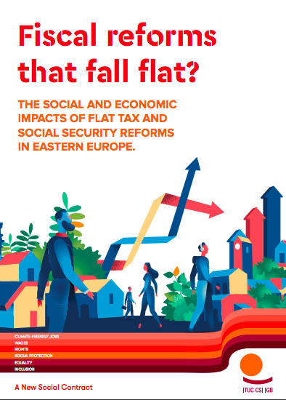
https://www.ituc-csi.org/IMG/pdf/tax-social-security-reforms-perc-v2.pdf

Slide 3
Overview of reforms taken
Country | Year | Overview of reform
Moldova | 2018 | Flat rate personal income tax
Ukraine | 2015/2016 | Flat rate personal income tax
Romania | 2018 | Social security contributions shifted to employees
Georgia | 2009 | Social insurance system abolished; flat rate personal income tax introduced

Slide 4
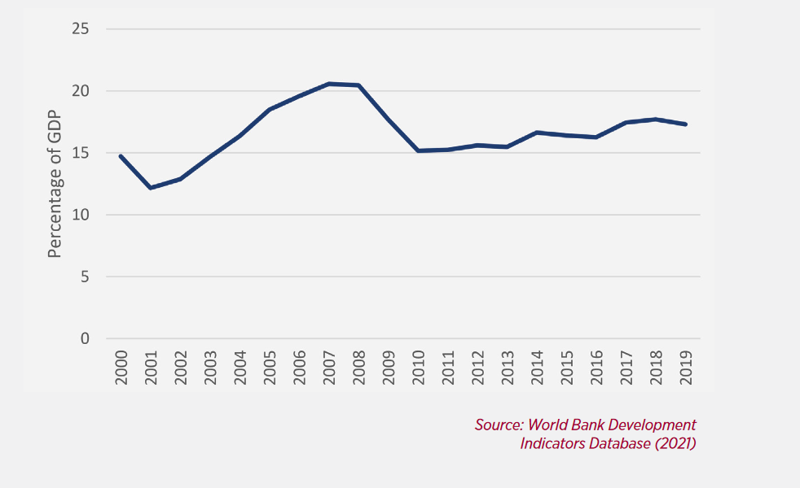
Annual tax revenue in Moldova pre- and post- reform

Slide 5
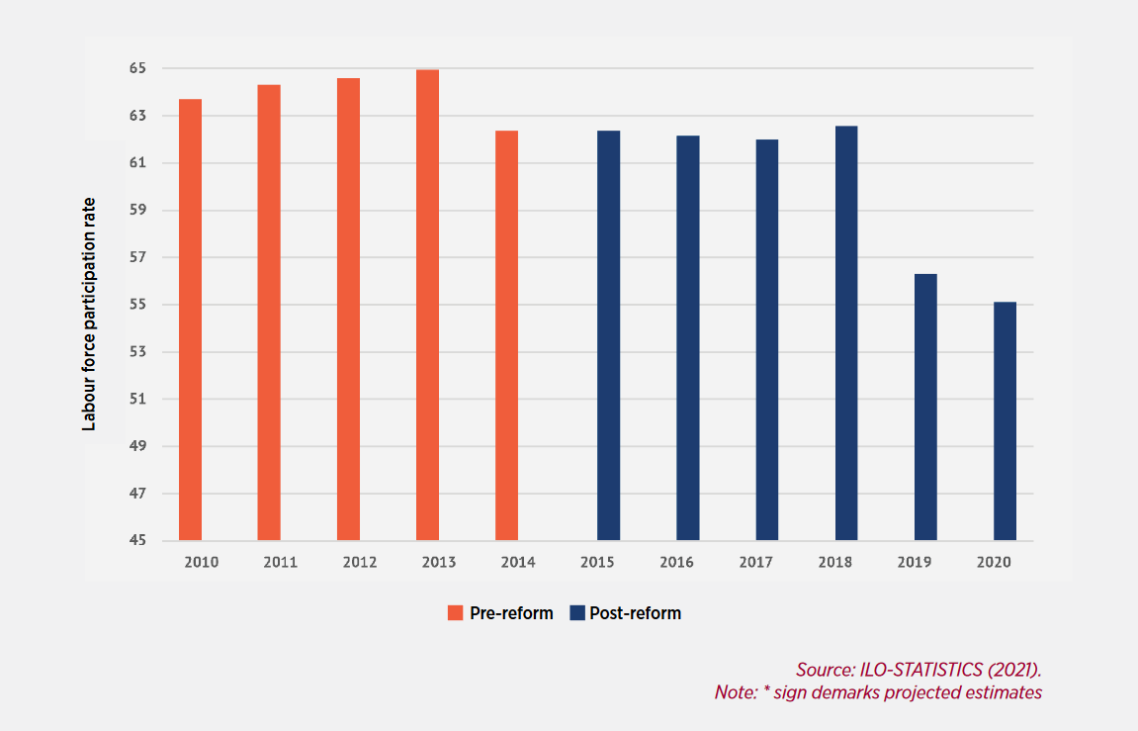
Labour force participation rate in Ukraine pre- and post- reform

Slide 6
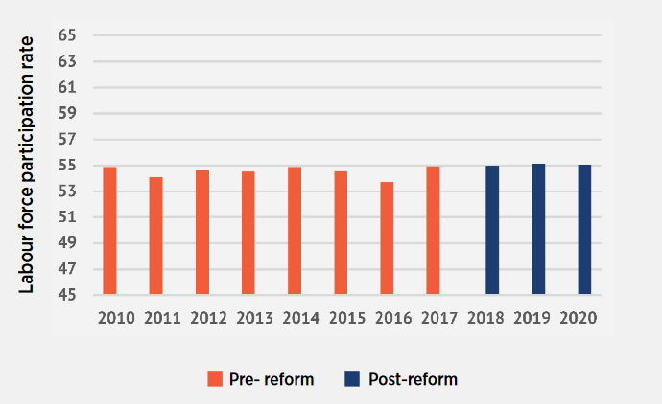
Labour force participation rate in Romania pre- and post- reform

Slide 7
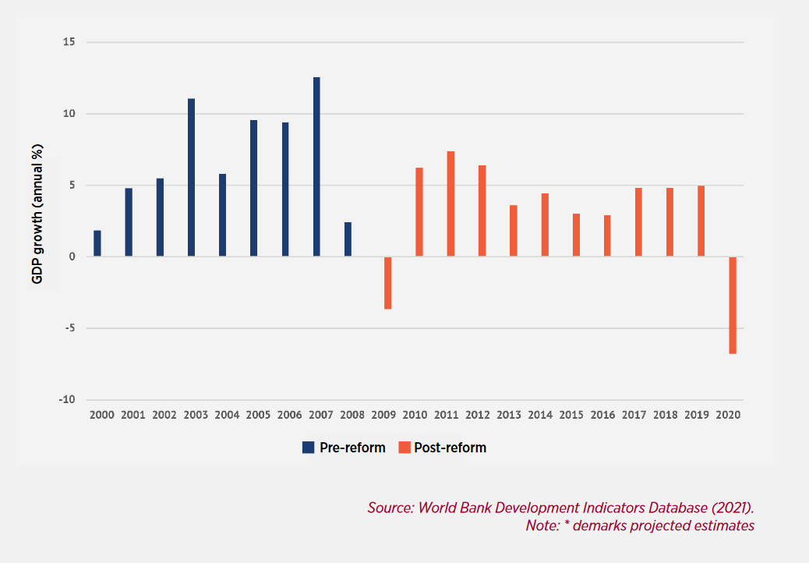
GDP growth rate in Georgia pre- and post- reform

Slide 8
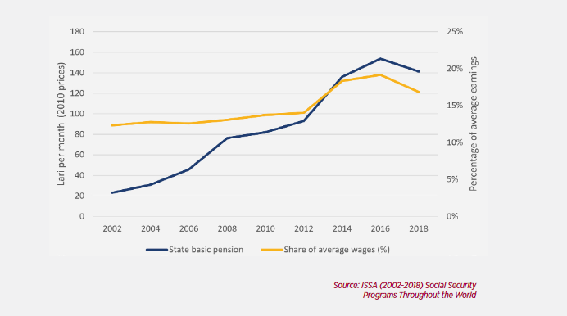
Adequacy of Georgia’s pensions pre- and post-reform

Slide 9
What happened after the reforms?
Country | Year | Overview of reform | What happened after?
Moldova | 2018 | Flat rate personal income tax | Tax revenue declined GDP declined
Ukraine | 2015/2016 | Flat rate personal income tax | Labour force participation declined
Romania | 2018 | Social security contributions shifted to employees | Labour force participation stable, pension adequacy declined
Georgia | 2009 | Social insurance system abolished; flat rate personal income tax introduced | No stable trend in employment participation rates; average pension values declined

Slide 10
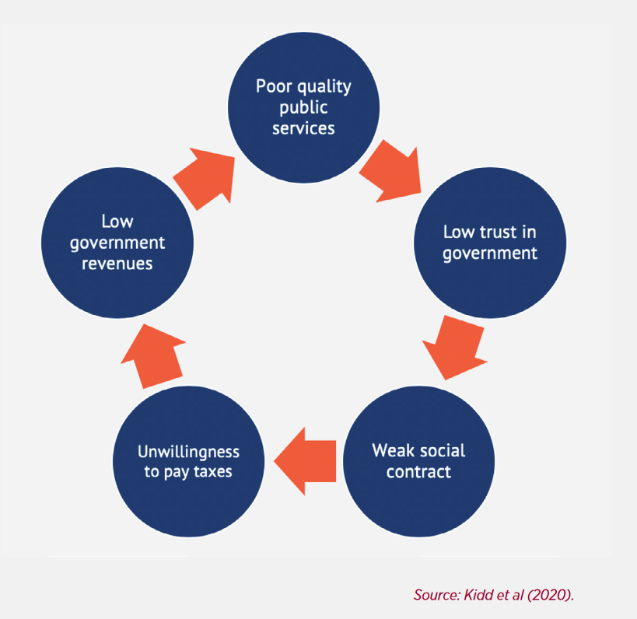
The vicious circle of low trust in government and low government revenues

Slide 11
Broader implications beyond the country case studies…
The World Bank’s new Social Protection and Jobs Compass promotes cutbacks to contributory social security
86 countries currently planning to introduce/increase consumption taxes
47 countries planning to reduce social security contributions

Slide 12
Resources
ITUC (2022) Fiscal reforms that fall flat: the social and economic impacts of flat tax and social security reforms in Eastern Europe
ITUC (2022) Response to the World Bank’s Social Protection and Jobs Compass
Ortiz and Cummings (2022) End Austerity: A Global Report on Budget Cuts and Harmful Social Reforms in 2022-25

