Slide 1
ITUC campaign to end gender based violence in the world of work Towards an ILO standard
equality@ituc-csi.org

Slide 2
Why a campaign on gender-based violence?
35 per cent of women - 818 million women globally - over the age of 15 have experienced sexual or physical violence at home, in their communities or in the workplace.
60 per cent of garment workers in Bangladesh have been intimidated or threatened with violence at work
90 percent of female waitresses in the US have experienced sexual harassment on the job
One in three transgender workers are discriminated against
Female migrant domestic workers worldwide report stories of verbal, sexual and physical abuse

Slide 3
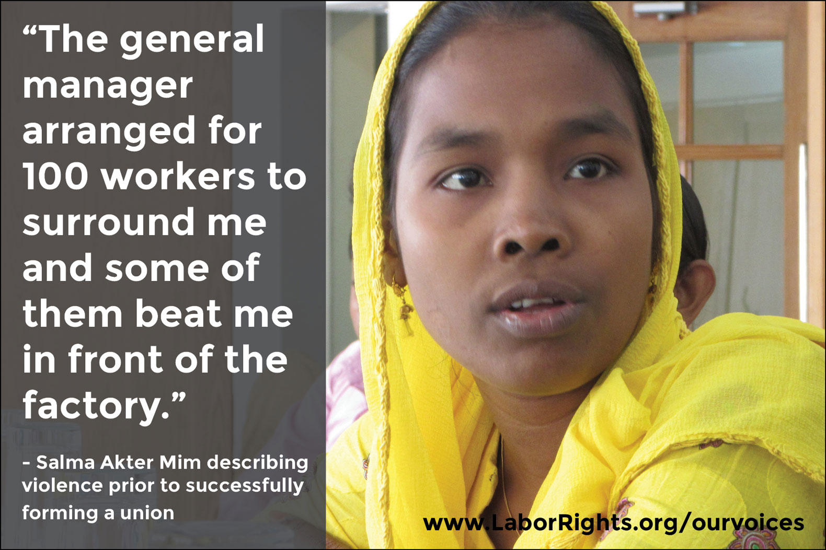
Why an ILO standard on violence and harassment?
Both women and men experience violence and harassment in the world of work, but unequal status and power relations in society
Gender-based violence one of the most tolerated violations of human rights (including workers’ rights )
But NO law at international level that sets a baseline (minimum standard)

Slide 4
Towards an ILO standard
Result of a long campaign by ITUC working with ILO Workers’ Group and Global Union Federations
2009 ILO report Gender Equality at the Heart of Decent Work: “Gender-based violence in the workplace should be prohibited; policies, programmes, legislation, and other measures, as appropriate, should be implemented to prevent it.”
Proposal put before ILO Governing Body at least 5 times (2012, 2013, 2014)
Employers oppose
Some governments support strongly; others not convinced

Slide 5
Towards an ILO standard
In October 2015, the ILO GB finally agrees to place a standard-setting item on “Violence against women and men in the world of work” on the agenda of the 107th Session (June 2018) of the Conference
But first….

Slide 6
We need an experts’ meeting!
What is ‘violence’in the world of work?

Slide 7
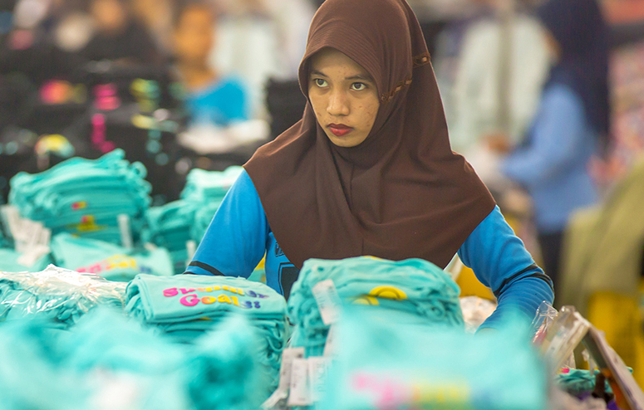
ILO tripartite meeting of experts
October 2016

Slide 8
Key conclusions
The term violence and harassment should be treated as a continuum of unacceptable behaviours and practices, which could result in physical, psychological or sexual harm or suffering
The principle of zero tolerance should be the objective. Violence and harassment should not be seen “as part of the job”
The world of work means not only the traditional physical workplace, but also commuting to and from work, work-related social events, public spaces including for informal workers, and the home, in particular for homeworkers, domestic workers and teleworkers
Domestic violence and other forms of violence and harassment are relevant to the world of work when they impact the workplace

Slide 9
Key conclusions
Unequal/imbalanced power relationships, including due to gender, race and ethnicity, social origin, education and poverty could lead to violence and harassment
Discrimination based on these and other grounds, including disability, HIV status, sexual orientation and gender identity, migrant status and age, are also important factors
Women are disproportionately represented in low-wage jobs, especially in the lower tiers of the supply chains
The gender dimensions of violence need to be addressed specifically

Slide 10
Key conclusions
Workers who cannot exercise their rights to freedom of association and collective bargaining, due to the “inappropriate use of contractual arrangements leading to decent work deficits”, including the misuse of self-employment, are also likely to be more at risk of violence and harassment.
Weak enforcement mechanisms, including understaffed and poorly equipped and insufficiently trained labour inspectorates, also contribute to individuals’ higher exposure to violence and harassment.
http://www.ilo.org/gender/Informationresources/Publications/WCMS_546303/lang--en/index.htm

Slide 11
The questionnaire
(49 questions in total)

Slide 12
I. Form of the international instrument
or instruments
1. Should the International Labour Conference adopt an instrument or instruments
concerning violence and harassment in the world of work?
Comments:
_________________________________________________________
2. If so, should the instrument or instruments take the form of:
(a) a Convention?
□
(b) a Recommendation?
□
(c) a Convention supplemented by a Recommendation, as two separate
instruments or a single instrument comprising binding and non-binding
provisions?
□
Comments:
_________________________________________________________

Slide 13
What can unions do now?
Designate someone responsible for coordinating your union’s response.
Reply to questionnaire:
http://www.ilo.org/ilc/ILCSessions/107/reports/reports-to-the-conference/WCMS_553577/lang--en/index.htm
Ask for the ITUC guidance and model replies by sending an email to: equality@ituc-csi.org
Make sure to submit your union’s reply to the questionnaire by the deadline of 22 September 2017!
It is crucial that as many national trade union centers as possible respond. If we are to win an ILO Convention, we must do this together!

Slide 14
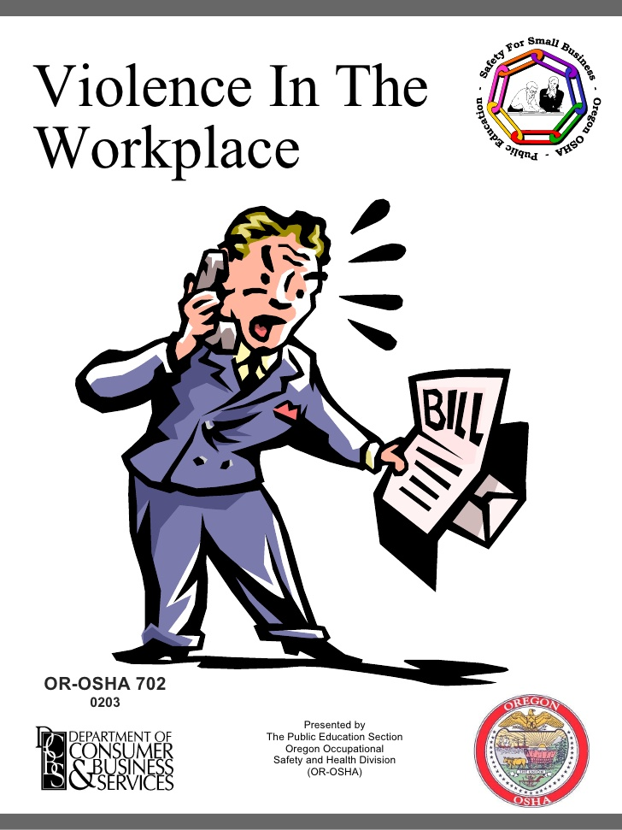
What can unions do now?
Find out whether your national employers’ federation supports an ILO Convention and Recommendation on violence and harassment in the world of work
Use the ITUC guide to explain why it is in employers’ interests to support such an instrument: http://www.ituc-csi.org/IMG/pdf/stop_gender_based_violence_at_work_en_final.pdf
Ask them to tell the IOE about their support
Workplace violence costs everyone

Slide 15
What can unions do now?
Find out which department/ministry/person will be responsible for coordinating your governments’ reply to the questionnaire.
Seek a meeting with government representative(s) to discuss how they intend to reply to the questionnaire.
Explain to your government why it is important to support an ILO Convention supplemented by a Recommendation, with a focus on gender-based violence
Visit the ITUC pages for more information: http://www.ituc-csi.org/gender-based-violence?lang=en

Slide 16
What can unions do now?
Spread the word: Plan and attend trade union meetings and events to inform and sensitise members, activists, organisers, members of collective bargaining teams, experts and activists on gender, migration, youth, as well as trade union decision makers in and across unions about the ILO discussion on new ILO standards;
Conduct a survey among union members to assess the nature and extent of GBV at your workplace
Collect and share stories from members on violence and harassment and GBV, anonymously if necessary. This will help to show why ILO action is urgently needed.

Slide 17
Trade Union Priorities
An ILO Convention, accompanied by a Recommendation, which could cover, for example:
A broad definition of violence and harassment in the world of work, including physical abuse, including assault, battery, attempted murder and murder; sexual violence, including rape and sexual assault; verbal abuse; bullying; psychological abuse and intimidation; sexual harassment; threats of violence and stalking
A strong focus on gender-based violence and harassment in the world of work
Provisions to prevent, address and redress violence and harassment in the world of work

Slide 18
Trade Union Priorities
A description of the workers most at risk of experiencing violence and harassment such as women, LGBTI workers, indigenous and migrant workers, workers living with disabilities and with HIV/AIDS, workers in the informal economy, people trapped in forced and child labour
Measures to address the impact of domestic violence in the world of work
A broad concept of the “world of work”
Specific provision for the appropriate and sensitive treatment of complainants of violence and harassment, including protection from reprisals or penalties for making the complaint.

Slide 19
Building alliances to get rid of gender-based violence in the world of work
Rallying support for an ILO Convention and Recommendation is a great opportunity to heighten awareness on gender-based violence, expose its harmful impacts, to collectively empower women workers and end tolerance of gender-based violence in the world of work.
Working together, unions, feminist movements, LGBTI organisations, labour support organisations, migrants associations, human rights organisations and other civil society allies can be a powerful force against gender-based violence in the world of work.

Slide 20
Gender-based violence (GBV) and Violence against women
Violence against women is defined by the UN Declaration on the Elimination of Violence against Women, adopted by the General Assembly on 20 December 1993, as “any act of gender-based violence that results in, or is likely to result in, physical, sexual or psychological harm or suffering to women, including threats of such acts, coercion or arbitrary deprivation of liberty, whether occurring in public or in private life”.
Gender-based violence (GBV) is violence that is directed against an individual or group of individuals based on their gender identity. GBV encompasses violence against women and girls as well as against men and boys, people who are lesbian, gay, bisexual, transgender and intersex (LGBTI), and other individuals who do not conform to dominant perceptions of gender.

Slide 21
https://www.ituc-csi.org/gender-based-violence

