Slide 1
PERC
4th PERC WOMEN’S CONFERENCE
Women’s Committee – Tbilisi, 20.10.2016
Work Program 2017-2018

Slide 2
PROCEDURE
CONFERENCE -> WORK PROGRAM 2017-2018
WOMEN’S COMMITTEE -> ANNUAL WORK PLAN

Slide 3
SCHEDULE
10:30:
11:50:
17:00:
presentation
discussion
vote adoption Work Program

Slide 4
BACKGROUND 1
ITUC Congress Berlin 2014
union growth
(sustainable) jobs
secure income and social protection
realizing rights

Slide 5
BACKGROUND 2
ITUC on-going priorities:
Count us in
Organizing (women)
…

Slide 6
BACKGROUND 3
Gender equality program of PERC
Women’s structure of PERC
equal treatment M/W
organizing (young) women
the CEE & NIS Women

Slide 7
HOW DO WE WORK ?
Influencing
Training
Women’s Committee
Collaboration with ITUC and ETUC

Slide 8
SO MUCH IS HAPPENING
WOMEN MUST FIGHT
FOR THEIR RIGHTS
AND
FOR EACH OTHER

Slide 9
LET’S BE REALISTIC
AND
PUT OUT PRIORITIES

Slide 10
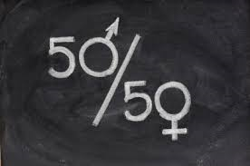
EQUAL TREATMENT

Slide 11
WORK-LIFE BALANCE

Slide 12
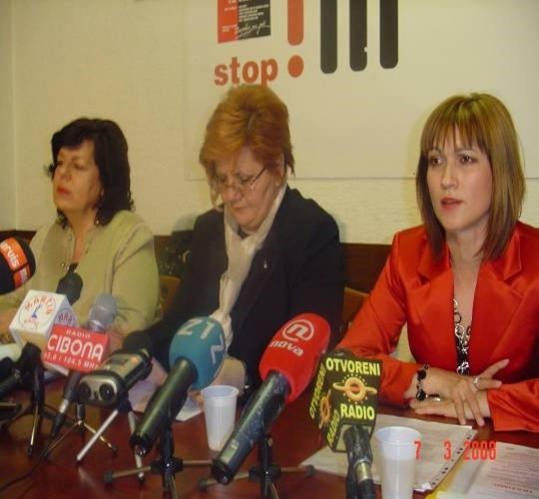
WOMEN IN DECISION-MAKING POSITIONS

Slide 13
FIGHT AGAINST VIOLENCE AT WORK

Slide 14
1. TO PROMOTE EQUAL TREATMENT
-> WHAT ?
To increase union activity for pay equity at
national level
regional level
international level

Slide 15
1. TO PROMOTE EQUAL TREATMENT
-> KEY ACTIONS:
Collective bargaining
Research and information dissemination
Intensify the “Decent Work for Decent Life for Women” campaign

Slide 16
1. TO PROMOTE EQUAL TREATMENT
8th of March Action
8th of March Survey
To strengthen the Women’s Committee at national level

Slide 17
2. WORK-LIFE BALANCE
-> WHAT ?
To deal with Challenges W-L
To fight for decent living wages
To fight for full-time contracts

Slide 18
2. WORK-LIFE BALANCE
-> KEY ACTIONS:
To lobby for improved legislative framework
ILO conventions
Child care
“Care economy”: improvement of pay and work conditions
Count us in – campaign in the care economy

Slide 19
3. WOMEN IN DECISION-MAKING POSITIONS IN TRADE UNIONS
-> WHAT ?
To achieve gender parity in
programs
access to positions of responsibility in the leadership
With particular attention to young women

Slide 20
3. WOMEN IN DECISION-MAKING POSITIONS IN TRADE UNIONS
-> KEY ACTIONS
Data
Count us in – campaign
Organizing young women
Training

Slide 21
4. FIGHT AGAINST VIOLENCE AT WORK
-> WHAT ?
WE JUST DO NOT ACCEPT !

Slide 22
4. FIGHT AGAINST VIOLENCE AT WORK
-> KEY ACTIONS
25 November: International day for elimination of violence against women
ILO convention

