Slide 1
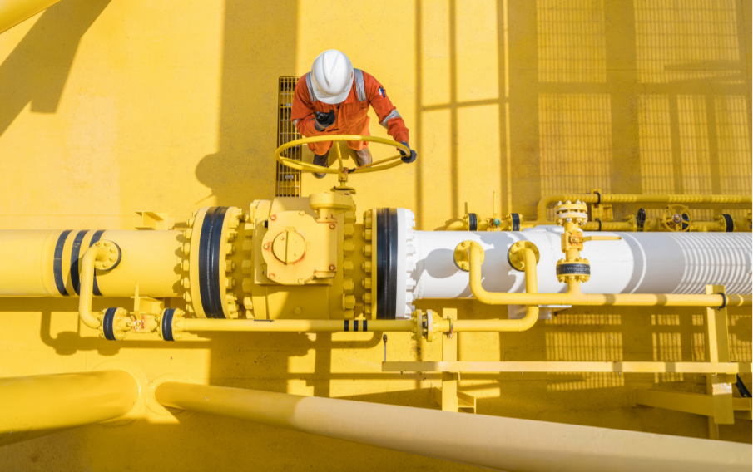
Trade unions demand a Just Transition
International Trade Union Confederation

Slide 2
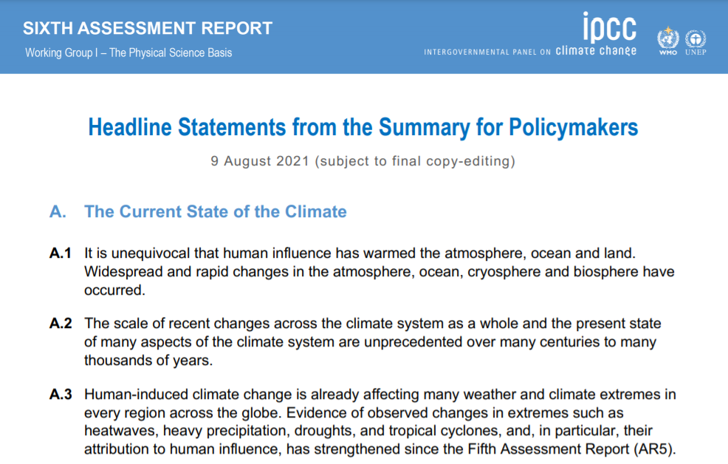
https://www.ipcc.ch/report/sixth-assessment-report-working-group-i/

Slide 4
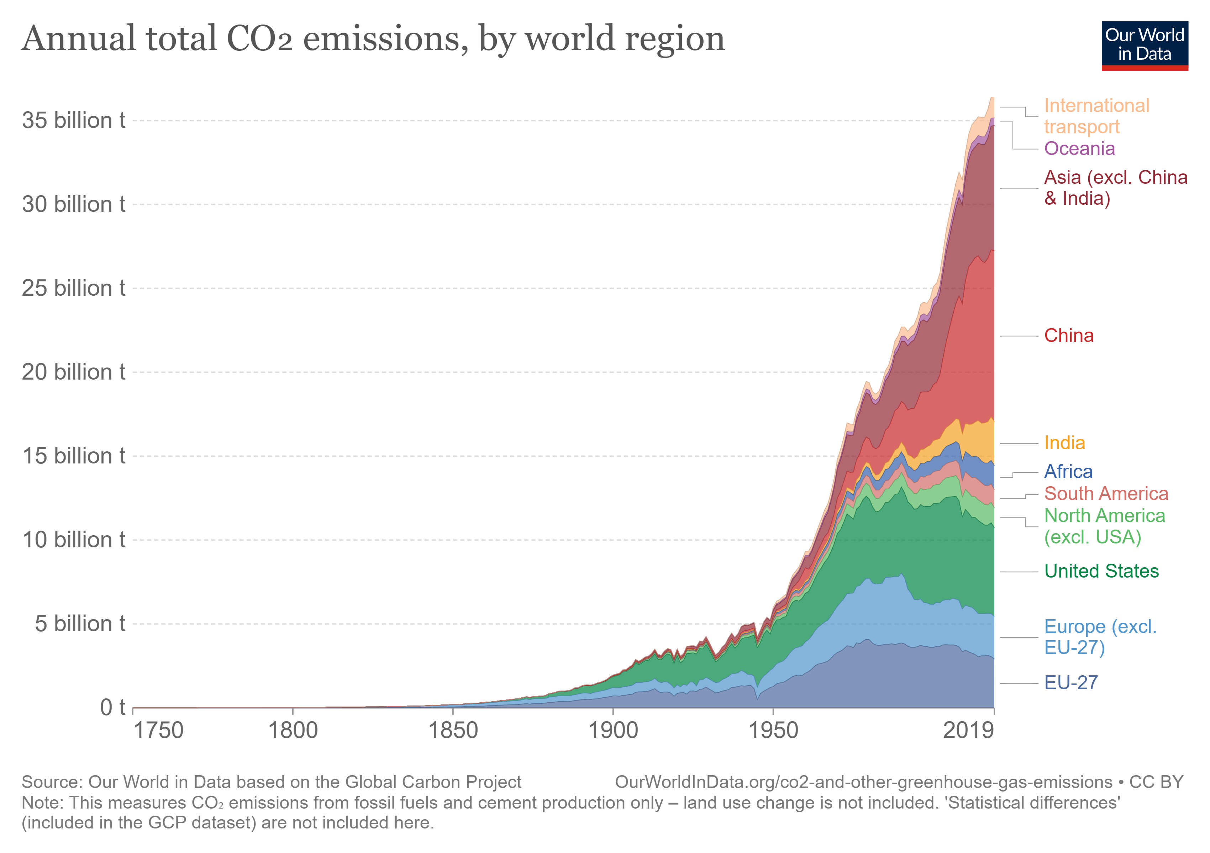

Slide 5
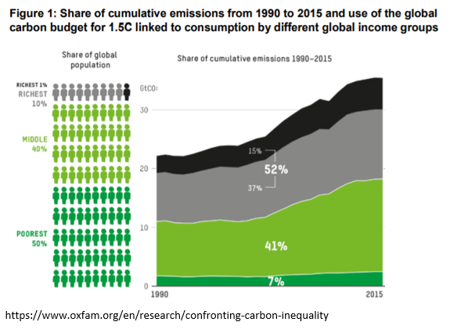

Slide 6
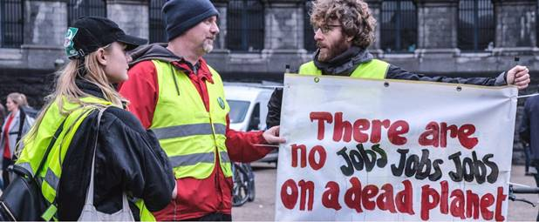

Slide 7
What is Just Transition and why do we need it?
“A Just Transition secures the future and livelihoods of workers and their communities in the transition to a low-carbon economy. It is based on social dialogue between workers and their unions, employers, government and communities. A plan for Just Transition provides and guarantees better and decent jobs, social protection, more training opportunities and greater job security for all workers affected by global warming and climate change policies.”
https://www.ituc-csi.org/social-dialogue-for-sdgs-promoting-just-transition

Slide 9
The global labour movement has climate policies at the centre of a vision for a fairer, more resilient society for all, reflected in our five demands for a New Social Contract:
Creation of climate-friendly jobs with Just Transition. Job-creating industrial transformation plans to achieve net-zero carbon emissions, along with jobs in health, education, care and other quality public services.
Rights for all workers, regardless of their employment arrangements, to fulfil the promise of the ILO Centenary Declaration with its labour protection floor including rights, maximum working hours, living minimum wages and health and safety at work.
Universal social protection, that underpins a Just Transition and builds resilience. The establishment of a Global Social Protection Fund to build social protection systems for the poorest countries. See also: 109th International Labour Conference
Equality. Ending all discrimination due to income, race or gender, to ensure that all people can share in prosperity. The appalling concentration of wealth in the hands of a few at the expense of the many must be undone.
Inclusion. No one will be left behind. Working people want a peaceful world and a just, rights-based development model with the promise of the SDGs.

Slide 10
A Just Transition framework is supported by the following pillars:
Early assessment of the social and economic consequences of climate change and responses to it.
Promotion of substantial public investment in low-carbon sectors and technologies.
Implementation of active policies for the restructuring and diversification of the economy.
Promotion of professional training and retraining for the development of skills.
Strengthening of social protection systems and public investment in health, education, etc.
Promotion of social dialogue, collective bargaining and social participation.
More Just Transition stories: https://www.equaltimes.org/just-transition-putting-planet#.YNrf4egzZPY Just Transition Centre: https://www.ituc-csi.org/just-transition-centre

Slide 11
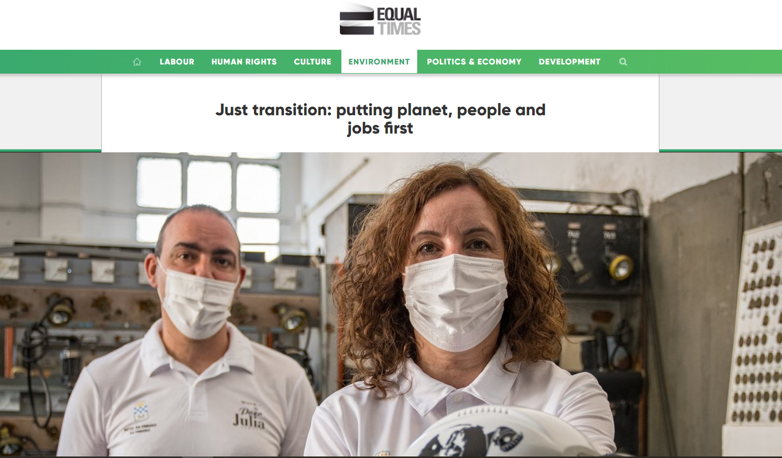
https://www.equaltimes.org/just-transition-putting-planet

Slide 12
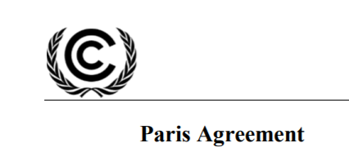
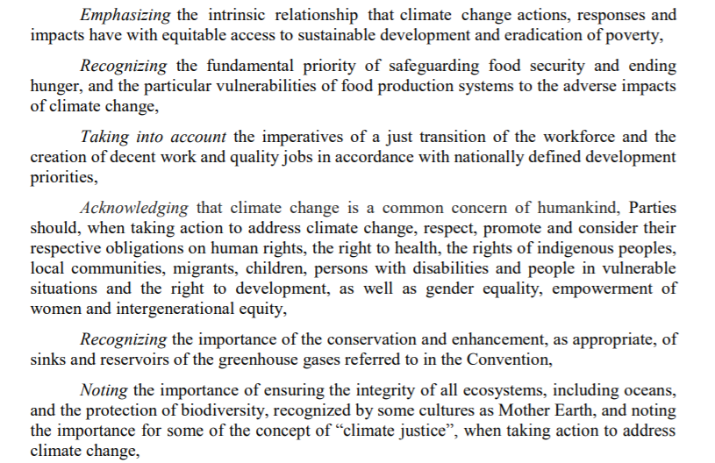
Notes:
The preamble of the Paris Climate agreement of 2015 explicitly asks countries to take into account the imperatives of a just transition of the workforce and decent jobs.

Slide 13
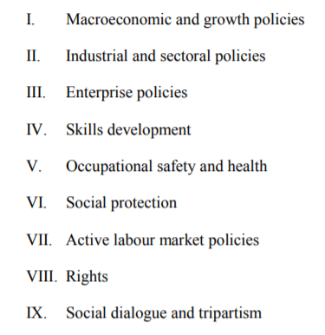
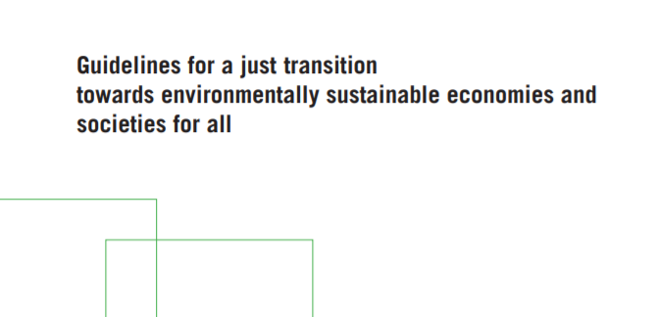
https://www.ilo.org/global/topics/green-jobs/publications/WCMS_432859/lang--en/index.htm
Notes:
The preamble of the Paris Climate agreement of 2015 explicitly asks countries to take into account the imperatives of a just transition of the workforce and decent jobs.

Slide 14
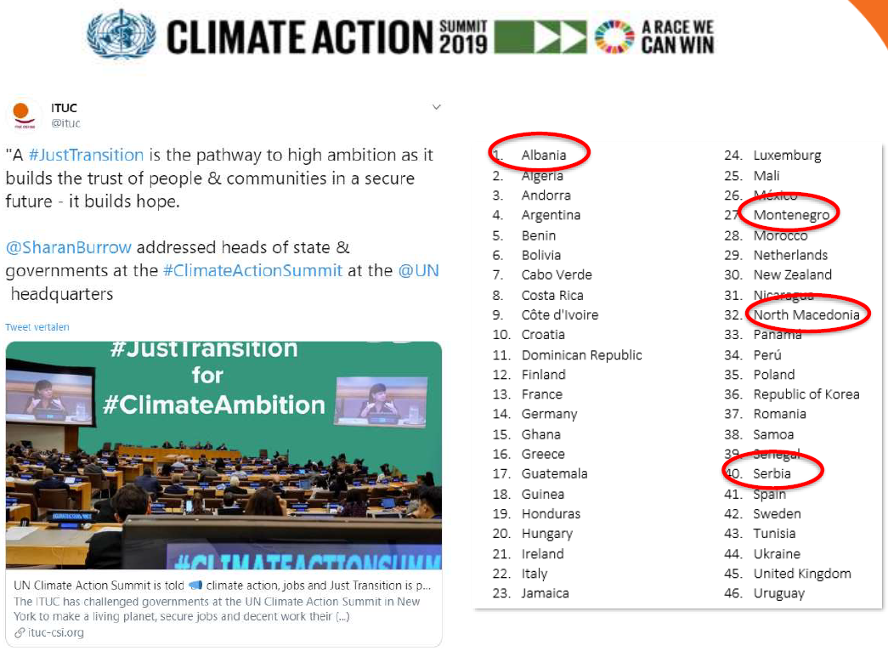
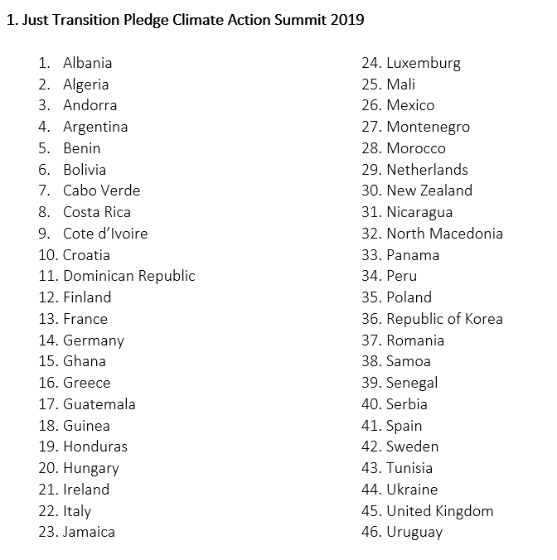

Slide 15
Governments fail to live up to Paris Agreement promises and put planet stability at risk
Only 46 countries from the 197 UNFCCC parties mention the words “just transition” in their updated NDC, 3 countries have it in their second NDC.
The ten worst countries for climate ambition and just transition are: Russia, Brazil, Mexico, Australia, Italy, Belgium, Austria, Poland, Japan, South Korea. Some of the world’s biggest emitters of CO2, such as China and India, have still not presented their new NDCs.

Slide 16
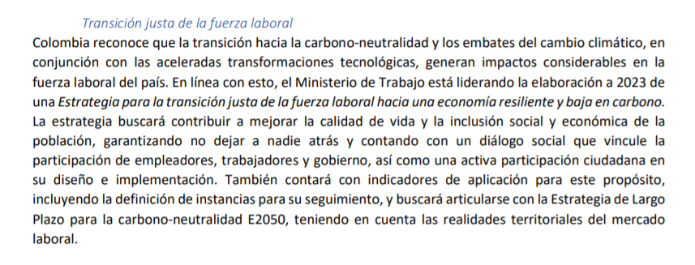
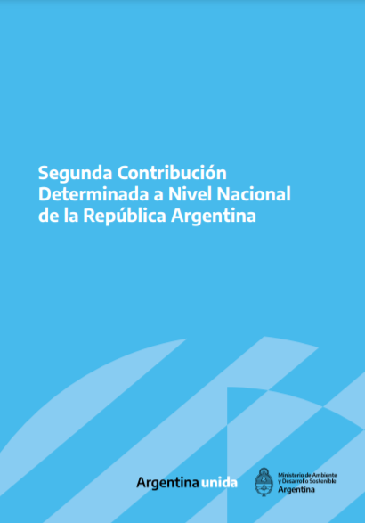
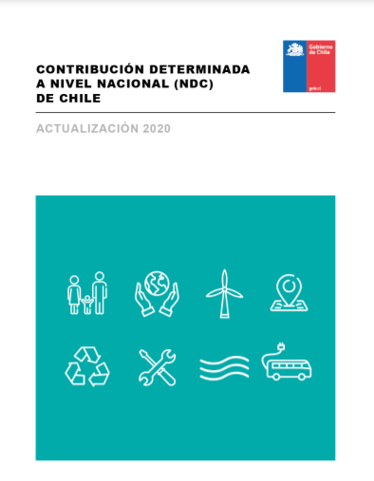
Just Transition in the NDCs in Latin America: a mixed picture including promising examples and plain green wash.

Slide 17
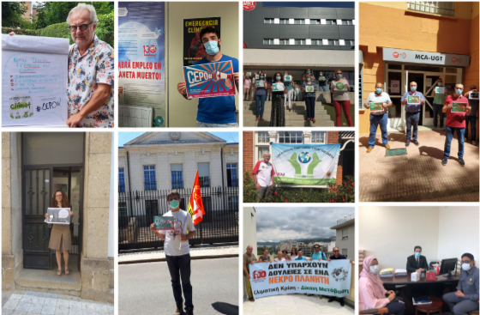

Slide 19
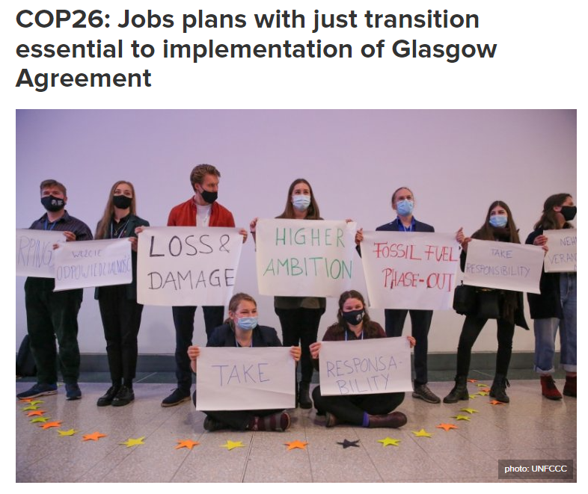
https://www.ituc-csi.org/cop26-jobs-plans-with-just-transition

Slide 20
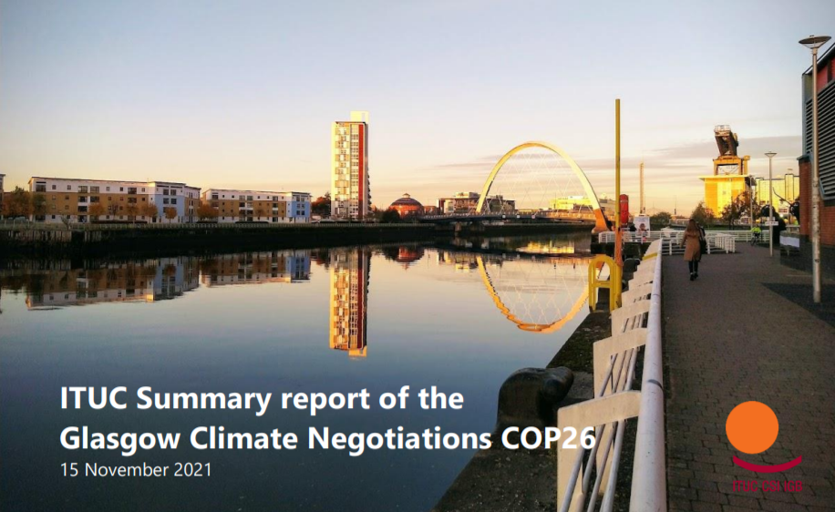
https://ituc.sharepoint.com/sites/public/ESP/Climate/ITUC%20COP26%20Summary%20report.pdf?isSPOFile=1&OR=Teams-HL&CT=1637244292987

Slide 21
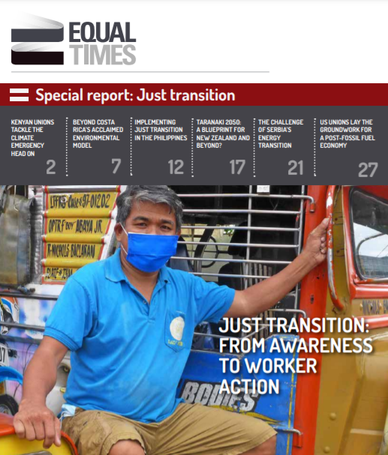
https://www.equaltimes.org/just-transition-from-awareness-to

Slide 22
Bert De Wel Climate policy officer International Trade Union Confederation
Bert.DeWel@ituc-csi.org Twitter: @bertdewel

