Slide 1
Labour inspections and enforcement capacity (in the times of crisis): the case of Visegrad countries and the Baltic States
Regional conference
«Compliance of national legislations with the ILO Convention 81 on Labour Inspection and the Respective Protocol 55»
Ieva Bloma, Ph.D. cand. (EUI)
26-27 September 2018, Tbilisi, Georgia

Slide 2
A comparative cross-country research on Labour inspections
Study: organizational approach & state-centered enforcement approach
Challenge 1: institutional differences among the countries
- fragmentation (both vertical and horizontal)
- different content of the “inspector”
Challenge 2: Data collection & comparability
- between the countries
- between one country’s various reports

Slide 3
Labour inspections and enforcement capacity: how to assess
The main ILO indicators in the CEE during 2008-2014:
Number of inspectors = uneven: increase in CZ and PL; decrease in LV, HU, EST, LT, SLO (slightly).
Number of inspection visits = uneven, mostly decrease; increase in CZ and SLO.
Inspectors per 10 000 employed persons;.
Visits per inspector.

Slide 4
The number of inspectors per 10 000 employees, selected years
 | CZ | SLO | HU | EST | LT | LV | PL
2008 | 1.1 | 1.4 | 0.71 (2006) | 0.75 | 1.5 | 1.4 | 1.0
2011 | 0.7 | 1.9 | 0.66 | 0.71 | 1.79 | 1.45 | 1.3
2012 | 1.4 (2013) | 1.5 | 0.26 | 0.64 | 1.77 | 1.4 | 1.36
2014 | 1.2 | 1.6 | 0.35 | 0.62 | 1.43 | 1.5 | 1.35
Notes:
Inspectors per employed = EE and HU has experienced decrease. All other countries more or less the same, except PL which has experienced increase (but then, PL also had budget increase).
Inspections per inspector

Slide 5
The number of inspections per inspector, selected years
 | SLO | EST | LT | LV | PL
2008 | 119 | 108 | 77 | 91 | 64
2011 | 131 | 101 | 63 | 94 | 61
2012 | 123 | 94 | 51 | 88 | 59
2013 | n/a | 96 | 53 | 86 | 58
2014 | 206 (2015) | 102 | 59 | 86 | 57
Notes:
Slovakia – demonstrates an increase, all other countries – decrease. CZ and HU – still in progress.

Slide 6
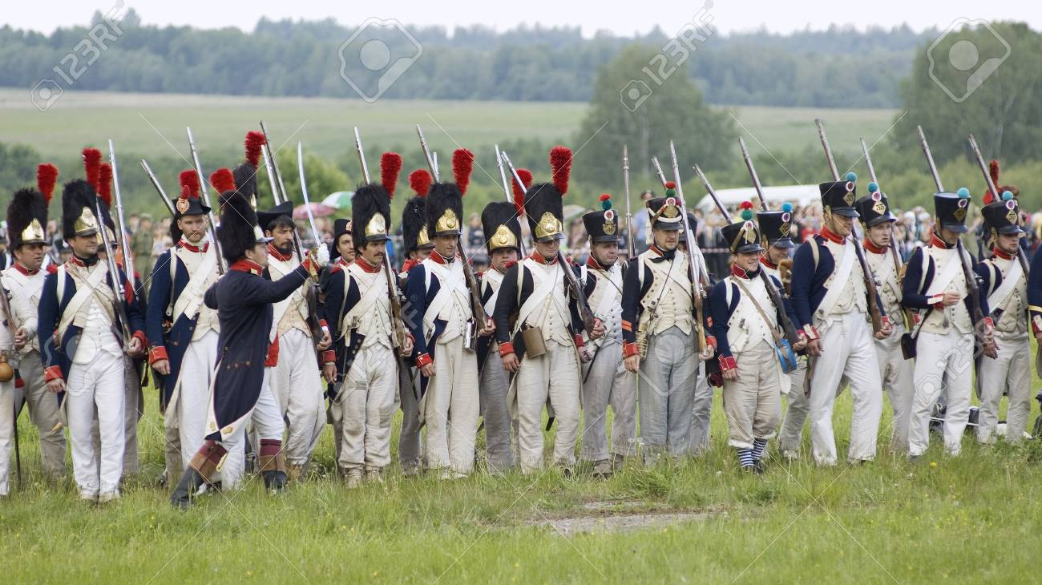
INSPECTORS = INPUT VARIABLE

Slide 7
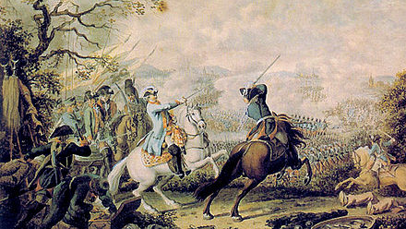
But you can deploy your army in various ways…

Slide 8
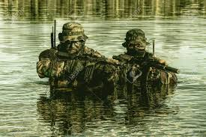
… through the water

Slide 9
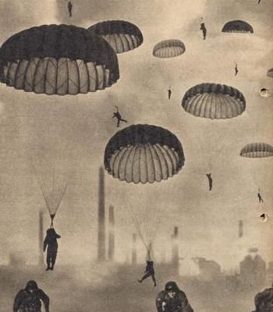
…or landing from the sky

Slide 10
Enforcement:
Available resources
The use of the available resources
=
How to decide
Where to send them in?

Slide 11
Enforcement styles and enforcement strategies (1)
Academic literature:
focus on enforcement styles, enforcement strategies
Deterrence model (= to inspect + to raise the fear of being non-compliant)
Co-operative / persuasion model (= to persuade to comply)
Responsive regulation (= differentiated enforcement)
Strategic enforcement (= prioritization)

Slide 12
 | High motivation | Low motivation
High knowledge | High motivation High knowledge DO NOTHING | Low motivation High knowledge MOTIVATE (incl. DETER)
Low knowledge | High motivation Low knowledge EDUCATE | Low motivation Low knowledge EDUCATE & MOTIVATE

Slide 13
Enforcement styles and enforcement strategies (2)
Senior Labour Inspectors’ Committee’s (SLIC) Common Principles of inspection (in relation to occupational health and safety):
Planning and monitoring carried out by the LI;
Inspector’s independence and powers;
Protection for inspectors;
Guidance for inspectors;
Internal communication.

Slide 14
Weak points in the times of crisis (1): prioritization & training
Number of inspections ↓
Number of complaints ↑ (LV, LT, EST, in HU – announcements of general interest and anonymous notices)
= This means that the number of reactive inspections increases at the expense of proactive inspections
Training budget ↓
= This implies, among other consequences, that the inspectors are less capable to grasp the new and emerging OSH risks

Slide 15
Other points in the times of crisis (2): new powers/priorities for inspection
Undeclared work (CZ and PL – inspectors on Legality of employment; LV – also, but was topical in political rhetoric already before the crisis)

Slide 16
Thank you for your attention!
E-mail: ieva.bloma@eui.eu

Slide 17
The number of improvement notices per inspection, selected years
 | SLO | HU | EST | LT | LV
2008 | 0.03 | 0.86 | 0.28 | 0.69 | 0.35
2011 | ? | 0.44 | 0.29 | 0.56 | 0.42
2012 | ? | 0.40 | 0.41 | 0.52 | 0.35
2013 | ? | 0.41 | 0.46 | 0.19 | 0.33
2014 | ? | 0.39 | 0.42 | 0.16 | 0.32

Slide 18
The number of (administrative) fines imposed per inspection, selected years
 | CZ | SLO | HU | EST | LT | LV | PL
2008 | 0.23 | 0.05 | 0.28 | 0.02 | 0.16 | 0.22 | 0.21
2011 | 0.11 | 0.009 | 0.07 | 0.04 | 0.04 | 0.2 | 0.19
2012 | n/a | 0.11 | 0.04 | 0.09 | 0.02 | 0.24 | 0.2
2013 | 0.06 | n/a | 0.03 | 0.06 | 0.05 | 0.2 | 0.2

Slide 19
Institutional outputs, enforcement of OSH – 1 (here: LATVIA but represents the general trend in all Baltic States, unless stated otherwise), 2007-2016
 | Budget | Inspectors | Visits to workplaces | Offenses / violations detected
2007 | 2.7 m | 140 | 13 538 | 13 538
2008 | 3 m | 139 | 13 238 | 25 601
2009 | 2.98 m | 117 | 12 189 | 26 610
2010 | 1.61 m | 112 | 10 477 | 25 455
2011 | 1.62 m | 112 | 10 378 | 21 603
2012 | 1.64 m | 97 | 9 848 | 14 653
2013 | 1.9 m | 113 | 10 817 | 13 658
2014 | 2.65 m | 120 | 10 317 | 16 387
2015 | 2.89 m | 121 | 10 514 | 16 905
2016 | 2.72 m | 115 | 10 516 | 15 547

