Slide 1
The PERC Regional Meeting
“Trade union approaches and strategic opportunities in OHS:
Challenges in providing a safer and healthier work environment for workers in the Balkan region countries”
3 – 5 October 2018, Montenegro, IGALO
Relations between a stable OHS policy and protection at workplace
in context of current situation in Balkan countries
Ivan Majer (Slovakia)

Slide 2
WHY A STRATEGY IS NEEDED?
NO PLAN — NO ACTiONS
PERC Regional Meeting, October 2018, Montenegro, IGALO

Slide 3
WHAT DOES STRATEGY MEAN?
Determination of priorities (objectives, goals, expectations)
Determination of sources
Planning of actions
Strategy is a high level plan to achieve specified goals
PERC Regional Meeting, October 2018, Montenegro, IGALO

Slide 4
WHY THE OSH AREA SHALL BE IMPROVED?
Social dimension (protection of workers)
Reduction of losses (from accidence and occ. diseases)
Influence for productivity (good conditions brings good bussines)
Support of employment (status of employees)
Improvement of market competition (reputation of companies)
Interest of government (in reduction of black labour)
Social dialog (social peace of social partners)
Political dimension (engagement with international community)
PERC Regional Meeting, October 2018, Montenegro, IGALO

Slide 5
The fundamentals and challenges for efficient health and safety policy on national level
Good will to reach improvement of working conditions
Right motivation
To know needs and realistic capacities of a country (analysis)
To understand safety and health principles
Clear vision and capability to identify priorities and objectives
Ability to accept partners, to cooperate
To appear from a high level concept
To accept a comprehensive systematic approach
SMART approach
PERC Regional Meeting, October 2018, Montenegro, IGALO

Slide 6
The fundamentals and challenges for efficient health and safety policy on national level
Good will to reach improvement of working conditions
Right motivation
To know needs and realistic capacities of a country
To understand safety and health principles
Clear vision and capability to identify priorities and objectives
Ability to accept partners, to cooperate
To appear from a high level concept
To accept a comprehensive systematic approach
SMART approach
PERC Regional Meeting, October 2018, Montenegro, IGALO

Slide 7
Good will to reach improvement of working conditions
Who has an interest to improve working conditions and OSH ?
Who has no interest ?
What is a balance of strength of particular sides ?
How they can be persuaded for good will ?
Right motivation
Money - challenge for prosperity
PERC Regional Meeting, October 2018, Montenegro, IGALO

Slide 8
PROSPERITY
Objective of companies
A wish of individuals
Purpose of Government
Prosperity rises from a productive work, technical advance, inovative aproach, successful bussines...
How can the OSH contribute to the prosperity?
PERC Regional Meeting, October 2018, Montenegro, IGALO

Slide 9
2 dimensions of OSH
1) Social dimention - protection of workers with regards to all aspects of work, better life for people
2) Economic dimention – avoiding losses of work accidents, promotion of productivity, quality, better bussiness for employers
PERC Regional Meeting, October 2018, Montenegro, IGALO

Slide 10
OSH – aspect of
competitiveness
Good OSH management ensures proper functioning of all processes in a company, it brings company prosperity
OSH at a workplace is important also because human resource are the most important resource of a company
The title of the EU OSH Strategy 2007-2012 was: „Improving quality and productivity at work“
PERC Regional Meeting, October 2018, Montenegro, IGALO

Slide 11
Quality of working life
Work Culture
Are people happy at work?
Orientation on human resources: Happy and motivated employee is a guarantee of productivity and quality of work, is a guarantee of company prosperity.
The key to employee productivity is to keep them motivated.
Employees can remain motivated if they feel safe and happy at their workplace.
PERC Regional Meeting, October 2018, Montenegro, IGALO

Slide 12
The fundamentals and challenges for efficient health and safety policy on national level
Good will to reach improvement of working conditions
Right motivation
To know needs and realistic capacities of a country
To understand safety and health principles
Clear vision and capability to identify objectives
Ability to accept partners, to cooperate
To appear from a high level concept
To accept a comprehensive systematic approach
SMART approach
PERC Regional Meeting, October 2018, Montenegro, IGALO

Slide 13
Occupational Safety and Health
is an integral part of working conditions
covers prevention of negative consequences of work, positive health promotion, satisfactory working conditions, working relations, combating with stress,....
is a key aspect of the labour culture
is a significant condition for productivity, quality and efficiency of work
harmonisation of legislations supports acting at the EU market
PERC Regional Meeting, October 2018, Montenegro, IGALO

Slide 14
The condition for prosperity – – to avoid isolation
Open economy – good bussiness
Associated countried have bargain access to the EU market, with adventageous movement of products, investment , people and services
The condition is – harmonised economic, legal and social environment
Harmonised OSH legislation
PERC Regional Meeting, October 2018, Montenegro, IGALO

Slide 15
How to ensure safety and health at work?
HISTORICAL APPROACH:
Compliance with laws, regulations and standards
--- 1989 ---
ACTUAL APPROACH:
Active assessment of individual worplaces, work equipment and work activities...
... with regard to all aspects of work.
Tailored for real conditions
PERC Regional Meeting, October 2018, Montenegro, IGALO

Slide 16
What actually has been changed?
1. philosophy of prevention,
2. philosophy of workers protection,
3. philosophy OSH enforcement
PERC Regional Meeting, October 2018, Montenegro, IGALO

Slide 17
1. Philosophy of prevention
Preventing of shortcomings occurrence, it means to make necessary measures so as shortcomings do not occur at all
Risk assessment, it means the ability to identify and evaluate things which can give rise to accident or other damage for persons, environment or property,
Taking into account the human factor, it means to be targeted not only on technical safety, but mainly preventing of human mistakes
System approach, it means an implementation of system tools, such as OSH policy, risk assessment, communication, education and control system, continual improvement etc.
Two steps – on the one hand to make all possible measures so that ineligible incident does not occur and on the other hand to prepare for eventuality that the incident will occur
PERC Regional Meeting, October 2018, Montenegro, IGALO

Slide 18
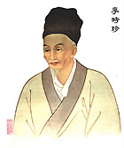
Prevention means to admit no shortcomings
Example of health understanding
What do we expect of a medical doctor?
...to treat us, when we are ill...
In Old China, if the Imperator became ill ...
... his doctor was put to death
PERC Regional Meeting, October 2018, Montenegro, IGALO

Slide 19
Principles of prevention
(Framework Directive)
Prevention of occupational risks and hazards,
Evaluation of risks that are impossible to be prevented,
Fighting with risks at their source,
To choose work equipments, working and production methods to make the work suitable for the employees,
Adapting to technical developments,
Replacing the dangerous techniques with safe ones or less dangerous ones,
Building general policies on OSH.
Prioritizing the collective measures over the individual protection measures,
Giving appropriate instructions to employees,
PERC Regional Meeting, October 2018, Montenegro, IGALO

Slide 20
Basic pillars of the regular OSH approach
Responsibility of employer
Risk assessment
Prevention principles
OSH professionals, OSH services
Training, informing
Control, planning, safety management principles
Emergency management
Involvement of workers, workers representatives
Working conditions
Reporting of work accidents and occupational diseases
PERC Regional Meeting, October 2018, Montenegro, IGALO

Slide 21
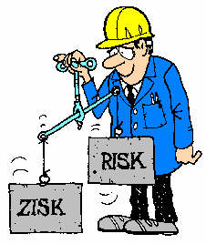
What does risk assessment mean?
It is a method that discover the sources of possible dangerous situations and unwanted occurrence, analyse them, assess them and provide guidance for the adoption of appropriate measures
AXIOMS:
Absolute safety does not exist, zero risk does not exist
Safety is the stage, when the risk is acceptable
Bounds of acceptability are not strictly defined
PROFIT
PERC Regional Meeting, October 2018, Montenegro, IGALO

Slide 22
2. Philosophy of workers protection
– Taking into account all circumstances relating to work, it means not only safety and health, but also wellbeing and welfare working conditions, social protection, comfort, psycho social factors, inter human relations, stress aspects, load, etc.., „HOLISTIC“ APPROACH
– Adapting technics and processes to human being
– All employees involvement into OSH management, it means to enable workers to participate at OSH problems, to discuss with them in advance all questions relating to work, working conditions and organisation.
PERC Regional Meeting, October 2018, Montenegro, IGALO

Slide 23
3. Philosophy of OSH enforcement
- Advise and consulting, campaigns and promotion programmes it is concerning not only labour inspection but also the activities of safety technicians in enterprises. It is important to support an awareness and to change the attitude of persons relating to OSH
Culture of labour environment it means not only „cultural working environment“ but also discipline in observations of OSH rules responsibility, interest and positive understanding of protection needs
Wide understanding of education role which is not limited just by training performance, but it continues by everyday commanding of observance of rules, by control, inspection, consistence and leadership by example
Enforcement of good practice it means to collect and implement information about procedures and good practices, which have been identified as effective
- Financial motivation It is important inside a company. Managers have to know, that the same activities leading to the good safety and health at work and to the improvement of working conditions; they lead at the same time to the improvement of productivity, effectiveness and quality of the work itself. Good practice should be rewarded

Slide 24
The fundamentals and challenges for efficient health and safety policy on national level
Good will to reach improvement of working conditions
Right motivation
To know needs and realistic capacities of a country
To understand safety and health principles
Clear vision and capability to identify priorities and objectives
Ability to accept partners, to cooperate
To appear from a high level concept
To accept a comprehensive systematic approach
SMART approach
PERC Regional Meeting, October 2018, Montenegro, IGALO

Slide 25
EXERCISE
Create small national teams (according countries)
Try to identify main needs and priorities for OSH in your country
Try to formulate the vision for your national OSH policy
Try to identify main objectives for the policy
Finally present your results in front the audience
PERC Regional Meeting, October 2018, Montenegro, IGALO

Slide 26
What is a base of a strategy?
Employment strategy
Previous OSH strategy
Own analysis
Government Programme
EU OSH Strategy
ILO Conventions
PERC Regional Meeting, October 2018, Montenegro, IGALO

Slide 27
The fundamentals and challenges for efficient health and safety policy on national level
Good will to reach improvement of working conditions
Right motivation
To know needs and realistic capacities of a country
To understand safety and health principles
Clear vision and capability to identify priorities and objectives
Ability to accept partners, to cooperate
To appear from a high level concept
To accept a comprehensive systematic approach
SMART approach
PERC Regional Meeting, October 2018, Montenegro, IGALO

Slide 28
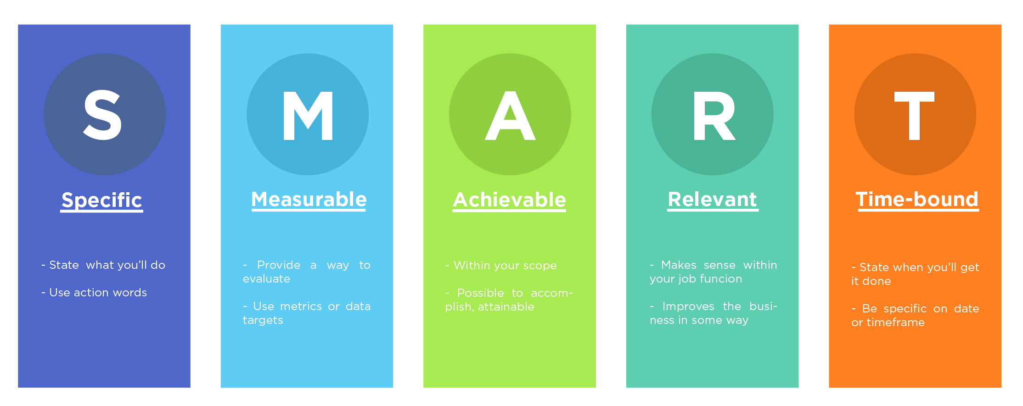
SMART approach
Identification of objectives and goals:
PERC Regional Meeting, October 2018, Montenegro, IGALO

Slide 29
An example of the main challenge of EU OSH Strategy (2007-2012)
Reduction by 25% the total incidence rate of accidents in the EU 27
GDP of EU is ~ 12 000 billions €
Losses of OSH accidents and diseases are estimated ~ 3,5%
It represents: 420 billions € of losses
25% reduction represents 100 billions €
Lack of effective OSH prevention has besides considerable human dimension also a major negative impact on the economy.
These figures are a challenge for every company. It can decide to profit on good safety and health protection.
PERC Regional Meeting, October 2018, Montenegro, IGALO

Slide 30
OSH Strategic Framework 2014 -2020
THREE MAJOR CHALLENGES:
to improve implementation of existing health and safety rules, in particular by enhancing the capacity of micro and small enterprises to put in place effective and efficient risk prevention strategies
to improve the prevention of work-related diseases by tackling new and emerging risks account without neglecting existing risks
to take of the ageing of the EU's workforce.
PERC Regional Meeting, October 2018, Montenegro, IGALO

Slide 31
EU OSH Strategic Framework 2014 -2020
SEVEN STRATEGIC OBJECTIVES:
Further consolidating national health and safety strategies through, for example, policy coordination and mutual learning.
Providing practical support to small and micro enterprises to help them to better comply with health and safety rules.
Improving enforcement by Member States for example by evaluating the performance of national labour inspectorates.
Simplifying existing legislation where appropriate to eliminate unnecessary administrative burdens, while preserving a high level of protection for workers’ OSH
Addressing the ageing of the European workforce and improving prevention of work-related diseases to tackle existing and new risks such as nanomaterials, green technology and biotechnologies.
Improving statistical data collection to have better evidence and developing monitoring tools.
Reinforcing coordination with international organisations such as the ILO, the WHO and OECD and partners to contribute to reducing work accidents and occupational diseases and to improving working conditions worldwide.

Slide 32
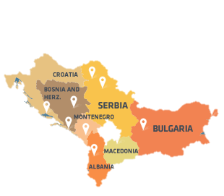
Experiences from Balkan
MUTUAL FEATURES:
Socio-economic situation
Agreement with EU
High unemployment
Lower production rate of economy
Gray and black economy
Partly harmonised OSH legislation
Poor enforcement and implementation of OSH
Poor reporting of work accidents
Low promotion of the OSH and working culture
Deficiency of motivation tools
KOSOVO
PERC Regional Meeting, October 2018, Montenegro, IGALO

Slide 33
Example from Albania
(Decision of Council of Ministers No. 371, dated of 18/5/2016)
Chapter 1: Occupational Safety and Health Policies
Chapter 2: Vision and Strategic Priorities
Pillar A: Improvement of labour protection with effective OSH policies and legal framework
Pillar B: Creation of decent working conditions and safer and healthier workplaces
Pillar C: Establishment of transparent and effective OSH system and institutions
Chapter 3: Policy Objectives
Chapter 4: Estimated Costs and Sources of Financing
Chapter 5: Accountability, Monitoring and Evaluation
On the road to a safer and healthier culture at work
March 2016
ANNEX A: Action Plan and Indicators, 2016–2020
ANNEX B: Summary of non-implemented or only partially implemented actions for 2009–2015 period 71
ANNEX C: List of OSH directives and policies to be adopted or implemented over the period 2016–2018 72

Slide 34
Thank you for your attention
PERC Regional Meeting, October 2018, Montenegro, IGALO

