Slide 1

Tackling the gender pay gap
Dr. Jolanta Reingardė
Programme coordinator
Research & Statistics
ITUC/PERC Women’s School
September 25-26, 2019, Vilnius

Slide 2
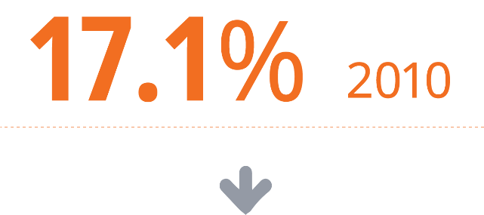

Slow progress: gender pay gap in the EU
Notes:
EIGE’s research note on gender pay gap:
provides insights on how the gender pay gap varies across the life course and for different groups of employees
explores the link between gender pay gap and work-life balance = one of the major factors underlying the gender pay gap
More action is needed and for the first time Commission adopted an EU Action Plan 2017-2019 to tackle the gender pay gap.

Slide 3
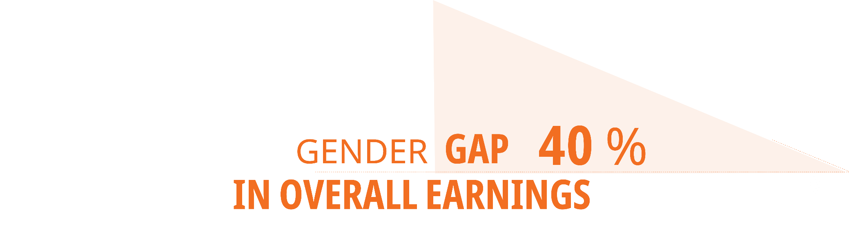
Not full reality of inequalities at work is reflected
Measures: - average hourly earnings
- monthly average of the number of paid hours
- employment rates of men and women
Measures the difference in gross hourly wage
between women and men
Notes:
Gender pay gap measures the difference in average gross hourly wage between men and women. It is now at 16.2 % to the detriment of women. The focus on the hourly wages implies that factors such as monthly working hours or the share of women and men in formal employment are beyond the scope of the indicator. Measurement at the level of gross rather than net wages shows that the effect of national taxation systems is not taken into account.
The gender pay gap offers important but limited information about the income inequalities present in the labour market.
The gender gap in overall earnings, which is at around 40 % in the EU-28, gives a more comprehensive picture as it takes not only the pay difference between women and men, but the number of hours worked & paid and the employment rate of both women and men. Eg. We noted gender gaps in extra payment for additional hours of work and overtime, Sunday or payments based on the overall performance of a company

Slide 4
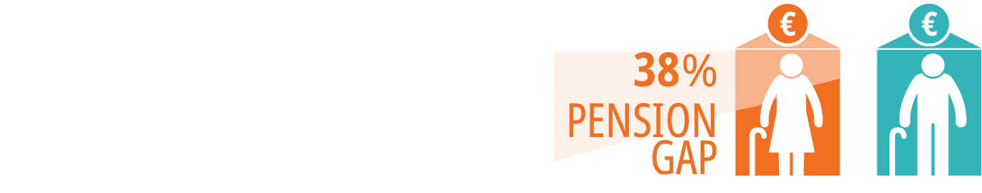
Gender inequalities in pay generate pension gap and risk of poverty
EU gender inequalities in pay:
16% - gender pay gap
40% - gender overall earnings gap
38% - gender pension gap
EU risk of poverty rate –
60 years or over
Women – 16.7%
Men – 13.7%
75 years or over
Women – 19.2%
Men – 13.0%
Notes:
The accumulated impact of gender inequalities generates a 38 % gender gap in pensions to the disadvantage of women at the EU level
Despite a smaller gender pay gap, gender overall earnings gap and gender pensions gap shows important gender inequalities in Slovenia.
Furthermore, elderly women poverty rate is double of that of men in Slovenia.

Slide 5
Gender pay gap must be looked at along other employment indicators
NL: High women employment (76.5), but essentially
part-time (74.1%)
IT: Very low women employment (59.8%), considerable part-time (32.5%)
AT: High women employment (75.0%), high part-time (47.9%)
EE: High women employment (79.4%), low part-time (12.9%)
FI: High women employment (79.4%), lower part-time (18.6%)
LT: High women employment (80.2%), low part-time (9.2)
SI: High women employment (75.3%), low part-time (13.7%)
Source: Eurostat
Notes:
Eurostat has developed a gender overall earnings gap. This is a synthetic indicator, which measures the impact of the three factors combined: (1) average hourly earnings; (2) monthly average of the number of hours paid; and (3) the employment rate of women compared to men (Eurostat, 2018b). The gender gap in overall earnings, which is at around 40 % in the EU-28, gives a more comprehensive picture of the level of economic independence and labour market opportunities of women and men.
Estonia has the highest gender pay gap (25 %), while four countries (CZ, DE, UK, AT) have a gap higher than 20 %.
Variation in gender gap levels require cautious interpretation in view of country specific contexts, given that a low gender pay gap might not necessarily mean that gender equality in labour market opportunities has been achieved.
Some countries with lower levels of gender pay gap (e.g. IT, MT, EL) have high gender overall earnings gaps. In these countries a low gender pay gap is largely associated with low women’s employment (e.g. 60 % of Italian women are active in the formal labour market – employed or unemployed – compared to an EU average of 72 %). In these countries, women with lower qualifications tend to be economically inactive. On average, those women who are in employment have higher qualifications than men, leading to a lower gender pay gap.
In the countries with the highest overall earnings gaps (NL, UK, AT, DE), women’s participation in the labour market is high, but predominantly in part-time work (e.g. 74 % of women work part-time in the Netherlands).
In countries with a moderate gender pay gap and low overall earnings gap (e.g. LT, SE, LV), the high rate of women’s participation in the labour market is undermined by high labour market segregation, which typically indicates a disproportionate share of women employed in jobs and sectors that are lower paid and less valued (Rubery & Koukiadaki, 2016).
The lower level of regulation of labour markets, including wage-setting mechanisms, has been linked to higher national gender wage gaps (Christofides, Polycarpou, & Vrachimis, 2013). In addition, within a number of countries (e.g. SE, DK), moderate gender pay gap levels reflect a positive influence of more equal levels of earnings across all (OECD, 2017).

Slide 6
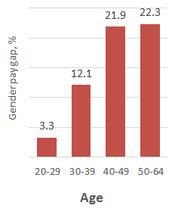
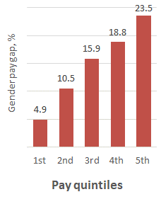
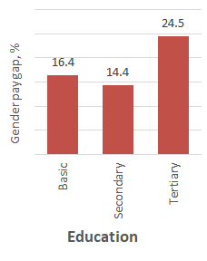
Gender pay gap enlarges substantially along the career path
Source: Eurostat
Notes:
In the EU, on average, the gender pay gap across all educational levels increases with age and income. If the gender pay gap is only 3 % in the age group 20-29, it reaches 22 % among those aged 40-49 or older. Among the different age groups - and despite differences in educational attainment levels - the largest increase in the gender pay gap is observed in the age group 30-39 (compared to 20-29), potentially showing the impact of increased work-life balance strains. From age 40 onwards, the gender pay gap remains more or less consistent across the respective educational levels. The gender pay gap also progressively increases alongside income levels, with the highest gender pay gap (33 %) found among those with tertiary education and the highest income (fifth quintile). This may be influenced by vertical gender segregation. In the EU, on average, the gender pay gap progressively increases with the level of income: at 7 % in the first income quintile, 13 % in the second, 15 % in the third, 18 % in the fourth, and 26 % in the fifth.

Slide 7
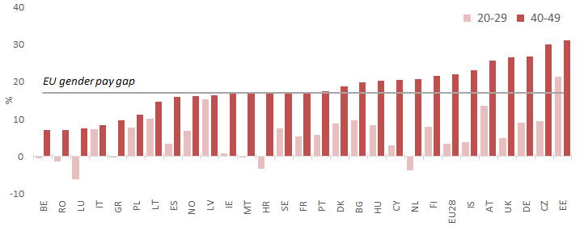
Life-course inequalities accumulate impact on gender pay gap
Source: Eurostat

Slide 8
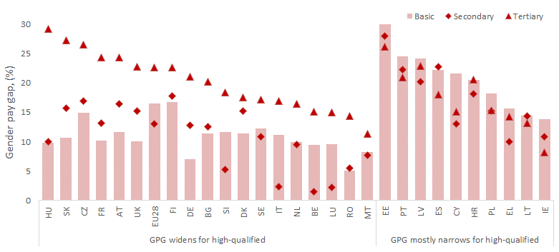
Gender pay gap increases with qualification
Source: EIGE calculations based on Eurostat data
Notes:
The gender pay gap between women and men with high qualifications in the EU is, on average, greater (25 %) than that for other qualification levels, with particularly large pay differences (more than 25 %) between women and men with high qualifications noted in Hungary, Slovakia and Czechia. In some countries (HU, SK, FR, DE) the gender pay gap among the highly qualified is not only large but significantly greater than the gender pay gap observed among low-qualified employees. A somewhat reverse pattern is noted in a number of EU countries (e.g. EE, PT, LV, ES, CY, HR, PL, EL, LT, IE), where gender pay gaps among low-qualified employees are typically higher than among those with high qualifications.
Overall, gender pay gaps for those with basic and secondary education levels vary considerably from country to country, with the average gender pay gap in the EU being somewhat lower for those with secondary education (14 %) than basic education (16 %).

Slide 9
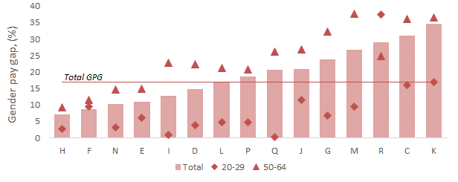
Gender pay gap is particularly large in certain sectors
Professional, scientific and technical activities
Arts, entertainment and recreation
Manufacturing
Financial and insurance activities
NACE codes: B) mining and quarrying; C) manufacturing; D) electricity, gas, steam and air conditioning supply; E) water supply, sewerage, waste management and remediation activities; F) construction; G) wholesale and retail trade; repair of motor vehicles and motorcycles; H) transportation and storage; I) accommodation and food service activities; J) information and communication; K) financial and insurance activities; L) real estate activities; M) professional, scientific and technical activities; N) administrative and support service activities; O) public administration and defence, compulsory social security; P) education; Q) human health and social work activities; R) arts, entertainment and recreation.
Notes:
Across the EU economic sectors, the gender pay gap in financial and insurance activities is one of the highest, as is that in manufacturing. The current levels of gender pay gap at the sectoral level (particularly to the disadvantage of older women) are still primarily determined by accumulated gender pay inequalities across the life course. For example, the gender pay gap is notably large (>30%) among elderly people working in trade, manufacturing, financial or scientific sectors (NACE codes G, C, K, M), compared to younger workers. Nonetheless, the reverse trend can also be noted in certain areas of economic activity, such as entertainment and the arts (NACE code R), where the gender pay gap among the young is much greater than among older workers.
Besides age, the gender pay gap across economic sectors varies in line with other characteristics, such as educational level. For example, highly qualified men earn much more than women in financial and insurance or trade jobs, whereas the level of education does not lead to much of a pay differential between women and men in education or administrative and support jobs.

Slide 10
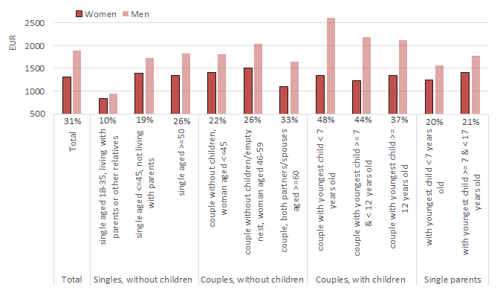
Increasing family demands: among the most influential reasons of gender inequalities in pay
Net monthly earnings, EU-28 (2015):
Source: EIGE calculations on the basis of EWCS (2015) data
Notes:
Across different life stages, gender gaps in net monthly earnings are greatest for women with younger children (Figure 9). While the total gender gap in net monthly earnings in the EU stands at 31 % (to the detriment of women), for couples with children under the age of seven, it reaches 48 %, the highest level observed across the life stages examined. This life stage is associated not only with the levelling off of women’s earnings, but also to a notable increase in men’s earnings. The family formation implies an earnings’ “penalty” for mothers and a “reward” for fathers, a finding consistently observed in wider research (EIGE, 2017b, p. 23; ILO, 2018). Among couples whose youngest child is over seven years of age, the gender gap begins to reduce, but remains considerably higher compared to women in partnerships without children or in comparison to other life stages. In single parent families, with children of different ages, gender gap in net monthly earnings is at about 20%. Despite majority of single parent families being led by women, this statistics shows that earnings of both women and men in such intense care situation of children is reduced. The existent but lower gender gap in comparison to what is observed among couples with children is mainly due to much lower earnings received by single fathers in comparison to fathers living couples, whereas earnings of single mothers are only a fraction lower in comparison to earnings of mothers living in couples. The lowest gender gap in net monthly earnings is observed among the youngest generations having no children.

Slide 11
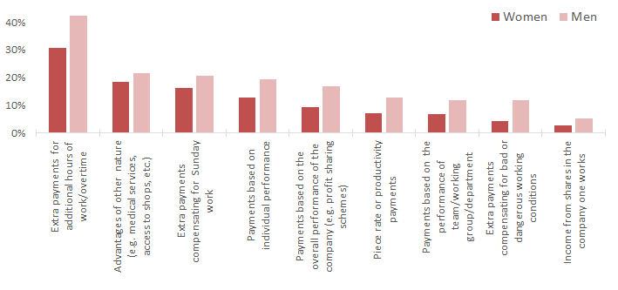
Women receive less of any kind of supplementary earnings
Source: EIGE calculations on the basis of EWCS (2015) data
Notes:
Research has shown that not only are women less likely to work at companies that offer higher premiums to their employees, but they receive premiums of lower value in comparison to men working in the same companies (Card, Cardoso, & Kline, 2015; EIGE, 2018; Flory, Leibbrandt, & List, 2014, pp. 122-155; McKinley, 2016). As noted by EIGE (2017a) in its recent research on gender segregation in education and labour markets, “the gender gap in bonuses is found to be the greatest gap across different remuneration sources, both in terms of the share of women and men receiving them and in terms of the generosity of bonuses”. Fewer women than men in the EU receive any type of main salary supplementary earnings (Figure 2).
An important proportion of the gender pay gap is referred to as “unexplained” (Anspal et al., 2011, p. 4; Blau & Kahn, 2017). This implies that differences in the average characteristics of women and men employees, as observed in survey data, cannot capture the considerable heterogeneity of people’s characteristics (Anspal et al., 2011). The “unexplained” gender pay gap is also linked to women’s discrimination in hiring, in career progression and generally limited opportunities in the labour market (European Commission, 2018b). Recent experimental studies suggest that gender differences in wage bargaining may widen the gap (Leibbrandt & List, 2014, pp. 2016-2024). Important knowledge gaps in respect of the gender pay gap remain, showing the need for a better understanding of how gender intersects with other individual characteristics, such as race, or certain ethnic or immigrant backgrounds that are systematically linked to social inequalities

Slide 12
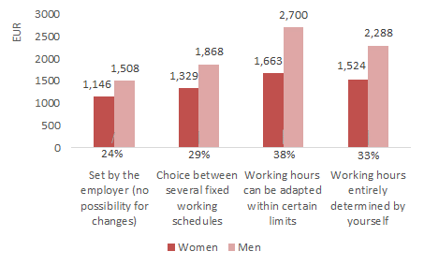
Higher autonomy in setting own working time goes along higher earnings...and larger gender gaps
Source: EIGE calculations on the basis of EWCS (2015) data
Note: Indicated percentages refer to gender gap in net annual earnings for the respective group
Notes:
Overall, some or full flexibility in working time arrangements is related to higher levels of absolute earnings, for both women and men (Figure 10). However, men earn significantly more than women in jobs where they can adapt their working hours within certain limits (gender gap of 38 % to the detriment of women) and in jobs where they entirely determine their working time (gender gap of 33 %). The gender pay gap among employees with no possibility of introducing changes in their workings hours is lower, at 24 %. These differences in gender gaps are largely determined by absolute levels of men’s earnings, whereas women’s earnings change somewhat less across different levels of autonomy in setting working hours. This may be due to women more frequently requesting (and being granted) access to the flexible working arrangements available, which may lead to loss of earnings or career progression. Generally, the EWCS data show that the distribution of flexible working arrangements between women and men is less different than the financial penalty linked to the arrangements taken-up by women. This could be due to potential barriers to women in accessing jobs and positions which offer higher flexibility in working time arrangements and do not introduce a pay penalty.

Slide 13
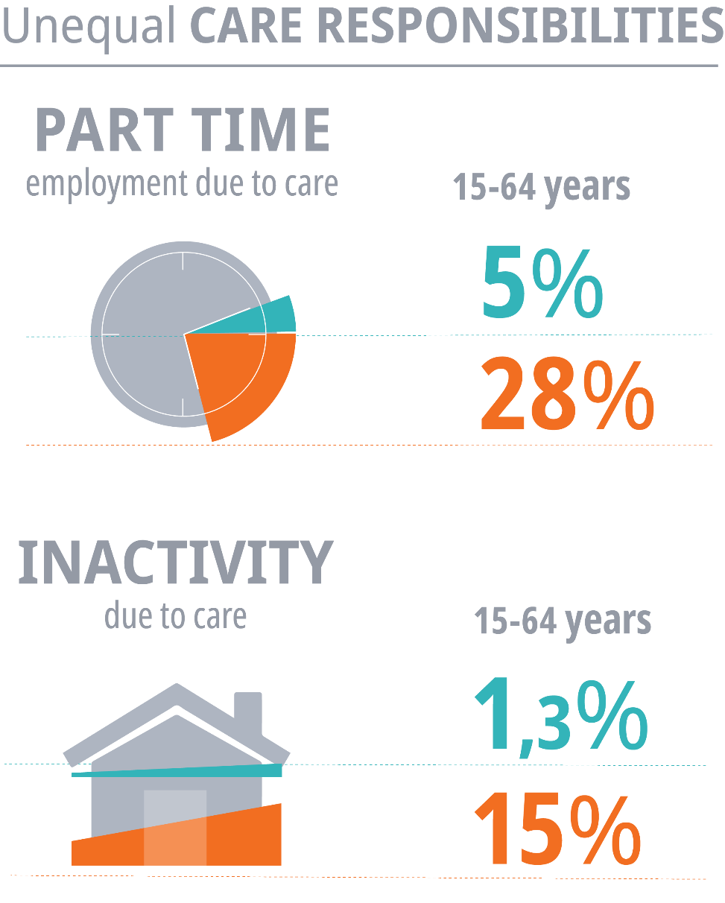
Factors affecting pay inequalities in the EU
Notes:
Across the EU, women are less likely to be employed, work longer hours (paid and unpaid work) than men, take more career breaks, and choose more part-time work to reconcile work and care responsibilities
Such gender-specific working patterns contribute to the gender pay gap.
In addition to working fewer paid hours, part-time workers may have lower hourly wages than full-time workers
Temporary work (which is often remunerated at lower rates than permanent jobs and career breaks, including those due to care leave, as well as unemployment, contribute to the gender pay gap.
Women’s more frequent and longer career breaks to cover care and other household needs weakens opportunities for better remuneration given to those who are more visible at work, work longer hours and have uninterrupted working schedules (men)

Slide 14
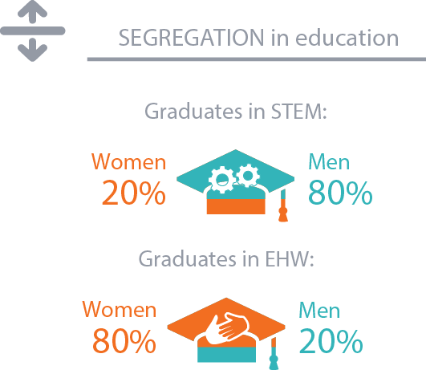
Factors affecting pay inequalities in the EU
Notes:
Human capital related factors, such as level of education and training or work experience, help explain the gender pay gap,
the gender gap in educational attainment is now reversed in most countries: women are more likely to have university degrees than men in 20 EU Member States
Nevertheless, gender differences in the type of education (e.g. fewer women enrolling in the STEM fields and few men in education, health and welfare studies), is one of key determinants of the pay gap
On the labour market women are largely concentrated in lower-paid range of jobs (occupational / horizontal segregation) or at lower-paid levels of the same job (vertical segregation).

Slide 15
What measures can help tackling the gender pay gap?
Broad and systematic policy response, with best effects when different activities are closely coordinated and complement one another:
  Defining ‘equal pay for work of equal value’
  Pay transparency legislation
  Wage gap calculators
  Collective bargaining
  Gender neutral job evaluation methodology
  Strong national equality bodies
  Gender-sensitive design of public policies
  Research, monitoring and awareness-raising campaigns
Any comprehensive policy response should be followed by continuous monitoring and evaluation activities.

Slide 16
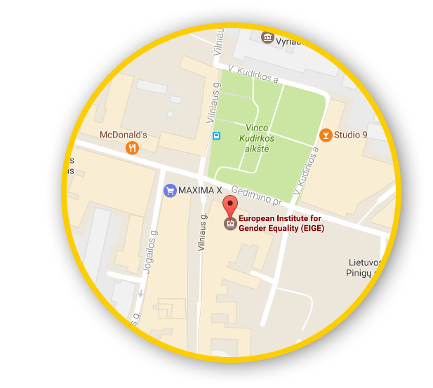





Let’s talk
Connect with us!
eige.europa.eu
facebook.com/
eige.europa.eu
twitter.com/
eurogender
come in for a chat!
eige.europa.eu/
newsletter
eurogender.eige.
europa.eu
youtube.com/
user/eurogender
Gedimino pr. 16,
LT-01103 Vilnius,
Lithuania

