Slide 1
Inflation, interest rate, wages, and others Challenges of 2023
Belgrade, June 2023

Slide 2
Brief outline of events
Recovery? Real recovery?
After COVID what?
Wages stagnation
What happen with real wages
“Greed-flation”
Profits leading inflation
Interest rate hikes

Slide 3
Wages and productivity

Slide 4
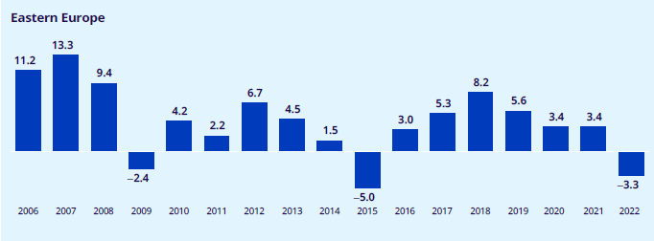
Real wages Eastern Europe GWR

Slide 5
Minimum wages in the region
The region saw heterogeneous increases during the last years
Country | 2016 | 2017 | 2018 | 2019 | 2020 | 2021 | 2022 | 2023
Bosnia and Herzegovina | 406 | 406 | 406 | 406 | 406 | 406 | 543 | 596
Georgia | 40 | 40 | 40 | 40 | 40 | 40 | 40 | 48
Moldova | 1.000 | 1.000 | 1.000 | 1.000 | 2.775 | 2.935 | 3.500 | 4.000
Montenegro | 288 | 288 | 288 | 331 | 331 | 331 | 533 | 568
North Macedonia | 10,080 | 12,000 | 12,000 | 14,500 | 14,500 | 15,194 | 18,000 | 20,175
Serbia | 28.379 | 33813 | 33.355 | 36.365 | 40.502 | 43.044 | 47.193 | 53.993

Slide 6
Real minimum wages
How much would be the purchasing power of wages of 2016 today?
How much 2023 wages lost in relation to 2016?
Country | MW 2016 at 2023 prices | MW 2023 | % diff
Bosnia and Herzegovina | 681 | 596 | -12,5
Georgia | 98 | 48 | -50,9
Moldova | 3.618 | 4.000 | 10,6
Montenegro | 521 | 568 | 9,0
North Macedonia | 19.229 | 20.175 | 4,9
Serbia | 49.204 | 53.993 | 9,7

Slide 7
Inflation has been eroding wages in the region…
Inflation affects all, but not the same…
Inflation of food and energy has been higher than the average
Even after the decline, prices didn’t go down
Transport and housing
This affects more those with lower and fixed incomes

Slide 22
INFLATION
Cost push inflation
Structural inflation
Demand push inflation
International prices increases
Productive bottlenecks
Lack of previous investment
Monopolistic structures
Domestic prices increases
Food
Energy
Logistics
Foreign Inputs and technology
Wages
Domestic inputs
Taxes
Interest rate
Exchange rate
Higher demand by public
Low savings rate
Price setting
Access to credit
Land tenure
High disposable income
Low quantity produced
Excess consumption
Lack of investment

Slide 23
Wage-Price inflation?
Inflationary context
This episode of high inflation is not the result of the “wage-led inflation”.
Wages don’t show a trend that would put additional pressure on costs of production. (price-wage spiral)
The myth of the “great resignation”
The myth of the “skills mismatch”
The supposed increased ‘tightness’ of the labour market after the pandemic is not materialising in higher wages.

Slide 24
Why it is argued that there is “labour market tightness”?
The Beverdige curve
Shows the relationship between unemployment and job openings (vacancies)
The hypothesis is that there is an inverse relationship between both variables
When the curve “shifts” inwards means that there is labour market tightness
If there are mismatches between the skills of job seekers and the skills required for available jobs, the curve may shift inward
Unemployment %

Slide 25
The relationship between unemployment and vacancies in the region is unconclusive…

Slide 26
Perhaps the explanation should be searched somewhere else…

Slide 27
Interest rates as the sole tool…
Interest rates, inflation and wages

Slide 28
“A banker is a fellow who lends you his umbrella when the sun is shining but wants it back the minute it begins to rain.”
Quote attributed to Mark Twain

Slide 29
(Central) Banks as a key actors of bad economic policies
Since 1980s Central Banks have been empowered with unprecedent independence.
The main argument is the defence of the currency and institutional continuity
Delinked of the governmental daily policies
CBs have just a few of instruments to do their work
Interest rates are the main tool of Central Banks
And they have a level of secrecy and power not achieved by any other democratically elected institution

Slide 30
Banks getting more powerful
Increases in the degree of freedom for Banks operations
Allowing Banks to intervene in speculative activities transcending the role of lenders
Reduction of reserves requirements
“Too big to fail”

Slide 31
The relationship between employment and loans is quite direct

Slide 32
Log of Loans to the non-financial private sector and Employment moving averages

Slide 33
The case of Moldova

Slide 34
North Macedonia and Ukraine

Slide 35
Where banks “find” money to lend?
Banks receive deposits from the public and make loans:
Open an account to the “passive” client
Lend to the “active” client by opening another account
Banks must keep the “legal reserves” from each deposit from clients
In the past, legal reserves used to be homogeneous.
Since the financial deregulation they are differentiated and reduced.

Slide 36
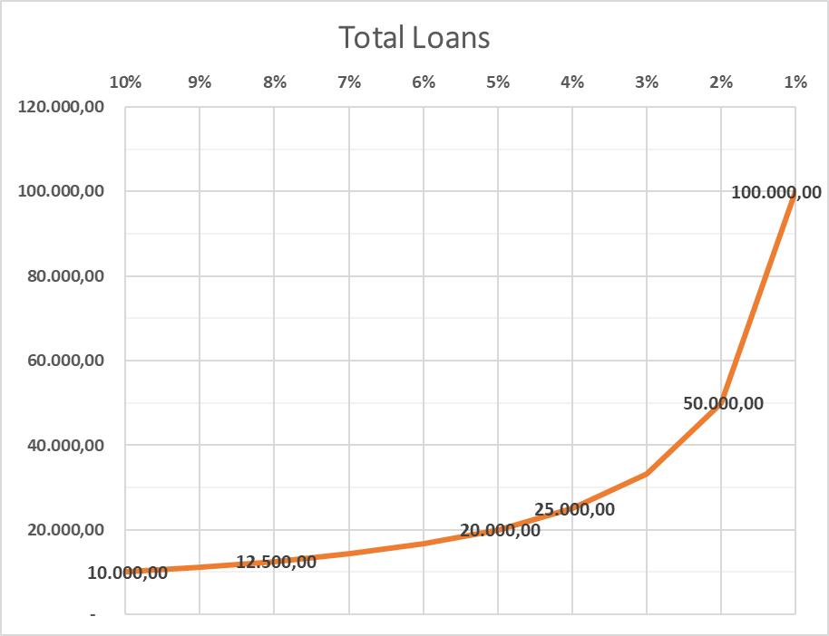
How banks create money?
Legal reserves 10%
Legal reserves 5%
Loan Nr. | Deposits | Reserves
1 | € 1.000,00 | € 100,00
2 | € 900,00 | € 90,00
3 | € 810,00 | € 81,00
4 | € 729,00 | € 72,90
… | … | …
Total | € 10.000,00 | € 1.000,00
Loan Nr. | Deposits | Reserves
1 | € 1.000,00 | € 50,00
2 | € 950,00 | € 95,00
3 | € 855,00 | € 85,50
4 | € 769,50 | € 76,95
… | … | …
Total | € 20.000,00 | € 2.000,00
The money creation capacity:
$$M=\frac{Deposits}{Legal Reserves/100}$$

Slide 37
What is the relationship between banks and employment?
The micro-foundations of economic growth and employment creation
Enterprise creation
Financing
Expansion

Slide 38
Moment 0: initiation of business and search for working capital
Supplier 1
Supplier 2
Supplier 3
Banks
Acme inc.
Past savings and retained profits

Slide 39
Moment 1: Production and Sales
Supplier 1
Supplier 2
Supplier 3
Banks
Client 1
Acme inc.
Past savings and retained profits
Client 2
Client 3

Slide 40
Moment 2: Recovery
Supplier 1
Supplier 2
Supplier 3
Banks
Client 1
Acme inc.
Client 2
Past savings and retained profits
Client 3

Slide 41
Moment 3: Paying and servicing
Supplier 1
Supplier 2
Supplier 3
Banks
Client 1
Acme inc.
Client 2
New savings and retained profits
Client 3
Wages
Utilities
Lease

Slide 42
Moment 4: Accumulation & renegotiation
Supplier 1
Supplier 2
Supplier 3
Banks
Client 1
Acme inc.
Client 2
Savings and retained profits
Client 3
Stocks
Wages
Utilities
Lease

Slide 43
Business cycle firm, suppliers, banks
Moment 0
Initiation of business searching working capital
Moment 1
Production and sales
Moment 2
Recovery
Moment 3
Payments and servicing
Moment 4
Accumulation and renegotiation

Slide 44
How interest rate increases affect employment creation?
Increasing the costs of borrowing to firms
Reducing profits or operating surplus
Opening alternative investments to banks, besides production
Flight to quality Public bonds mainly
Forcing the reimbursement of loans
Reducing hiring prospects
Forcing the provision of new collateral
Credit rationing to all firms

Slide 45
The agenda for workers…
Wage increases now…!!!
Regulate financial markets
Interest rates
Capital flights
Develop industrial policies
Employment strategies
State interventions

Slide 46
The long and the short run have something in common…
…they both start today!!!

Slide 47
Recommendation No. 2
The cost of living should be covered, but also considered the expected inflation until the next round of negotiations.
Never forget about productivity increases

Slide 48
Additional Recommendations…
The erosion on the purchasing power of wages only can be compensated by the negotiation of new levels in wages, especially the minimum wages (MW) that have a light house effect, not only for the workers of the formal economy.
Regular social dialogue helps to correct the lagging of remunerations in relation to inflation.
Rather than “gather pressures” is better to have a schedule of meetings
In case of high inflation could be better to have agreements that either impose more frequent adjustments (negotiations) or even, trigger clauses.
It would even be necessary to advance the negotiations
Warning: The closer the MW to the living wage basket, the less tolerance to price changes.

Slide 49
The evidence based approach…
Develop tools for evidence based analysis in order to generate knowledge that will serve the negotiations.
Have a clear picture of the relevance of the CPI in relation to the basket of workers, especially minimum wages
The recovery is central, but inflation still operate at the next day of the adjustment…
Follow up the evolution and prospects of prices of the relevant baskets
Follow up the share of wages on total costs of production
Keep an eye in the labour income share, or share of wages in GDP
SDG 8 is very handy for these discussions. Keep updated.
It is important to have a long-term perspective (both backward but mainly forward) on how to negotiate wage increases.

