Slide 1
Identifying gaps: why is a wage increase needed? An ACTRAV perspective
Rafael Peels
Bureau for Workers’ Activities (ACTRAV)
International Labour Organization (ILO)
10th PERC Summer School, Stockholm
18-20 September 2017

Slide 2
As a starter …
Why are we talking about wages?
Rights’ perspective
Political perspective: discontent …
Economic perspective: increasing concerns with globalization …
The very reason of the ILO …

Slide 3
ILO Constitution …
Wages …
… “provision of an adequate living wage” as well as “the recognition of the principle of equal remuneration for work of equal value” and to further “policies in regard to wages and earnings, hours and other conditions of work calculated to ensure a just share of the fruits of progress to all, and a minimum living wage to all employed and in need of such protection”
(ILO Constitution, 1919 and amended by the Philadelphia Declaration in 1944)

Slide 4
Structure …
An ILO perspective …
ACTRAV priorities …
WHY is a wage increase needed ?
The way forward and debate …

Slide 5
International Labour Standards on minimum wages
The Minimum Wage Fixing Machinery Convention, 1928 (No. 26) and Recommendation, 1928 (No. 30)
Standards for particular categories of workers and sectors
The Minimum Wage Fixing Convention, 1970 (No. 131) and Recommendation, 1970 (No. 135)
broad scope of application
adjust from time to time
full consultation with social partners and independent experts
take into account the needs of workers and their families, as well as economic factors;
ensure effective application
Additional standards …

Slide 6
International Labour Standards on collective bargaining
Freedom of Association and Protection of the Right to Organise Convention, 1948 (No. 87) and the Right to Organise and Collective Bargaining Convention, 1949 (No. 98)
Fundamental Right
Enabling Right
Human Right
Collective Bargaining Convention, 1981 (No. 154) and Recommendation, 1981 (No. 163)
Definition, parties, purpose …
Collective bargaining “extends to all negotiations which take place between an employer, a group of employers or one or more employers’ organisations, on the one hand, and one or more workers’ organisations, on the other, for: (a) determining working conditions and terms of employment; and/or (b) regulating relations between employers and workers; and/or (c) regulating relations between employers or their organisations and a workers’ organisation or workers’ organisations”
Additional standards and instruments…

Slide 7
Ratification of C131 in PERC
Country | Date of Ratification
Albania | 2004
Andorra
Armenia | 2005
Austria
Azerbaijan | 1993
Belarus
Belgium
Bosnia and Herzegovina | 1993
Bulgaria
Croatia
Cyprus
Czech Republic
Denmark
Estonia
Finland
France | 1972
Georgia
Germany
Greece
Hungary
Iceland
Ireland
Italy
Kazakhstan
Kyrgyzstan | 2007
Kosovo
Latvia | 1993
Liechtenstein
Country | Date of Ratification
Lithuania | 1994
Luxembourg
Malta | 1988
Moldova, Republic of | 2000
Monaco
Montenegro | 2006
Netherlands | 1973
Norway
Poland
Portugal | 1983
Romania | 1975
Russia
San Marino
Serbia | 2000
Slovakia
Slovenia | 1992
Spain | 1971
Sweden
Switzerland
Tajikistan
Turkey
Turkmenistan
The former Yugoslav Republic of Macedonia | 1991
Ukraine | 2006
UK
Uzbekistan
Vatican City
Source: NORMLEX

Slide 8
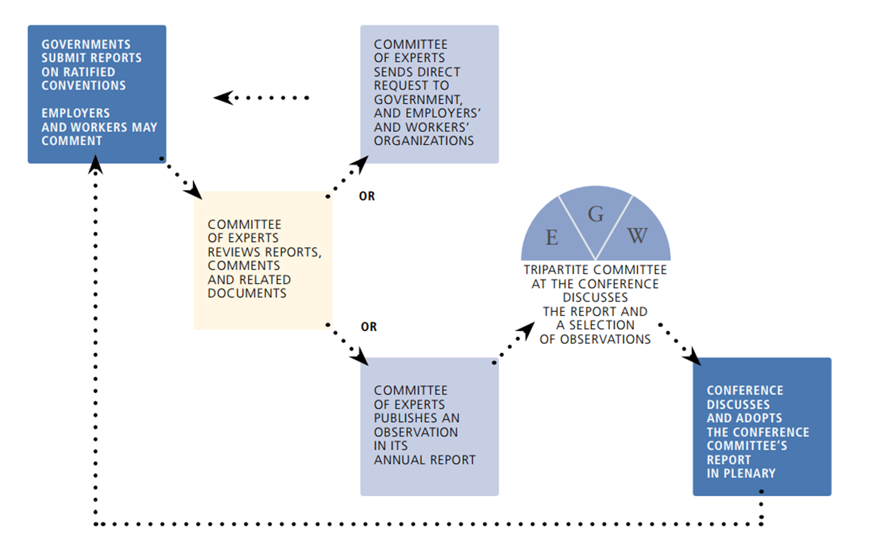
ILO supervisory mechanism and the role of workers’ organisations
Reference: regular review of “de jure” and “de facto” application of ILS http://www.ilo.org/dyn/normlex/es/f?p=NORMLEXPUB:1:0::NO:::
Regular supervisory mechanism …
Source: ILO Rules of the Game (http://www.ilo.org/global/standards/information-resources-and-publications/publications/WCMS_318173/lang--es/index.htm)
Notes:
-

Slide 9
Outcomes of the ILO supervisory mechanism on C131 in the region …
Criteria for determining the minimum wage
Albania; Armenia; Azerbaijan; Bosnia and Herzegovina; France; Kyrgyzstan; Latvia; Lithuania; Moldova; Montenegro; Romania; Spain; the former Yugoslav Republic of Macedonia; Ukraine; …
Full consultations with the social partners and experts
Albania; Armenia; Azerbaijan; France; Kyrgyzstan; Malta; Moldova; Montenegro; Netherlands; Portugal; Romania; Slovenia; Spain; the former Yugoslav Republic of Macedonia; Ukraine; …
Practical application of the Convention (e.g. workers remunerated at the minimum wage rate, evolution of the minimum wage, labour inspection results, sanctions, studies, …)
Albania; Armenia; Azerbaijan; France; Kyrgyzstan; Lithuania; Moldova; Montenegro: Romania; Serbia; Slovenia; …

Slide 10
ACTRAV agenda on wages: HOW ?
… supporting workers’ organizations in effective wage setting
… through complementary mechanisms, such as minimum wage fixing and collective bargaining
… at different levels, from the enterprise, sectoral, national to European/international
… through different depths of involvement, ranging from being informed, ad hoc consultation, institutionalized participation to bi-partite joint decision-making
… based on reliable data
… that is adequate
… that is inclusive, covering young and female workers, non-standard forms of employment, agency work, …

Slide 11
WHY is a wage increase needed ?
To establish a wage-led growth model:
Develop counter-discourse regarding wages - employment - aggregate demand :
From a Rights perspective : Decent / Living Wage
From a Political Economy perspective : address Inequality
From an Economics perspective :
… instead of emphasis on cost of production … and employment effects
… increase demand … and productivity
… balancing exercise : set wages to maximize aggregate demand, however, in line with productivity so as to prevent choking off exports and investment

Slide 12
WHY is a wage increase needed ?
In an international trade context
Decent Work in Global Supply Chains (ILC, 2016)
Labour provisions in trade agreements : FPRW ...
… but what about employment and wages ?
Coordination among international actors
… IFIs, G20, OECD, …
Look beyond labour market institutions …
… financial markets

Slide 13
The way forward …
Momentum … and important role for workers’ organisations
Based on ILS
Need for coordination
Further research …
…

