Slide 1
Social protection in the context of COVID: implications for women?
PERC Women’s School
4 October 2020
Evelyn Astor
Economic and Social Policy Advisor
International Trade Union Confederation
Evelyn.Astor@ITUC-CSI.org

Slide 2
Major coverage gaps in social protection even before COVID…
Source: ILO World Social Protection Report 2017-2019
Note: population coverage by social protection: proportion of the total population receiving a contributory or non-contributory benefit, or actively contributing to at least one social security scheme

Slide 3
Social protection coverage in Eastern Europe was weak before the crisis…

Slide 4
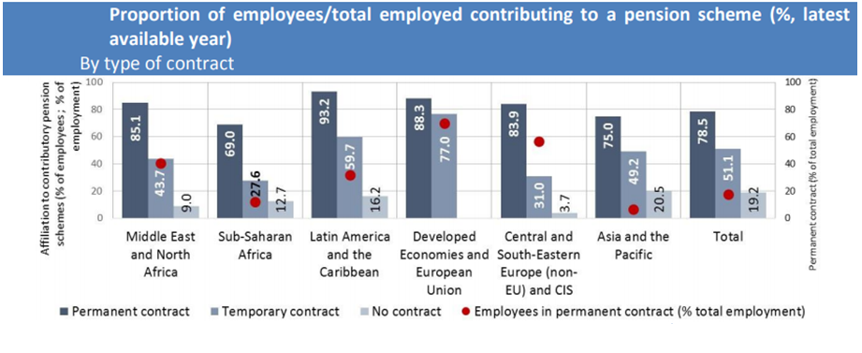
People in precarious forms of work tend to be least likely to be covered by social protection
Source: ILO (2016) Social Protection Coverage Across Employment Patterns

Slide 5
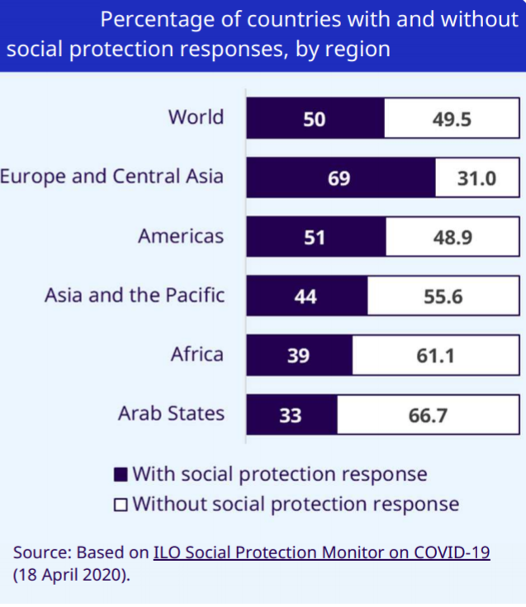
Many countries are stepping up social protection responses…

Slide 6
Main types of responses
Healthcare
Sickness benefits
Unemployment benefits
Parental leave
Social assistance
Around 18% of measures have been explicitly gender sensitive

Slide 7
Women are disproportionately affected as they are:
the majority of vulnerable workers who are losing their jobs and incomes at an alarming rate;
victims of increased rates of domestic violence;
unpaid caregivers in families and communities,
picking up the majority of additional care responsibilities where schools, childcare and other services are shut down or scaled back.
Notes:
Globally, 70 per cent of health workers and first responders are women, and yet, they are not at par with their male counterparts. At 28 per cent, the gender pay gap in the health sector is higher than the overall gender pay gap (16 per cent).

Slide 9
Financing gaps for social protection have increased in the COVID crisis
Increased demand for social protection benefits and services
Decreased tax revenue due to fewer people in employment
Governments have reduced taxes and social security contributions obligations to support businesses stay afloat

Slide 10
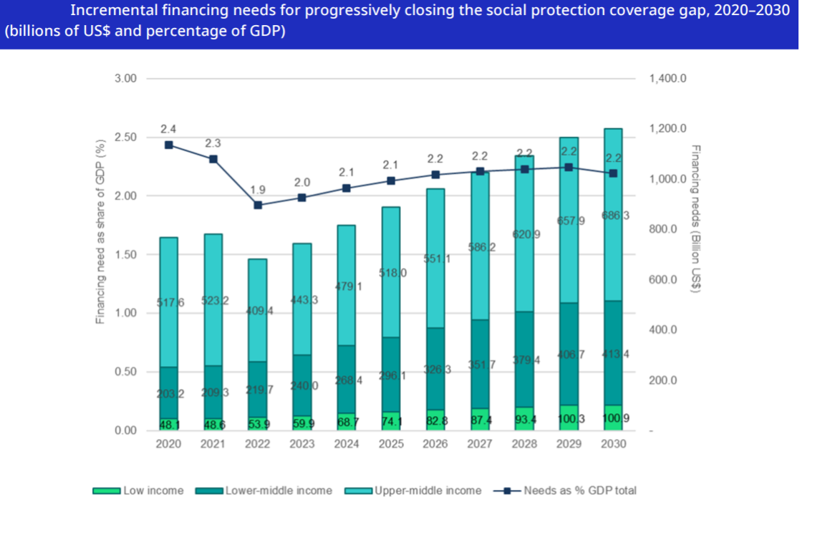
Financing gaps for social protection have increased with COVID

Slide 11
Closing social protection gaps – what is needed?
Turning emergency stop-gap measures into durable reforms that strengthen social protection systems
Extending social protection to all forms of employment
Taking a gender sensitive approach to social security
Increased fiscal space at national level through fair taxation
A global fund for social protection: increased international solidarity to kickstart social protection schemes in the world’s poorest countries

Slide 12
Further reading
ILO (2020 ) Social Protection Monitor: Social protection responses to the COVID-19 crisis around the world https://www.ilo.org/secsoc/information-resources/publications-and-tools/Brochures/WCMS_741212/lang--en/index.htm
ILO (2020) Financing gaps in social protection: Global estimates and strategies for developing countries in light of the COVID-19 crisis and beyond https://www.ilo.org/wcmsp5/groups/public/---ed_protect/---soc_sec/documents/publication/wcms_755475.pdf
ITUC (2020) A global fund for social protection is posible
https://www.ituc-csi.org/IMG/pdf/ituc_campaign_brief_-_a_global_social_protection_fund_en.pdf
UN Women (2020) COVID-19 and its economic toll on women: The story behind the numbers https://www.unwomen.org/en/news/stories/2020/9/feature-covid-19-economic-impacts-on-women?utm_source=dlvr.it&utm_medium=facebook

