Slide 1
PERC Women’s school 4/11/2020 Social dialogue and safety and health measures during pandemic - a Belgium example
Sabine Slegers
National secretary ACLVB-CGSLB
President PERC Women's Committee

Slide 2
Importance of Social dialogue
This generic guide is the result of co-operation between the social partners in the High Council for Prevention and Protection at Work, the Economic Risk Management Group, the FPS ELSD and the policy unit of the Minister for Employment.
“Based on their expertise, they have developed a tool that;
carries considerable support, containing a number of necessary and minimum building blocks to enable workers to return to work as safely as possible in the post-lockdown period by keeping the risk of infection as low as possible and avoiding infections as much as possible.”
Notes:
1) de tot stand komen van de gids (via proces van sociaal dialoog), rol van de FOD WASO/sociale partners...
Deze generieke gids is het resultaat van de samenwerking van de sociale partners in de Hoge Raad voor Preventie en Bescherming op het werk, de Economic Risk Management Group, de FOD WASO en de beleidscel van de minister van Werk. Zij hebben vanuit hun expertise een gedragen instrument ontwikkeld dat een aantal noodzakelijke, minimale bouwstenen bevat om werknemers zo veilig mogelijk (terug) te kunnen laten werken in de post-lockdown periode door het besmettingsrisico zo laag mogelijk te houden en besmettingen zoveel mogelijk te vermijden.

Slide 3
What does the guide cover?
GENERAL MEASURES
HYGIENE MEASURES
FROM HOME TO WORK
UPON ARRIVAL AT WORK
CHANGING ROOMS
DURING WORK / AT THE WORKSTATION
SANITARY FACILITIES
REST AND LUNCH BREAKS
CIRCULATION
GOING BACK HOME
RULES FOR EXTERNAL PERSONS, SUCH AS VISITORS, CUSTOMERS, SUPPLIERS, PARENTS
WORKING WITH EXTERNAL WORKERS OR SELF-EMPLOYED PERSONS ('WORKING WITH THIRD PARTIES') OR WITH SEVERAL EMPLOYERS AT THE SAME WORKPLACE
WORKING ON THE MOVE (AT OTHER EMPLOYERS OR AT PRIVATE HOUSES)
OFF-SITE WORK ON CONSTRUCTION SITES, PUBLIC PROPERTY, PARKS AND ROADS
WORKING AT HOME
SOCIAL DISTANCING: ILLUSTRATION OF SCENARIOS
Taking work-life balance into account!

Slide 4
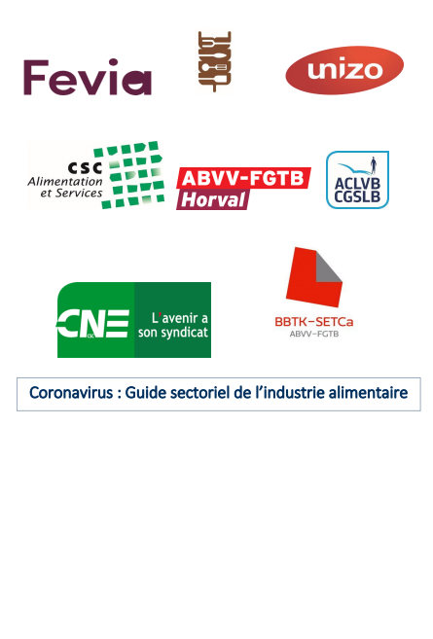
How does this generic guide relate to the sectoral guides and their application in the company?
This generic tool can then be further tailored by the different sectors to take maximum account of their sector-specific context, and by any employer who needs it, so that activities can be restarted in safe conditions.
EXAMPLE: Coronavirus : Guide sectoriel de l’industrie alimentaire
Notes:
2) goede praktijk voorbeeld om dit aan te passen voor een sector (waar de ACLVB ook een rol had gespeeld?)
Dit generieke instrument kan vervolgens verder op maat worden ingekleurd door de verschillende sectoren om maximaal rekening te kunnen houden met hun sectorspecifieke context, en door elke werkgever die daar nood aan heeft, zodat activiteiten opnieuw kunnen worden opgestart in veilige omstandigheden.
https://werk.belgie.be/nl/themas/coronavirus/veilig-aan-het-werk-tijdens-de-coronacrisis-generieke-gids-versie-2-en
Sectorgids voedingsindustrie is volgens mij een goed voorbeeld maar ik vraag dit ook nog eens na bij onze sectoren!

Slide 5
Care sector
Based on the guide: the trade union and health sector employers has developed some common guidelines:
- Protective measures
Employers and trade unions are urging the government to continue to take the necessary measures to purchase and distribute protective equipment to all employees.
- Measures for consultation
The employer ensures good communication with the staff and the social consultation bodies
- Handling acute staff shortages through an influx of temporary care staff
- Absence of employee
Does the employee have a certificate from a doctor? The employee is entitled to the guaranteed salary and in case of absence longer than 30 days, sickness benefit from the health insurance fund.
- Monitoring evolution
ACLVB Representative Cindy Bellens, Deputy Head of Service at the Vascular Unit:
“The past period was particularly exhausting, both physically and mentally: the application of the strict safety measures required enormous stamina and flexibility from the staff, we saw Covid patients die lonely, ...
But it was also an enriching period. We had to go through it together with the entire hospital team, we got to know each other better as a colleague and department, which brought about solidarity. As trade unions we have also been able to mean a lot, that aspect gives me a warm feeling. ”
Notes:
Wereldwijd maken vrouwen 70% van de zorgsector uit, in België is dat zelfs meer dan 80%.
https://www.aclvb.be/nl/non-profit-en-onderwijs/gezondheidsinrichtingen-en-diensten/artikels/gemeenschappelijke-richtlijnen
https://www.aclvb.be/nl/non-profit-en-onderwijs/artikels/zorgen-voor-de-patient-en-de-collegas

Slide 6
What have the Belgium government promised?
More than 80% of the health workers in Belgium is female!
1 billion euros for a new social plan for the Federal Health Services:
The federal government is putting 1 billion euros on the table for health care personnel. It concerns 400 million euros for the health personnel fund and 600 million euros for better wages and working conditions. Finally a future-oriented structural budget that offers perspective!
The Belgium Trade Unions asked the 8 other ministers of welfare and public health in the various regions to offer a similar perspective to the sectors under their jurisdiction. The employees from those sectors deserve at least as much respect!
This budget will allow for structural investments to meet the demands of the health sector workers:
- attract and recruit additional staff in the interest of patients,
- improve the working conditions of employees,
- to better reconcile work and private life,
- but also an increase in the salary scales of all employees in the health sector.
Notes:
https://www.aclvb.be/nl/artikels/1-miljard-euro-voor-nieuw-sociaal-plan-federale-gezondheidsdiensten

Slide 7
Other measurement negotiated by the Belgium government and social partners
Temporary unemployment (70% of their brut wage, + 5,63 euro p/d)
Extension of temporary unemployment benefits to different groups of workers
Works life balance
Corona Parental leave
Child care for front line and other workers
When children have to go in quarantine and be at home, parent can ask for temporary unemployment benefits

Slide 8
Use in the companies
Social dialogue at all levels plays a central and crucial role here.
Existing consultation bodies within the organisation, such as the Committee for Prevention and Protection at Work, the trade union delegation, or the workers themselves (if there is no trade union delegation) should be involved in the choice and implementation of the safty measures.
Call on the expertise available internally and externally, such as the prevention advisor and the external prevention services.
Notes:
3) Toepassing in de onderneming:
Het sociaal overleg op alle niveaus speelt hierbij een centrale en cruciale rol. De bestaande overlegorganen in de onderneming, zoals het comité voor preventie en bescherming op het werk, de vakbondsafvaardiging, of de werknemers zelf (indien er geen vakbondsafvaardiging is) moeten worden betrokken bij de keuze en het uitrollen van deze maatregelen. Bovendien moet er ook een beroep worden gedaan op de expertise die intern en extern aanwezig is, bv. bij de preventieadviseur en de externe preventiediensten, zeker in ondernemingen waar de interne expertise ontbreekt of beperkt is.

Slide 9
Q&A

