Slide 1

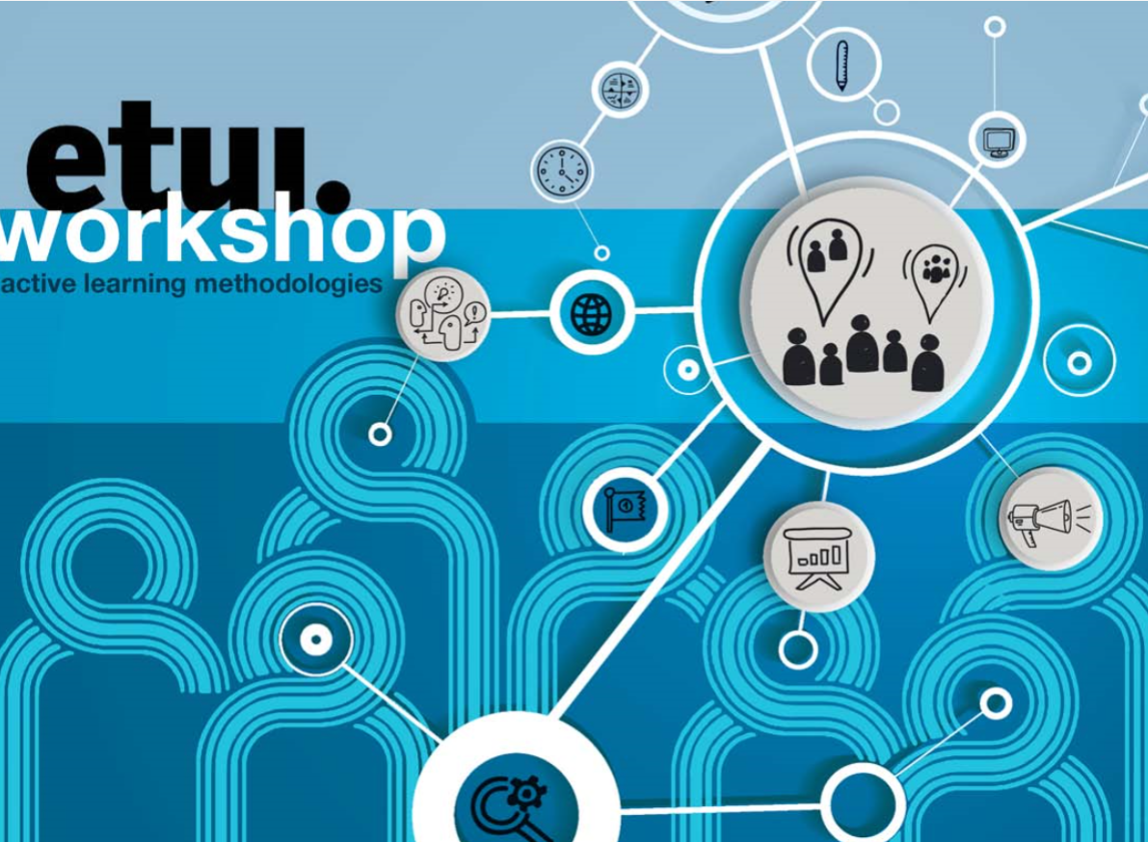

Slide 2


Participatory Learning approach :
Learners as active participants in the full life cycle of their learning process

Slide 3
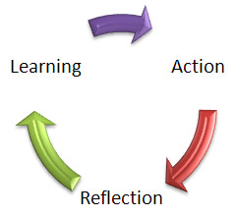
Opportunities to learn

Slide 4



Slide 5

Trainers
Eurotrainers

Slide 6
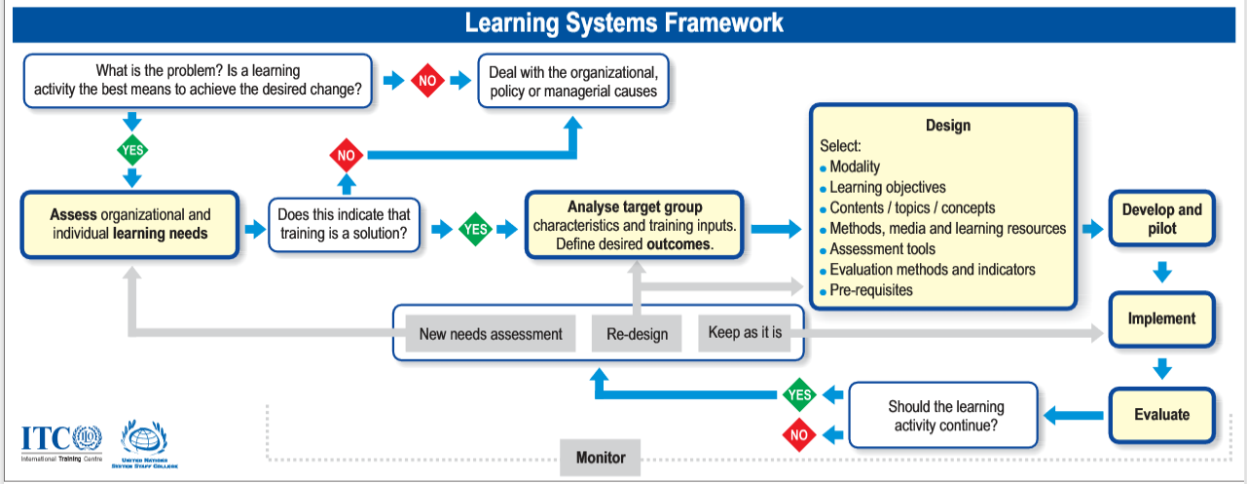

Slide 7
objectives
Explore learning & training cycle
Design learner-centered activities
Participatory facilitation approaches
Skills & knowledge visual communication and facilitation
Multisensory & participatory learning environments

Slide 8


