Slide 1
ITUC Survey and Global Rights Index

Slide 2
ITUC Survey
Database on violations of trade union rights in law and practice accross countries
Compiled through :
legal analysis
responses to a questionnaire sent to all ITUC affiliates
Available online: survey.ituc-csi.org

Slide 3
Content of the Survey
Violations recorded on:
Freedom of Association
Anti-union discrimination
Collective Bargaining
Right to Strike
Country page with information on:
violations in law
violations in practice
Updated on an annual basis

Slide 4
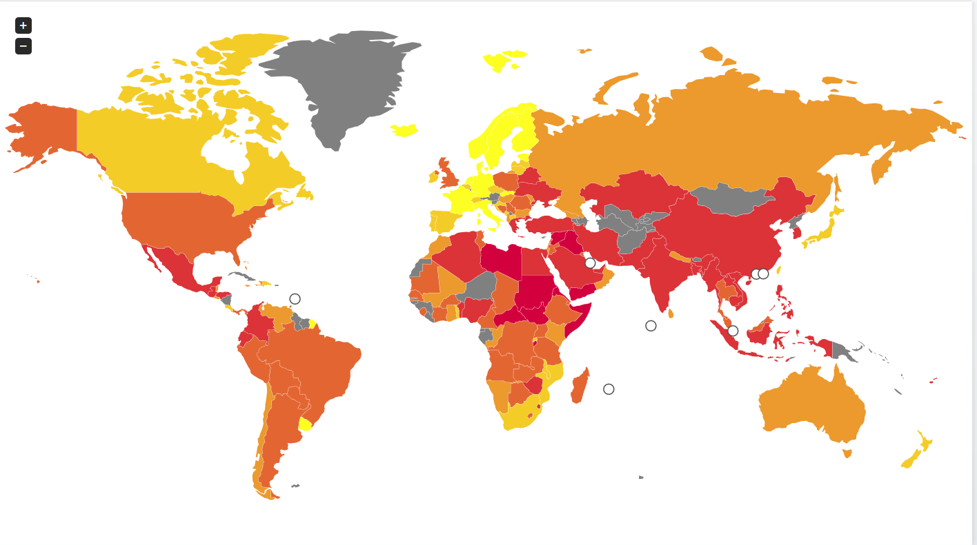
ITUC Global Rights Index
142 countries rated from 1 to 5
based on their degree of respect for collective labour rights
1
2
3
5
4

Slide 5
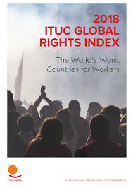
ITUC Global Rights Index
Information for each country coded against 97 indicators
Numerical presentation
of the information
Analysis of trends in the world
More information on the methodology
survey.ituc-csi.org

Slide 6
2018 findings
Large-scale exclusion of workers
65% of countries exclude some groups of workers from labour law
87% of countries have violated the right to strike
81% of countries deny some or all workers collective bargaining
Attacks on civil liberties
Out of 142 countries, 54 countries still deny or constrain free speech and freedom of assembly
Increase in violence
The number of countries where workers are exposed to physical violence and threats increased by 10% (from 59 to 65)
Unionists were murdered in 9 countries, including Brazil, China, Colombia, Guatemala, Guinea, Mexico, Niger, Nigeria and Tanzania

Slide 7
2018 findings
The ten worst countries for workers in 2018 are
Algeria
Bangladesh Cambodia
Colombia
Egypt
Guatemala Kazakhstan
the Philippines Saudi Arabia Turkey
The worst region for workers in 2018 remains the Middle East and North Africa

Slide 8
2018 findings: MENA
State persecution against independent unions: Algeria, Egypt
Violent repression of protests and arbitrary arrests and detention: Algeria, Egypt
Exclusion of most workers from labour protection: Saudi Arabia, Qatar, Kuwait

Slide 9
2018 findings: Asia
Increase in violence: India, Bangladesh, the Philippines
Massive dismissals in retaliation against strikes: Indonesia, Myanmar, Cambodia
Criminalisation of trade unions activities: Cambodia, Korea, India

Slide 10
2018 findings: Africa
Violent repression of protests: Nigeria, Zimbabwe, South Africa
Arbitrary arrests: Cameroon, Niger, DRC
Exclusion of most workers from labour protection (informal economy): Mali, Lesotho, Togo

Slide 11
2018 findings: Americas
Increase in violence against workers and unionists:
Increase in assassinations: Colombia (19 assassinations), Guatemala, Brazil
Increase in physical assaults and death threats
Erosion of collective bargaining: Argentina

Slide 12
2018 findings: Europe
Remains the region with the lowest score
State repression of independent unions: Belarus, Kazakhstan, Turkey
Increasing recourse to judicial proceedings to suppress protests: Spain, Ukraine, Kazakhstan
Lack of tripartite social dialogue and undermining of governance: Macedonia, Poland, France

Slide 13
Contribute to the Survey

Slide 14
Response rates for 2019
 | AFRICA | AMERICAS | ASIA-PACIFIC | EUROPE | MENA
Nb of countries covered in Index | 40 | 26 | 22 | 43 | 14
Nb of respondent countries | 11 | 12 | 5 | 28 | 4
% | 27% | 46% | 22% | 65% | 28%

Slide 15
Contribute to the Survey
Send information on violations whenever they happen to legal@ituc-csi.org
Information can be sent in any format (news article, e-mail, report)
Respond to the ITUC annual questionnaire

Slide 16
How to collect information
Record complaints/violations reported by your affiliates throughout the year
Distribute questionnaire to affiliates
Collect testimony through interviews at workplaces
Check media sources and verify information

Slide 17
How to report violations
Name person (if possible) and/or union concerned
Date/timeline/location of incident(s)
Description of the incident
Who is responsible? Company/sector? Which government institution?
Steps taken at national or international level?
Further consequences or implications of the violation?
Isolated incident or part of a pattern of abuses?

