Slide 1
ITUC Campaign: Ratify ILO Convention 190 PERC Women’s School - Women at the frontline during the pandemic challenges and way forward
4 November 2020

Slide 3
C190 and R206 – Timely instruments
Since the start of the pandemic and the announcement of containment measures, we have seen:
Rise in violence and harassment against key, front lines or essential workers
Increase in use of information and communication technology to perpetuate violence and harassment (cyber bullying and harassment)
Exponential increase in domestic violence due to confinement

Slide 4
Core principles
Respect, promote and realise the right of everyone to a world of work free from violence and harassment, including gender-based violence and harassment
Adopt an inclusive, integrated and gender-responsive approach
Respect, promote and realise the fundamental principles and rights at work (Core Conventions and 1998 Declaration) and promote decent work
Ensure right to equality and non-discrimination, including for women and vulnerable groups or groups in situations of vulnerability, disproportionately affected by violence and harassment in the world of work

Slide 5
Inclusive, Integrated and Gender-responsive Approach
Addressing violence and harassment through labour, equality and non-discrimination, OSH, migration and criminal laws and policies
Protecting those in the world of work, in all sectors, in the formal and informal economy, in rural or urban areas
addressing discrimination and abuse of power relations, harmful gender norms and stereotypes that support violence and harassment
Recognise different and complementary roles and functions of governments, employers and workers, with the varying nature and extent of their responsibilities

Slide 6
Focus on Ratification and Implementation
Bi-monthly newsletter
Training for trade unionists:
Contents of Convention 190 and Recommendation 206
Handling Complaints
ACTRAV ITCILO
Coming soon: Global Unions Toolkit on Violence and Harassment in the World of Work
Training session for affiliates
#RatifyC190 campaign toolkit
19-06-2020
1. Mini guide to C190 and R206 (also available in: Arabic, Russian, Kiswahili and Serbo-Croatian)
2. FAQs
3. Sample letter for lobbying governments
4. Mini explainers - cards
5. GIFs
https://www.ituc-csi.org/ratifyc190-campaign-toolkit

Slide 7
Focus on Ratification and Implementation
Campaign materials:
#RatifyC190 campaign toolkit
1. Mini guide to C190 and R206 (also available in: Arabic, Russian, Kiswahili and Serbo-Croatian)
2. FAQs
3. Sample letter for lobbying governments
4. Mini explainers - cards
5. GIFs
https://www.ituc-csi.org/ratifyc190-campaign-toolkit
https://trello.com/b/q2I5lfD3/ituc-social-media

Slide 8
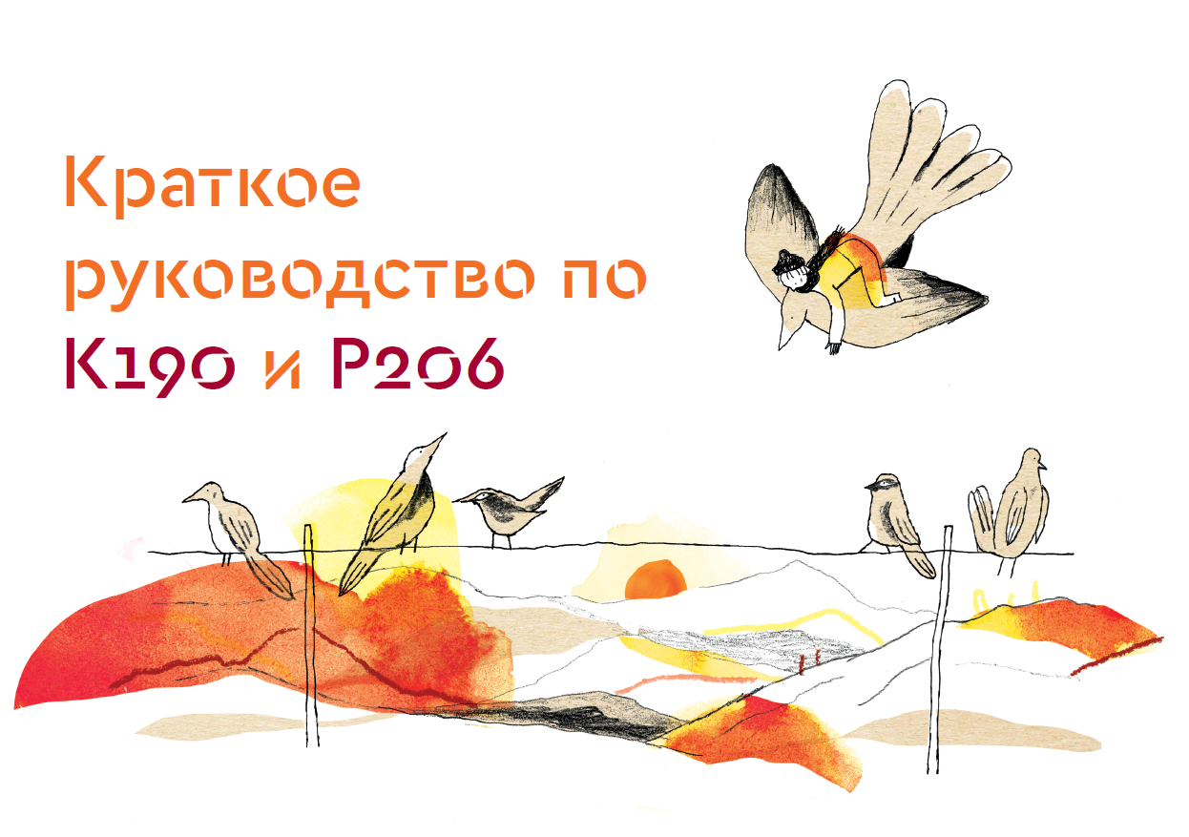
Mini guide

Slide 9
Frequently Asked Questions

Slide 10
Bi-monthly campaign newsletter

Slide 17
Thank you

