Slide 1
Addressing the gender pay and social protection gaps
PERC Women’s Committee
Vilnius, 26 September 2019
Evelyn Astor
Economic and Social Policy Advisor
International Trade Union Confederation
Evelyn.Astor@ITUC-CSI.org

Slide 2
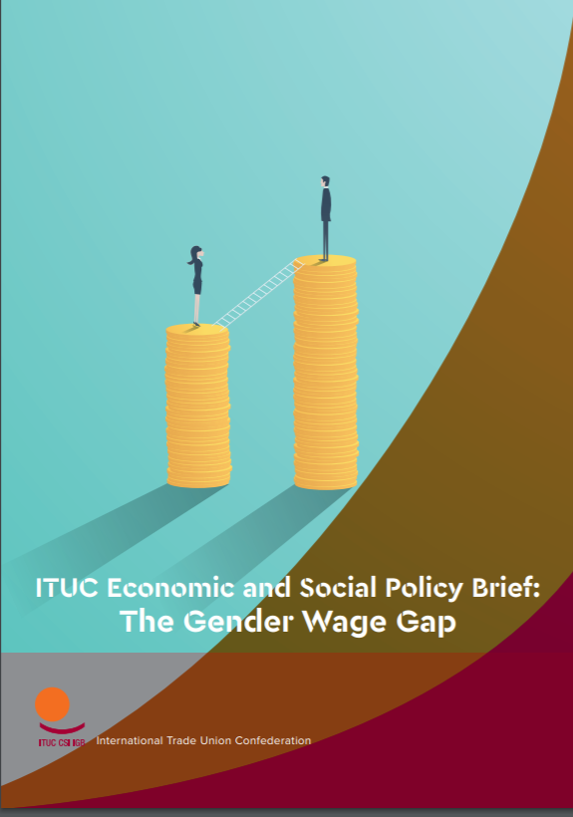
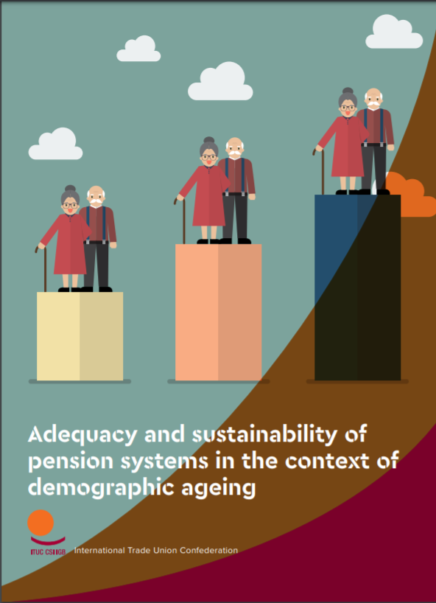
Recent publications

Slide 4
Gender wage gap – stylised facts
Women average hourly wages are on average 23% less than men’s
The gender pay gap is wider for parents
Worldwide estimates show that at current trends, gender differences in pay will not close until 2069

Slide 5
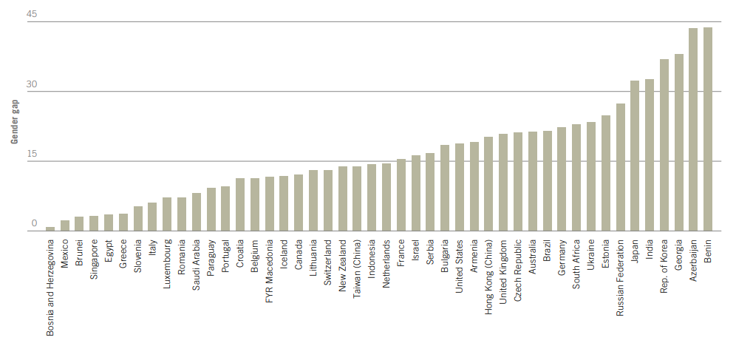
Gender pay gap (average hourly earnings)
ILO Global wage report

Slide 6
Multiple interrelated drivers
Discrimination- direct and indirect
Overrepresentation in low paid jobs and sectors
Underrepresentation in management
Career penalties due to care responsibilities

Slide 7
Policy levers
Raising minimum wages
Collective bargaining on wages
Work-life balance measures
Pay transparency requirements
Gender quotas for management
Tackling gender norms and stereotypes

Slide 9
Gender gaps in social protection
Globally only 26.4% of women are covered by a contributory old-age pension vs 31.5% of the total population
Women on average have lower pension benefit levels than men – the gender pension gap stands at 40.2% in the EU
Women are over-concentrated in social assistance benefits that tend to have low benefit levels
Recent social protection reforms have disproportionately disadvantaged women

Slide 10
Drivers
Labour market disadvantage:
Lower pay
Lower participation in formal employment
Greater interruption in careers
Higher concentration in part-time work
Overrepresentation in informal and precarious work
Social protection design features
Gender-blind contribution rules
Differentiated retirement ages between women and men
Inadequate indexation of benefits

Slide 11
Policy levers
Labour market measures
Tackling gender pay gap
Removing barriers to women’s employment (investing in the care economy, paid and gender-balanced parental leave)
Reforms to social protection systems:
Ensuring adequate social protection floors
Crediting care periods in social security contributions
Equalising retirement provisions for women and men
Adequately indexing benefits

Slide 12
Bridging research with action at the international level in 2019
ILO Centenary Declaration on the Future of Work
UN Commission on the Status of Women
L20 Summit
UN High-level Political Forum

Slide 13
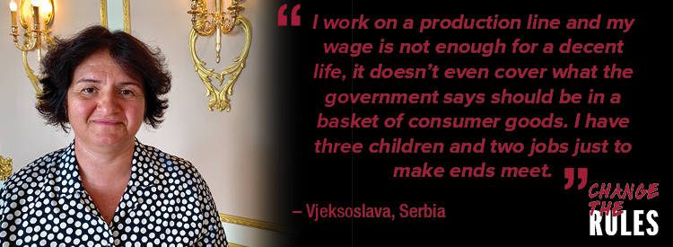
ITUC-PERC Wage Campaign

Slide 14
Main messages of the campaign
Need for minimum living wages based on the cost of living
Strengthened collective bargaining on wages
Wage increases will support demand and sustainable economic growth
Need for EU upward convergence on wages and living standards

Slide 15
Main campaign activities
Forthcoming ITUC-PERC report on the scandal of poverty wages in Eastern Europe
Technical support activities to strengthen evidence base of unions’ wage claims
Lobbying EU for decent wages and decent work within the European Semester (EU MS) and in enlargement hearings (candidate countries)

Slide 16
Further reading…
ILO (2018) Global Wage Report
ITUC (2018) The Gender Wage Gap
ITUC (2018) Gender Gaps in Social Protection
ITUC (2019) Adequacy and Sustainability of Pensions in the Context of Demographic Ageing
Global Unions (2018) Statement for the 63rd Session of the UN Commission on the Status of Women

