Slide 1
Addressing the gender pay and social protection gaps
PERC Women’s Committee
Brussels, 20 February 2019
Evelyn Astor
Economic and Social Policy Advisor
International Trade Union Confederation
Evelyn.Astor@ITUC-CSI.org

Slide 2
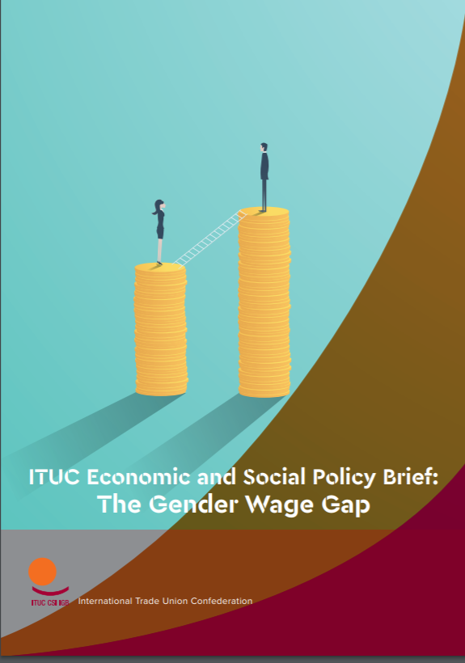
Recent publications

Slide 4
Gender wage gap – stylised facts
Women average hourly wages are on average 23% less than men’s
The gender pay gap is wider for parents
Worldwide estimates show that at current trends, gender differences in pay will not close until 2069

Slide 5
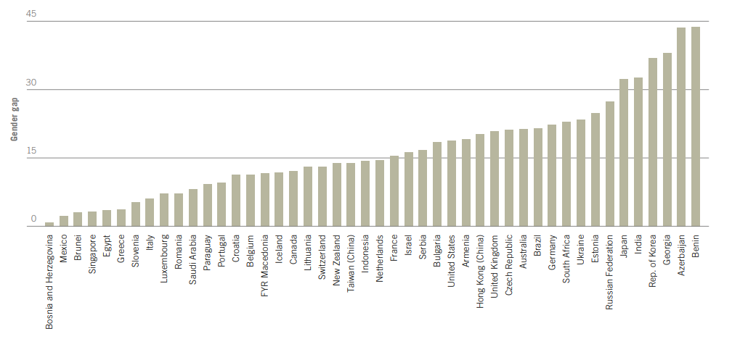
Gender pay gap (average hourly earnings)
ILO Global wage report

Slide 6
Multiple interrelated drivers
Discrimination- direct and indirect
Labour market segregation
Underrepresentation in management
Career penalties due to care responsibilities

Slide 7
Policy levers
Raising minimum wages
Collective bargaining on wages
Work-life balance measures
Pay transparency requirements
Gender quotas for management
Tackling gender norms and stereotypes

Slide 9
Gender gaps in social protection
Globally only 26.4% of women are covered by a contributory old-age pension vs 31.5% of the total population
Women on average have lower pension benefit levels than men – the gender pension gap stands at 40.2% in the EU
Women over-concentrated in social assistance benefits that tend to have inadequate benefit levels
Cutbacks to benefits mostly used predominantly by women: e.g., maternity and survivors’ benefits

Slide 10
Drivers
Labour market disadvantage:
Lower pay
Lower participation in formal employment
Greater interruption in careers
Higher concentration in part-time work
Overrepresentation in informal and precarious work
Social protection design features
Gender-blind contribution rules
Differentiated retirement ages between women and men
Inadequate indexation of benefits

Slide 11
Policy levers
Labour market measures
Tackling gender pay gap
Removing barriers to women’s employment (investing in the care economy, paid and gender-balanced parental leave)
Reforms to social protection systems:
Ensuring adequate social protection floors
Crediting care periods in social security contributions
Equalising retirement provisions for women and men
Adequately indexing benefits

Slide 12
Relevant international frameworks
International Human Rights Frameworks
UDHR, ICESCR
Beijing Platform for Action
ILO Conventions
C100, C111, C156, C183, C102, C131
ILO Recommendations
R202, R165
UN Sustainable development goals
1, 5, 8, 10
Equal Pay International Coalition

Slide 13
Further reading…
ILO (2018) Global Wage Report
ITUC (2018) The Gender Wage Gap
Global Unions (2018) Statement for the 63rd Session of the UN Commission on the Status of Women
ITUC (2018) Gender Gaps in Social Protection

