Slide 1
SEE Trade Union Economic Experts’ Meeting
“The impact of the Covid pandemic and conflict in Ukraine on the employment and economies of the Western Balkans; Inflation and wages – trade union activities "
11 – 12 May 2022, IGALO, Montenegro
The long-term impact of the COVID-19 pandemic and conflict in Ukraine on employment and economies.
Bruno S. Sergi
ETUI and University of Messina

Slide 2
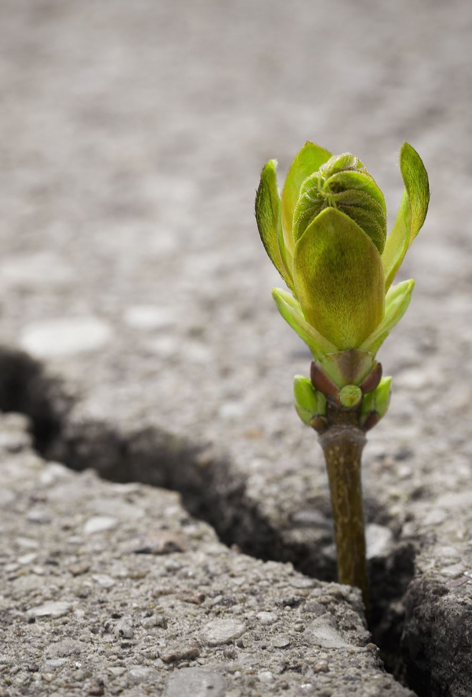
From our last online meeting on 11 May 2021

Slide 4
From Short Term to Long Term.
Short-term supply challenge has been the factory output fell and declining consumption because workers were quarantined to reduce the virus's spread through social interaction.
Long-term challenge causes multilevel disruptions to the linkage of existing global trade, investment, financial flow and travelling.

Slide 5
The Impact of COVID-19 Pandemic.
Source: IMF

Slide 6
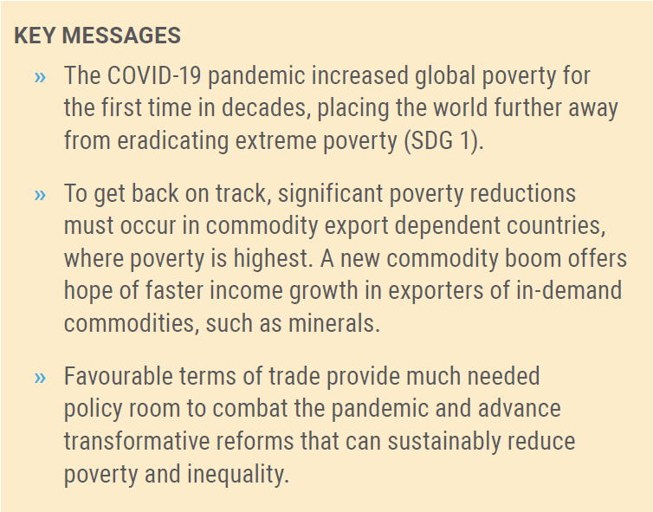
The Impact of COVID-19 Pandemic
Source: UN

Slide 7
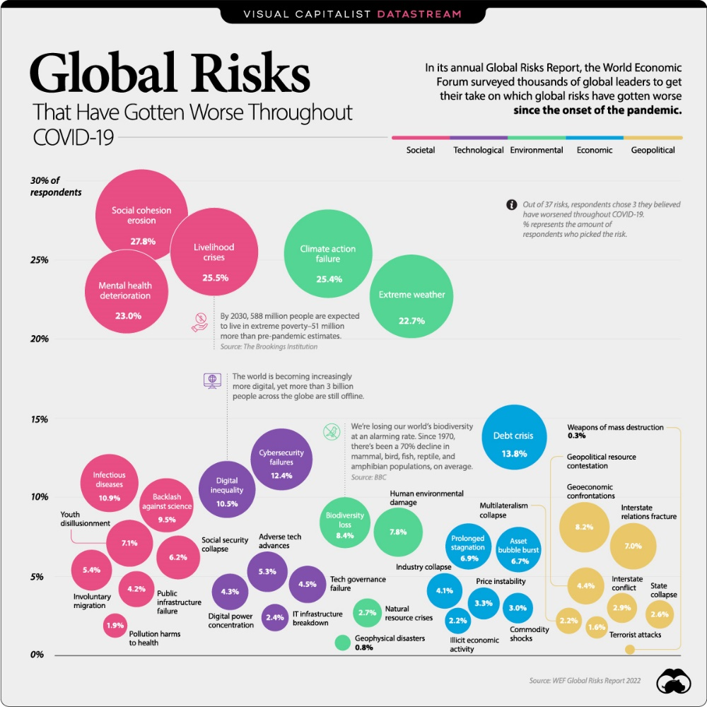
The erosion of social cohesion is a global risk that has intensified in the past few years.

Slide 8

Today!

Slide 9
The IMF: "Beyond the suffering and humanitarian crisis from Russia’s invasion of Ukraine, the entire global economy will feel the effects of slower growth and faster inflation.”
“Longer term, the war may fundamentally alter the global economic and geopolitical order should energy trade shift, supply chains reconfigure, payment networks fragment, and countries rethink reserve currency holdings. Increased geopolitical tension further raises risks of economic fragmentation, especially for trade and technology.”
Source: IMF

Slide 10
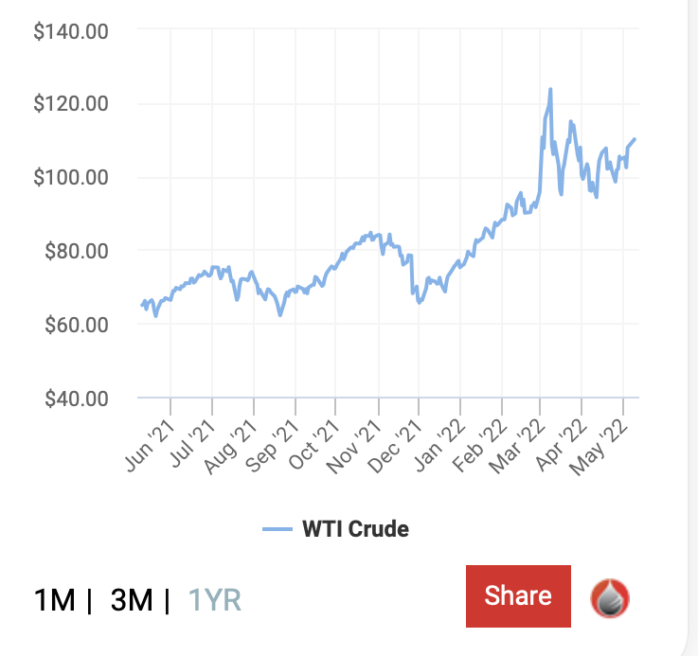
International Implications of the War in Ukraine
The ongoing war in Ukraine and sanctions on Russia generate substantial economic spillovers:
  Sharp increase in commodity prices: War-related interruptions to production, sanctions, and strongly impaired access to cross-border payment systems will disrupt trade flows, notably for energy and food.
  Inflation expectation is going to persist. Oil and gas prices increase more severely in 2022 and food prices well into 2023 (because of the lagged impact from the harvest in 2022). For 2022, inflation is projected at 5.7% in advanced economies and 8.7% in emerging markets.
  Russia’s economy is back on its feet
  https://www.economist.com/finance-and-economics/2022/05/07/russias-economy-is-back-on-its-feet
Source: IMF

Slide 11
Source: IMF

Slide 12
Indicators 2020-2021 and Outlook 2022-2024 - Basic Scenario
 |  | GDP |  |  |  |  |  | Consumer prices |  |  |  |  |  | Unemployment (LFS)
 |  | real change in % against prev. year |  |  |  |  |  | average change in % against prev. year |  |  |  |  |  | rate in %, annual average
 |  |  |  | Forecast |  |  |  |  |  | Forecast |  |  |  |  |  | Forecast
 |  | 2020 | 2021 ¹⁾ | 2022 | 2023 | 2024 |  | 2020 | 2021 | 2022 | 2023 | 2024 |  | 2020 | 2021 ¹⁾ | 2022 | 2023 | 2024
BG | Bulgaria | -4,4 | 4,2 | 2,0 | 3,7 | 3,5 |  | 1,2 | 2,8 | 14,0 | 8,0 | 5,0 |  | 5,1 | 5,3 | 5,0 | 4,5 | 4,0
CZ | Czechia | -5,8 | 3,3 | 2,6 | 3,5 | 4,2 |  | 3,3 | 3,3 | 8,7 | 3,8 | 2,3 |  | 2,6 | 2,8 | 2,5 | 2,5 | 2,2
EE | Estonia | -3,0 | 8,3 | 1,8 | 3,4 | 3,1 |  | -0,6 | 4,5 | 11,0 | 3,5 | 2,8 |  | 6,8 | 6,2 | 8,0 | 6,0 | 5,2
HR | Croatia | -8,1 | 10,4 | 3,5 | 4,0 | 3,1 |  | 0,0 | 2,7 | 6,5 | 2,9 | 2,3 |  | 7,5 | 7,7 | 7,1 | 6,4 | 6,5
HU | Hungary | -4,7 | 7,1 | 2,5 | 3,9 | 4,5 |  | 3,4 | 5,2 | 9,0 | 5,0 | 3,5 |  | 4,3 | 4,1 | 3,9 | 3,8 | 3,5
LT | Lithuania | -0,1 | 5,0 | 1,7 | 2,8 | 2,6 |  | 1,1 | 5,5 | 12,0 | 6,5 | 4,0 |  | 8,5 | 7,1 | 6,8 | 7,0 | 6,0
LV | Latvia | -3,8 | 4,7 | 1,4 | 2,2 | 2,3 |  | 0,1 | 3,2 | 10,0 | 6,5 | 3,5 |  | 8,1 | 7,6 | 7,5 | 5,8 | 6,0
PL | Poland | -2,5 | 5,7 | 4,0 | 3,5 | 3,6 |  | 3,7 | 5,2 | 10,0 | 6,5 | 3,5 |  | 3,2 | 3,4 | 3,0 | 3,1 | 3,2
RO | Romania | -3,7 | 5,9 | 2,0 | 3,5 | 4,5 |  | 2,3 | 4,1 | 9,0 | 5,0 | 3,0 |  | 5,0 | 5,6 | 5,6 | 5,3 | 5,0
SI | Slovenia | -4,2 | 8,1 | 4,1 | 3,3 | 2,8 |  | -0,3 | 2,0 | 4,8 | 1,7 | 1,4 |  | 5,0 | 4,8 | 4,5 | 4,3 | 4,1
SK | Slovakia | -4,4 | 3,0 | 2,4 | 3,1 | 3,0 |  | 2,0 | 2,8 | 8,0 | 4,5 | 2,0 |  | 6,7 | 6,8 | 6,5 | 5,9 | 5,7
 | EU-CEE11 ¹⁾²⁾ | -3,7 | 5,6 | 3,0 | 3,5 | 3,8 |  | 2,7 | 4,3 | 9,5 | 5,4 | 3,2 |  | 4,4 | 4,5 | 4,3 | 4,1 | 3,9
 | EA19 ³⁾ | -6,4 | 5,3 | 2,5 | 2,7 | 2,1 |  | 0,3 | 2,6 | 6,0 | 3,0 | 2,0 |  | 7,9 | 7,7 | 7,3 | 6,9 | 6,6
 | EU27 ³⁾ | -5,9 | 5,3 | 2,7 | 2,9 | 2,3 |  | 0,7 | 2,9 | 6,2 | 3,2 | 2,2 |  | 7,1 | 6,9 | 6,5 | 6,1 | 5,8
AL | Albania | -3,5 | 8,5 | 3,5 | 3,7 | 3,9 |  | 1,6 | 2,0 | 6,0 | 3,4 | 2,5 |  | 11,7 | 11,5 | 11,2 | 11,0 | 10,6
BA | Bosnia and Herzegovina | -3,1 | 7,1 | 1,8 | 2,3 | 2,3 |  | -1,1 | 2,0 | 8,0 | 4,0 | 3,0 |  | 15,9 | 17,4 | 16,8 | 16,3 | 15,7
ME | Montenegro | -15,3 | 12,4 | 3,5 | 3,7 | 3,3 |  | -0,3 | 2,4 | 6,4 | 3,0 | 2,0 |  | 17,9 | 16,6 | 15,3 | 14,8 | 14,0
MK | North Macedonia | -6,1 | 4,0 | 2,5 | 2,7 | 2,7 |  | 1,2 | 3,2 | 8,0 | 5,0 | 4,0 |  | 16,4 | 15,7 | 15,2 | 14,8 | 14,5
RS | Serbia | -0,9 | 7,4 | 3,6 | 3,4 | 3,4 |  | 1,6 | 4,1 | 10,0 | 6,0 | 4,0 |  | 9,0 | 11,0 | 10,5 | 10,0 | 9,5
XK | Kosovo | -5,3 | 10,5 | 3,3 | 3,7 | 3,9 |  | 0,2 | 3,4 | 7,0 | 4,0 | 2,0 |  | 25,9 | 24,5 | 24,3 | 23,8 | 23,5
 | WB6 ¹⁾²⁾ | -3,2 | 7,6 | 3,1 | 3,2 | 3,3 |  | 0,9 | 3,2 | 8,5 | 4,9 | 3,4 |  | 13,0 | 13,9 | 13,4 | 13,0 | 12,6
TR | Turkey | 1,8 | 11,0 | 2,7 | 2,8 | 3,2 |  | 12,3 | 19,6 | 55,0 | 20,0 | 10,0 |  | 13,2 | 12,0 | 11,5 | 10,5 | 9,5
BY | Belarus | -0,7 | 2,3 | -3,5 | 1,6 | 2,0 |  | 5,5 | 9,5 | 15,0 | 12,0 | 11,0 |  | 4,0 | 3,9 | 4,1 | 4,0 | 4,0
KZ | Kazakhstan | -2,5 | 4,0 | 1,5 | 3,2 | 4,0 |  | 6,8 | 8,0 | 11,0 | 8,0 | 6,0 |  | 4,9 | 4,9 | 5,0 | 4,8 | 4,8
MD | Moldova | -7,4 | 13,9 | -3,0 | 3,0 | 4,0 |  | 3,8 | 5,1 | 20,0 | 10,0 | 4,0 |  | 3,8 | 3,2 | 3,5 | 3,3 | 3,2
RU | Russia | -2,7 | 4,7 | -9,0 | -1,5 | 1,0 |  | 3,4 | 6,7 | 20,0 | 14,0 | 4,0 |  | 5,8 | 4,8 | 7,5 | 7,0 | 6,5
UA | Ukraine | -3,8 | 3,4 | -38,0 | 5,0 | 13,0 |  | 2,7 | 9,4 | 15,0 | 10,0 | 6,0 |  | 9,5 | 9,9 | 25,0 | 15,0 | 10,0

Slide 13
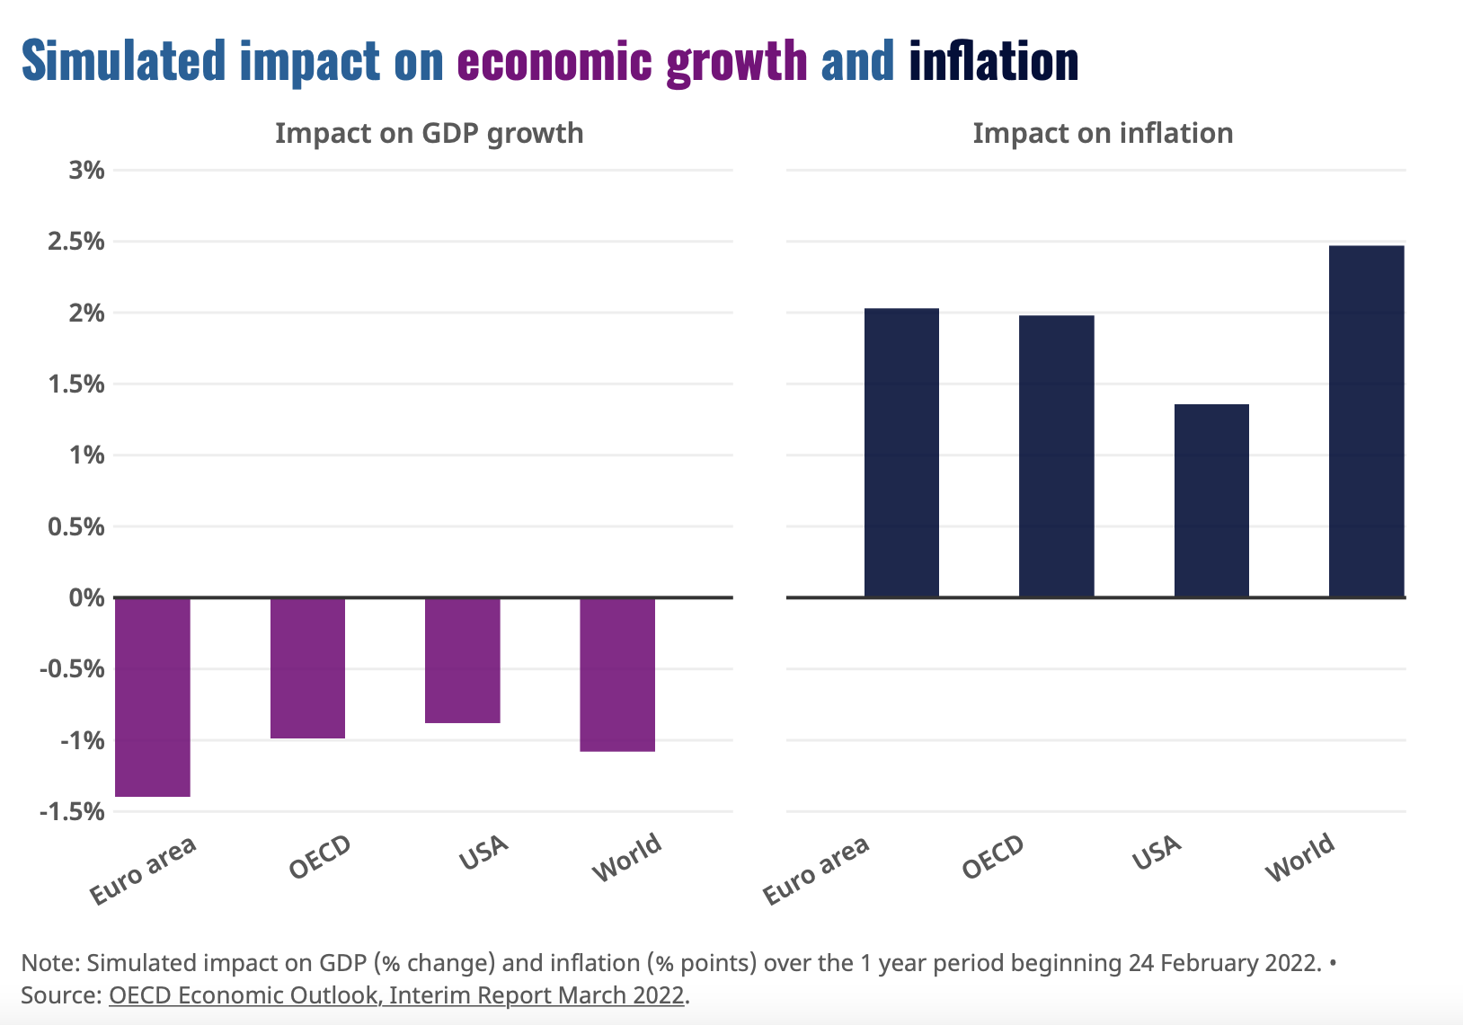
Russia Invasion of Ukraine
Amid the uncertainty, the OECD estimates global economic growth could be more than 1 percentage point lower this year than was projected before the conflict. In contrast, inflation, already high at the start of the year, could be higher than it would have been if the war had not broken out by at least a further 2.5 percentage points on aggregate across countries.
Source: https://www.oecd.org/economic-outlook/

Slide 14
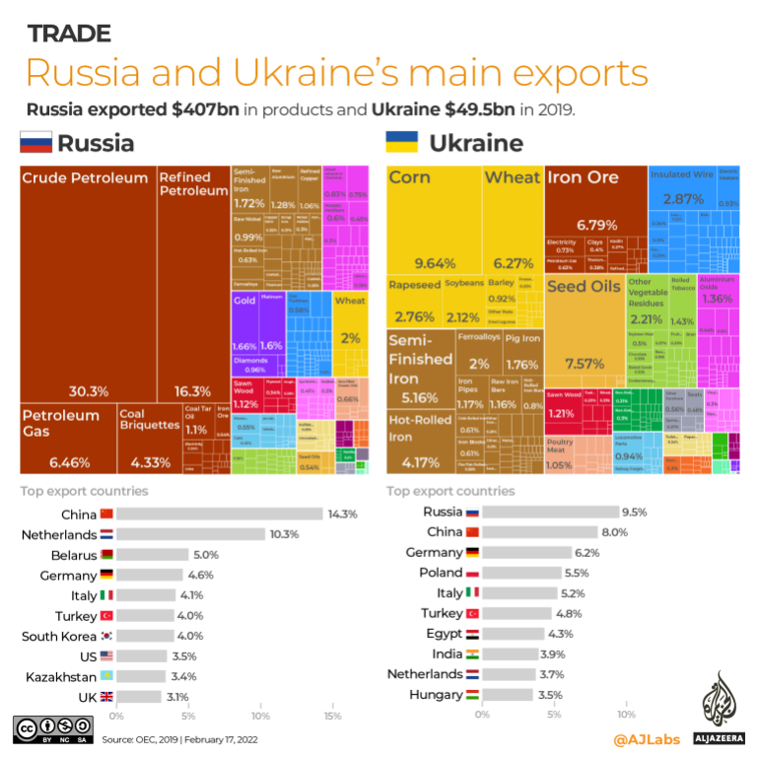
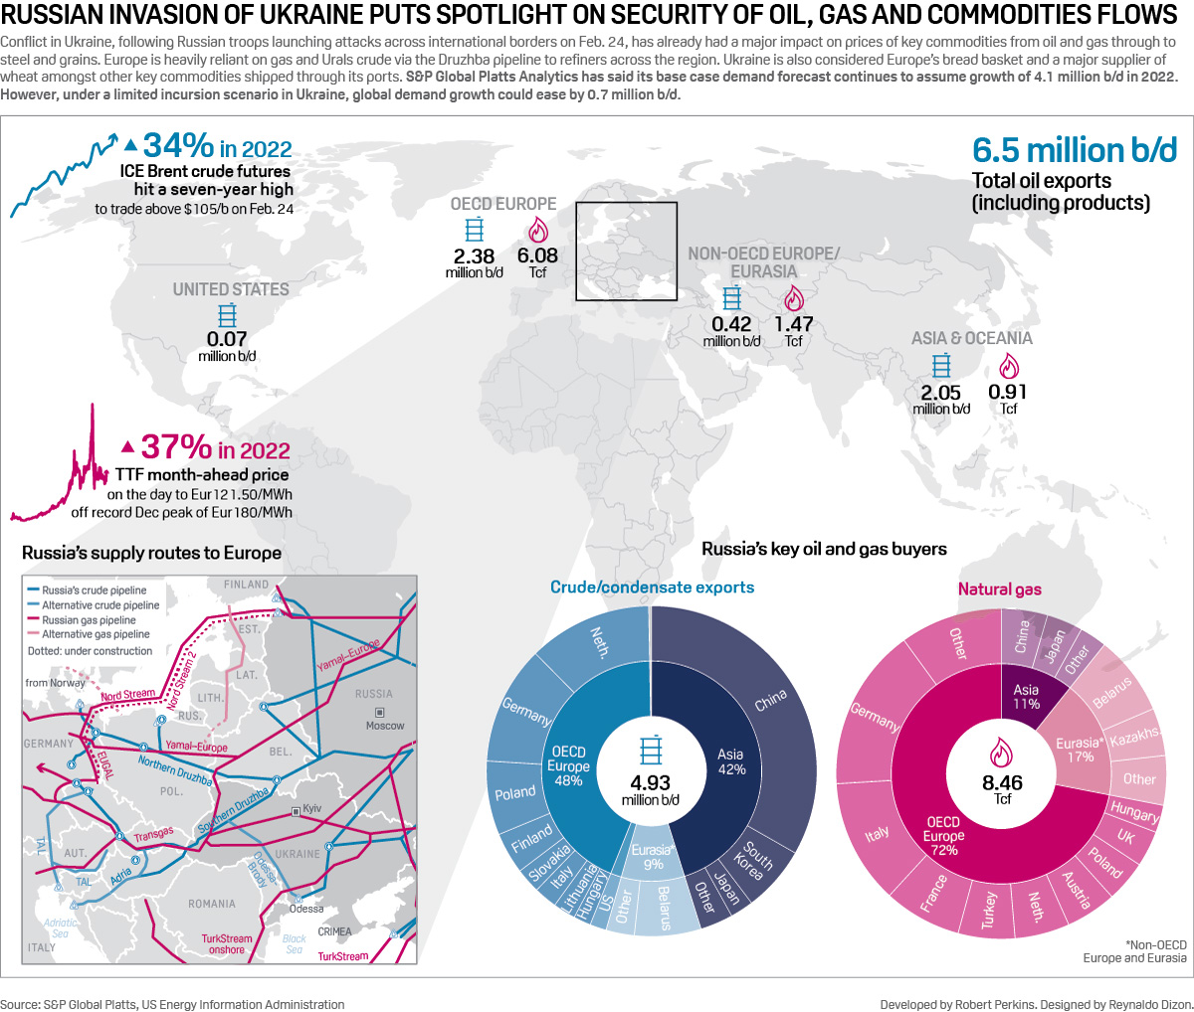

Slide 15
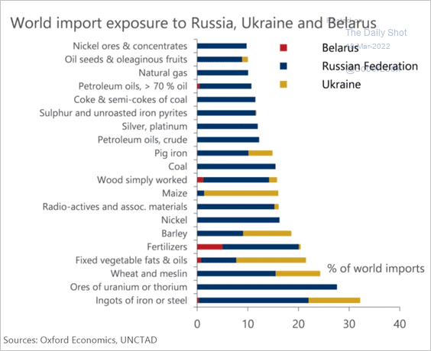

Slide 16
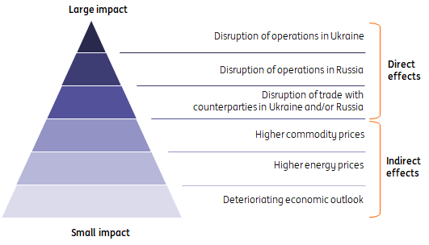
The impact of the war in Ukraine on the European supply chain.
Among the most pressing vulnerabilities is an overreliance in Europe on natural gas and crude oil from Russia and dependence on both Russia and Ukraine for key agricultural commodities.
According to the UN’s Food and Agriculture Organization, Russia and Ukraine account for more than 25% of the world’s wheat trade and more than 60% of global sunflower oil and 30% of global barley exports.
Russia (together with Belarus) is also a major global exporter of fertilizers, which means any supply shortages, or restricted access, could impact crop yields in many nations.
https://think.ing.com/articles/the-impact-of-the-war-in-ukraine-on-food-agri-has-only-just-started-to-unravel

Slide 17
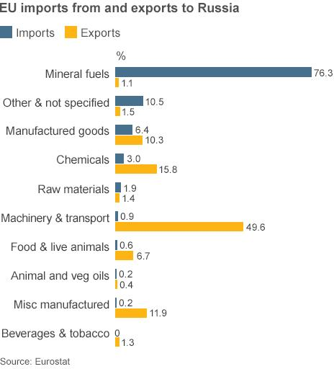
EU imports from and Exports to Russia
The sanctions imposed by various Western countries create a risk that trade in commodities could become disrupted, especially exports of oil and gas commodities to Europe.
This risk is manifested in a sizable increase in the prices of key commodities, potentially leading to even higher global inflation and weaker global growth.
Sanctions have led some companies to become opposed to trading with Russia, potentially disrupting key supply chains. The magnitude of the economic impact will depend on how the war progresses and how that affects global trade in key commodities.

Slide 18
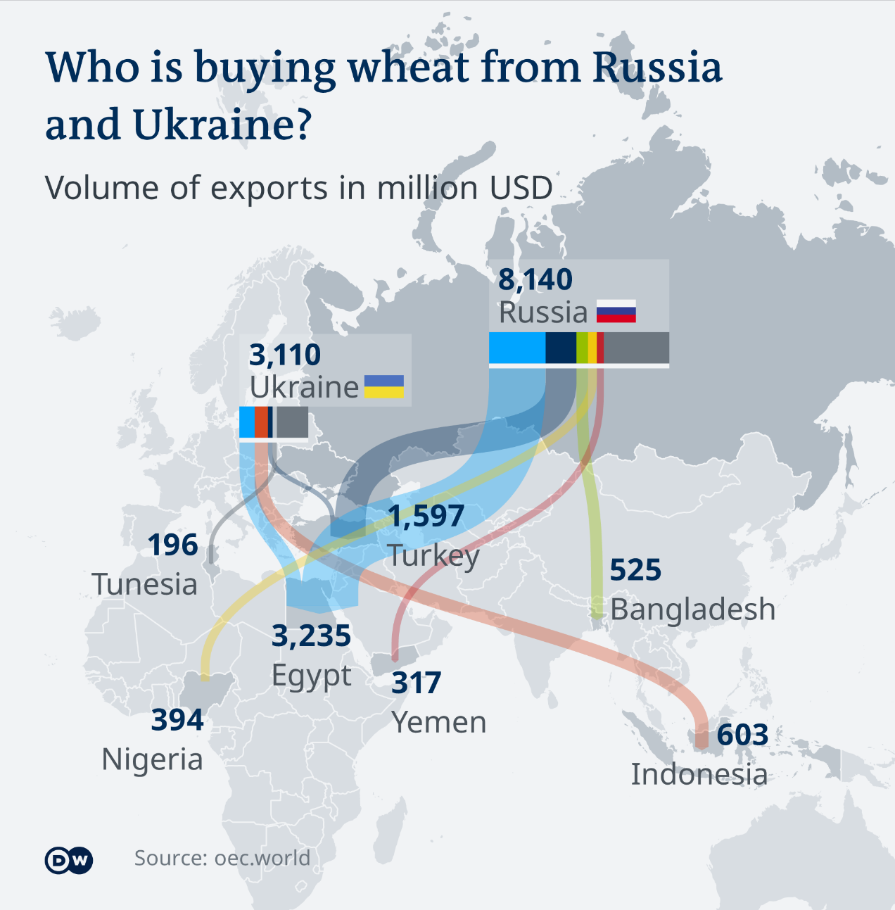
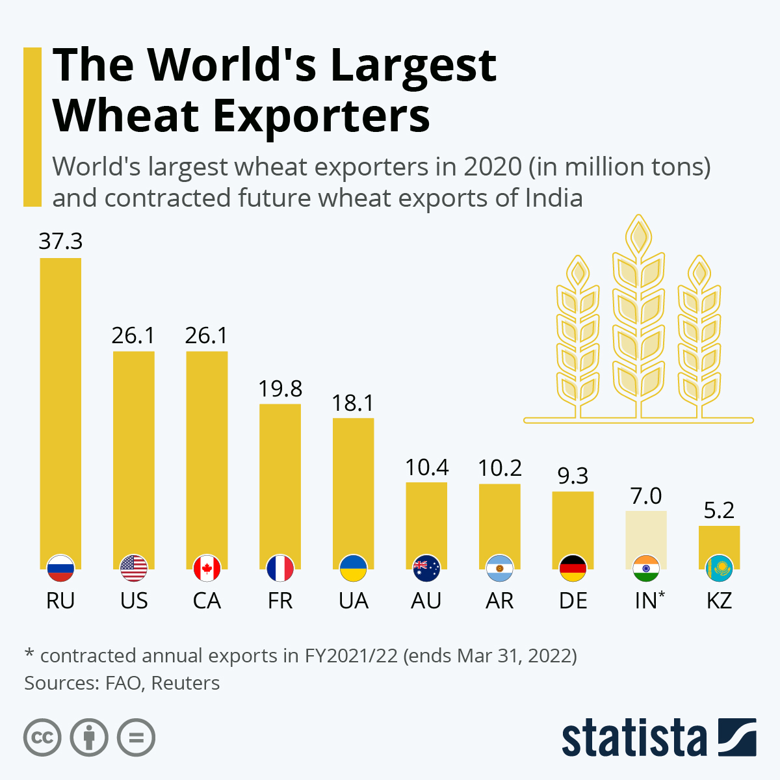

Slide 19
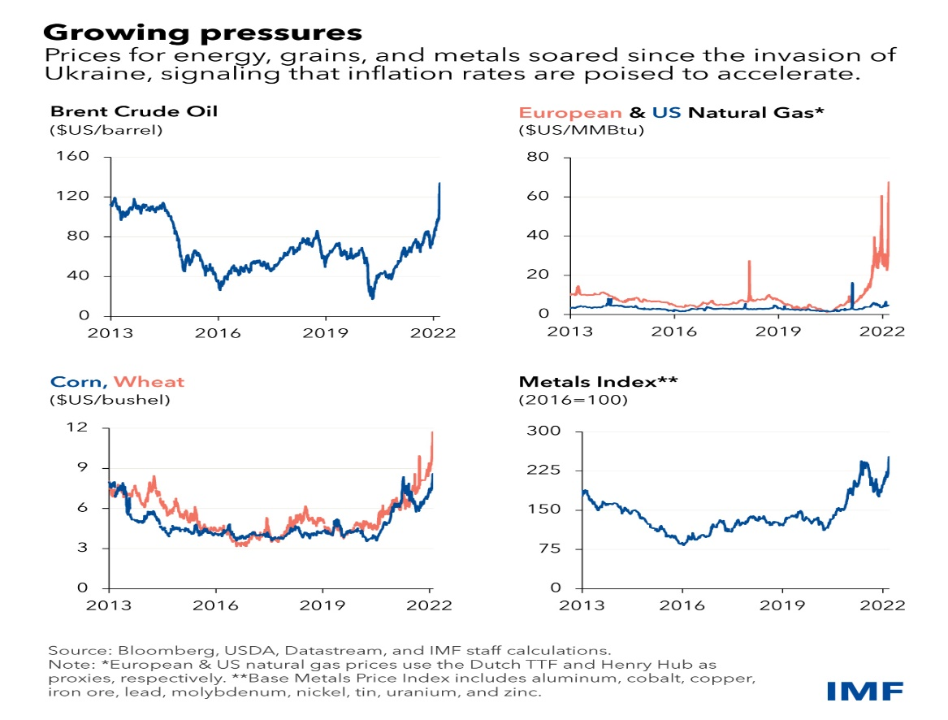
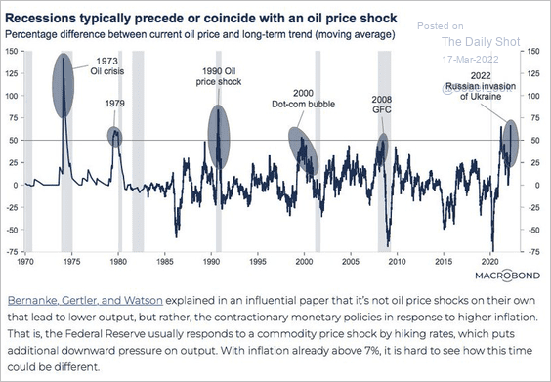
Global Economic Consequences
Due to the scale of Russia’s economy, the global spillover affects countries with direct trade, tourism, and financial exposures to feel downward pressures. Economies reliant on oil imports will see wider fiscal and trade deficits and more inflation pressure.

Slide 20
Economic Impact Across the World.
European governments also may confront fiscal pressures from additional spending on energy security and defense budgets.
Energy is the main spillover channel for Europe as Russia is a critical source of natural gas imports. Broader supply-chain disruptions may also be consequential. These effects will fuel inflation and slow the recovery from the pandemic.
Beyond Europe, these neighboring nations will feel greater consequences from Russia’s recession and the sanctions. Close trade and payment-system links will curb trade, remittances, investment, and tourism, adversely affecting economic growth, inflation, and external and fiscal accounts.
Source: IMF

Slide 21
Economic Impact Across the World.
Major ripple effects from higher food and energy prices and tighter global financial conditions are likely. Egypt, for example, imports about 80% of its wheat from Russia and Ukraine. And, as a popular tourist destination for both, it will also see visitors spending shrink. Rising prices may raise social tensions in some countries, such as those with weak social safety nets, few job opportunities, limited fiscal space, and unpopular governments.
In Sub-Saharan Africa, countries are particularly vulnerable to the war’s effects because of higher energy and food prices, reduced tourism, and potential difficulty accessing international capital markets.
Source: IMF

Slide 22
Geoeconomics consequences: Europe / SEE

Slide 23
Oil and natural gas
The International Energy Agency (IEA, 2022) published a 10-point plan to reduce the reliance on Russian natural gas. The European Union could reduce its imports of Russian natural gas by more than one-third within a year through measures consistent with the European Green Deal and support energy security and affordability. The EU also indicated its intention to reduce its reliance on Russian gas by 2030.
Imports via pipeline to the EU from Norway, Algeria, and Azerbaijan could be increased by 10 bcm compared to 155 bcm imports from Russia in 2021, accounting for around 45% of EU gas imports and close to 40% of its total gas consumption—the IEAcy, 2022.
LNG imports could increase by 20 bcm (IEA, 2022).
Growth will suffer downward pressure, stagflation already occurring, mainly from the impact on energy prices and supply chains, including raw materials.
https://www.iea.org/news/how-europe-can-cut-natural-gas-imports-from-russia-significantly-within-a-year

Slide 24
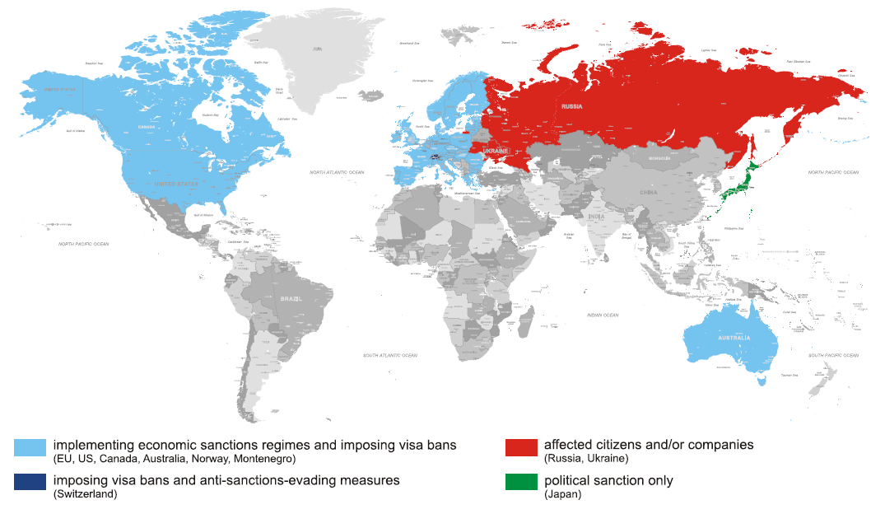
Supply chain reconfiguration
Historically, the logistics links that connect global supply chains have been taken for granted.
Firms have taken advantage of reliable, low-cost transportation and a benign trading environment to leverage low-cost labor in Asia to deliver a plethora of products to distant markets.
Now, supply-chain “resilience” is tangled with economic and technological “sovereignty,” a euphemism for more localized production.
The invasion of Ukraine by Russia and sanctions imposed on it for doing so, and new pandemic-related shutdowns in China are the latest events to rock global supply chains.

Slide 25
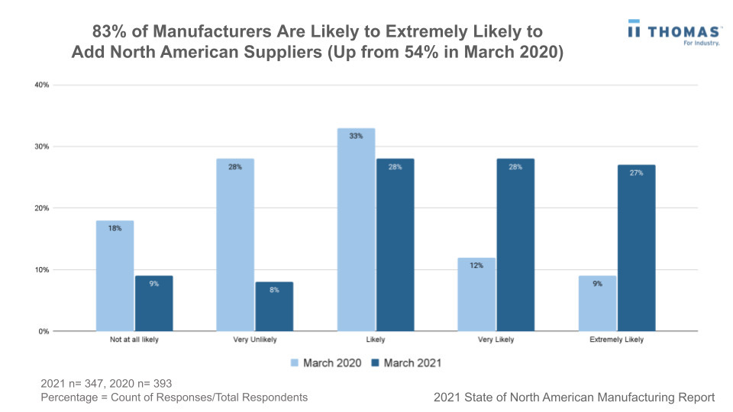
Rising reshoring interests in the U.S.
According to the latest 2021 Thomas State of North American Manufacturing Report, 83% of manufacturers are planning to add North American suppliers to their supply chains within a year, a significant increase from 54% in March 2020.

Slide 26
The future of employment
Developing and enhancing human skills and capabilities through education, learning and meaningful work are key drivers of economic success, of individual well-being and societal cohesion.
The global shift to a future of work is defined by an ever-expanding cohort of new technologies, by new sectors and markets, by latest global political economic circumstance that are more challenging than in any other point of the past 40 years since the end of the cold war.
The past decade of technological advancement has also brought about the looming possibility of mass job displacement, untenable skills shortages and a competing claim to the unique nature of human intelligence now challenged by artificial intelligence.
The coming decade will require purposeful leadership to arrive at a future of work that fulfils human potential and creates broadly shared prosperity.
Source: WEF

Slide 27
Before the Pandemic, employment trends in the United States were at “high risk” of automation.
Source: https://es.weforum.org/reports/the-future-of-jobs-report-2020

Slide 28
Business adaptation in response to COVID-19.
Source: https://es.weforum.org/reports/the-future-of-jobs-report-2020

Slide 29
Top skills in demand
The WEF research group has tracked the cross-functional skills in increasing demand.
These include critical thinking, analysis, and problem-solving groups, which have stayed at the top of the agenda with year-on-year consistency.
Newly emerging are skills in self-management such as active learning, resilience, stress tolerance, and flexibility.

Slide 30
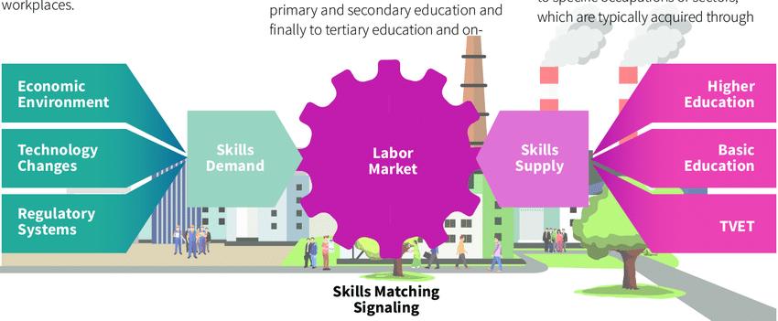
The education system should act as a mediator among employers, the government, and individuals, providing potential employees and workers with a complete toolkit for personalized lifelong training and offering new forms of training that consider employers’ continually changing requirements.

Slide 31
Does education prepare for skills?
Almost half of the young people surveyed in both developed and developing economies feel they don’t have the right skills, according to the World Economic Forum’s Davos Labs Youth Recovery Plan 2021.
Source: https://www3.weforum.org/docs/WEF_Davos_Lab_Youth_Recovery_Plan_2021.pdf

Slide 32
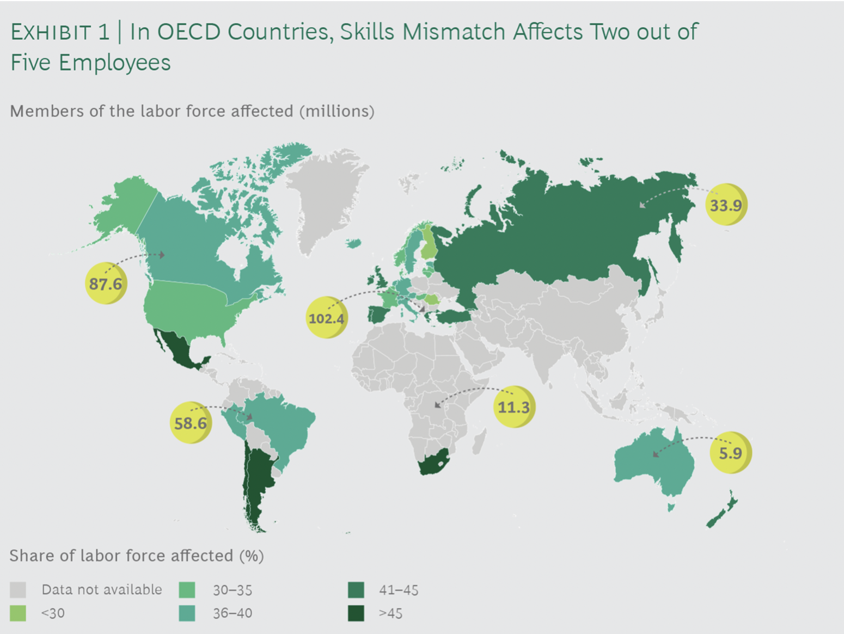
Ongoing technological change and market transformations require flexible thinking, quick and continuous learning, and mobility.
The skill demand of the economic sector doesn’t always meet by the education system.

Slide 33
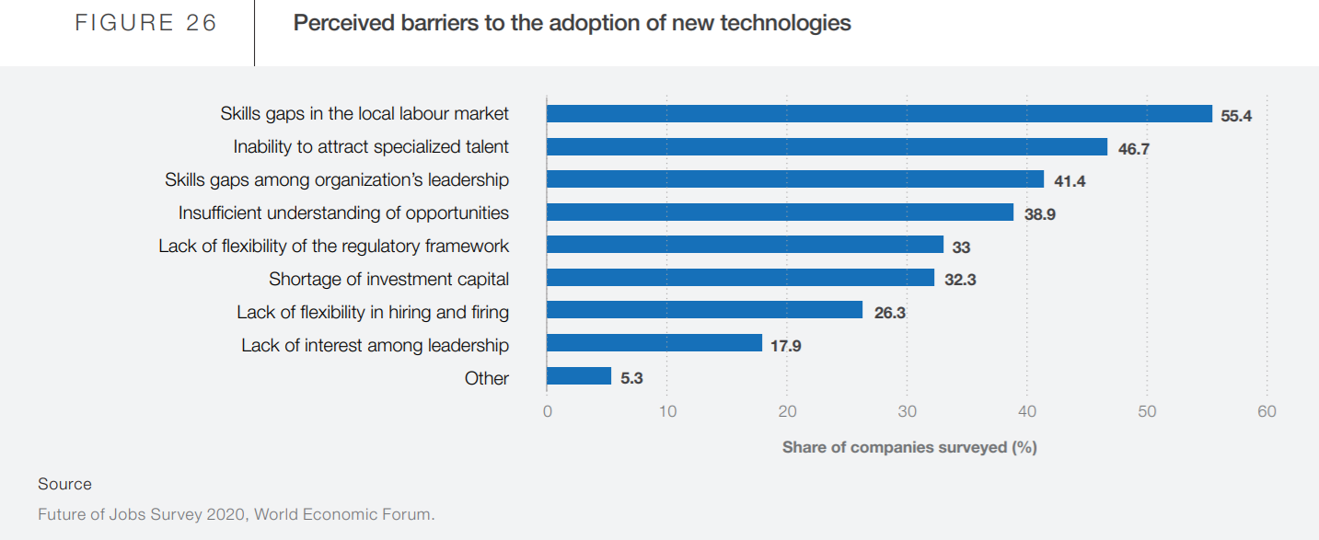

Slide 34
This slide from tomorrow speech.
A need to achieve climate neutrality requires a massive financial commitment and to support emerging green sectors and 'green jobs' in all sectors where skills gaps need to be addressed.
The European Green Deal to create 487,000 new jobs in the EU in the construction sector by 2030. Of these, nearly 70% will go to workers with manual and non-manual skills, who usually have a background of vocational education and training (VET).
The EU Commission supports transforming VET systems to make them sit well with the green transition. An example is Erasmus + funding helps establish Centers of Professional Excellence, where local partners develop "ecosystems of skills", contributing to regional development.
Greenovet, the European platform for VET excellence for green innovation; Eplug, the European platform for urban greening and 3Loe, professional excellence in the green economy.
The Pact for Skills is a forum where all partners can discuss current and future skills needs and set up partnerships; the Pact acts as an intermediary between the supply and demand for talent in Europe.
600+ organisations have helped equip 6 million people with the right skills, and that's just the beginning. The EU goal for 2030 is to reach 60% of adults in the EU who participate in training each year.

Slide 35
China’s overseas graduates ‘mismatched’ with jobs back home
“Research by Beijing-based recruitment platform Lockin has identified a “mismatch” between the career aspirations of Chinese returnees from Australian universities and the qualities sought by employers.”
Wrong times;
Wrong way;
Wrong credentials “education” for most of the most promising jobs.
May 3, 2022. Times Higher Education: Overseas graduates ‘mismatched’ to Chinese jobs | Times Higher Education (THE)

Slide 36

Thank you and let’s discuss!
Notes:
Presenter: Jason Jorgenson

