Slide 1
Global employment and social trends: what response for trade unions?
SEE Economist Meeting
7-8 December 2017
Evelyn Astor
Economic and Social Policy Department
International Trade Union Confederation
Evelyn.Astor@ituc-csi.org

Slide 2
Objectives
Summarise global employment and social trends – discuss relevance of these trends for SEE countries
Outline the international agenda on employment and social policy issues and opportunities for trade unions’ involvement

Slide 3
Worrying global trends
Low wage growth, inadequate wages
Underdeveloped social protection systems: low coverage and adequacy
Decline in unionisation and collective bargaining coverage
Persisting gender inequalities in the labour market
Increased ‘flexibilisation’ of work and fragmentation of working relationships
According to the ILO, ‘non-standard’ jobs represented the largest share of jobs created in 2016
Labour regulations and social protection systems not sufficiently adapted to new forms of work

Slide 4
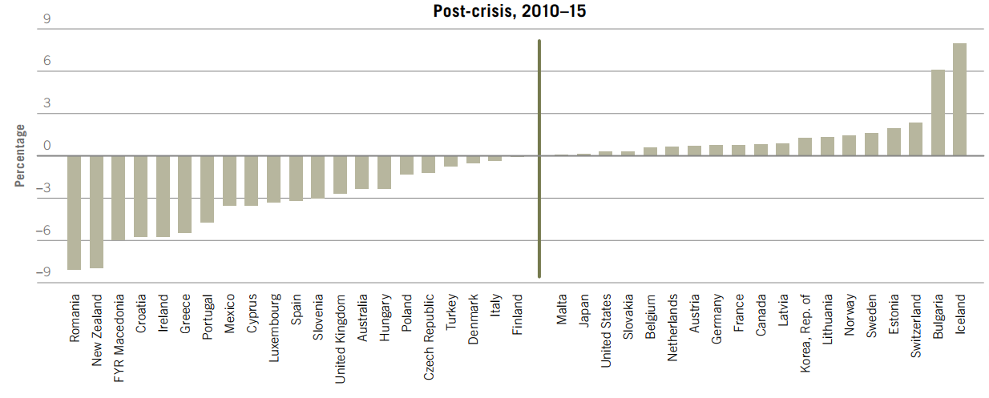
Changes to the adjusted labour income share (% GDP)
Source: ILO 2017 Global Wage Report

Slide 5
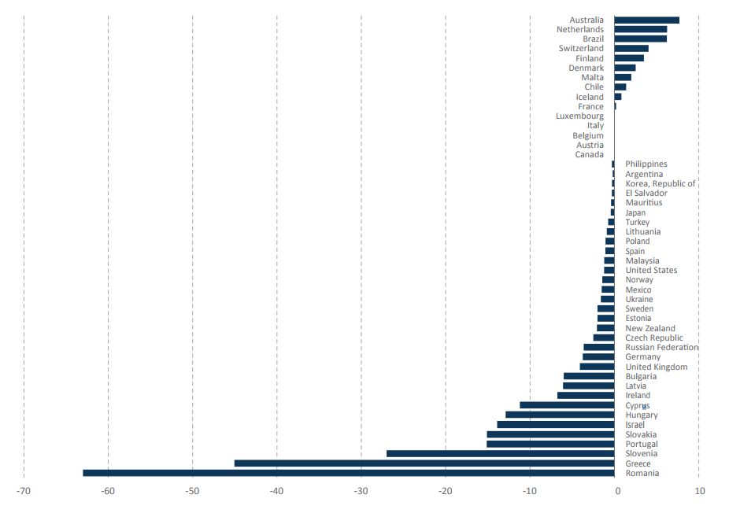
Changes in collective bargaining coverage between 2008 and 2013 (%)
Source: ILO 2015 issue brief on labour relations and collective bargaining

Slide 6
Minimum wages vs. Poverty lines Gross monthly minimum wage levels compared to poverty line (for a single person and family of four)

Slide 7
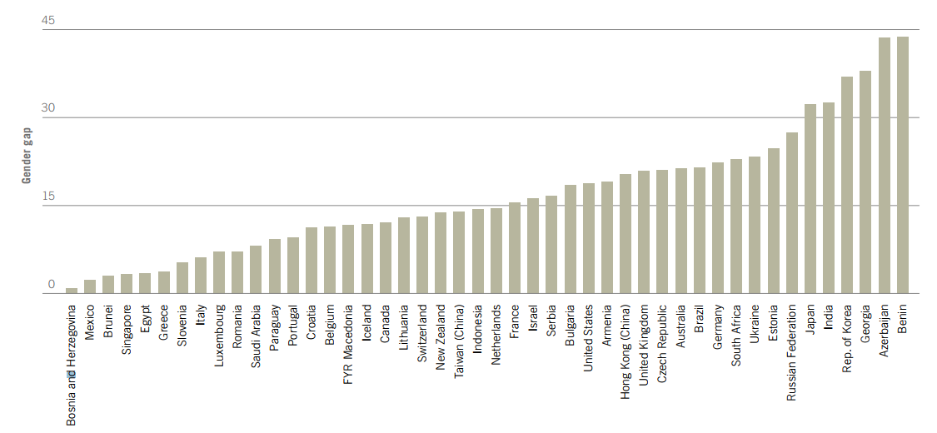
Gender gap in hourly earnings (%)
Source: ILO 2017 Global Wage Report

Slide 8
Low social protection coverage
Effective coverage of unemployment benefits: Percentage of the unemployed who receive unemployment benefits
Source: ILO World Social Protection Report 2014/2015

Slide 9
Inadequacy of social benefits and services
Minimum social assistance benefits as % of median income
Source: OECD tax-benefit model, 2014

Slide 10
Are these global trends relevant for SEE countries?

Slide 11
ITUC response to these issues
Need for minimum living wages – based on the cost of living for workers and their families, developed with social partners
Respect and encouragement of freedom of association and collective bargaining with wide coverage
Strengthened access to skill training and lifelong learning schemes to support workers transition between jobs
Adequate, comprehensive social protection, including social security entitlements that are portable between employers
Measures to address the gender pay gap and other gender inequalities in the labour market, including work-family reconciliation colleagues
Strengthened regulations on multinationals to ensure respect of international labour standards and national obligations, including mandatory due diligence, effective grievance mechanisms and remedy

Slide 12
Defining basic living costs for a minimum living wage
Basic living costs
Food Accommodation and basic furnishing Transport Clothing Medical expenses | Education expenses Household bills Essential care costs Contingency for emergencies Recreation
Source: ITUC regional wage floor forums

Slide 13
Current activities of the ITUC
Support in affiliates’ monitoring and evaluation of employment and social policies
TUDCN tool for monitoring implementation of the SDGs
2016-2017 Studies on Investing in the Care Economy
Facilitating regional and international cooperation between affiliates
Regional living wage campaigns
Development of the Social Protection, Freedom and Justice for Workers’ Network with the ILO
Supporting affiliates’ advocacy work with their national governments
Living wage campaigns
National social protection workshops
Advocacy at international level:
With ILO, UN, G20, IFIs, COP, EU, Global Partnership for Universal Social Protection
Notes:
In partnership with Civil Society: e.g., Oxfam, Global Coalition on Social Protection floors
Promoting decent work as part of development policy (UN, OECD, EU, IFIs)

Slide 14
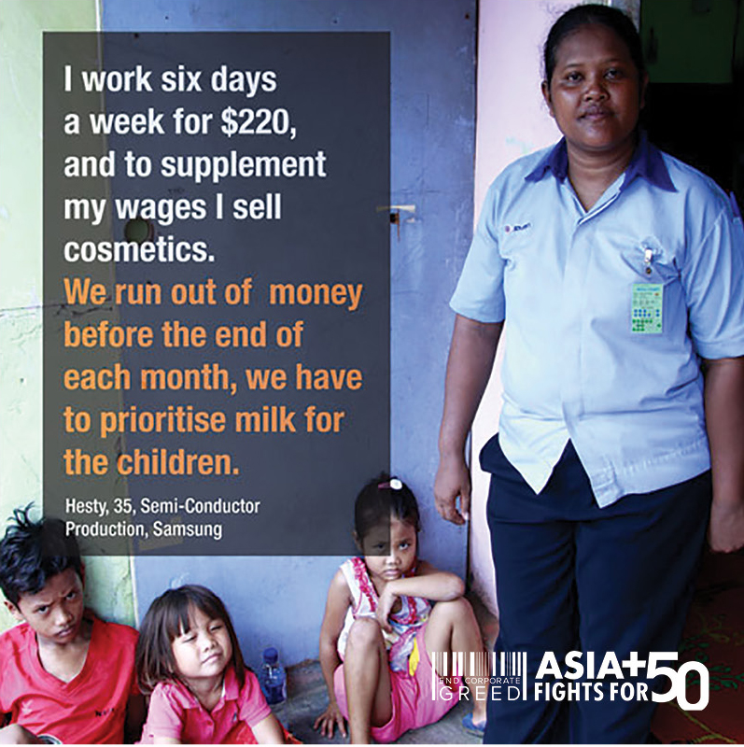

Slide 15
Upcoming opportunities on the international agenda
ILO Centennial Conference on the Future of Work in 2019
2018 Labour 20 in Argentina
ILO General Survey on Social Protection Floors in 2019
2018 COP24 conference in Katowice, Poland
National monitoring of Sustainable Development Goals
Voluntary national reviews: Albania, Romania, Slovakia in 2018
UN High-level political forum for sustainable development
2018: Transformation towards sustainable and resilient societies
2019: Inclusiveness and Equality

Slide 16
Further reading
ILO Future of Work agenda
ITUC (2016) Scandal: Inside the supply chains of the 50 top companies
ITUC (2017) Scandal: Exporting Greed through the Panama Canal
ITUC (2017) Investing in the Care Economy reports
TUDCN (2016) Monitoring tool for the SDGs
ILO (2017) Global Wage Report
ILO (2017) World Social Protection Report
L20 (2017) Statement to the G20 Labour and Employment Ministers’ meeting
TUAC (2017) Trade Union Recommendations on Digitialisation and the Future of Work

