Slide 1
EU Strategic Framework on Health and Safety at Work 2021-2027 Occupational Safety and Health in a changing world of work

Slide 2
Timeline of EU OHS

Slide 3
After 2020 …
Communication = a tool for contact and inform people about EU issues
SF = Comission Policy document
Defines the key priorities and actions for improving workers’ health and safety, addressing rapid changes in the economy, demography and work patterns.

Slide 4
New Strategic Framework
We start from: Conclusion
This strategic framework aims at mobilising EU institutions, MS, social partners, and other relevant stakeholders around common priorities on workers’ H&S protection. It applies to all relevant parties dealing with H&S (national administrations including labour inspectorates, employers, workers, and other relevant OSH actors) and creates a framework for action, cooperation and exchange.
EC will work with MS and social partners to address change in the new world of work; improve the prevention of workplace accidents and illnesses in line with the ‘vision zero’ approach; and increase preparedness for potential future health crises.
EC calls on MS to update and draw up their national OSH strategies in line with this strategic framework – in cooperation with social partners – to ensure that the new measures are applied on the ground. The 2023 OSH summit will allow taking stock of progress on this ambitious framework as well as an assessment of adaptation in light of the rapidly changing context.

Slide 5
New Strategic Framework
Content
1. OHS in the EU
2. An updated vision for OHS – Three key objectives
Anticipating and managing change
Improving prevention of work-related diseases and accidents
Increasing preparedness – responding rapidly to threats
3. Implementing the updated strategic framework
Social dialogue
Evidence base
Aplication and monitoring of the strategic framework
Avareness raising and capacity building
Funding

Slide 6
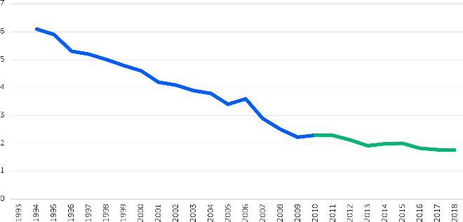
1. OHS in EU
Last three decades: Fatal accidents
Source: Eurostat, data for common economic sectors in EU-15 (1994 - 2009), and for all economic sectors in EU-27 (2010 - 2018).

Slide 7
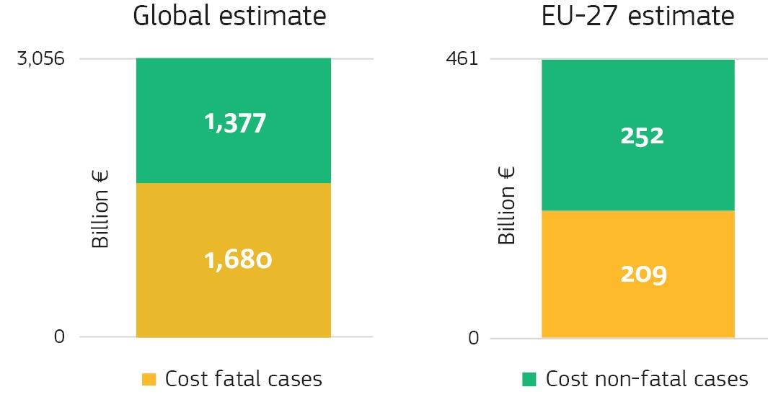
1. OHS in EU
Costs to society of work-related injury and illness, 2019 (billion €)
Source: “An international comparison of the cost of work-related accidents and illnesses” (EU-OSHA, 2017),
estimation based on Eurostat and World Bank data.

Slide 8
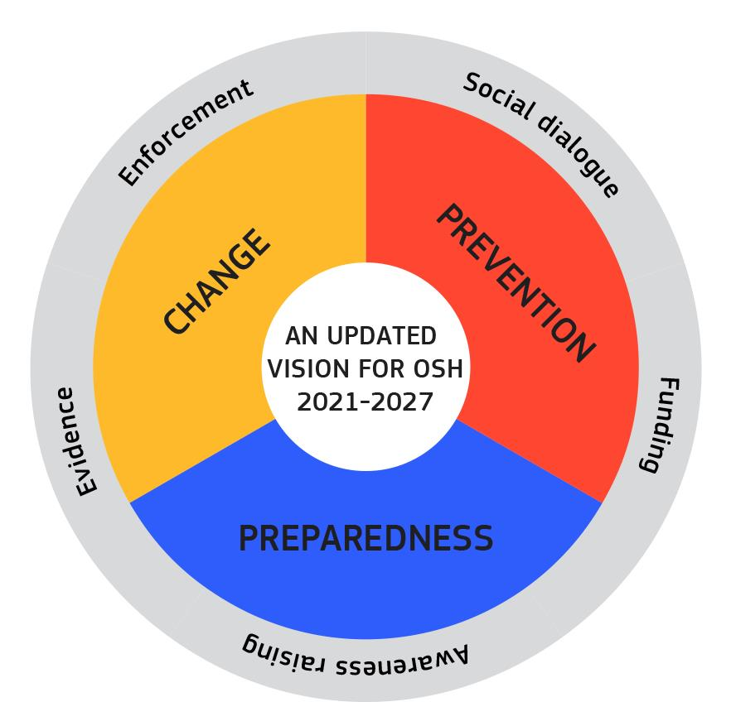
2. Anticipating and managing change
COM:
Legislation
Non-legislative measures
Campaining
Tools, Guidelines
GOV:
National strategies reg. green and digital transitions
Efficient labour inspection
Mental and PSR across sectors
SP:
Update industry agreements – PSRs, MSD
Focus on solutions for TW, digi, disconnect

Slide 9
The Commission will:
Modernise the OSH legislative framework related to digitalisation by reviewing the Workplace Directive and the DSE Directive by 2023;
- Propose protective limit values on:
- asbestos in the Asbestos at Work Directive in 2022;
- lead and diisocyanates in the Chemical Agents Directive in 2022;
- cobalt in the Carcinogens and Mutagens Directive in Q1 2024.
Launch an EU-OSHA HWC 2023-2025 on creating a safe and healthy digital future covering psychosocial and ergonomic risks in particular.
In cooperation with MS and social partners, prepare a non-legislative EU-level initiative related to mental health at work that assesses emerging issues related to workers’ mental health and puts forward guidance for action before end of 2022.
Develop the analytical basis, e-tools and guidance for risk assessments related to green and digital jobs and processes, including in particular psychosocial and ergonomic risks.
Ask the expert panel on effective ways of investing in health, to deliver an opinion on supporting the mental health of healthcare workers and other essential workers by the end of 2021.
Ensure appropriate follow-up to the EP Resolution on the right to disconnect .
The Commission calls on the Member States to:
Update their national legal frameworks, in consultation with social partners, to address OSH risks and opportunities related to the green and digital transitions.-
Member States should focus on the use of digital tools to make labour inspection more efficient by both preventing and detecting breaches of legislation.
Host ‘peer reviews’ addressing occupational psychosocial and ergonomic issues.
Strengthen monitoring and data collection on the situation of mental and psychosocial risks across sectors.
The Commission invites the social partners to:
Take action and update existing agreements at cross-industry and sectoral level to
address new OSH issues related to the digital labour market, particularly
PSR and ergonomic risks, by 2023.
Find commonly agreed solutions to address the challenges raised by telework, digitalisation, and the right to disconnect, building on the ESP FA on digitalisation.

Slide 10
2. 2. Improving prevention of work-related diseases
Causes of work-related fatalities (%) in the EU
Source: “An international comparison of the cost of work-related accidents and illnesses”, EU-OSHA 2017

Slide 11
The Commission will : -extract- Promote a ‘Vision Zero’ approach to work-related deaths by: improving data collection on accidents at work and occupational diseases setting up a dedicated Vision Zero ACSH tripartite working group strengthening enforcement update the EU rules on hazardous substances to combat cancer, reproductive, and respiratory diseases Support awareness raising on MSD, cancer and mental health Provide sector-specific information to SMEs Propose a legislative initiative on preventing and combatting gender-based violence against women and domestic violence before the end of 2021.
2. 2. Improving prevention of work-related diseases (1)

Slide 12
The Commission will: Promote a ‘Vision Zero’ approach to work-related deaths by: improving data collection on accidents at work and occupational diseases, and analysing the root causes for each work-related death or injury; setting up a dedicated Vision Zero ACSH tripartite working group, and developing targeted information actions and tools to increase awareness; strengthening enforcement by supporting the SLIC in increasing awareness on reducing work-related deaths at company level, sharing good practices, and supporting increased training for labour inspectorates. update the EU rules on hazardous substances to combat cancer, reproductive, and respiratory diseases by: launching a social partner consultation on reduced limit values for welding fumes, polycyclic aromatic hydrocarbons, isoprene, and 1,4-dioxane under CMD in 2023; identifying a priority list of reprotoxicants to be addressed through the relevant directives by the end of 2021. Provide updated guidelines, including on training, protocols, surveillance and monitoring, for protecting workers against exposure to hazardous medicinal products by 2022. Produce an OSH overview of the health and care sector, in cooperation with the EU-OSHA by Q1 2024. Support awareness raising on musculoskeletal disorders, cancer and mental health as well as workplace harassment and gender bias. Provide sector-specific information to SMEs in cooperation with the EU-OSHA. Propose a legislative initiative on preventing and combatting gender-based violence against women and domestic violence before the end of 2021.
2. 2. Improving prevention of work-related diseases (1)

Slide 13
The Commission calls on the Member States to: -extract- Work towards fulfilling the ‘vision zero’ approach Address occupational risks related to circulatory diseases. Assess and address risks on groups most affected by pandemic - persons with disabilities. Reintegration, non-discrimination and the adaptation WC of cancer patients/ survivors Promote gender considerations in design, implementation and reporting. Actively address hazards in the healthcare sector Provide guidance/training for the risk-assessment and prevention measures, esp. to MSMEs. Provide training to farmers The Commission invites the social partners to: Develop a guidance for the health care sector focusing, among other things, on workers protection from the exposure to hazardous medicinal products, paving the way for developing the online interactive risk assessment (OiRA) tool specifically for the health care sector in collaboration with the EU-OSHA.
2. 2. Improving prevention of work-related diseases (2)

Slide 14
The Commission calls on the Member States to: Work towards fulfilling the ‘vision zero’ approach to work-related deaths in the EU. Address occupational risks related to circulatory diseases. Promote the European Code against Cancer among workers to improve their health literacy and reduce cancer. Assess and address risks with a particular focus on groups most affected by the pandemic, such as persons with disabilities. Actively support reintegration, non-discrimination and the adaptation of working conditions of workers who are cancer patients or cancer survivors. Promote gender considerations in design, implementation and reporting. Actively address hazards in the healthcare sector by putting in place and implementing safe working procedures and providing appropriate training. Provide improved guidance and training for the risk-assessment and prevention measures, in particular to micro enterprises and SMEs. Provide training to farmers via Farm Advisory Services to increase their skills and awareness on the health and safety rules on farms, including safe use of chemical substances, in particular plant protection products. The Commission invites the social partners to: Develop a guidance for the health care sector focusing, among other things, on workers protection from the exposure to hazardous medicinal products, paving the way for developing the online interactive risk assessment (OiRA) tool specifically for the health care sector in collaboration with the EU-OSHA.
2. 2. Improving prevention of work-related diseases (2)

Slide 15
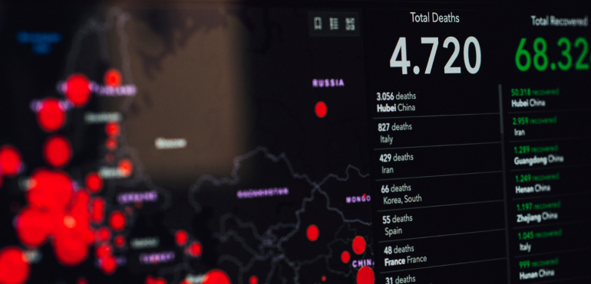
2. 3. Increasing preparedness (1)
Responding rapidly to threats

Slide 16
The Commission will: -extract- in-depth assessment of the effects of the pandemic, efficiency of EU/national OSH frameworks Guidance- rapid deployment, implementation and monitoring in potential future health crises, Update of the Comm Recommendation on occupational diseases to include COVID-19 by 2022. Guidance for LI on assessing quality of risk assess/manag measures under the BAD by 2022. The Commission calls on the Member States to: Draw up preparedness plans for future crises in the national OSH strategies Draw up coordination mechanisms between public health and OSH authorities by 2023. Increase monitoring and effective inspections of OSH obligations towards seasonal workers Strengthen cooperation and exchange of information between LI and other national authorities
2. 3. Increasing preparedness (2)

Slide 17
The Commission will: Immediately launch an in-depth assessment of the effects of the pandemic and the efficiency of the EU and national OSH frameworks to develop emergency procedures and guidance for the rapid deployment, implementation and monitoring of measures in potential future health crises, in close cooperation with public-health actors. Update of the Commission Recommendation on occupational diseases to include COVID-19 by 2022. Develop guidance for labour inspectors on assessing the quality of risk assessments and risk-management measures under the Biological Agents Directive by 2022. The Commission calls on the Member States to: Draw up preparedness plans for future crises in the national OSH strategies, including implementation of EU guidelines and tools. Draw up coordination mechanisms between public health and OSH authorities by 2023. Increase monitoring and effective inspections of OSH obligations towards seasonal workers in high-risk professions. Strengthen cooperation and exchange of information between labour inspectorates and other relevant national authorities to improve health and safety standards in all employment sectors
2. 3. Increasing preparedness (2)

Slide 18
IMPLEMENSTATION
3. (SF) IMPLEMENTING THE UPDATED STRATEGIC FRAMEWORK
This strategic framework will be underpinned by:
Strengthened evidence base;
Strong social dialogue;
Mobilised funding;
Improved enforcement; and
Awareness raising.

Slide 19
ETUC Resolution
ETUC (2019)
Opportunity to give workers the right to a high level of protection of their OHS (EPR)
Promote new and improved national OHS strategies
Social partners involvement
Support implementation in MSMe and self-employed
Enforcement
New work patterns
Prevent W-R diseases, accidents, violence and harassment
Improve statistical data collection and OSH evidence base
Strengthen international cooperation
Mainstreaming OSH
ETUC Resolution on the upcoming EU Occupational Safety and Health strategy in light of Covid-19, Brussels, March 8th 2021
ETUC (2020)
Covid-19 as a biggest health, economic and social challenge in the history of the EU

Slide 20
Most burning issues
Many of the over 1 million victims of Covid-19 in Europe contracted the disease at work
More than 100,000 people still die every year from work-related cancer
No real improvement in numbers of fatal workplace accidents
There is a rocket increase in PSRs related diseases in the EU
The number of OHS field labour inspectors is cut in more than 50% in last 10 years

Slide 21
Trade Union objections to a new Strategic Franework
Too few binding exposure limits of carcinogens (27 from at least 50), moreover too heavy and sometimes not transparen process, the same regarding reprotoxins
Missing legislative initiatives (MSD, PSR, work-related cancer) - MSD most frequently reported problem, organisation of work, stress, cancer
Strange way to Vision Zero – ISSA – DuPont – neglect long-term health problems – top-down approach dominated by employers – employers leadership – games with ambassadors and profiles – coca cola siemens or multinationals producing azbestos
Self-employed / migrant workers are not included in the SF seriously
Climate change and work in dangerous temperatures
New forms of work like platforms / precarious work / agency workers…
Weak risk assessment

Slide 22
Trade Union objections to a new Strategic Franework
Dying labour inspection / weak enforcement
Worsening occupational health / disappearing occupational physicians
Preparedness should be accelerated – lessons from Covid – missing European solution – responsibility to MS – structural and inequality problems (vulnerable groups) could be even worse
Classification of Covid-19 as an occupational diseases
No promotion for workplace democracy
Does EU continue in old manners or are there new opportunities in post-Covid world?
Could the SF pave the way to better OHS to everyone, better working conditions and a real workplace democracy?
Could trade unions increase social mobilisation on labour issues in post-Covid world?
…

Slide 23
Few suggestions for trade unions
To mobilize workers and generally public in process of humanization of work in all employment areas including vulnerable groups of workers
To prioritize OHS in own agenda and demand addressing of main issues through clear action plans and deadlines by EC
To be involved in crucial discussion on implementation of SF in different areas including all monitoring projects
To increase involvement in working on strategies on national and sectoral level
To use opportunities given by the Strategic Framework including funding schemes

Slide 24
4. (SF) PROMOTING EFFECTIVE OSH STANDARDS WORLDWIDE
Candidate countries and potential candidates will be supported in their efforts to align their legal frameworks and policies on OSH with the EU acquis.
For the Western Balkans, this includes support through:
The Economic and Reform Programme process;
Subcommittee meetings;
Chapter 19 negotiations where relevant; and
Financial assistance provided to EU-OSHA activities and in support of the OSH agencies.

Slide 25
Thank you
vkempa@etui.org

