Slide 1
Good practice exchange in OSH — the best of 10 years of EU-OSHA campaign partnership

Slide 2


Viktor Kempa
Technical University in Ostrava
Mining industry 80th of previous century
Trade union of mine workers 90th of previous century
Trade Union Technical Bureau 1st decade of 21st century
European Trade Union Institute 2nd decade of 21 century
Topics: Enlargement, OHSM, migrant workers, regional cooperation, different projects and variable issues (OP, GRI304, scenario building, EUOSHA, etc.)

Slide 3
Good practice exchange in OSH — the best of 10 years of EU-OSHA campaign partnership
Bilbao, Nov. 22, 2017

Slide 4


European Trade Union Confederation
United action for Social Europe
The ETUC aims to ensure that the EU is not just a single market for goods and services, but is also a Social Europe, where improving the wellbeing of workers and their families is an equally important priority.
The ETUC believes that this social dimension, incorporating the principles of democracy, social justice and human rights, should be an example to inspire other countries.
The European social model – until the onset of the crisis – helped Europe to become a prosperous, competitive region with high living standards.

Slide 5





































ETUC
ASI, BSRB
3 observers
CTUBiH
Workers’ organization, European Social Partner
Founded in 1973
Headquarters: Brussels
The ETUC represents 45 mil members in 89 national trade union confederations in 39 countries, + 10 European trade union industrial federations
ETUI
The independent research and training centre of the ETUC
Headquarters: Brussels
Composed of two departments:
A research department with three units:
  Europeanisation of industrial relations;
  Economic, employment & social policies;
  Working Conditions, Health and Safety.
An education department.
AKAVA
SAK
STTK
CTUM ,UFTUM
Montenegro
LO-N
YS
UNIO
SSM, FTUM
FYROM
LO-S SACO TCO
LANV
EAKL TALO
AC, FTF
LO-D
LBAS
ICTU
LDF
LPSK-LTUC
LPSS-LDS
TUC
CNV, FNV MHP
NSZZ Solidarnosc
OPZZ FZZ
DGB
OGB-L
LCGB
CMKOS
ABVV/ FGTB
ACV/ CSC CGSLB
KOZ SR
ÖGB
ASzSz, LIGA, MOSz MSzOSz, SZEF, ESZT
CFDT- UNSA CFTC, CGT CGT-FO
Travail.Swiss
SGB
ZSSS
BNS
CARTEL ALFA
CNSLR-Fratia
CGTP-IN
UGT-P
SSSH
NHS
CDLS, CSdL
CITUB
PODKREPA
CCOO
STV-ELA
UGT-E
USO
USDA
DISK, HAK-IS
KESK, TURK-IS
CGIL
CISL, UIL
ADEDY, GSEE
CMTU, GWU
FOR.U.M.
SEK, DEOK, TURK-SEN

Slide 6
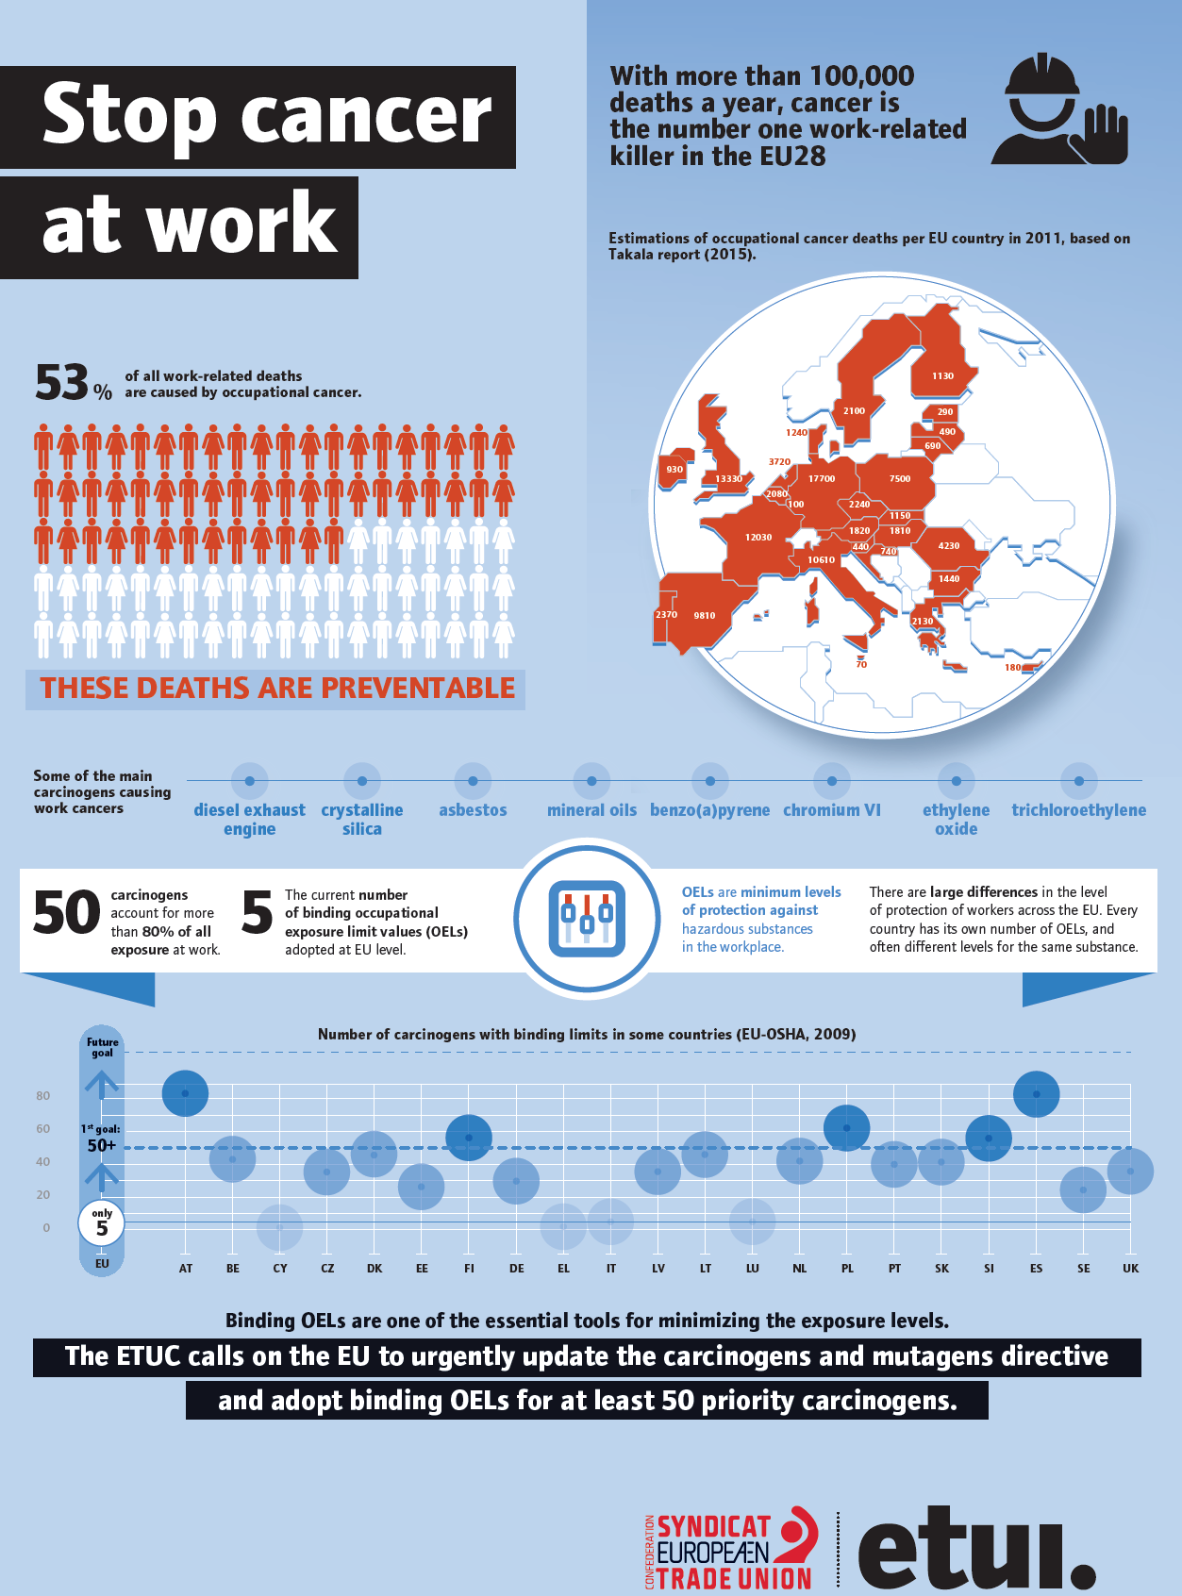
ETUC & EU-OSHA
Campaign Partnership
Good OHS benefits both workers and employers, and prevention of risks is key. Pressure from trade unions is a major factor in driving prevention measures. Unions make workplaces safer and union action at EU level to promote improvement in EU H&S rules is crucial.
Examples of ETUC documents
New EU occ. cancer protection in sight after TU pressure
Unions define arduous jobs
ETUC backs EU on "Healthy Workplaces for all ages"
Work shouldn't hurt
Everyone’s health and safety counts
Union antidote to workplace stress
Healthy, happy workers are more productive, research shows
More carcinogens exposure limits must be adopted

Slide 7
ETUC & EU-OSHA
Campaign Partnership
Luca VISENTINI, ETUC General Secretary
The ETUC expects the campaign to raise awareness on the necessity of involving workers and safety committees to improve prevention throughout ages and workplaces and of the need for actions on the legislative level to improve working conditions and in the OHS educational and training systems in Europe
2016-17 Healthy workplace for all ages
  Western Balkan Countries meeting with Rudnik, Serbija
  ETUI Training course on ageing and prevention with Tarkett Italy
  Annual seminar for the ACHS WIG with Austrian experience
Ten years of campaigns – The best of? Examples?
2014-15 Healthy workplaces manage stress
2012-13 Working together for risk prevention
  Joint leaflets on participation and leadership
2010-11 Safe maintenance
  Swedish firefighters
2008-09 Risk assessment
2007 Lighten the load (MSDs)
Notes:
We use campaign materials

Slide 8
Looking ahead
Better legislation and preventive structures, especially workers Reps
Carcinogens, MSDs and PSRs are the priority topics
Maintaining of workers rights in OHS, response to new circumstances, capacity building and education
New hazards in changing economy, jobs and work organization
Proactive and collective prevention
More transparency and clarity in corporate records regarding hazards, risk and exposure of workers to most dangerous hazards

Slide 9
Thank you for you attention!
etuc.org
etui.org
facebook.com/ETUCCES
twitter.com/etuc_ces
youtube.com/user/etucces

