Slide 1
The PERC Regional Meeting
The PERC Regional Meeting
Trade union approaches and strategic opportunities in OHS:
Challenges in providing a safer and healthier work environment
for workers in the Balkan region countries
4 - 5 October 2018, Montenegro

Slide 2
Meeting objectives
Exchange opinions and considerations about possible trade union strategies and opportunities for future
Strengthen
the trade union capacities on OHS
Build the trade union networking and capabilities to develop an independent OHS systems and databases
Equip the participants with information on recent developments in the EU and tool for PSRs

Slide 3
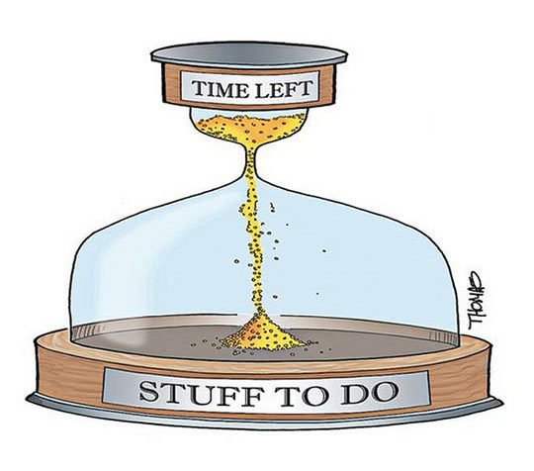
Working Methods
Plenary
Learning about strategies & policies
Round table
Joint planning and scheduling
Work in group
Knowledge and experience exchange, Building regional cooperation
Discussion / exchange
Everytime

Slide 4
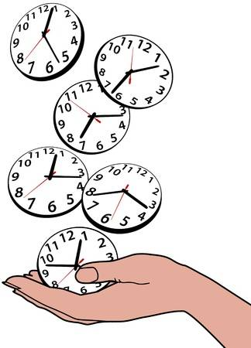
Agenda - Thursday
10.30 - 11.00
Introduction
11.30 - 13.00
Participating countries
14.30-16.00
OHS policy and its impact
16.30-18.00
Work in group & reporting
Notes:
- Introduction of agenda, objectives of the meeting and working methods, presentation of participants
- Presentation of participating countries: current developments & main challenges
- Relationship between a stable OHS policy and protection of the workers in context of a current situation in the Balkan
- Work in group & reporting from the groups

Slide 5
Agenda -
09.00-10.30
Evaluation-work in groups
News from the EU
11.00- 12.30
EU H&S and Croatia
14.30-15.30
PSRs and trade unions
Work in group
15.30-17.30
Round table: PERC OHS network
Evaluation and Conclusions
Notes:
09.00-10.00 Evaluation of work in groups
10.00-10.30 2018-2019 HWC: Dangerous substances, ETUC Campaigns
11.00-12.00 OHS developments in the EU, ETUC and ITUC programs
12.00-13.00 EU projects in Croatia on OSH issues
14.30-15.30 How to identify, evaluate and manage psycho-social risks
15.30-17.30 Round table discussion: PERC OHS network

Slide 6
Portrait of the EU workforce(15-64y in 2015)
221 million people employedin the EU-28
employmentrate is66% (71% men; 60% women)
increased participation of women in the labour market
gender segregation remains very high
ageingof the workforce (31% of employed people >50 y)
rise in part-time employment ( 33% women & 10 % men)
indefinite contract (73%), fixed-term contract (12%), other cont. types or no cont. (8%)
self-employed: 15 % of the EU workforce
one-third of workers in the EU work to tight deadlines and at high speed
one worker in five (22%) works in their free time to meet work demands several times a month.
Source: 6th EWCS, Eurofound, 2017

Slide 7
Accidents at workin the EU-28 (2015)
over 3.2 million non-fatal accidents that resulted in at least four calendar days of absence from work (ex: wounds and superficial injuries; dislocations, etc.)
3 876 fatal accidents at work in the EU-28 during 2015, an increase of 102 deaths compared with the year before (a ratio of ~ 830 non-fatal accidents for every fatal accident)
1.83 fatal accidents per 100000 persons employed in the EU-28
incidence rates vary with countries: <1 in DE, SE and >5 RO)
more than one fifth of all fatal accidents at work in the EU-28 took place within the construction sector
Source: European statistics on accidents at work (ESAW)

Slide 8
Accidents at work in the EU-28 (2015)

Slide 9
11.30 - 13.00 Participating countries
PRIORITIES – SUCCESSESS AND FAILURES – SPECIAL MESSAGES
10 min max + Q&A
Albania
Bosnia Herzegovina
Federation BiH
Republica Srpska
Croatia
F.Y.R.O.M.
Kosovo
Montenegro
Serbia

Slide 10
Albania
Bosnia Herzegovina
Federation BiH
Republica Srpska
Croatia
F.Y.R.O.M.
Kosovo
Montenegro
Serbia

Slide 11
3 trade union priorities for the strategy
What is your vision about the OHS strategy in general
What is our best tool/action/procedure to get success in OHS?

Slide 12
Izlaganja po državama (do 10 minuta)
Jedan predstavnik za svaku državu (eventualno komentari kolega)
Stanje u vezi sa zdravljem i zaštitom na radu u državi (stanovište sindikata)
Glavni problemi u vezi sa izloženošću opasnostima / pitanja koja treba rješavati u najkraćem roku
Zakonska ,,klima” u zemlji, uključujući i strategiju o zdravlju i zaštiti na radu
Pitanje koje biste iznijeli pred ostalim učesnicima (koje nije pomenuto pod tačkom a.)

