Slide 1


The PERC Regional Meeting
Встреча сети профсоюзных экспертов по охране труда стран ННГ «Профсоюзный подход и стратегические возможности охраны труда: вызовы в достижении более безопасной и здоровой среды для трудящихся в странах ННГ»
Минск (Беларусь), 10-11 октября 2018 года

Slide 2

Meeting objectives
Exchange opinions and considerations about possible trade union strategies and opportunities for future
Strengthen
the trade union capacities on OHS and environment
Build the networking and capabilities to develop an independent trade union OHS systems and databases
Equip the participants with information on recent developments in the EU

Slide 3
New mandate of the ETUC
Democracy from different angels
New economic growth model – to address all people – fair globalization
Redistribution – wages – bargaining system
Managing change in modern society – digitalization
European social model – European charter of social rights
Migration

Slide 4
Portrait of the EU workforce(15-64y in 2015)
221 million people employedin the EU-28
employmentrate is66% (71% men; 60% women)
increased participation of women in the labour market
gender segregation remains very high
ageingof the workforce (31% of employed people >50 y)
rise in part-time employment ( 33% women & 10 % men)
indefinite contract (73%), fixed-term contract (12%), other cont. types or no cont. (8%)
self-employed: 15 % of the EU workforce
one-third of workers in the EU work to tight deadlines and at high speed
one worker in five (22%) works in their free time to meet work demands several times a month.
Source: 6th EWCS, Eurofound, 2017

Slide 5
Accidents at workin the EU-28 (2015)
over 3.2 million non-fatal accidents that resulted in at least four calendar days of absence from work (ex: wounds and superficial injuries; dislocations, etc.)
3 876 fatal accidents at work in the EU-28 during 2015, an increase of 102 deaths compared with the year before (a ratio of ~ 830 non-fatal accidents for every fatal accident)
1.83 fatal accidents per 100000 persons employed in the EU-28
incidence rates vary with countries: <1 in DE, SE and >5 RO)
more than one fifth of all fatal accidents at work in the EU-28 took place within the construction sector
Source: European statistics on accidents at work (ESAW)

Slide 6
Accidents at work in the EU-28 (2015)

Slide 7

EU and MEMBER STATES

Slide 8
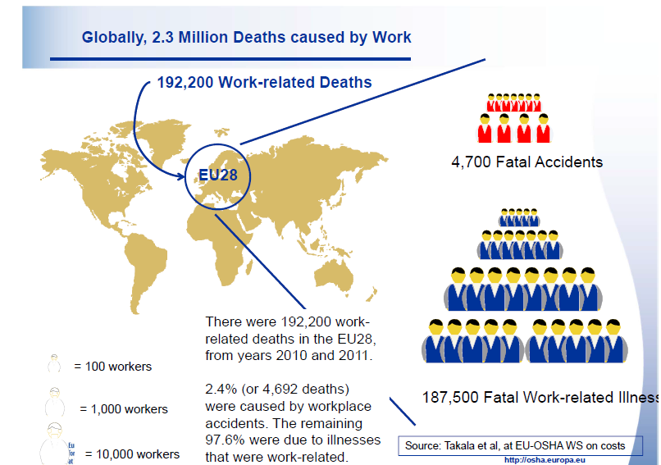
OSH or OHS? MOST IMPORTANT IS ALARMING DATA !

Slide 9
Deaths associated with work-related diseases and accidents in the EU
vkempa@etui_2018
Source: OSHWiki

Slide 10
OHS in the EU: The EU OHS machinery
Policies & strategies
Legislation: regulations and directives
Standards
Principles, recommendations
Institutions & agencies (tripartite)
Social dialogue (EFAs, SDCs)
Guidelines, practical instructions (non-leg)
Fundings, projects National OHS policy, Transposition & Implementation
EU Social Policy:
More and better quality jobs. A safe and healthy working
environment is an essential element of the quality of
work.
EU Action in OHS:
Has its legal bases in Article 137 of the EU Treaty.

Slide 11
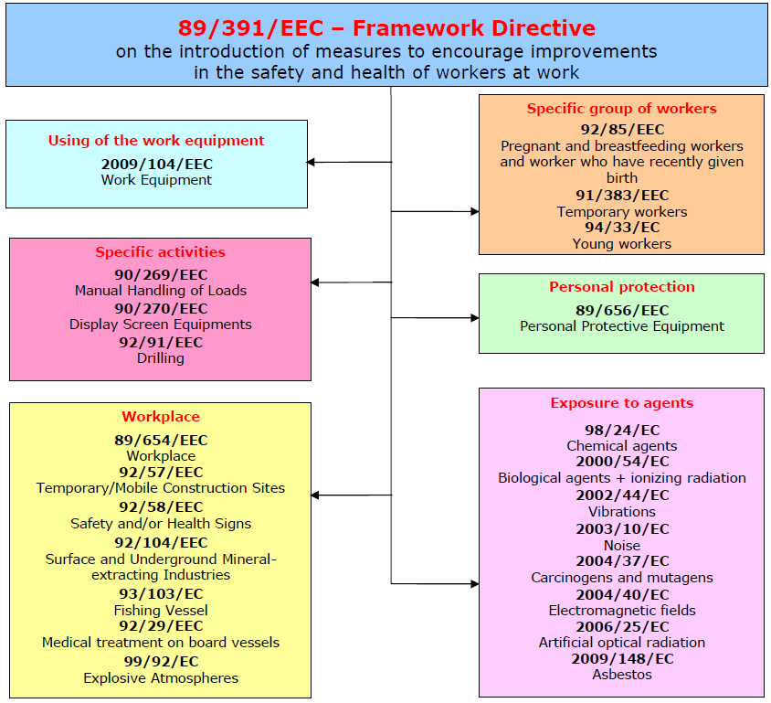

All sectors of activity, both public and private, except for specific public service activities, such as the armed forces, the police or certain civil protection services.

Slide 12
European Social Partners’ framework agreements
23/03/2017: EU Social Partners’ Autonomous FA on Active Ageing
25/03/2010: Framework agreement on inclusive labour markets
18/06/2009: Framework Agreement on Parental Leave (Revised)
01/04/2007: Joint Framework Agreement on Harassment and Violence at Work
01/10/2004: Framework agreement on work-related stress
16/07/2002: Framework Agreement on Telework

Slide 14
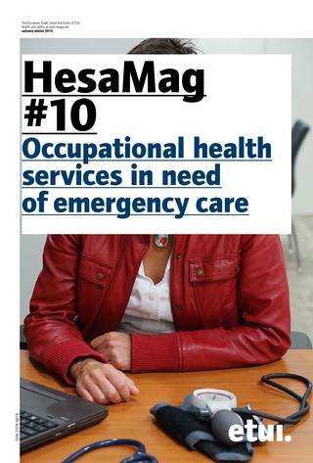

HESA - The ETUI Research unit
‘Working Conditions, Health & Safety’
organisation, competences,
publications
SCOPE OF ACTIVITIES
EU policies / strategies / legislation
National prevention systems
Workers representation in H&S
Work organisation / precarious work
Psychosocial risks - stress, violence, harassment
Musculoskeletal disorders
Chemicals, carcinogens, asbestos
Nanomaterials / technologies
Work equipment safety / CEN
Coordination / EU tripartite bodies
EU enlargement
Information: Publications - HESA Mail - HESA Newsletter
Knowledge transfer / workshops
Expert input / ETUC
Website
networking
etui.org
14
Notes:
14

Slide 15
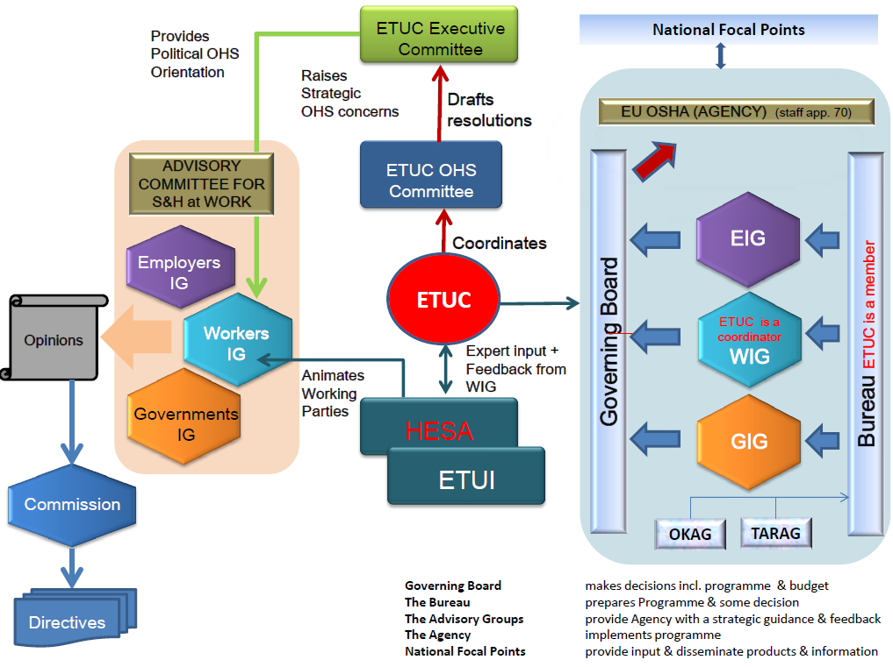
OHS in the EU: Workers voice in EU OHS machinery
I
N
F
O
R
M
A
T
I
O
N
ECHA
Eurofound
SLIC
SCOEL
EU social dialogue committees
etc
POLICY
ACSH
EUOSHA

Slide 16

https://ec.europa.eu/commission/priorities/deeper-and-fairer-economic-and-monetary-union/european-pillar-social-rights_en

Slide 17
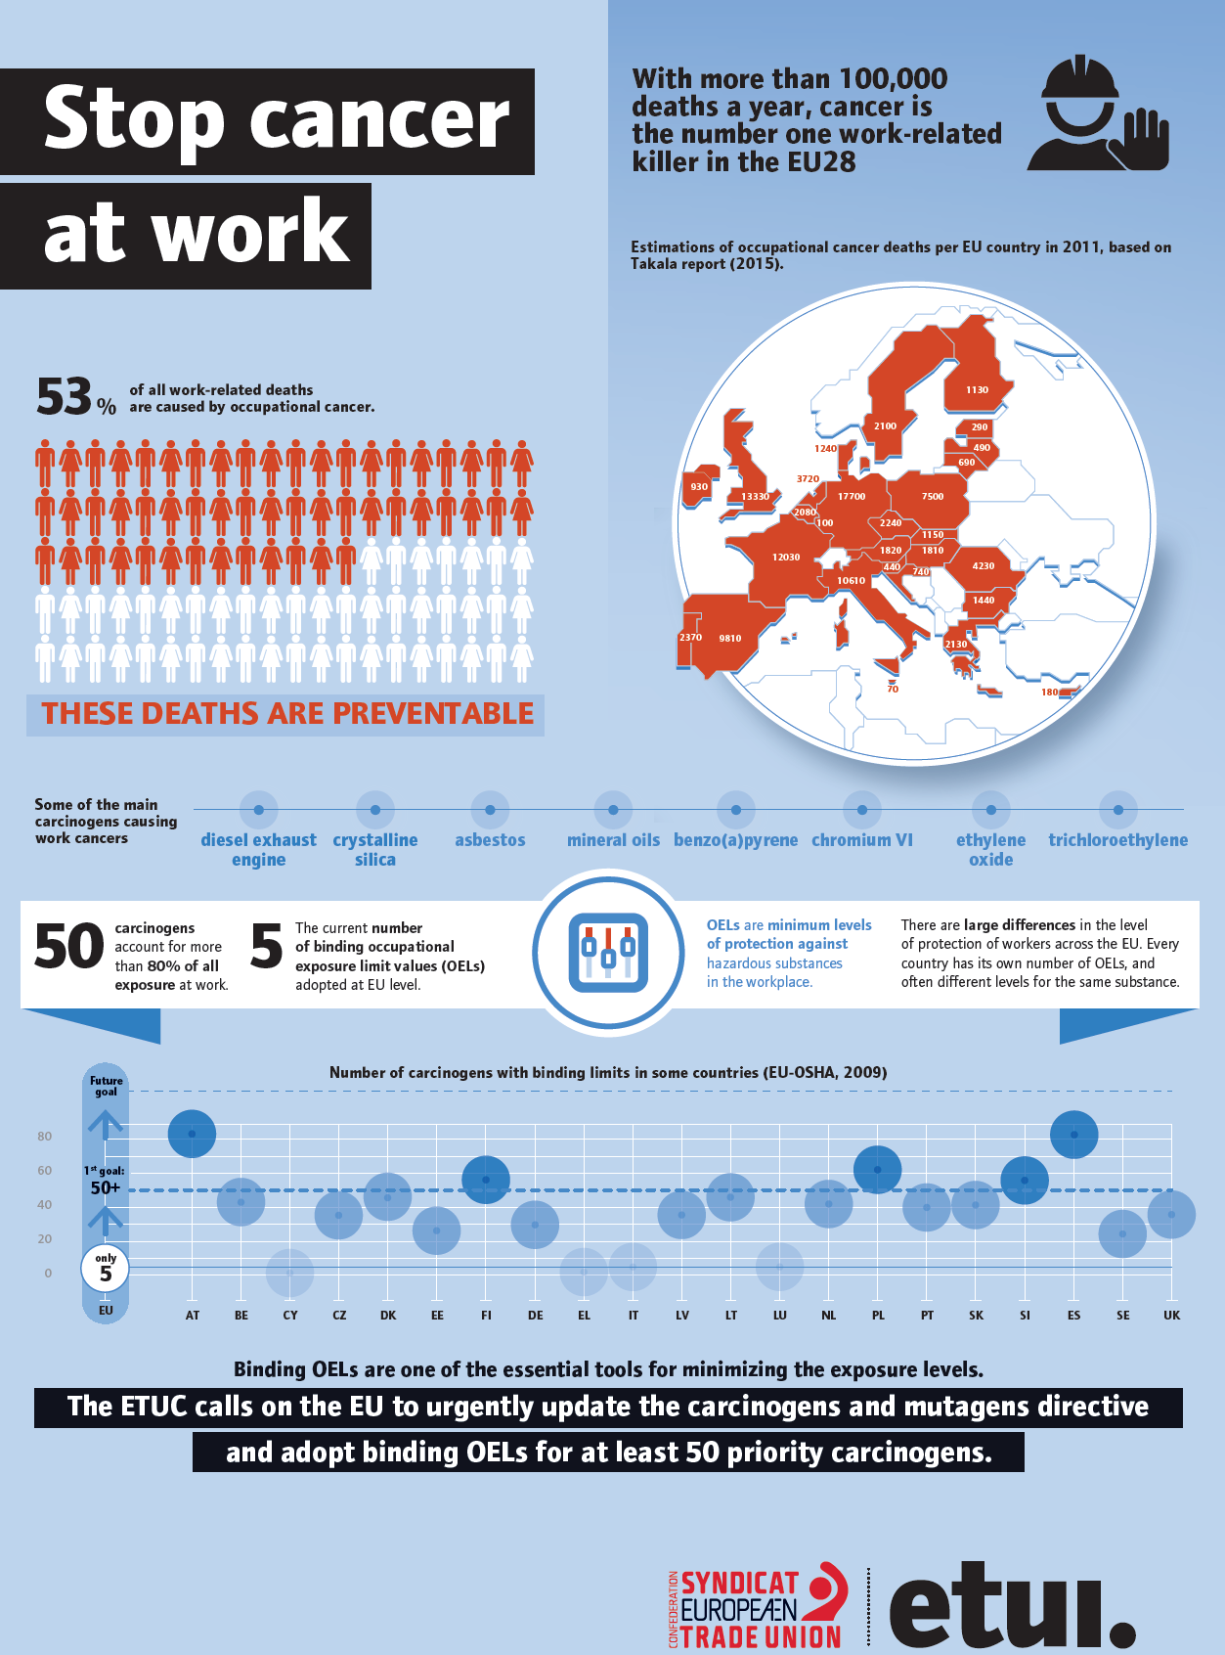


ETUI PRIORITIES AND CAMPAIGNING
Good OHS benefits both workers and employers, and prevention of risks is key. Pressure from trade unions is a major factor in driving prevention measures. Unions make workplaces safer and union action at EU level to promote improvement in EU H&S rules is crucial.
Examples of ETUC ressolutions
New EU occ. cancer protection in sight after TU pressure
Unions define arduous jobs
ETUC backs EU on "Healthy Workplaces for all ages"
Work shouldn't hurt
Everyone’s health and safety counts
Union antidote to workplace stress
Healthy, happy workers are more productive, research shows
More carcinogens exposure limits must be adopted

Slide 18


Looking ahead
FRAMEWORK
Better legislation incl. proactive preventive structures
Maintaining of workers rights in OHS, response to changing world of work, capacity building, education and training
More transparency and clarity in corporate records regarding hazards, risk and workers’ exposure to most
PRIORITY TOPICS
CMD directive (OELs)
Musculo-skeletal disorders (neck, back and elbow pain)
Psycho-social risks, incl. stress, violence and harassment
Notes:
BL – PS, OELs,

Slide 19
Notes:
We use campaign materials

Slide 20
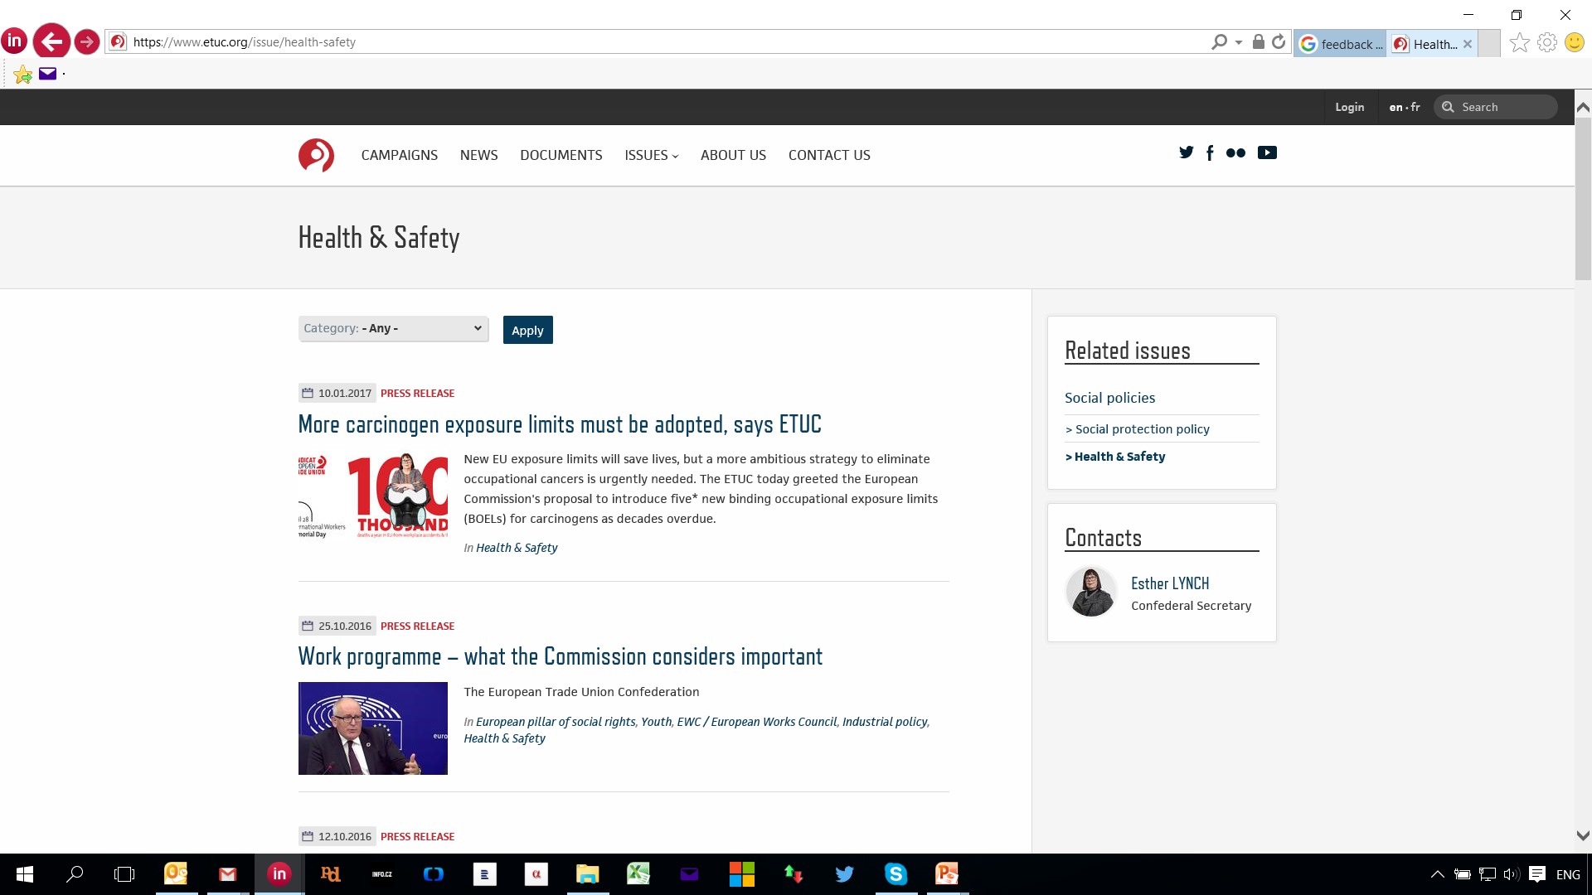
ETUC priorities
https://www.etuc.org/issue/health-safety

Slide 21
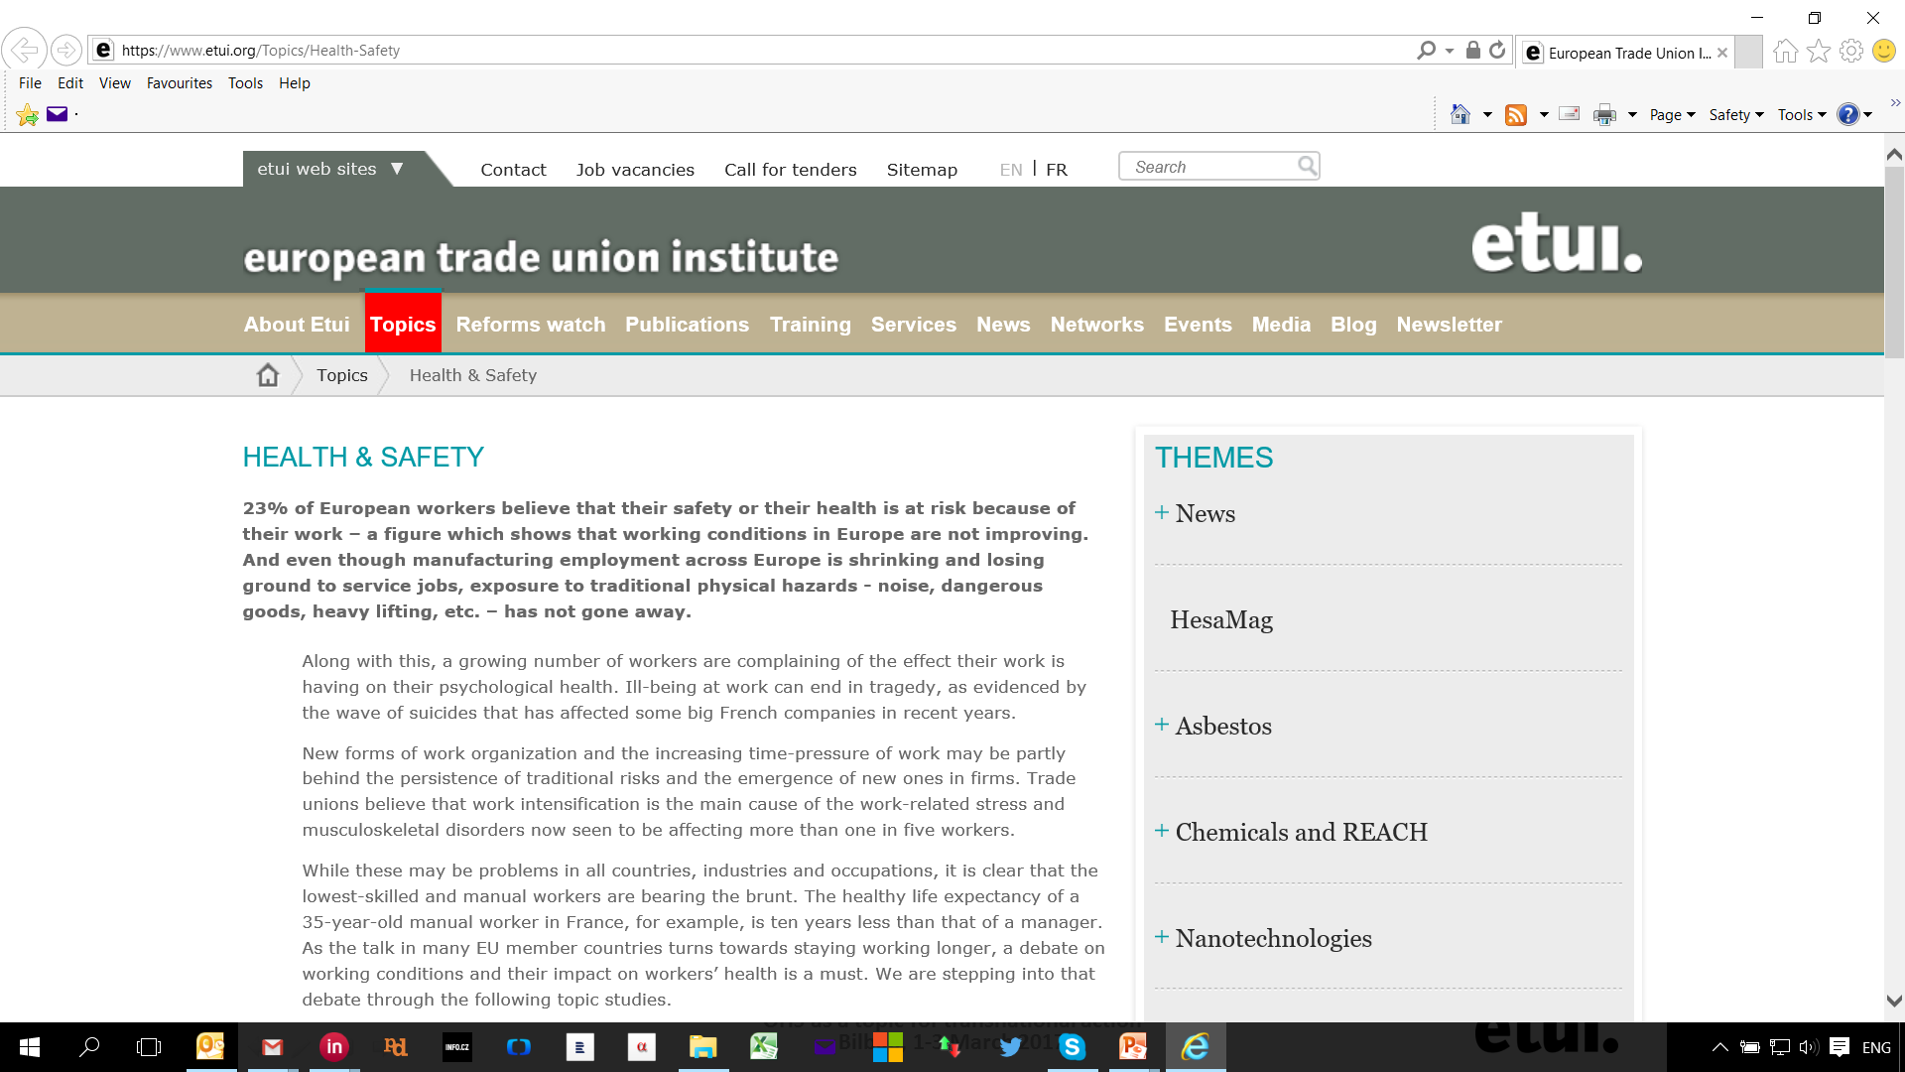
HESA topics
https://www.etui.org/Topics/Health-Safety

Slide 22
EU Occupational Safety and Health Strategic Framework 2014-2020
1. Legislation
2. EU Funds
3. Social dialogue
4. Communication and information
5. Mainstreaming OHS toother politics
6. Implementation of this framework
6 EU Instruments
7 key
strategic objectives
3 key
challenges
1. To improve
implementation of
existing H&S rules, in particular by
enhancing the capacity of MSEs to put in place
effective and efficient risk prevention strategies
2. To improve the
prevention of work
related diseases by
tackling new and
emerging risks without
neglecting existing
risks
3. To take account of the ageing of the EU's workforce.
1. Further consolidate
national strategies
2. Facilitate compliance with OSH legislation,
particularly by MSEs
3. Enforcement of OSH legislation by MS
4. Simplifying existing
legislation
5. Address the ageing of workforce, emerging new risks, prevention of W-R and o. diseases
6. Improve statistical data collection, develop the information base
7. Better coordinate EU and int. efforts to address OSH and engage with int. org.
http://ec.europa.eu/social/main.jsp?catId=151
Notes:
,

Slide 23
MAIN PRIORITIES IN OHS
European Trade Union Confederation
Carcinogenes / OELs
Musculo-skeletad disorders (MSDs)
Psychosocial risks, namely stress at work, harrrassment, bullying, bossing
European Trade Union Institute
Carcinogenes / OELs
MSDs
Psychosocial risks
Prevention pillars
Workers’ Safety Reps
European Commision
Implementation of directives/ MSEs
Occ. diseases incl. new and emerging risks and traditional hazards
Ageing from OHS perspective

Slide 24
Current actions
Transpozition status of OSH directives – Standard legislative procedure
Amendment of 204/37/EC (CMD)
New initiatives by the Commission
CMD
OSH/REACH interface
Revision of a regulation on tripartite agencies
OTHERS
Lists of IOELv
Update od EU OSH directives (W, VDU, OHS SIGNS, BIO, MEBW, PPE)

Slide 25
Current actions
SMART LEGISLATIVE PROGRAMME
REFIT – continuation ofi post evaluation of OSH-acquis
Other legislation – Enforcement directive on posting of W, EU platform to fight against undeclared work
OTHERS
Occupational diseases
Nanomaterials/technologies
Mental health in the workplace in EU
Study on exposure to reprotoxic chemicals
OSH RELATED SOCIAL DIALOGUE INITIATIVES
Fishing
Hairdressers
OSH Statistics

Slide 26
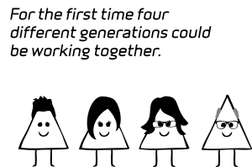
First time in history
four generations will be working together at the workplace!
Communication skills!

Slide 27
