Slide 1
ILO / ITUC-PERC
International Seminar of Trade Union Economists on Wage Setting and Objectives in Eastern Europe and Central Asia
Yerevan, Armenia – 15-16 October 2018
Wages from an international and regional perspective: Main trends and policy implications
Bruno S. Sergi
ETUI and University of Messina

Slide 2
Outline
World data on average net wages, average income, income disparities, and ageing societies
The case of Armenia: wages and growth
An overview: the Eurozone and the mainstream economics.
From the past ... a large stock of human capital
Brain drain and inequalities in transition

Slide 3
Let’s kick off our meeting in Yerevan with the average monthly net salary
https://www.numbeo.com/cost-of-living/country_price_rankings?itemId=105

Slide 4
Average income
https://www.worlddata.info/average-income.php

Slide 5
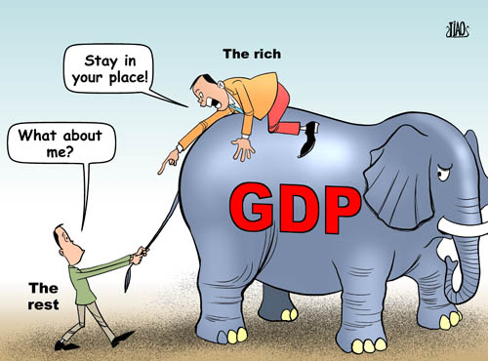
Widening income disparities ranked as one of the greatest worldwide risks during our time!
The World Economic Forum’s “Outlook on the Global Agenda 2014” ….. “impacting social stability within countries and threatening security on a global scale.”
“The fight against poverty will not be won until the inequality crisis is tackled.” Oxfam.

Slide 6
A global wealth pyramid that is concentrated in the hands of a small wealthy elite
  Today 8 men own same wealth of half the world;
  In 2013 … the wealth of the 1% richest people in the world was 65 times the total wealth of the bottom half of the world’s population.
  The number of billionaires has doubled since the great financial crisis of 2008 (# 1542 billionaires today).
  7 out of 10 people live in countries where economic inequality has increased in the last 30 years;
  In the US, the wealthiest 1% captured 95% of post-financial crisis growth since 2009, while the bottom 90% became poorer!
.

Slide 7
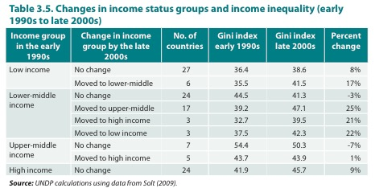
Inequality Between Nations

Slide 8
Gini coefficient levels from the past to present in Emerging Markets

Slide 9
Income Inequality in Emerging Countries,
¹⁹¹⁰⁻²⁰¹⁰
Inequality trends have been more mixed in emerging markets and developing countries, with some countries experiencing declining inequality, but the pervasive inequality in access to education, health care, and finance still remain in all developing countries
Source: Thomas Piketty “Capital in the 21st century”, 2013

Slide 10
Interactive Map on Inequality by United Nations
  https://www.wider.unu.edu/project/wiid-world-income-inequality-database

Slide 13
Inequality in Eastern Europe and CIS Transitional Economies
In Eastern Europe, changes in the distribution of income and wealth associated with
  The restoration of market economy, privatization of state assets
  Globalization
The political implications are country specific, as the countries are diverse in terms of size, level of development, historical background, and social and political structure.
After drastic increase in income equality during the market liberalization period, some Central European nations have improved or maintained the same level of Gini since 2000 due to economic growth, effective fiscal redistribution for social service.

Slide 14
 | Latest Gini 2012
Bulgaria | 36.01
Poland | 32.39
Romania | 27.33
Czech | 26.13
Hungary | 30.55
Slovakia | 26.58
Slovenia | 25.59
Estonia | 33.15
Latvia | 35.48
Lithuania | 35.15
Belarus | 26.01
Moldova | 29.16
Russia | 41.59
Ukraine | 24.74
Kazakhstan | 27.43
Kyrgyz | 27.35
Turkmenistan | 40.77 (1998)

Slide 15
Inequality in Russia
Top 10% of the population control 85% of wealth.
83% of the population has less than $10,000 in personal wealth.
Income gains in recent years have benefited Russia’s wealthy energy hubs, while bypassing the nation’s poorest areas.
In regions where at least half of economic output comes from the oil, gas and minerals industries, incomes are one-third higher, on average, than in the rest of Russia. Centers of oil and gas production are home to the greatest income inequality.
http://www.pbs.org/wgbh/frontline/article/inequality-and-the-putin-economy-inside-the-numbers/, 2015

Slide 16
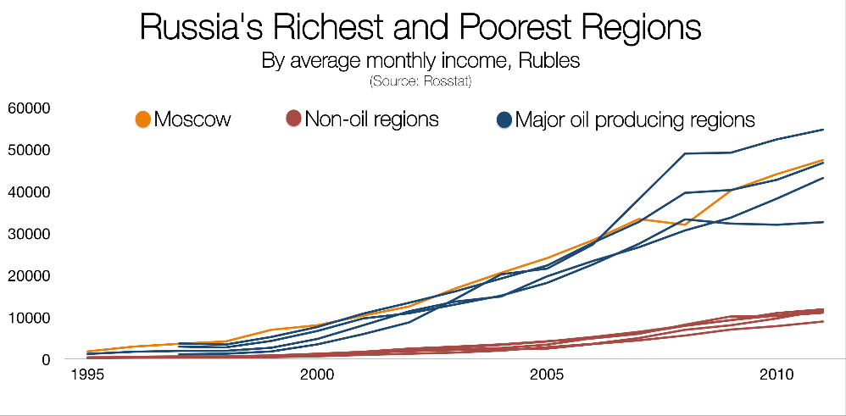
Income gains in recent years have primarily benefited Russia’s wealthy energy hubs, while bypassing the nation’s poorest areas. The research showed that in regions where at least half of economic output comes from the oil, gas and minerals industries, incomes are one-third higher, on average, than in the rest of Russia. Four of the five highest-income regions in the analysis were centers of oil and gas production, and all were home to the greatest income inequality.
http://www.pbs.org/wgbh/frontline/article/inequality-and-the-putin-economy-inside-the-numbers/, 2015

Slide 17
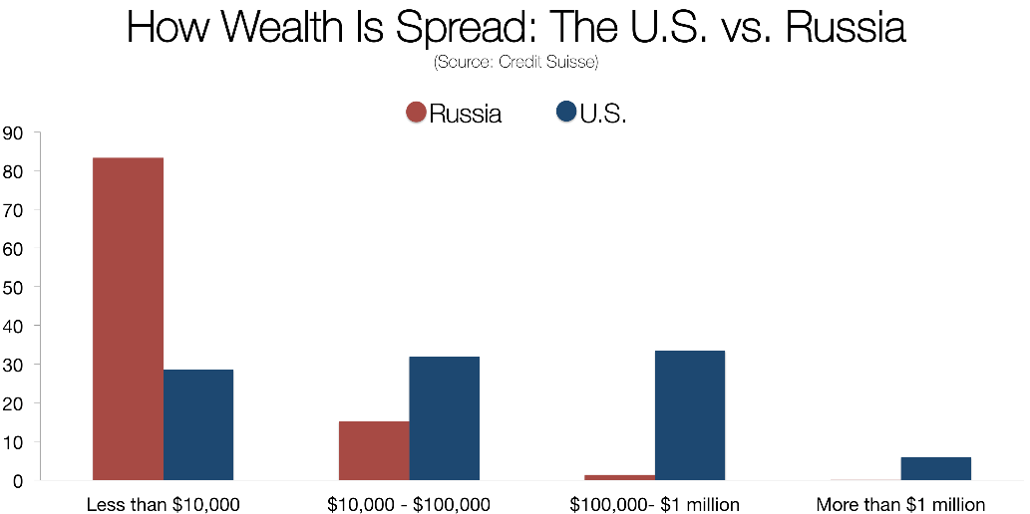
The average middle-class Russian earns between $4,000 and $10,000 per year, according to a 2012 Forbes analysis of data from Rosstat.
http://www.pbs.org/wgbh/frontline/article/inequality-and-the-putin-economy-inside-the-numbers/, 2015

Slide 18
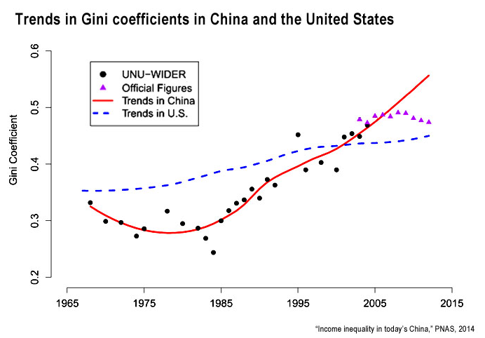
Income inequality in China

Slide 19
From China’s Experience: Income distribution favored capital and high skill labor

Slide 20
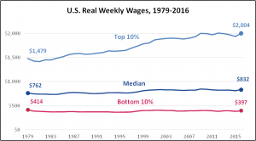
Wages in the United States, after taking inflation into account, have been stagnating for more than three decades. Typical American workers and the nation’s lowest-wage workers have seen little or no growth in their real weekly wages.

Slide 21
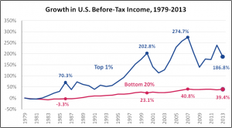
Since 1979, the before-tax incomes of the top 1% of America’s households have increased more than four times faster than bottom 20% incomes.

Slide 22
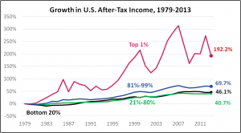
After taxes, top 1% incomes are increasing even faster than before taxes!
Before-tax income growth for the top 1% has averaged 186.8% since 1979. The after-tax increase: 192.2%. A progressive tax system should function to narrow income gaps between the affluent and everyone else. Over recent decades, America’s tax system has done no narrowing.

Slide 23
An overview: the Eurozone and the mainstream economics.

Slide 24
First of all ……………..
  Many eastern Europe nations inherited a relative large human capital stock from the socialist period, due to relative large investment and development in all stages of education.
  During the transformation, the quality of state financed education deteriorated quickly and a large number of research institutions ceased to exist.
  The increase in inequality resulted from increase of unemployment due to underinvestment in human capital

Slide 25
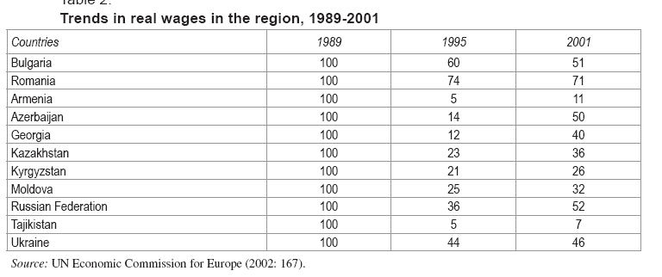
The drop of real wage during the transition to Market Economy

Slide 26
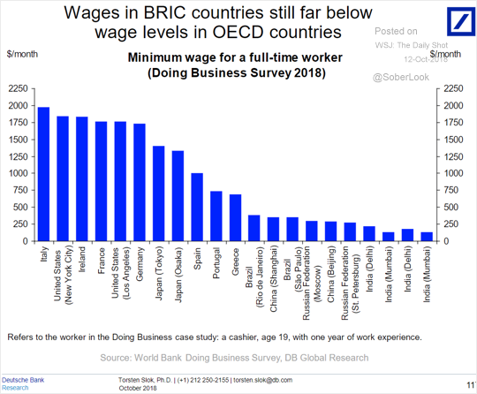
The minimum wage by country.

Slide 27
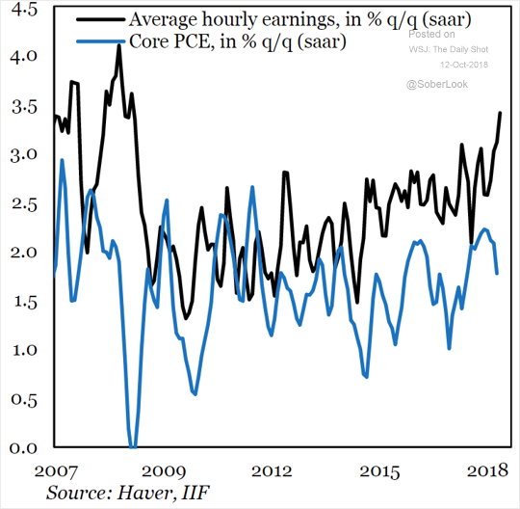
As wage growth improves, so should the core PCE inflation (the Fed’s preferred measure).

Slide 28
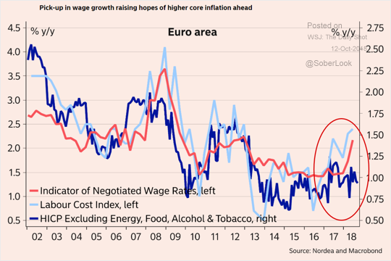
Will faster wage growth boost inflation across the Eurozone?

Slide 29
From the past ... a large stock of human capital
Many eastern Europe nations inherited a relatively large stock of human capital from the socialist period arising from the relative significant investment in and development of all stages of education.
The increase in inequality has resulted from an increase in unemployment due to recent under-investment in human capital.

Slide 30
CESEE’s Brain Drain
Bulgaria lost 21% of the population, Hungary 10%, Lithuania 24%, Latvia one third and Estonia over one sixth.
An area of just over one hundred million inhabitants has “lost” over 20 million people: The IMF estimates that until 2012 almost half of these migrants (mostly young and often graduates) went to Germany and about a tenth to Italy.
Since 1989 from Czechia, Slovakia, Hungary, Poland and Slovenia have emigrated 7 million workers.
More than 15% of the population emigrated from Bulgaria, Romania and Croatia.
Nations that are currently debating in a crisis that is no longer just demographic. It is fiscal because it becomes impossible to finance pensions when a third of the working age labor force went lost.

Slide 31
Inequality in Transition
Inequality in the transition economies of eastern Europe and the CIS comes from the past. In eastern Europe, changes in the distribution of income and wealth are associated with the restoration of market economies and the privatisation of state assets.
After the drastic increase in income equality during the market liberalisation period, some eastern European nations have improved or maintained the same level of Gini coefficient since 2000 due to economic growth and effective fiscal redistribution as regards social services.

Slide 32
The Balkan countries that didn’t experience Ottoman rule were the first to join the European Union (Slovenia in 2004; Bulgaria and Romania in 2007; and Croatia since July 2013 and has committed to adopt the euro once it fulfils the necessary conditions).
Albania, Macedonia, Montenegro and Serbia have recently gained candidate country status. Bosnia and Herzegovina and Kosovo still have a long way to go before starting the integration process.

Slide 33
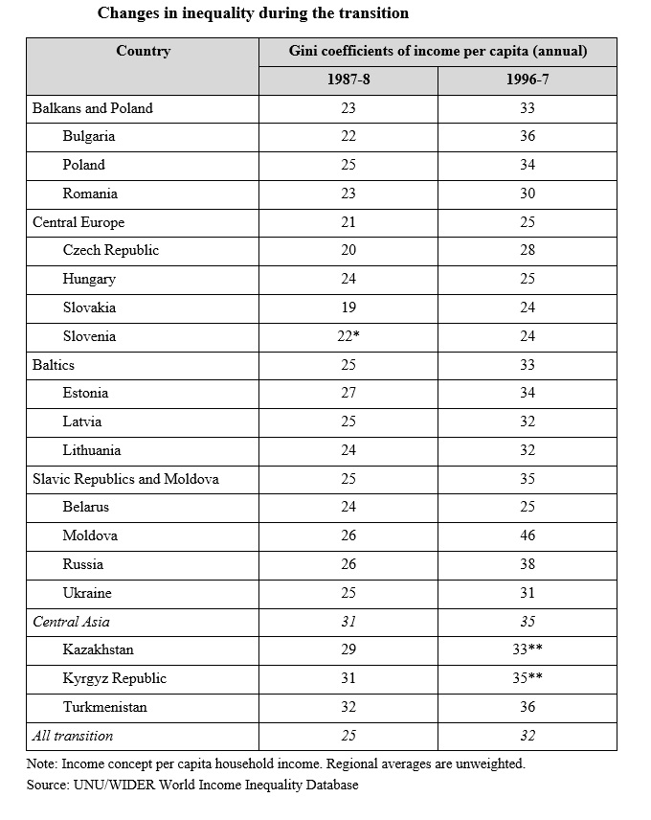

Slide 34
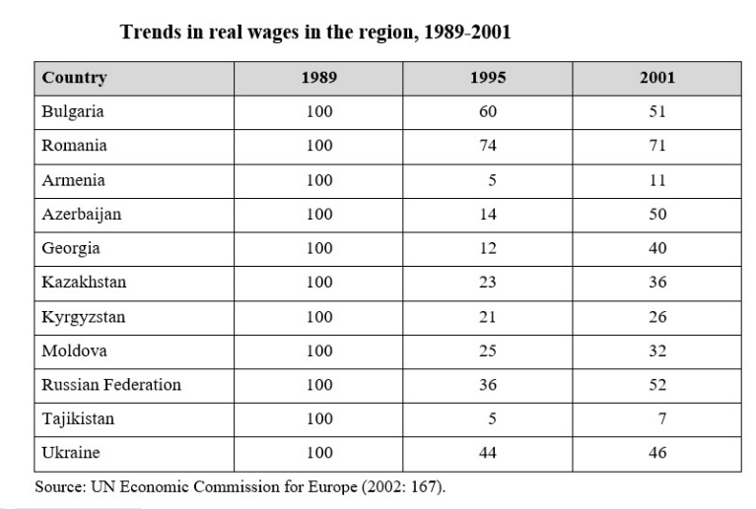

Slide 35
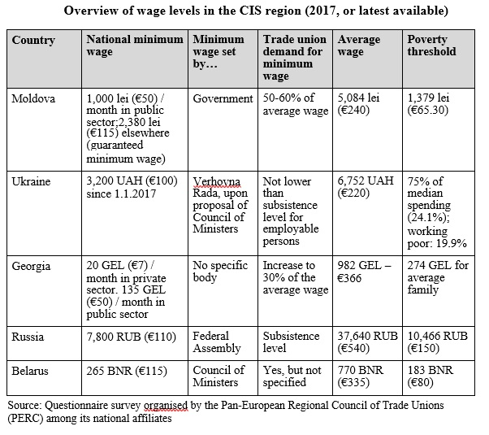
Wage levels in the CIS region, 2017

Slide 36
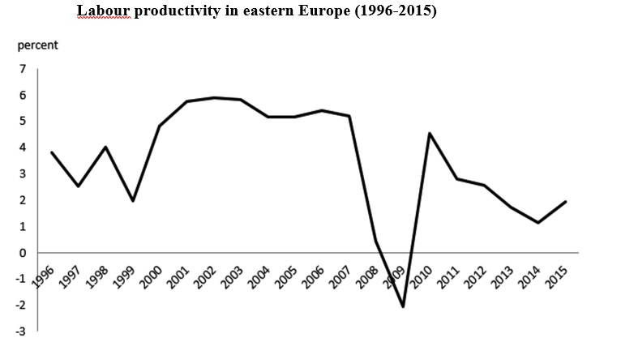
Labour productivity

Slide 37
Unemployment, ageing population, and poverty
Unemployment is reaching pre-crisis lows, wages have been growing at a strong pace for an extended period and current account balances have begun again to deteriorate. However, financial sustainability and economic competitiveness have gained priority over the social dimension.
With the ageing of the European population, the increasing dependency ratio and the limited interventions for recovery, social protection systems are under pressure while budget cuts reduce their coverage, adequacy and quality.
The population living below the poverty threshold and at risk of poverty or social exclusion is on the increase among several key groups: women; children and young people; elderly and retired people; people living in single parent households; people with low levels of education; and migrants.

Slide 38
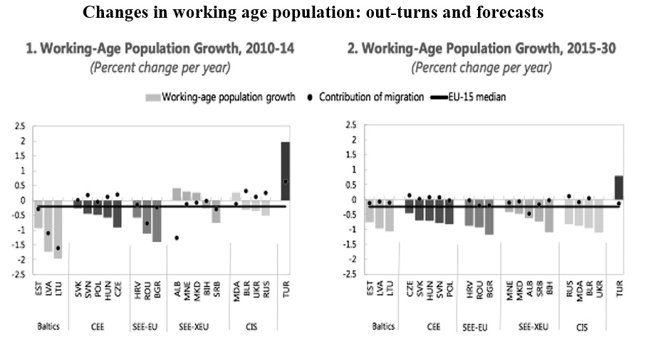
Working age population

Slide 39
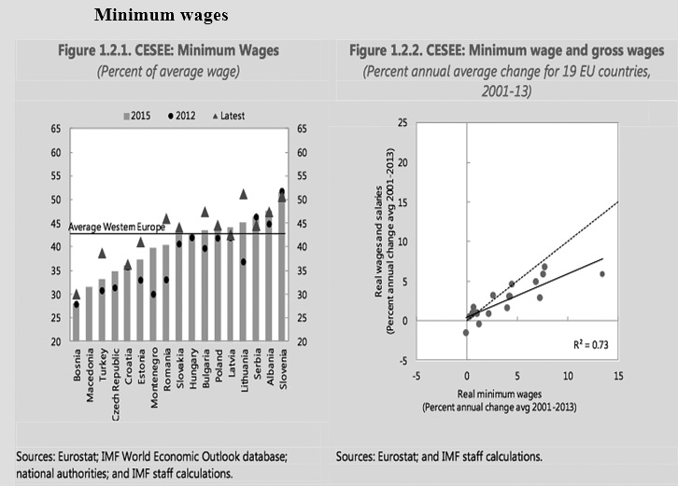
Minimum wages

Slide 40
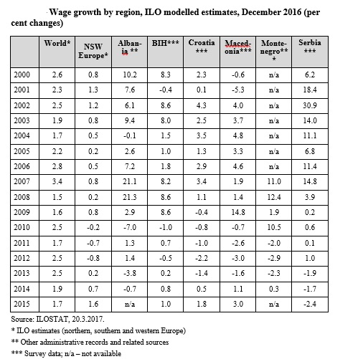
Wage growth

Slide 41
Minimum wages have been rising than average wages
Since 2012, minimum wages have been rising faster than average wages in most of the countries of eastern and SE Europe.
The pace of increase has been particularly sharp in Turkey as well as some of the Baltic States and south-east European countries.
Based on the limited available data, some 10-20 per cent of workers earn the minimum wage in the wider region.

Slide 42
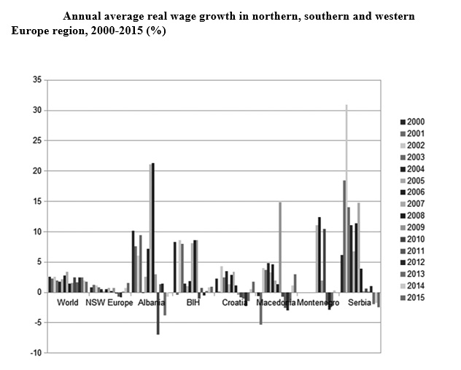
Annual average real wage growth

Slide 43
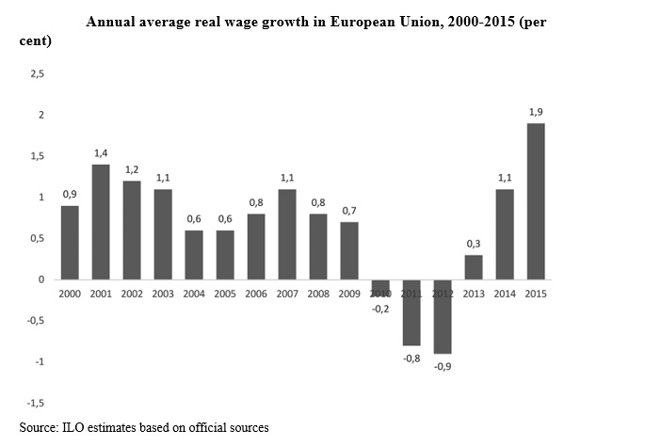
Annual average real wage growth in the EU

Slide 44
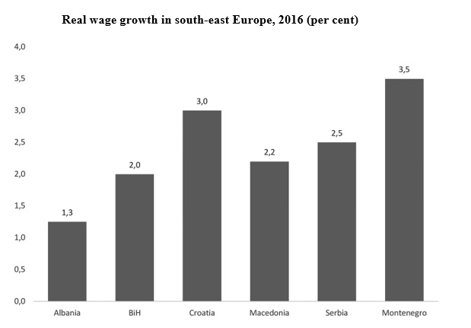
Real Wage growth in SE Europe, 2016

Slide 45
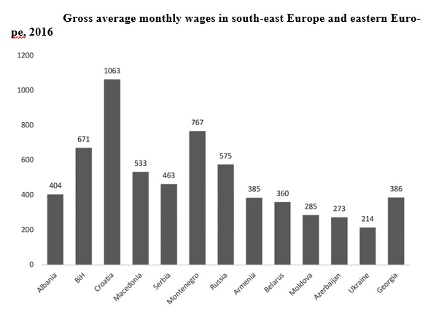
Gross average wages in SE and EE.

Slide 46
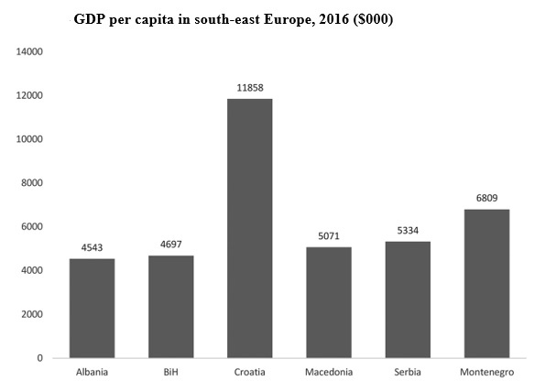
GDP per capita

Slide 47
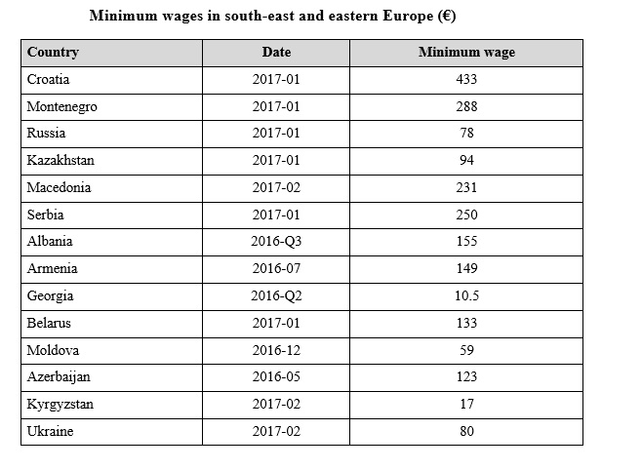
Minimum wages

Slide 48
Higher minimum wages can improve income distribution through four types of effects.
Minimum wages can reduce poverty by improving the incomes of minimum wage and low-wage earners, but minimum wage levels are often too low to push household incomes above the poverty level.
Minimum wages are likely to improve income distribution and reduce inequality, primarily by pushing up lower wages, if sufficiently high.
Minimum wage increases can improve workers’ incomes in general if a higher wage floor provides incentives for employers to increase the wages of better-paid workers to retain sufficient pay differentiation.
Minimum wages can influence the distribution of productivity between labour and capital by pushing up the share of income taken by wages. The latter has been declining across the world, with negative effects on inequality and economic growth (ILO and OECD, 2015).

Slide 49

Problems
low and irregular payment of salaries
differences in income levels between employees in the services sector (IT sector, financial services, oil processing...) on the one hand; and employees otherwise in the non-budget sector
major differences in average salary levels compared to EU member states (especially west European countries)
low salaries of employees as a factor in attracting sources of foreign investment
salary being insufficient to cover elementary costs of living and insufficient to exit from a state of social jeopardy.

Slide 50

Requirements
Salaries must follow increases in inflation
Sanctions enforcement for irregularities in the calculation and payment of salaries
low salaries must not represent a base argument in the attraction of foreign investment
people in employment must not be socially jeopardised.

Slide 51
Income distribution will matter for growth.
  If the income share of the top 20% increases by 1 percentage point, GDP growth is actually 0.08 percentage point lower in the following five years, suggesting that the benefits do not trickle down.
  Instead, a similar increase in the income share of the bottom 20 percent (the poor) is associated with 0.38 percentage point higher growth.
Source: Causes and Consequences of Income Inequality, a Global Perspective, 2015. IMF

Slide 52
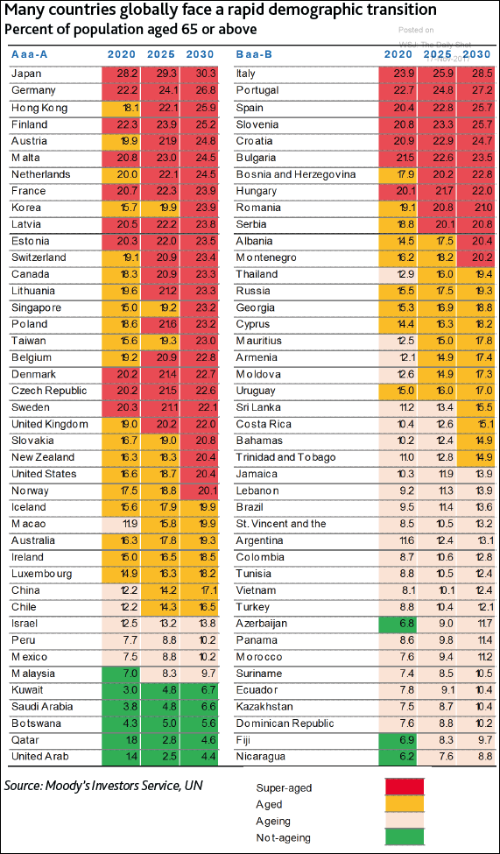
- “super-aged” countries, where more than 20% of the population is 65 or older ;
- “aged” countries, where at least 14% of the population is 65+;
- “ageing” countries, where at least 7% of the population is 65+

Slide 53
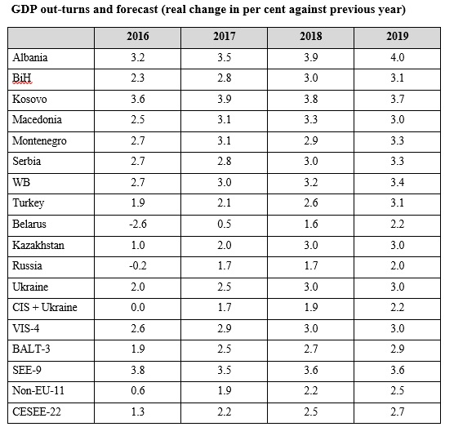
GDP

Slide 54
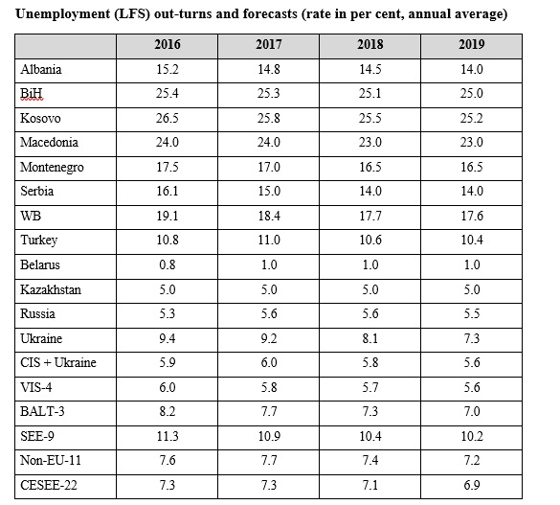
Unemployment

Slide 55
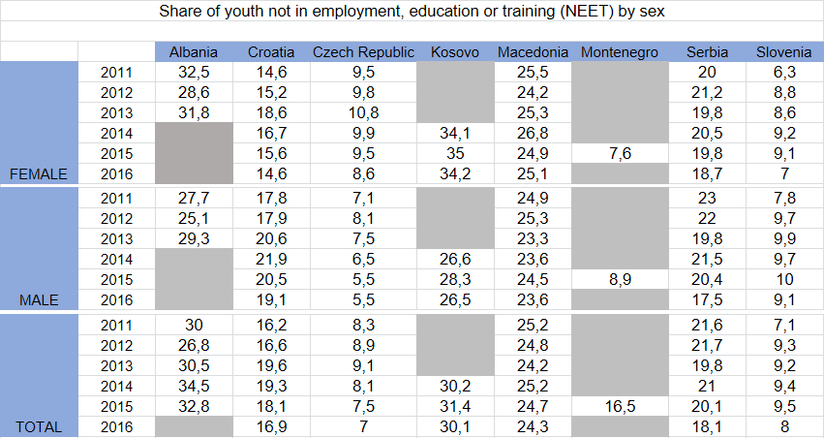

Slide 56
Thank you very much!
Bruno S. Sergi

Slide 57
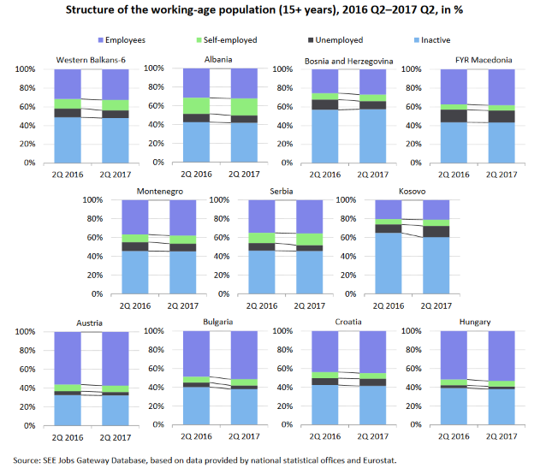

Slide 58
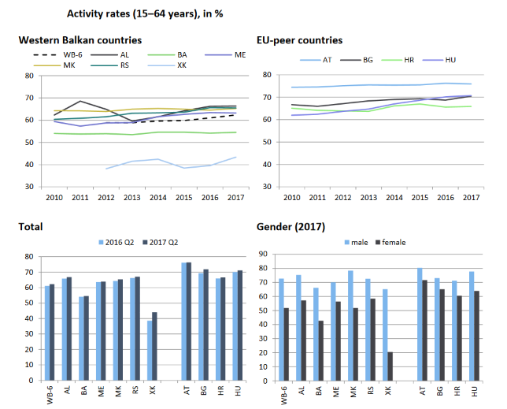

Slide 59
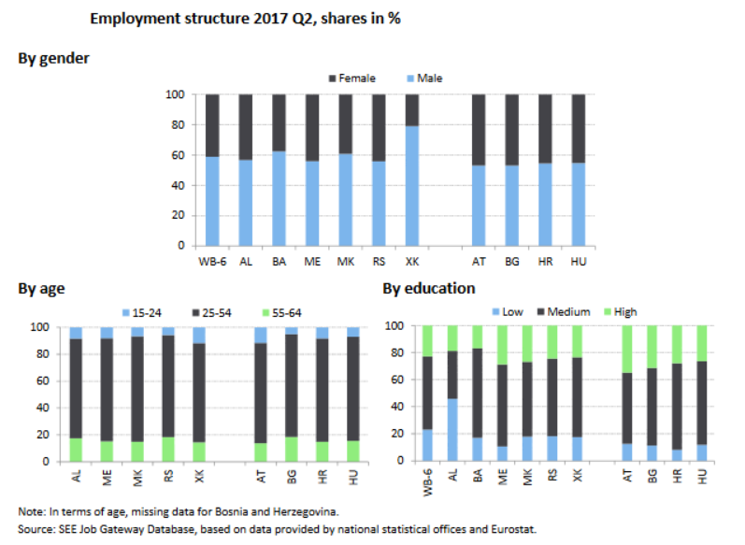

Slide 60
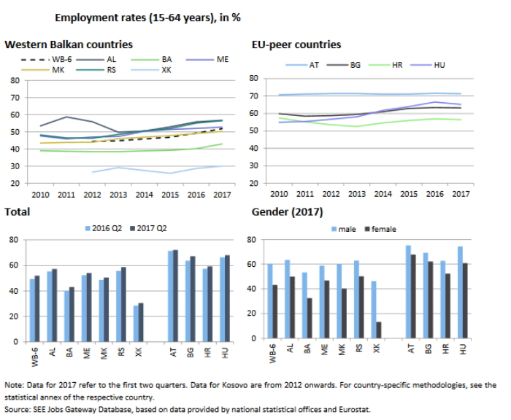

Slide 61
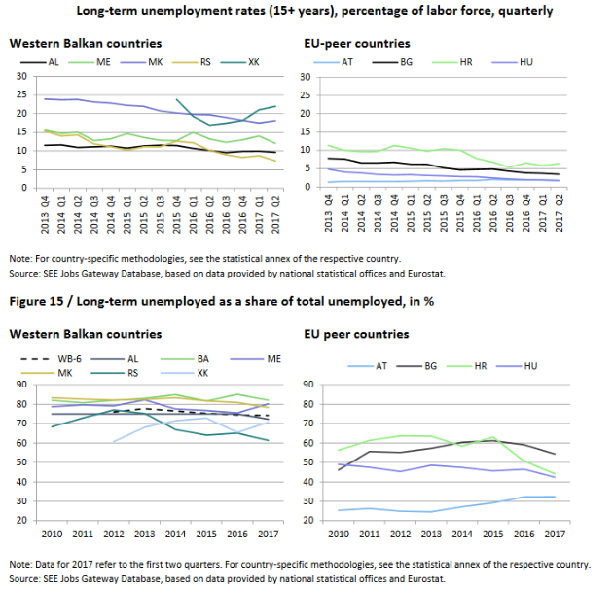

Slide 62
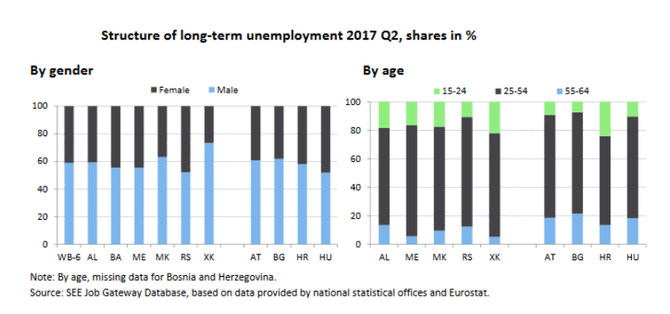

Slide 63
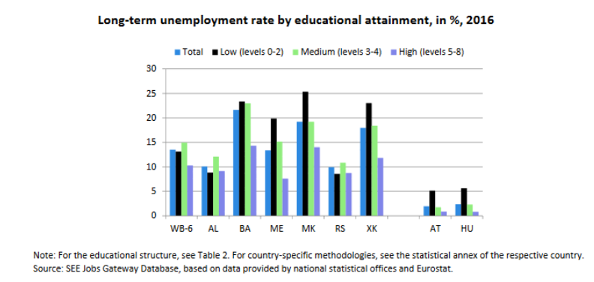

Slide 64
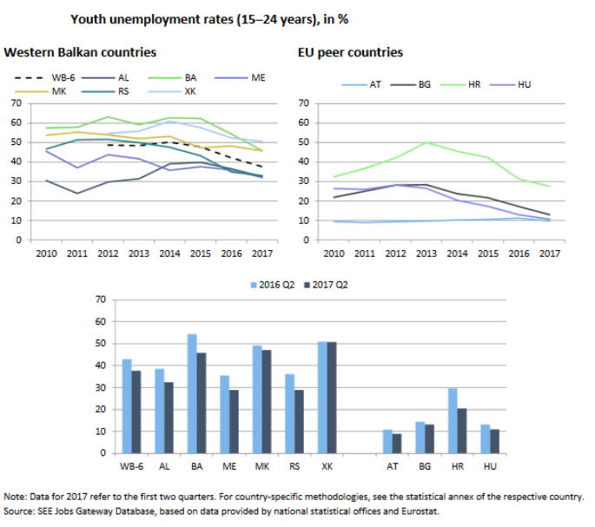

Slide 65
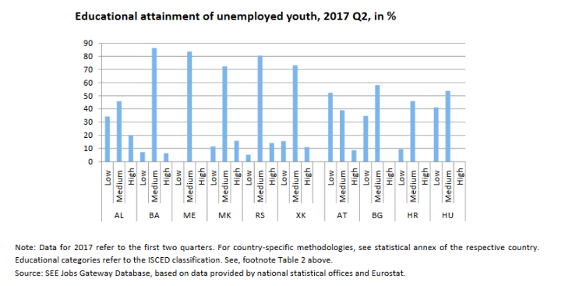

Slide 66
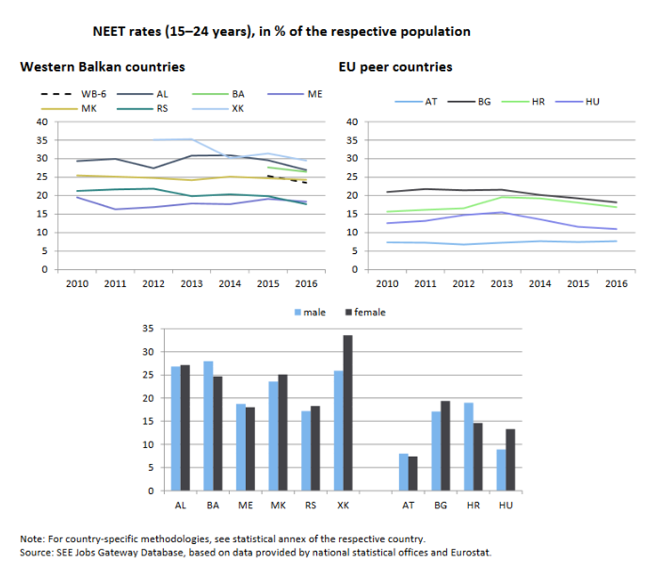

Slide 67
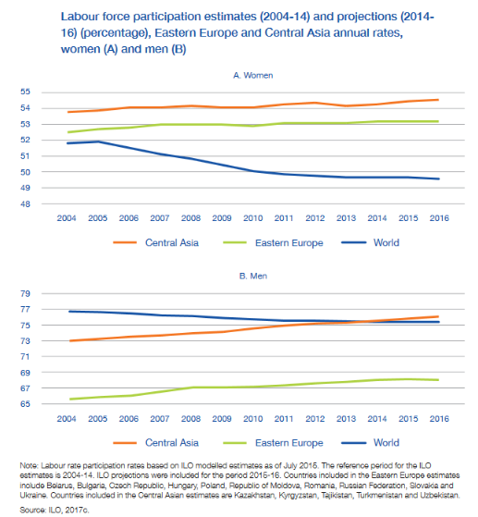

Slide 68
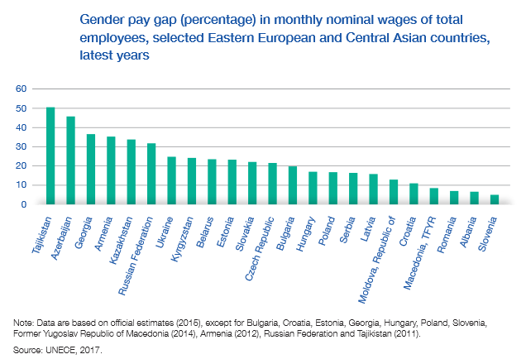

Slide 69
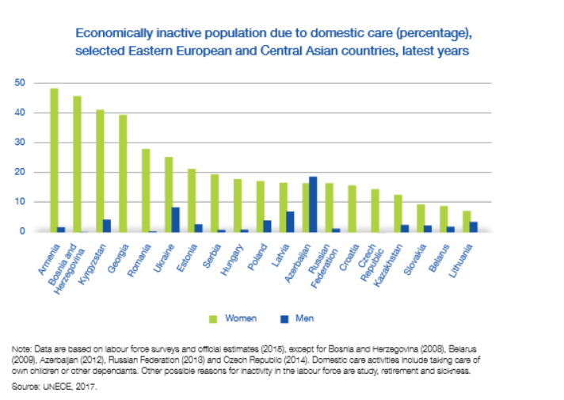

Slide 70
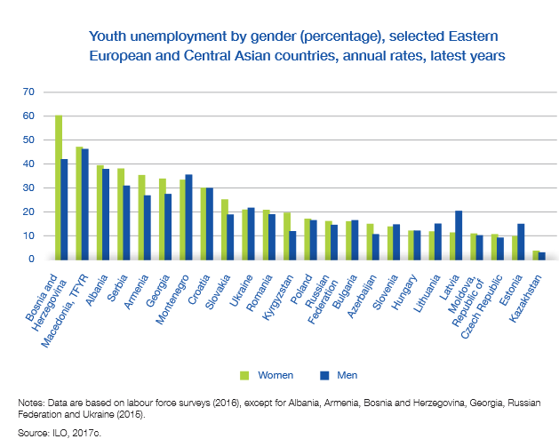

Slide 71
Armenia
Wages and growth

Slide 72
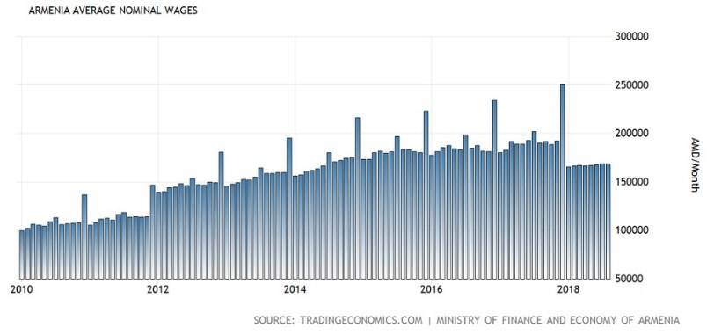

Slide 73
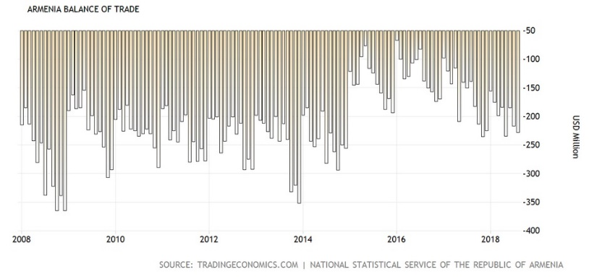

Slide 74
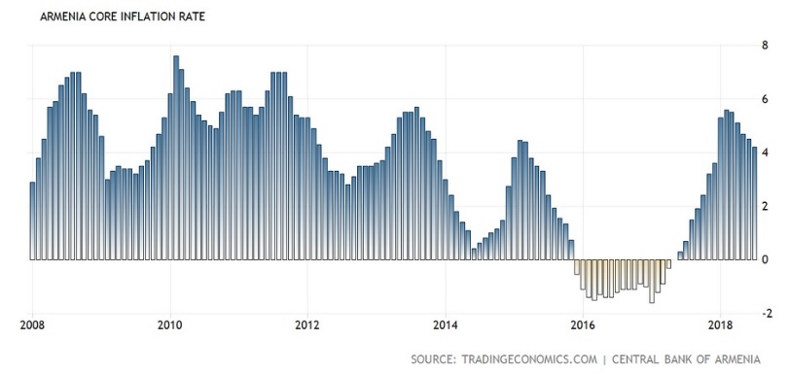

Slide 75
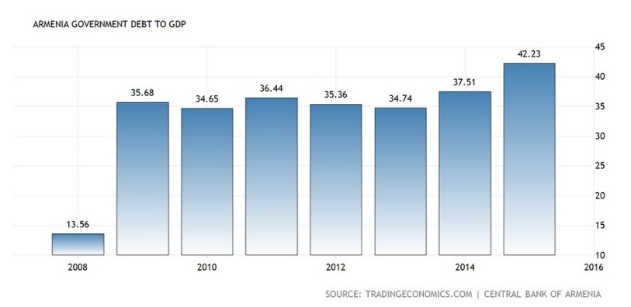

Slide 76
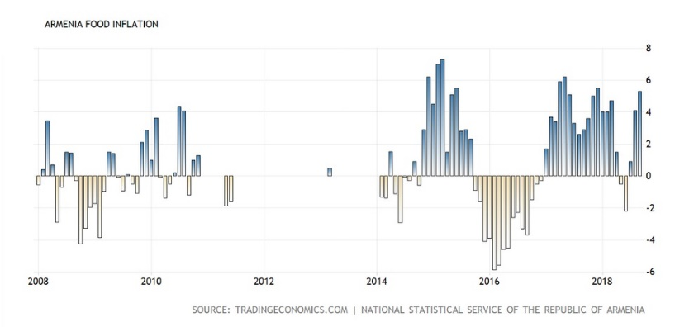

Slide 77
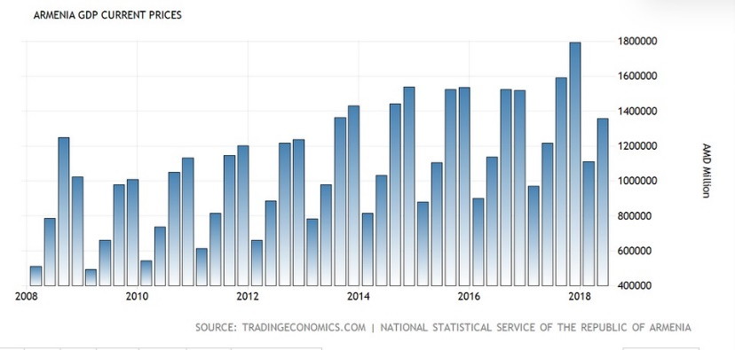

Slide 78
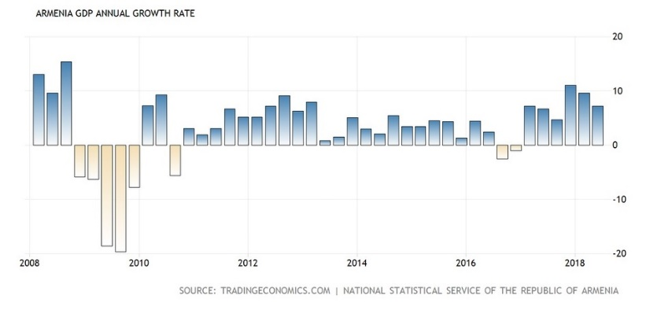

Slide 79


Slide 80


Slide 81


Slide 82


Slide 83


Slide 84


