Slide 1
The IMF and the World Bank Policies and trade union responses
Carolin Vollmann
Economic Advisor & Research Officer
International Trade Union Confederation
carolin.vollmann@ituc-csi.org 6th of October 2014

Slide 2
The current debate at the IMF
The IMF and the Inequality talk
- Growth
- taxation and public spending
- financial regulation
….versus country-specific policies.

Slide 3
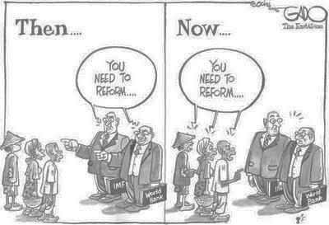
The current debate inside the IMF
Reforming the IMF

Slide 4
….and the World Bank
Safeguard review process
Doing Business Report

Slide 5
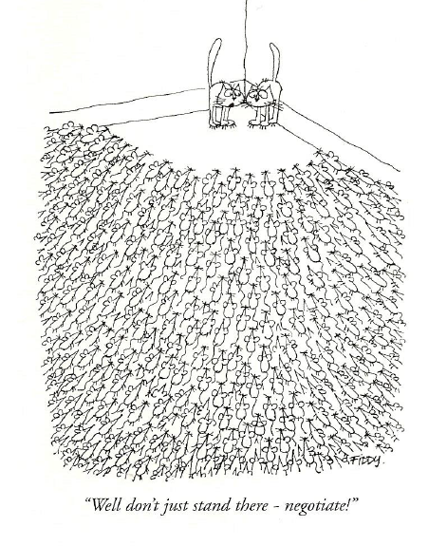
Trade union responses

Slide 6
There are differences in outcomes across countries
And while some parameters are impossible to influence…
(individuals at IMF, government and leading party, involvement of Troika partners)
…preparation can make a difference.
Notes:
Process: time, period, location, previous exchange on agenda items, persons involved, language/translation,

Slide 7
1. Interests The needs, concerns, goals, desires, and fears that motivate us
Setting clear priorities and an own agenda
(e. g. maintain public employment)
Estimate the other side’s interests
(Often their primary interest is to get a sense of the public/trade union opinion and a feeling for the likelihood of demonstrations/strikes)

Slide 8
2. Options All of the possibilities on which the parties might agree
Option generation should follow discussion of interests
(e. g. improve service, re-organise procedures) “You know your country best!”
Separate option generation from option evaluation
(allow all options to be identified and just then start evaluating them)

Slide 9
3. Criteria External standards against which to measure possible agreements
Use criteria as a “sword” – “Let me show you why this is fair.”
(e. g. compare public sector employment, public spending, public investment to other countries)
Use criteria as a “shield” – “Why is that a fair number?”
(e. g. ask for empirical evidence, and what lead them to chose this specific number/threshold)

Slide 10
4. Leverage The walk-away option everybody has
Improving the leverage in advance
- raise public awareness,
- elaboration of joint position between different confederation

Slide 11
5. Communication The exchange of thoughts, messages, or information by speech, writing, physical cues, etc.
Tailor your language
(they like economish and financish)
Combine advocacy with plenty of inquiry.
Ask about the government’s and employer’s position (national/foreign), and on their priorities/worries

Slide 12
6. Commitment Agreements about what a party will or will not do
There have been many social pacts in Europe
(your commitment will never be far-reaching enough)
Use process commitments at the beginning to move the negotiation forward
(e. g. commit to research and surveys to find out more on a topic, to meet again, to send a position paper, etc.)

Slide 13
Further material

Slide 14
Christine Lagarde:
“Business and political leaders at the World Economic Forum should remember that in far too many countries the benefits of growth are being enjoyed by far too few people. This is not a recipe for stability and sustainability,” , February 2014,
http://www.ft.com/intl/cms/s/0/b3462520-805b-11e3-853f-00144feab7de.html#axzz3EhN5sV5U
“Rising inequality can damage economic growth and social ties, and may also cause political instability”. "In the years ahead, it will no longer be enough to look simply at economic growth," she said. "We will need to ask if this growth is inclusive.“, February 2014
http://www.reuters.com/article/2014/02/25/imf-lagarde-idUSL1N0LU1VB20140225

Slide 15
Christine Lagarde:
“The IMF has always been interested in that matter [income inequality]. We have always paid attention to the risk that inequality bears on macroeconomic and other policies. I spoke about it over a year ago because we saw and still see worryingly increasing trends of inequality, which we believe has consequences on the macro-economy and other policies. It is trendy at the moment because quite a few people have written about it, but we have been concerned about it for two reasons. One, we believe that it tends to increase financial risks if you have too much disparity in income distribution. And two, based on the research that we’ve done, we see that rising inequality is not supportive of sustainable growth. To the extent that growth is part of our mandate and critical for stability in the world, we believe that inequality needs to be looked at. There are countries that are showing very strong signs of rising inequality, and that is the case in the U.S.”
“My own belief is that the first way to deal with inequality is to make sure that everybody has a job. You start with that one. Second, make sure that public spending is focused on those policies that will reduce inequalities, such as good health services for all, including the poorest, and access to education, including to those who are not well-off. And then you have the redistributive policies that can be applied, provided they’re well calibrated and not excessive…“ June 2014
http://fortune.com/2014/06/02/christine-lagarde-imf/

Slide 16
Dominique Strauss-Kahn:
“The crisis taught us that well-designed labour market policies can save jobs…We must get past the binary and unhelpful contrast between ‘flexibility’ and ‘rigidity’ in labour markets and ask instead if policies are effective in creating and sustaing jobs.”, “The Global Jobs Crisis – Sustaining the Recovery through Employment and Equitable Growth” speech delivered in Washington, 13 April 2011
https://www.imf.org/external/np/speeches/2011/041311.htm

Slide 17
IMF Literature:
“Redistribution, Inequality, and Growth”, IMF Staff Discussion Note, February 2014, http://www.imf.org/external/pubs/ft/sdn/2014/sdn1402.pdf
Lower net inequality is robustly correlated with faster and more durable growth, for a given level of redistribution.
Redistribution appears generally benign in terms of its impact on growth; only in extreme cases is there some evidence that it may have direct negative effects on growth. Thus the combined direct and indirect effects of redistribution—including the growth effects of the resulting lower inequality—are on average pro-growth
“Fostering Growth in Europe Now”, IMF Staff Discussion Note, June 18, 2012, p. 13, https://www.imf.org/external/pubs/ft/sdn/2012/sdn1207.pdf
“Several studies find that reforms have a small, and in some cases even negative, short-term effects on output and employment because of costly and timely reallocation of resources and restructuring, with a temporary rise in unemployment and potentially higher social costs.”

Slide 18
IMF Literature:
“Fiscal Policy and Income Inequality”, IMF Policy Paper, January 2014, http://www.imf.org/external/np/pp/eng/2014/012314.pdf
Reductions in the generosity of benefits and less progressive taxation have decreased the redistributive impact of fiscal policy since the mid-1990s.
The overall redistributive impact of fiscal policy is also influenced by the distribution of indirect taxes and in-kind transfers. Empirical evidence suggests that indirect taxes tend to be regressive or proportional to incomes.
As a corollary, this optimal-tax result suggests that flat personal income tax (PIT) structures are generally not the best way to organize redistribution efficiently

Slide 19
IMF Literature:
“Labor Market Policies and IMF Advice in Advanced Economies during the Great Recession”, Staff Discussion Note, March 2013, p. 14, https://www.imf.org/external/pubs/ft/sdn/2013/sdn1302.pdf
“The IMF has taken the view that high unemployment was and remains largely cyclical … and that policies that sustain aggregate demand are still of the essence”
Further links:
http://blog-imfdirect.imf.org/2014/04/29/central-eastern-and-south-eastern-europe-safeguarding-the-recovery-as-the-global-liquidity-tide-recedes/
http://www.imf.org/external/pubs/ft/reo/2014/eur/eng/pdf/ereo0414.pdf
http://www.imf.org/external/np/fad/inequality/index.htm
See also ITUC Frontlines Report “Ideology without economic evidence: IMF attacks on collective bargaining”, April 2013 http://www.ituc-csi.org/imf-labour-marketprescriptions

Slide 20
Jim Jong Kim:
“I have no doubt that the world can end extreme poverty within a generation. But it’s not a given and we cannot do it alone. It requires focus, innovation and commitments from everyone. This endorsement is an important step. If we succeed, together, we would have accomplished an historic milestone,” April 2013
http://www.worldbank.org/en/news/press-release/2013/04/20/historic-goals-to-end-extreme-poverty-endorsed-by-world-bank-governors
“And so, end extreme poverty, boost shared prosperity, and moreover, when we talk about boosting shared prosperity, we’re talking specifically about sharing prosperity with future generations,”, June 2013
http://www.worldbank.org/en/news/speech/2013/06/25/transcript-world-bank-group-president-jim-yong-kims-remarks-at-the-us-global-leadership-coalition-annual-conference

Slide 21
Jim Jong Kim:
“Unless you invest in people, you are not going to see growth in the long-term, the medium-term, and maybe even the short-term,” April 2014,
https://www.devex.com/news/jim-kim-addressing-inequality-investing-in-people-critical-to-sustainable-growth-83275
'I take from Piketty’s book a sense of even greater mission for us because we now can be part of those forces that bring the world to convergence'- Jim Yong Kim, May 2014
http://www.cbc.ca/news/business/world-bank-head-jim-yong-kim-takes-thomas-piketty-to-heart-1.2659771

Slide 22
World Bank Literature:
“Inequality in Focus - Analysing the World Bank’s Goal of Achieving “Shared Prosperity”, October 2013, http://www.worldbank.org/content/dam/Worldbank/document/Poverty%20documents/inequality-in-focus-october2013-v12.pdf
Economic growth can lead to broad-based prosperity if the growth pattern generates more and better quality jobs, higher earnings, and economic opportunities for all segments of the population.
“World Development Report 2013 on Jobs”, Chapter 8: Labor policies revisited, 2012, http://www.imf.org/external/np/pp/eng/2014/012314.pdf
The impact of labor policies is often the subject of heated debates. In the past decade, improved data and methods have generated a great deal of new information not only in industrial countries but increasingly in developing countries as well. The analyses of these data have led to fresh insights. Estimated effects prove to be relatively modest in most cases—certainly more modest than the intensity of the debate would suggest. Excessive or insufficient interventions can certainly have detrimental effects on productivity. But in between these extremes lies a “plateau” where effects enhancing and undermining efficiency can be found side by side and most of the impact is redistributive. Overall, labor policies and institutions are neither the major obstacle nor the magic bullet for creating good jobs for development in most countries.

Slide 23
World Bank Literature:
Doing Business 2013 - Fact sheet, http://www.doingbusiness.org/~/media/GIAWB/Doing%20Business/Documents/Fact-Sheets/DB13/DB13ECAFactSheetEnglish.pdf
Eastern Europe and Central Asia Eastern Europe and Central Asia leads the world in enhancing the business climate for local firms since 2005.
The region overtook East Asia and the Pacific to become the world’s second most business-friendly, after OECD high-income economies.
In the past year, Eastern Europe and Central Asia had the largest share of economies implementing regulatory reforms—with 88 percent reforming in at least one of the areas measured by Doing Business.

