Slide 1
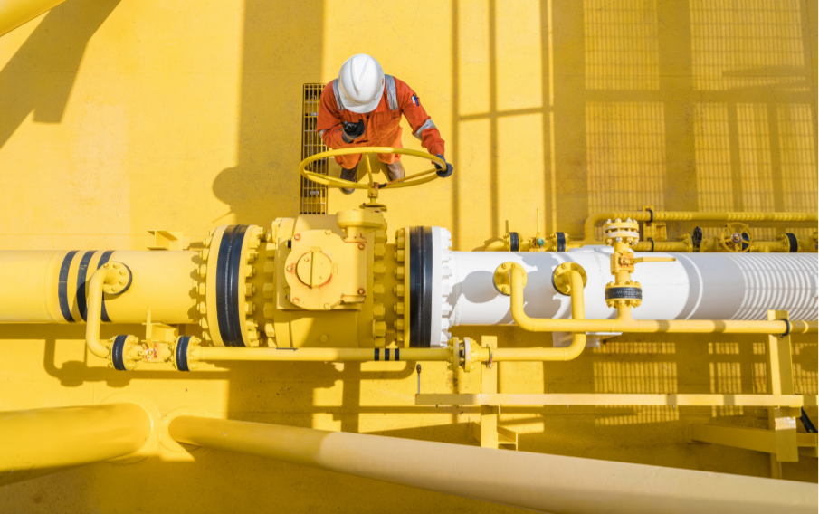
Trade unions demand a Just Transition
20 October 2021 – FTURK
Bert De Wel International Trade Union Confederation

Slide 2
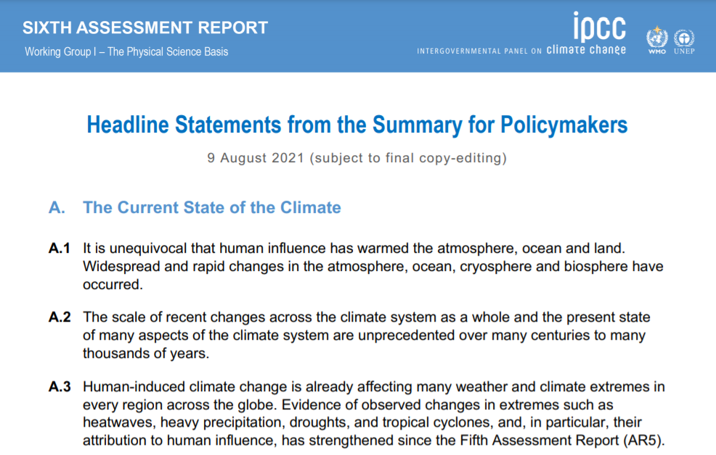
https://www.ipcc.ch/report/sixth-assessment-report-working-group-i/

Slide 3
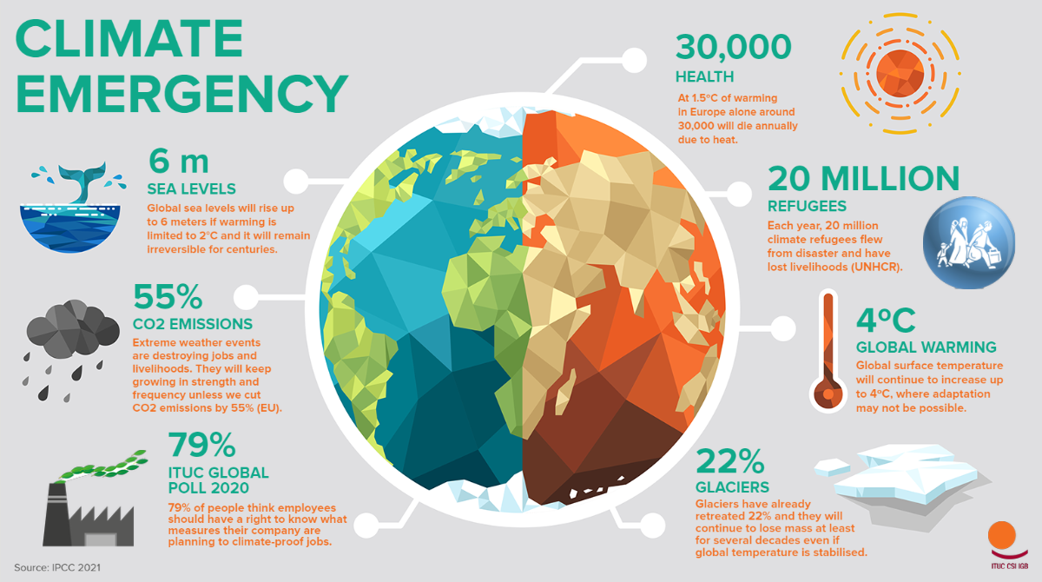

Slide 4
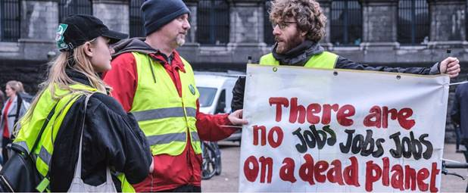

Slide 5
What is Just Transition and why do we need it?
“A Just Transition secures the future and livelihoods of workers and their communities in the transition to a low-carbon economy. It is based on social dialogue between workers and their unions, employers, government and communities. A plan for Just Transition provides and guarantees better and decent jobs, social protection, more training opportunities and greater job security for all workers affected by global warming and climate change policies.”
https://www.ituc-csi.org/social-dialogue-for-sdgs-promoting-just-transition

Slide 6
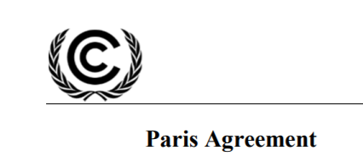
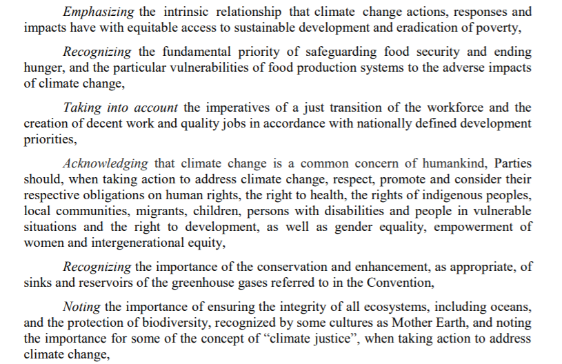
Notes:
The preamble of the Paris Climate agreement of 2015 explicitly asks countries to take into account the imperatives of a just transition of the workforce and decent jobs.

Slide 7
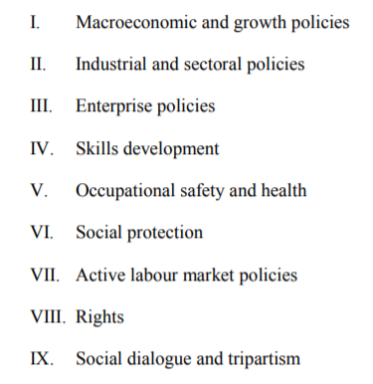
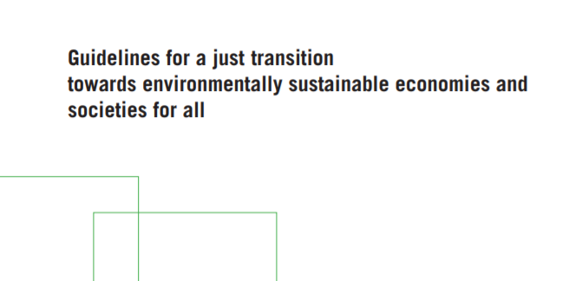
https://www.ilo.org/global/topics/green-jobs/publications/WCMS_432859/lang--en/index.htm
Notes:
The preamble of the Paris Climate agreement of 2015 explicitly asks countries to take into account the imperatives of a just transition of the workforce and decent jobs.

Slide 8
A Just Transition framework is supported by the following pillars (1):
 | Albania | BiH | Croatia | North Macedonia | Montenegro | Sebia | Kosovo
Climate change and Just Transition integrated in Trade Union priorities?
Dedicated staff to work on climate and JT at national and at sectorial level?
Engaged in social dialogue at national and sectorial level on JT/Climate?
Engaged in assessment of the social and economic consequences of climate change and responses to it.
Promotion of substantial public investment in low-carbon sectors and technologies.

Slide 9
A Just Transition framework is supported by the following pillars (2):
 | Albania | BiH | Croatia | North Macedonia | Montenegro | Sebia | Kosovo
Implementation of active policies for the restructuring and diversification of the economy.
Promotion of professional training and retraining for the development of skills.
Strengthening of social protection systems and public investment in health, education, etc.
Promotion of social dialogue, collective bargaining and social participation.

Slide 10
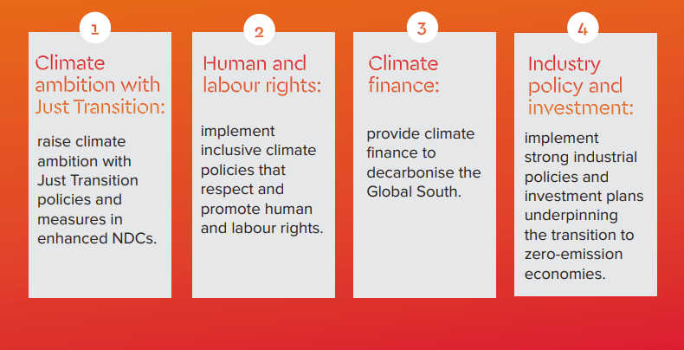

Slide 11
Bert De Wel Climate policy officer International Trade Union Confederation
Bert.DeWel@ituc-csi.org Twitter: @bertdewel

