Slide 1

Trade Unions actions in the sphere of labour migration policy

Slide 2
External labour migration
External labour migration
Legal foreign labour force
Irregular foreign labour force
Visa regime
Exploitation, salary dumping
Equal payment for equal labour
Free visa regime
Lack or absence of labour and social guarantees
Labour agreement, guaranteed salary and social package
Forced labour
Notes:
Главный недостаток нелегальной иностранной рабочей силы в том, что она приводит к тяжелым последствиям для общества. При высокой безработице и постоянно растущем количестве пенсионеров нелегальная занятость подрывает всю экономическую систему. Страна из-за этого ежегодно теряет большое количество официальных рабочих мест. Причина проста: честно работающие предприятия уже не могут успешно конкурировать с теми, кто использует дешевый нелегальный труд, и вынуждены увольнять сотрудников. При этом государство и внебюджетные фонды (социального, пенсионного страхования) теряют огромные средства.

Slide 3
General agreement between All Russian Trade Unions, Russian Unions of Entrepreneurs and the Government of the Russian Federation for 2011–2013 years
Parties obligations:
Annually consider the questions related to the migration policy implementation, provide estimation of the effectiveness of use of the foreign labour force
Hold consultations on Drafts of the normative and Legal acts those are regulating questions on external labour migration
Hold consultations on questions related to quota defining process on use and bring in of foreign labour force
Hold consultations on Drafts of the normative and legal acts those are regulating internal labour migration
Hold consultations on modernization and perfection of exiting mechanisms of defining economical demand of foreign labour force bring in, including spheres of its application and procedure of quotation

Slide 4
What are the Trade Unions targets?
Federation of Independent Trade Unions protects the rights of workers:
Decent work Agenda adopted, increase of real wage and leaving standards of the population
Obligatory social insurance and increasing the level of social protection
On OSH and health protection during the working process
Equality of right and freedoms despite of gender, nationality, language and etc. as stated in the ILO /UN Conventions and Constitution of the Russian Federation
Trade Union's membership – is a guarantee from unlawful dismissal

Slide 5
What is a Trade Union’s position in regard to the foreign citizens?
Trade Unions are standing for legal, regulated and well managed labour migration
Trade Unions consider, that legal migrants must have same rights and obligations in labour and social spheres as foreseen by the Russian legislation
Foreign citizens and stateless persons, those who are resident in the RF, generally, eligible to be members of the Russian trade unions.
Trade Unions are seeking the right of foreign workers on medical insurance, education, social security, that they are fully covered by legal labour norms and get the right on collective protection

Slide 6
Main Trade Unions activities and actions in the sphere of Labour Migration

Slide 7
Federal Level
Legal Foreigh Force
«Hot line» (established to provide consultations and information to labour migrants)
Irregular FLF
Suggestions on Legislation modernization
Monitoring implementation of the migration legislation on FLF
Leaflets and information brochures on labour activities for foreign citizens those who are coming to the RF
Defining demand of FLF bring in and quota establishment across RF
Suggestions on how to improve the legislation implementation and minimize its disregard
Notes:
Семинары МОТ
Опыт работы профсоюза строителей и жизнеобеспечения

Slide 8
Regional level
Revision of the Employers applications for FLF bring in, the frame of the Regional Tripartite Commissions on socio-labour relations regulation
Agreements on cooperation with the territorial representations of the FMS and Labour Inspections
Providing Consultations to FWs those who want to be employed in this respective subject of the RF, along with the offer to joint a TU
Trade Unions are part of the inter-agency commissions on bring in and usage of FLF in the subjects of the RF
Assistance to the grassroots TU organizations in arranging control functions over LL observance in relation to the FLW

Slide 9
Negotiation Process on FLF quota ( regional level)
Establishment of the inter agency commission
Trade Unions
Employers
Other interested agencies from the executive authorities, represented in the Subject RF
Territorial representation of the FMS; State Labour inspection
Tripartite commission on labour- social disputes resolution
in the Subject of the RF

Slide 10
Upon the results of work and decisions adopted by the Inter agency commissions
Employers’ requests on FLF were not supported and declined on the following reasons ( upon the results of the quota campaign in 2012)
Non full use of quota given in previous year
Non submission of information of planned volumes of work on the objects
Possibility to meet labour demand using local LF
Declaration of the min. wage lower then minimal guaranteed wage established for RF
Prooved information on active unpaid wages of workers
Prooved unremovable violations related to the process of FLF bring in and ITS use detected by LI
Incapacity to provide decent housing conditions

Slide 11
Dynamics of FLF bring in into the RF 1994 - 2011
Источник: государственная статистика, данные ФМС России
*по экспертной оценке

Slide 12
Gender aspects of labour migration in the Russian Federation
Иностранные граждане, имевшие действующее
разрешение на работу, по возрастным группам¹⁾
в 2011 г.
На конец года
¹⁾ По данным Федеральной миграционной службы.
 | Женщины | Мужчины | Распределение по полу, %
 |  |  | женщины | мужчины
Всего
тыс. человек | 139,1 | 888,8
процентов | 100 | 100 | 14 | 86
в том числе в возрасте, лет: 18-29 | 32,8 | 41,6 | 11 | 89
30-39 | 34,7 | 26,9 | 17 | 83
40-49 | 24,2 | 22,0 | 15 | 85
50-54 | 5,7 | 6,3 | 12 | 88
55-59 | 2,0 | 2,5 | 11 | 89
60 лет и старше | 0,6 | 0,8 | 10 | 90

Slide 13
Gender aspects of labour migration in the Russian Federation
Foreign citizens those who had legal labour authorizations (age group distribution)
in 2011.
By the end of the year
¹⁾ Federal Migration Service data.
 | Female | Male | Gender Distribution, %
 |  |  | Female | Male
Total
Thousands.. people | 139,1 | 888,8
% perset | 100 | 100 | 14 | 86
including age groups, age: 18-29 | 32,8 | 41,6 | 11 | 89
30-39 | 34,7 | 26,9 | 17 | 83
40-49 | 24,2 | 22,0 | 15 | 85
50-54 | 5,7 | 6,3 | 12 | 88
55-59 | 2,0 | 2,5 | 11 | 89
60 and older | 0,6 | 0,8 | 10 | 90

Slide 14
Migration Female and male in 2011 .
 | Thousands people |  | Gender distribution, %
 | female | male | female | male
Total number of migrants
inflow | 1764 | 1651 | 52 | 48
outflow | 1644 | 1451 | 53 | 47
Migration increase, decrease (-) | 120 | 200 | 38 | 62
Including:
International migration
inflow | 138 | 218 | 39 | 61
outflow | 18 | 18 | 50 | 50
Migration increase, decrease (-) | 120 | 200 | 38 | 62
Out of it:
With CIS countries
inflow | 122 | 189 | 39 | 61
outflow | 10 | 12 | 46 | 54
Migration increase, decrease (-) | 111 | 177 | 39 | 61
With far abroad countries
inflow | 17 | 29 | 37 | 63
outflow | 8 | 6 | 57 | 43
Migration increase, decrease (-) | 9 | 23 | 28 | 72

Slide 15
Distribution of migrants older then 14 on their matrimony status and migration flows in 2011 .
 | Thousands people |  | Gender distribution, %
 | female | male | female | male
Total | 1553 | 1427 | 52 | 48
Among them:
married | 653 | 642 | 50 | 50
Never being married | 490 | 502 | 49 | 51
Widow (er) | 134 | 29 | 82 | 18
divorced | 156 | 119 | 57 | 43
Not specified their status | 120 | 135 | 47 | 53
Arrived out of Russia | 127 | 206 | 38 | 62
Among them:
married | 55 | 83 | 40 | 60
Never being married | 30 | 59 | 34 | 66
Widow (er) | 9 | 2 | 83 | 17
divorced | 10 | 8 | 57 | 43
Not specified their status | 23 | 53 | 30 | 70

Slide 16
Distribution based on educational level among migrants older then 14 and migration flows in 2011 .
 | People |  | Gender distribution, %
 | female | male | female | male
Total arrived | 1552556 | 1426989 | 52 | 48
Among them:
High education | 420771 | 335275 | 56 | 44
Scientific degree:
Doctoral degree | 843 | 1190 | 41 | 59
PH.D | 4230 | 4813 | 47 | 53
Not finalized high education | 74248 | 61053 | 55 | 45
specialized secondary | 392211 | 358001 | 52 | 48
Primary specialized education | 37481 | 45880 | 45 | 55
general secondary education | 333549 | 339807 | 50 | 50
secondary education | 113522 | 120147 | 49 | 51
primary education | 54564 | 31720 | 63 | 37
Not specified | 126210 | 135106 | 48 | 52
Came outside of Russia | 127 310 | 205 771 | 38 | 62
Among them:
High education | 23 475 | 24 208 | 49 | 51
Scientific degree:
Doctoral degree | 55 | 112 | 33 | 67
PH.D | 341 | 501 | 40 | 60
Not finalized high education | 3893 | 5400 | 42 | 58
specialized secondary | 29186 | 39922 | 42 | 58
Primary specialized education | 2647 | 5434 | 33 | 67
general secondary education | 33068 | 61572 | 35 | 65
secondary education | 8862 | 14080 | 39 | 61
primary education | 3101 | 3141 | 50 | 50
Not specified | 23078 | 52014 | 31 | 69

Slide 17
Quota dynamics on labour permits issuing and its reserve
In Russia 2007-2012 .

Slide 18
The quantity of patents given to the FMW in Russia

Slide 19
Migrant remittances outflow 2009 - 2011
Legal bring in of FLF 2009 - 2011
Источник: государственная статистика, данные ФМС России и экспертные данные

Slide 20
Federation of Trade Unions of Sverdlovsk Region
Project on Migrant workers supported by the ILO/EU

Slide 21
Normative initiatives related to the labour migration management in the region
Structural organizational changes adopted to the MW TU membership’s
Main directions of activities related to work with LM and their TU membership
Cooperation and joint work with Diaspora and ethnic communities ( selection of potential leaders)
Cooperation with the TUs of countries of migrant’s origin
Agitation work among MW to bring them in the RF TUs

Slide 22
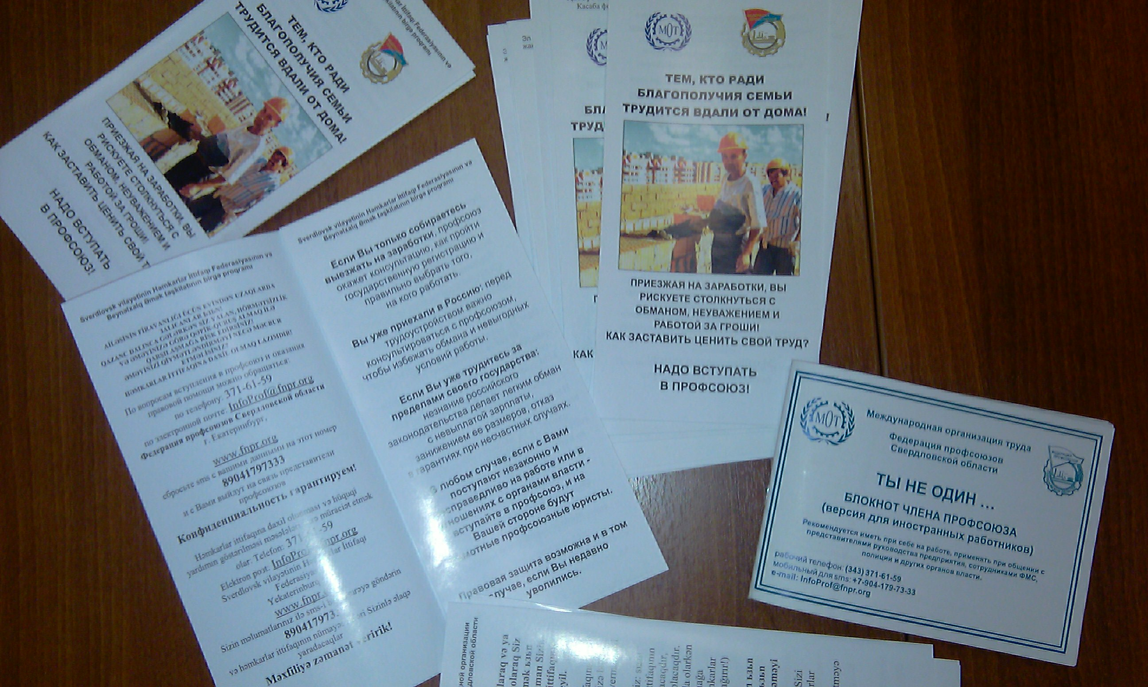
Information / agitation materials (translated on SIC languages)

Slide 23
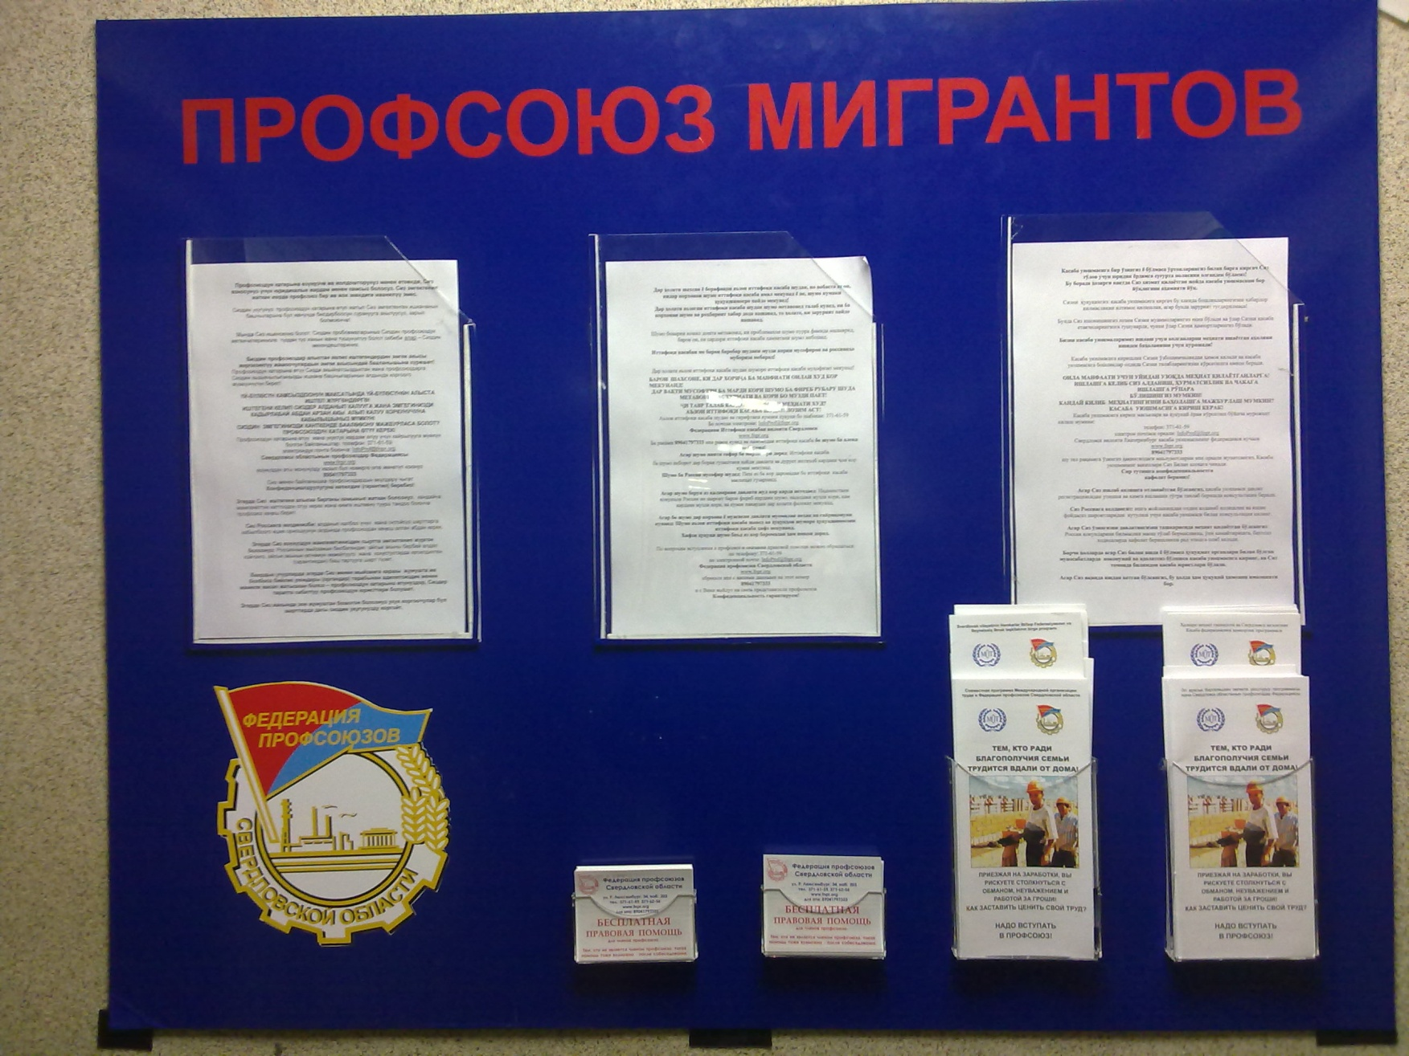

Slide 24
Problems on Migrants involvement into TUs
Language barrier
Seasonal character of presence in the country
Absence of proven labour relations

Slide 25
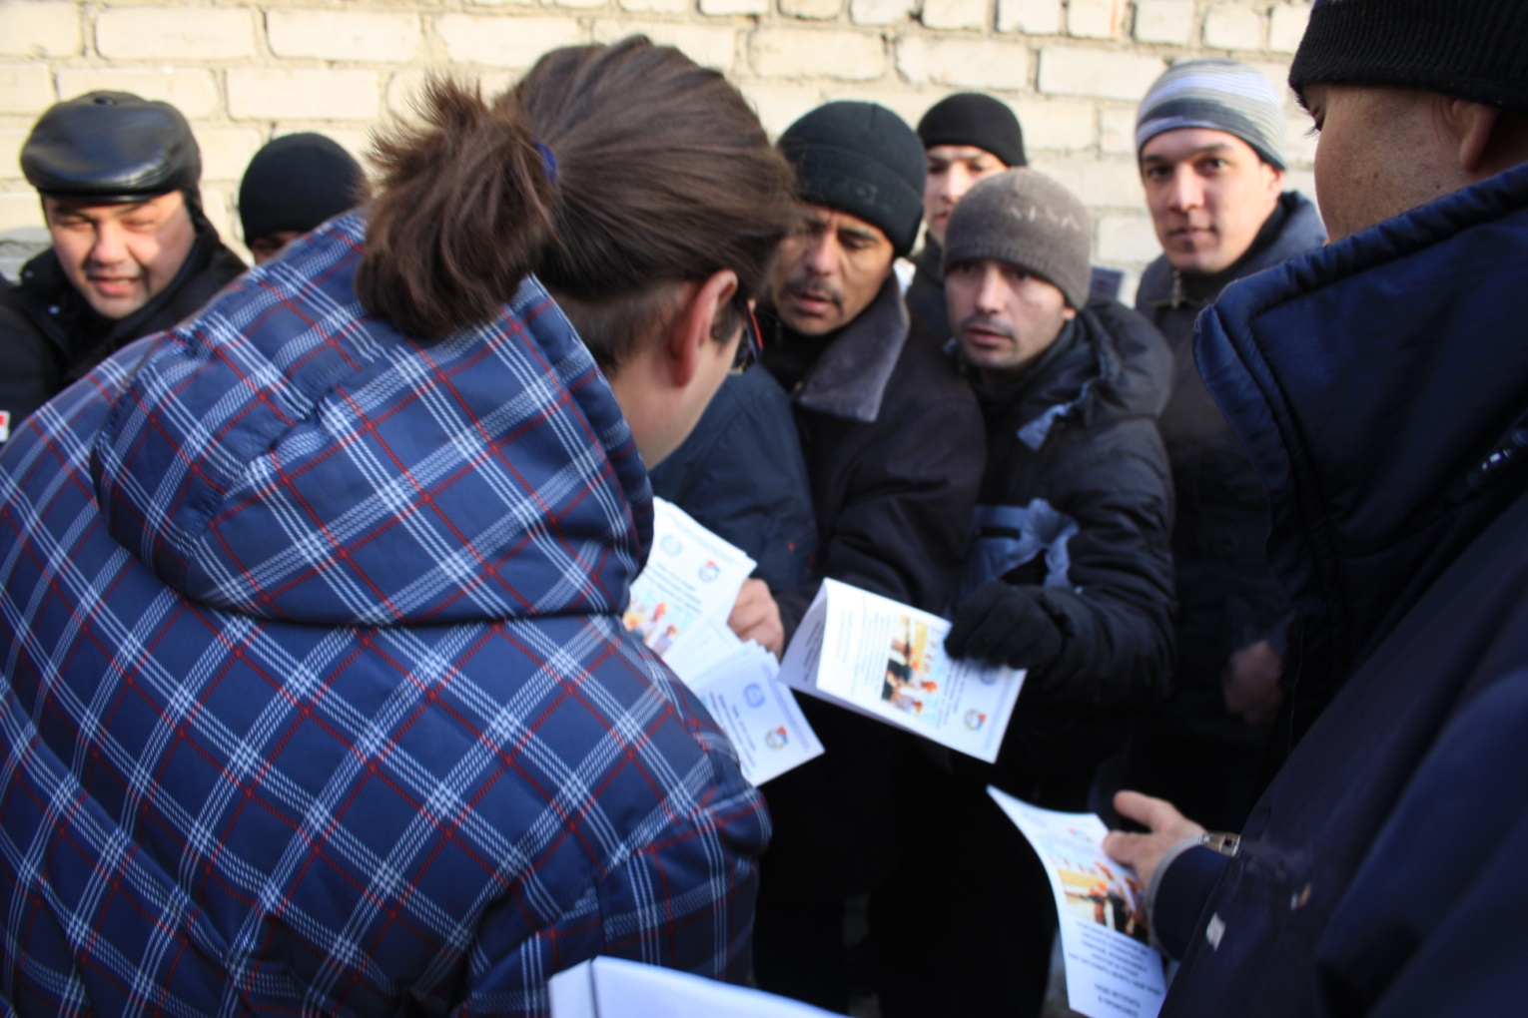

Slide 26
FNPR Inter-State Cooperation in the framework of LM Protection
Agreement on Cooperation between FNPR and ACTU ( Azerbaijan) signed,
3 regional agreements between FNPR regional Representations (Volgograd, Yekaterinburg, Astrakhan) and ACTU /ATUC are signed
Branch agreements in Agriculture signed by Volgograd and Vladivostok Agriculture TUs with Uzbekistan and China

Slide 27


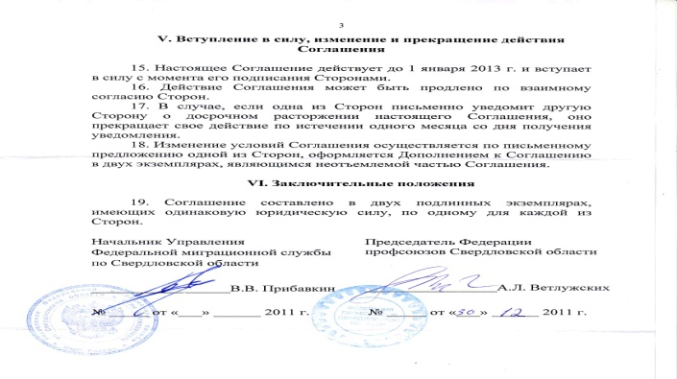

СОГЛАШЕНИЕ
территориальной (областной) организацией профсоюза работников агропромышленного комплекса РФ и
Нукусским региональным хозрасчетным Бюро по трудоустройству граждан за рубежом Министерства труда и социальной защиты населения Республики Узбекистан
о сотрудничестве между Волгоградской По вопросам трудовой деятельности и защите прав трудящихся-мигрантов граждан Республики Узбекистан
ДОГОВОР
о сотрудничестве между Волгоградским Областным Советом Профессиональных Союзов и Конфедерацией профсоюзов Армении
Волгоградский Областной Совет Профсоюзов (ВОСПС) и Конфедерация Профсоюзов Армении (КПА) руководствуясь своими уставами, далее именуемые как Стороны настоящего Договора, и стремясь к развитию профсоюзного сотрудничества в области социально-трудовых отношений, понимая важность защиты прав трудящихся-мигрантов, укрепления солидарности трудящихся, исходя из международных документов ООН и МОТ в области прав человека и защиты трудящихся-мигрантов,
договорились о нижеследующем:
1. В настоящем Договоре под термином «трудящийся-мигрант» понимается гражданин Республики Армения являющийся членом профсоюза, работающий или направляющийся на законных основаниях для работы на территории Волгоградской области Российской Федерации.
 | Азярбайжан Республикасы Щямкарлар Иттифаглары Конфедерасийасы иля Свердловск вилайяти Щямкарлар Иттифаглары Федерасийасы арасында ниййят П Р О Т О К О Л У
Чем профсоюзы могут помочь иностранному гражданину?
Федерацией с 2011 года организована система информирования и консультирования трудовых мигрантов («горячая линия») по вопросам трудового и миграционного законодательства и защите их трудовых прав. Телефон «горячей линии» – (495) 938-78-31. По данному телефону можно получить необходимую информацию по
интересующим вопросам.

