Slide 1
HealthCare Reform in Georgia Georgian Trade Unions Confederation Giorgi Tchanturidze Kiev, 17.05.2017

Slide 2
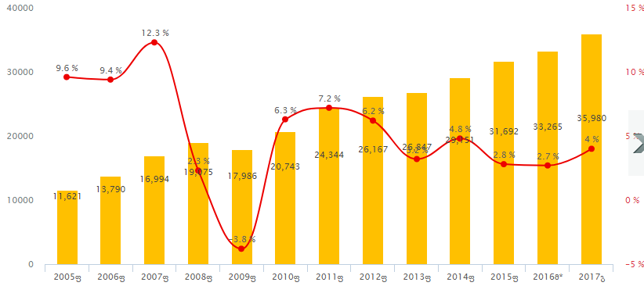
GDP of Georgia
GDP Growth in GEL

Slide 3
Share of Social Expenses in GDP
Social Expenses / GDP
2017

Slide 4
Share of Social Expenses in State Budget
Social Expenses / Budget
2017

Slide 5
Share of HealthCare Expenses in GDP
HealthCare Expenses / GDP
2017

Slide 6
Share of HealthCare Expenses in GDP

Slide 7
Share of HealthCare Expenses in State Budget

Slide 8
Composition of HealthCare Expenses

Slide 9
Universal HealthCare program
Until 2017:
- All citizens of Georgia were getting equal benefits;
- Citizens could use both private insurance and Universal HealthCare Program together

Slide 10
Universal HealthCare program
Since 2017:
-Population got divided in 6 groups:
- Not all groups are permitted to benefit from universal HealthCare if they are insured in private companies
1. Targeted group: 0-5 years old children; Students; Pensioners; Persons with disabilities; Socially vulnerable families; ( Total 1,7 Mil. Pers.). – Protection for this people increased and costs of medicines will completely financed for them. They can use private insurance as well.

Slide 11
Universal HealthCare program
2. High income persons- over 16 000 USD per year. This category will not be able to benefit from this program any more.
3. Average income persons – 5000-16 000 USD earners per year.
Their benefits got reduced, and they will not be able to use Universal Healthcare Program, if they are insured privately.
4. Low income persons- are close to poverty line. They will still have all the benefits and be able to use private insurance.
5. Youth – among 6-18 years. They will get all benefits of HealthCare.
6. Persons under average income; Self-employers; Persons with non-regular income. This category will still have all the benefits, but expenses of medicine will not be financed for them.

Slide 12
Thank You For Your Attention

