Slide 1
Migration in Europe, Challenges, Policies and Institutions
Natalia Popova
Labour Economist, Labour Migration Branch, ILO
27 September 2016

Slide 2
150 million of the 207 million working age migrants (73%) are “migrant workers”
Migrants (232 million)
Migrants 15+ (207 million)
Migrant workers (150 million)
MDW
(11.5ml)
Source: ILO Global Estimates on Migrant Workers and Migrant Domestic Workers: Results and Methodology, 2015

Slide 3
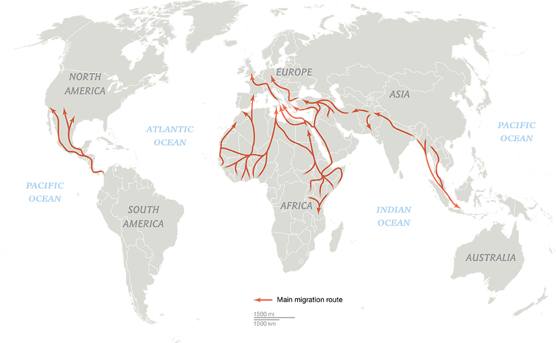
Major Migration Corridors Correlated with Unequal Regional GNI Per Capita (2014)
$35,718
$55,200
$7,429
$4,722
$1,496
$8,990
$1,638
$64,540
Maps by Matthew Chwastyk and Ryan Williams, National Geographic (September 2015), GNI Estimates, World Bank (2015)

Slide 4
Global View of International Labour Migration
Regions with a higher incidence of working poverty and lower levels of social protection coverage tend to have higher emigration rates
In 2013, over 116 million migrants were born in the South and residing in the South. South Asia is the largest contributor to South–South migration.
Regional labour mobility is a key priority for Regional Economic Communities (e.g. SADC, ASEAN, MERCOSUR, etc.).
Regions with a higher incidence of working poverty and lower levels of social protection coverage tend to have higher emigration rates.
Note: Emigration rate (2005–10) is based on the data by Abel and Sander (2014).
Working poor and social protection coverage are the ILO’s estimates.
Source: ILO Research Department

Slide 5
A Global View of International Labour Migration
Distribution of migrant workers, by broad sub-region, 2013 (percentages)
Source: ILO Global Estimates on Migrant Workers and Migrant Domestic Workers: Results and Methodology, 2015

Slide 6
A Global View of International Labour Migration
Global distribution of migrant workers, by broad branch of economic activity, 2013 (percentages)
Source: ILO Global Estimates on Migrant Workers and Migrant Domestic Workers: Results and Methodology, 2015

Slide 7
Current Developments
Migration flows are of mixed composition (migrants and refugees), characterized by complex spatial patterns of movement. Many countries are no longer just origin but have also become transit and destination countries for migration. This requires new policy approaches, involving relevant ministries, as well as the active participation of social partners;
Large movements of refugees and persons forcibly displaced by violence, conflict, human rights abuse, disasters and environmental change are creating considerable challenges for countries of first asylum, transit and destination, as well as countries of origin;
Displacement becomes increasingly protracted – UNHCR calculates that refugees are displaced for 17 years on average;
A very small minority of refugees gain access to labour markets in the formal economy;
Over 4.8 million Syrians have fled the country to seek safety, mainly in Jordan, Turkey, Lebanon, Egypt and Iraq. Around 6.6 million are internally displaced within Syria. The ILO has conducted assessments of the impact of Syrian refugees on labour markets in Jordan and Lebanon, both of which identify relatively high levels of labour market participation (around 50 per cent and over), primarily in sectors populated by other migrant workers (agriculture, construction and services/food industry).

Slide 8
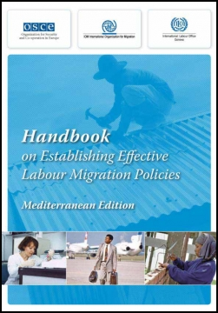
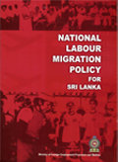
Key policy challenges – Enhancing labour migration governance
The growing impact of migration on the world of work requires better coherence migration and employment policies;
Maximizing the gains from migration for all requires that both short-term and long-term labour market needs are taken into account at all skills levels;
Failure to do so might result in skills mismatch, lower productivity and less competitiveness;

Slide 9
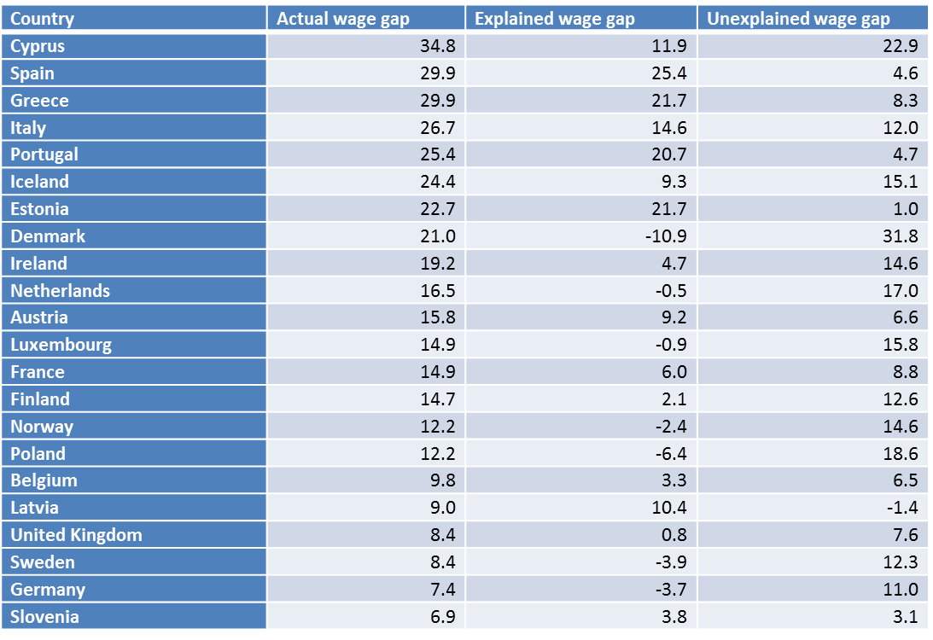
Key policy challenges – Enhancing the developmental impact of migration
ILO research found that there continued to be significant wage gaps between migrant workers and nationals. This concerns both high and low-wage earners. --Global Wage Report 2014-15
In Europe, the average wage gap is 17.5 per cent between nationals and migrants, 11.3 per cent of which falls into this category of potentially discriminatory factors.
Lack of access to equal and fair wages, decent working conditions, freedom of association and adequate social protection detracts from migrants’ ability to contribute to development.
Wage gap between migrants and nationals in Europe (%)
Source: ILO estimates. ILO Global Wage Report 2014/15. Wages and income inequality

Slide 10
Key policy challenges – reducing migration cost in the migration cycle
Document costs/recruitment fees, other service fees
Transportation costs to destination country
Return and re- integration
Costs associated with stay and work at destination
2

Slide 11
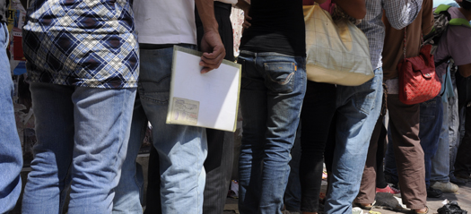
Key policy challenges – reducing migration cost ILO Fair Recruitment Initiative
Addressing high costs of labour migration would increase migrants’ disposable income and enhance the developmental impact of remittances
Strengthen knowledge base
Strengthen laws, policies and enforcement mechanism
Promote fair business standards and practices
Foster social dialogue and partnerships and promote good practices

Slide 12
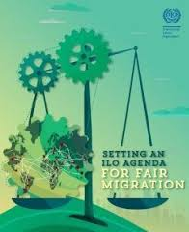
Fair Migration Framework
Making migration a choice and not a necessity, by creating decent work opportunities in countries of origin
Respecting the human rights, including labour rights, of all migrants
Ensuring fair recruitment and equal treatment of migrant workers to prevent exploitation and level the playing field with nationals
Formulating fair migration schemes in regional integration processes
Promoting bilateral agreements for well-regulated and fair migration between member States.
Countering unacceptable situations through the promotion of the universal exercise of fundamental principles and rights at work.
Promoting social dialogue by involving Ministries of Labour, trade unions and employers’ organizations in policy making on migration
Contributing to a strengthened multilateral rights-based agenda on migration

Slide 13
Thank you very much for your attention!

