Slide 1
New challenges of the rapidly changing world of work
changing workplace, employment relations - digitalisation, remote work, ...
how about workplace safety representatives?

Slide 2
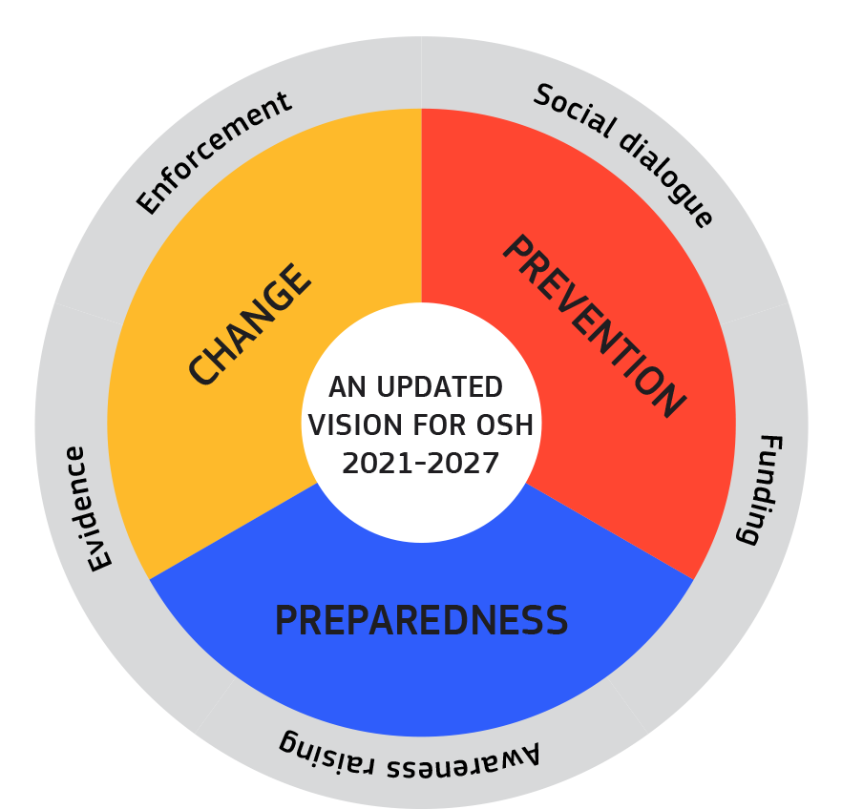
Modern and longstanding challenges on OSH Anticipating and managing change
Drivers of change
Green transition
Digitalisation
Ageing workforce
Alternative forms of employment
Shifting patterns of employment
New risks?
Trends in OSH outcomes
Injuries
Ergonomics-related illnesses
PSR-related illnesses
Illnesses related to dangerous substances
Illnesses related to physical agents

Slide 3
What are your main concerns:
What do you consider as most burning problems present?
What do you consider as problematic upcoming issues?
What do you see as possible issue to be positively resolvable?
Changes through trade and technology – capital’s interest?

Slide 4
Green transition
Risks arising from climate change mitigation
Refitting of buildings
Recycling and waste treatment
New technology
Risks arising from environmental effects of climate change
Geographical spread of diseases and vectors
Extremes of temperature
Natural disasters
Uncertainty and unpredictability

Slide 5
Digitalisation
Automation – advanced robotics and AI
Risk of injury
Psychosocial risks.
AI-based worker management
Psychosocial risks
Effects on OSH management
Digital platform work
Psychosocial risks
Ergonomic and injury risks
Effects on OSH management
Advanced OSH monitoring
Worker exposures
Physiological and psychological effects
Worker location / proximity warning
Context-relevant support in real time
Remote work
Isolation, intensity, privacy, right to disconnect, etc.

Slide 6
Digitalization: OSH opportunities and challenges
Remote work and hybrid working arrangements
The gig and platform economy
Wearables, monitoring devices and smart technology
Automation, AI and robotics
Digitalization - opportunities to improve OSH
working remotely - increased flexibility and the ability to work from home
Automation and use of AI and robotics for hazardous or repetitive tasks
Wearables and other smart devices can monitor hazards in the working environment
Digitalization also presents many OSH risks, which must be prevented and mitigated

Slide 7
‘OSH-Pulse’ survey – employer’s use of digital devices Flash Eurobarometer: EU27 – 25,683 interviews with workers from 25.04 - 23.05.2022 EU-OSHA

Slide 8
Teleworking – working from home
Form of remote work – outside the employer's workplace Voluntariness – based on mutual agreement Flexible scheduling of working hours by the employee Improved work-life balance Conflict of the employer's right to organize work and the inviolability of employee‘s home Framework Agreement on Telework 2002 – right to request OSH inspection of home work environment Specifics of OSH – difficult control, ergonomics, psychosocial aspect

Slide 9
Remote work and psychosocial factors
Common psychosocial factors when working remotely - Including work-pace, work-load and work-schedule; work-life balance; and violence and harassment
Inadequate information
Isolation
Frustration and boredom
Work-pace, work-load and work-schedule (Long working hours)
Work-Life Balance, blurring lines between work and family life
Multiple burdens (working duties, household chores, caretakers, home-schooling, etc.)
Violence and harassment (including domestic violence)

Slide 10
Impact of psychosocial risks and work-related stress on remote workers
Psychological responses: low mood, low motivation, exhaustion, anxiety, depression, burnout and suicidal thoughts
Physical reactions: digestive problems, dermatological reactions, cardio-vascular disease, musculoskeletal disorders, headaches or other unexplained aches and pains
Increased risk of work injuries and accidents (due to reduced accuracy)
Impact on workplace productivity: increased absenteeism and presenteeism, lower job engagement and reduced job performance (with respect to both the quality and quantity of work)
28. 04. 2023 Károly György Seminar on Trade unions and International Labour Standards – Skopje 15

Slide 11
Special focus on work-load, work-pace and work-schedule
Risks
Workers may experience either work overload or underload
Unrealistic work-pace or deadlines
Working long hours or late into the night
Impact on OSH
Stress and burnout
Physical and mental fatigue
Increased risk of mental health effects, such as anxiety or depression
28. 04. 2023 Károly György Seminar on Trade unions and International Labour Standards – Skopje 16

Slide 12
Improving the physical environment and ergonomic factors during remote work Suggested Actions
Employers should provide workers with adequate information on:
Ways to modify the physical environment to reduce risks
Reviewing where the screen is located to avoid glare;
How best to place equipment to minimize twisting or overreaching;
Varying work tasks to change positions;
Taking regular breaks and to stand and move for one minute every hour
Train people working from home in how to work from home safely and effectively
Adequate equipment should be provided when needed to complete the job tasks
Workers should be aware of (empowered for) their rights, duties - protection

Slide 13
Workload, work-pace and work-schedule and preventing stress Suggested Actions
Management commitment and support and connection with supervisors and colleagues
Review and clearly define tasks, responsibilities and results to be achieved
Assess workload and adjust and redistribute work assignments, if needed
Improve working methods and ensure that the necessary equipment and supports are available to help workers complete their tasks safely and efficiently
Arrange work schedules with hours of contactability and emphasize the right to disconnect
Include sufficient breaks and encourage workers to have regular breaks
Encourage relaxation exercises, stretching or recreational activities during breaks in meetings
28. 04. 2023 Károly György Seminar on Trade unions and International Labour Standards – Skopje 18

Slide 14
Special focus on work-life balance
Blurred boundaries between personal lives and work when working from home
Working hours and contactability
Lack of clarity around sick leave and other policies
Balancing work with family duties, such as young children or family members who may be at home
Potential Impacts on Occupational Safety and Health
Increased stress and other psychological effects
Physical and mental fatigue, burnout
Negative effects on social health and wellbeing
28. 04. 2023 Károly György Seminar on Trade unions and International Labour Standards – Skopje 19

Slide 15
Work-life balance Suggested actions
Increase flexibility in working-time arrangements
Inform workers
Allow workers to use annual leave and/or parental leave if needed
Combine flexibility with ground rules about when workers are or are not available for working in order to allow them to disconnect from work at specified times reserved for rest and personal life
Promote a focus on the quality of work rather than quantity
Advise workers about creating a dedicated workspace free from disruptions and establishing boundaries around their working hours with their partners, children and/or house mates
Right to disconnect!
28. 04. 2023 Károly György Seminar on Trade unions and International Labour Standards – Skopje 20

Slide 16
Special focus on violence and harassment
Risks
Cyberbullying,
Domestic violence,
Suggested Actions
Develop a workplace policy and ensure application
Regularly consult with workers and their representatives
Provide workers with clear instructions
Procedures to prohibit discrimination and harassment and promote fair treatment
Raise awareness
Improve communication
28. 04. 2023 Károly György Seminar on Trade unions and International Labour Standards – Skopje 21

Slide 17
Communication, information and training Suggested actions
Create an environment of open, honest and effective communication
Engage in dialogue between employer and workers about their concerns and needs
Train managers and supervisors to act as role models
Train managers and supervisors and workers’ OSH reps in how to recognize signs of depression and stress disorder and detect violence and harassment
Teach calming skills and maintenance of natural body rhythms (for example, nutrition, sleep, rest and exercise)
Educate managers about best practices for dealing with remote workers, so they are better able to mentor and support their teams
Respect workers’ privacy
28. 04. 2023 Károly György Seminar on Trade unions and International Labour Standards – Skopje 23

Slide 18
Remote Work and Health Promotion Health promotion and prevention of negative coping behaviours
Working from home can bring profound changes to normal routines, increasing the risk of some unhealthy behaviours, which may affect both physical and mental health and have a negative impact on job performance.
Psychosocial risks and work-related stress are associated with unhealthy behaviours, including
heavy alcohol consumption
increased cigarette smoking
poor eating habits
less frequent physical exercise
irregular sleep patterns
28. 04. 2023 Károly György Seminar on Trade unions and International Labour Standards – Skopje 24

Slide 19
Remote Work: Health promotion and prevention of negative coping behaviours Suggested actions
Revise working-time arrangements
Inform and educate workers about healthy routines for sleep
Encourage regular exercise,
Encourage healthy habits
Provide training and resources on alcohol and drugs and services available
Train managers and supervisors
28. 04. 2023 Károly György Seminar on Trade unions and International Labour Standards – Skopje 25

Slide 20
OSH in theory - main concerns for legislation
Basic conflict - inviolability of the dwelling vs. right to organize work No OSH exemptions when working from home The employer is still strictly liable for work-related accidents, even if they occur in the home environment In the area of OSH employers fulfil their tasks both by appropriate work organisation and by a system of preventive measures. The possibilities are narrowed down to mainly pre-discussed measures The costs associated with ensuring OSH are covered by the employer
28. 04. 2023 Károly György Seminar on Trade unions and International Labour Standards – Skopje 26

Slide 21
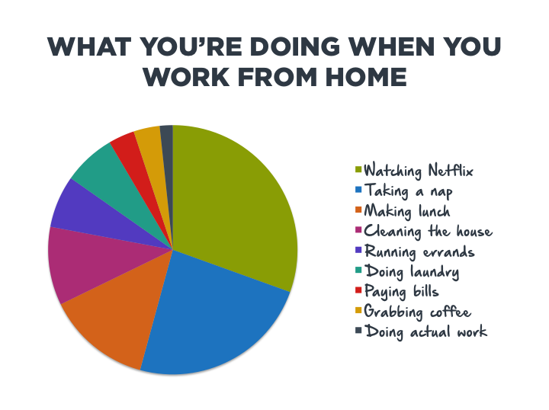
28. 04. 2023 Károly György Seminar on Trade unions and International Labour Standards – Skopje 28

Slide 22
Social Partner Agreement on digitalisation - aims to:
to support the successful digital transformation of Europe's economy and to manage its large implications for labour markets and the world of work.
- Raise awareness and improve understanding of employers, workers and their representatives of the opportunities and challenges in the world of work resulting from the digital transformation;
- Provide an action-oriented framework to encourage, guide and assist employers, workers and their representatives in devising measures and actions aimed at reaping these opportunities and dealing with the challenges, whilst taking into account existing initiatives, practices and collective agreements;
- Encourage a partnership approach between employers, workers and their representatives;
- Support development of a human-oriented approach to integration of digital technology in the world of work, to support/assist workers and enhance productivity;

Slide 23
Social Partner Agreement on digitalisation - aims to be achieved by:
By:
- Outlining a joint dynamic circular process, which takes into account the different roles and responsibilities of the different actors and can be tailored to different national, sectoral and/ or enterprise situations, industrial relations systems, jobs and different digital technologies/ tools;
- Highlighting concrete approaches, actions and measures, which employers, workers and their representatives can use, according to their specific needs and circumstances, to tackle topics such as skills, work organisation and working conditions.

Slide 24
Social Partner Agreement on digitalisation
The Autonomous Agreement has been concluded by the European cross-sectoral social partners and applies to the whole of the EU/EEA.
It covers all workers and employers in the public and private sectors and in all economic activities including in activities using online platforms where an employment relationship exists, as defined nationally.
When referring to ‚enterprises` in this agreement, it is meant organisations from private and public sector.
When referring to ‚workers representatives` in this agreement, the prerogatives of trade union representatives are to be recognised, in accordance with national law and practice.

Slide 25
Health and safety
Digitalisation can enhance autonomy, flexibility, work/life balance, attract or retain employees with disabilities
It also brings mental, cognitive and physical health risks due to intensification, excessive working hours, overtime, psychosocial risks
digitalisation introduced or deepened only if there are no negative health and safety issues for workers based on risk assessments.
Health risk assessments in consultation of trade unions must include staffing levels, workload, domestic violence
Teleworkers must have ergonomically fit equipment
Sufficient facility time provided to workers and trade union representatives to attend trade union health and safety training on digitalisation.
28. 04. 2023 Károly György Seminar on Trade unions and International Labour Standards – Skopje 32

Slide 26
Implementation
Trade union wins e.g. on right to consultation or collective bargaining on telework, right to disconnect, OSH risk assessments (including domestic violence), AI, outsourcing and public investment in own staff IT skills
Trade unions’ digital access to members and potential members
European Commission asked to look into follow up measures
28. 04. 2023
Károly György Seminar on Trade unions and International Labour Standards – Skopje 33

Slide 27
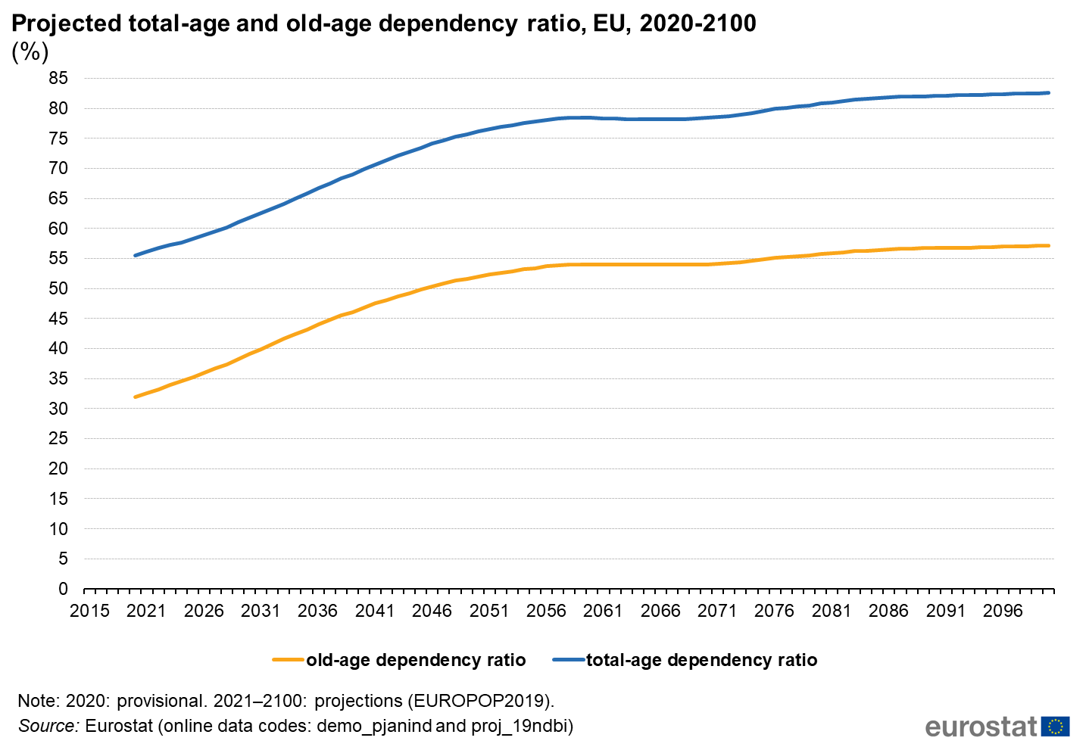
Ageing workforce
Longer working life
Increased likelihood of an accident
Increased likelihood of exposure
Increased exposure ‘dose’
Age-related vulnerabilities
Increased frailty
Underlying conditions and
comorbidities
Diminishing capacities
Poorer recovery
Caring responsibilities
Dependent older relatives or
partner

Slide 28
Alternative forms of employment
Temporary agency
Seasonal work
Self-employed
Platform work and bogus self-employment
Subcontracting chains
Poorer risk prevention
Many not covered by OSH legislation
Precarious employment
More likely to suffer other disadvantages

Slide 29
Shifting patterns of employment EUROSTAT, share of employment in selected sectors 1996 and 2019 (%)
Increasing service sector jobs
20-year changes: agriculture halved, industry down a quarter, and services up by half
Outsourcing or reshoring
Proposal for a Carbon Border Adjustment Mechanism (CBAM)
EU Plastics Strategy
Return of jobs in industry?

Slide 30
New risks?
Pandemics
Health and care sectors
Other essential jobs
Role of OSH
Structural ICT vulnerabilities
Systems need to be robust and resilient
Consider impact on workers
Shifts in society’s views and behaviours
E.g. ‘farmer bashing’, attitudes to COVID-19 healthcare workers, attention on meat processing and COVID-19
Ethical consumer, societal expectations, CSR and reporting systems
Attitudes to various industries’ impact on climate
New technology and materials
5G and the digital universe
Developing intelligent materials, nano-formulations and advanced composites

Slide 31
‘OSH-Pulse’ survey – health problems caused or made worse by work Flash Eurobarometer: EU27 – 25,683 interviews with workers from 25.04 - 23.05.2022 EU-OSHA

Slide 32
Contributing to a strong evidence base – OSH Overviews EU-OSHA
Musculoskeletal disorders (2017-2021)
Prevalence, costs, demographics
Chronic MSDs, static postures, rehabilitation and return to work, psychosocial link, telework
Digitalisation (2020-2023)
Automation (robotics and AI), AI-based worker management, online platforms, monitoring systems
Supporting compliance (2020-2023)
Enforcement, prevention services, social reporting, supply chains and business incentives
Psychosocial risks and mental health (2022-2025)
Scoping phase in 2021
Health and care sectors (2023-2026)
Scoping phase in 2022
Circulatory diseases (proposal for 2024-2027)
Describing the state of knowledge
Reviewing policy and practice
Exploring the role of intermediaries
Identifying prevention measures at the workplace
28. 04. 2023 Károly György Seminar on Trade unions and International Labour Standards For the Western Balkans Trade Unions

Slide 33
Research conclusions and policy pointers (EU-OSHA)
Need to focus on the ‘hard to reach’
MSEs as ‘learners’, ‘reactors’ and ‘avoiders’
Self-employed and false self employed
Regulation fit for purpose… but not only
Collective agreements
Awareness raising
Guidance and tools
Support and access to expertise
Inspection and enforcement
Importance of an ‘orchestrated’ approach
Tailored approach
Exploiting employers’ ‘contact points’
Essential role of social dialogue and worker representation on OSH
Genuine participation at workplace level
Examples of good practice
Participation in policy making and regulation
28. 04. 2023 Károly György Seminar on Trade unions and International Labour Standards For the Western Balkans Trade Unions

Slide 34
‘OSH-Pulse’ survey – initiatives on psychosocial risks in the workplace Flash Eurobarometer: EU27 – 25,683 interviews with workers from 25.04 - 23.05.2022 (EU-OSHA)
28. 04. 2023 Károly György Seminar on Trade unions and International Labour Standards For the Western Balkans Trade Unions

Slide 35
Work-life balance: discussion in Hungary
A lot of Hungarians work themselves into graves: „such a work slowly kills”
Spending significantly more time at work than the average of 40 hours a week can not only lead to chronic sleep deprivation and increase the likelihood of accidents at work,
but what is even more dangerous: the more overtime someone does, the more likely they are to have a heart attack or stroke.
What employers should do in times of crisis:
Talk the Walk
Walk the Talk
Get the „icebear” out of the mind
Develop – develop – develop
Employ a psychologist

