Slide 1
EU OSH Strategy Framework – National OSH policies – Trade union priorities

Slide 2
EU competences in the area of OSH
TFEU Art. 153 (1):
« (…) the Union shall support and complement the activities of the Member States in the following fields:
Improvement in particular of the working environment to protect workers’ health and safety
TFEU Art. 153 (2):
« To this end, the European Parliament and the Council may adopt (…) by means of directives, minimum requirements (…) »
27. 04. 2023 Skopje
Károly György Seminar on Trade unions and International Labour Standards

Slide 3
EU competences in the area of OSH
Directive 89/391/EEC - OSH "Framework Directive"
introduced measures to encourage improvements in the safety and health of workers at work. It applies to all sectors of activity, both public and private, except for specific public service activities, such as the armed forces, the police or certain civil protection services.
it is fundamental - the basic safety and health legal act which lays down general principles concerning the prevention and protection of workers against occupational accidents and diseases. It contains principles concerning the prevention of risks, the protection of safety and health, the assessment of risks, the elimination of risks and accident factors, the informing, consultation and balanced participation and training of workers and their representatives.
+24 individual specific directives
27. 04. 2023 Skopje
Károly György Seminar on Trade unions and International Labour Standards

Slide 4
« The European Pillar of Social Rights has been our reference point for building a strong social Europe. Now we breathe new life into it, turning its principles into actions. »
Nicolas Schmit, European Commissioner for Jobs and Social Rights
The 20 principles of the European Pillar of Social Rights are the beacon guiding the European Union, member states „towards a strong social Europe that is fair, inclusive and full of opportunity”.
27. 04. 2023 Skopje
Károly György Seminar on Trade unions and International Labour Standards

Slide 5
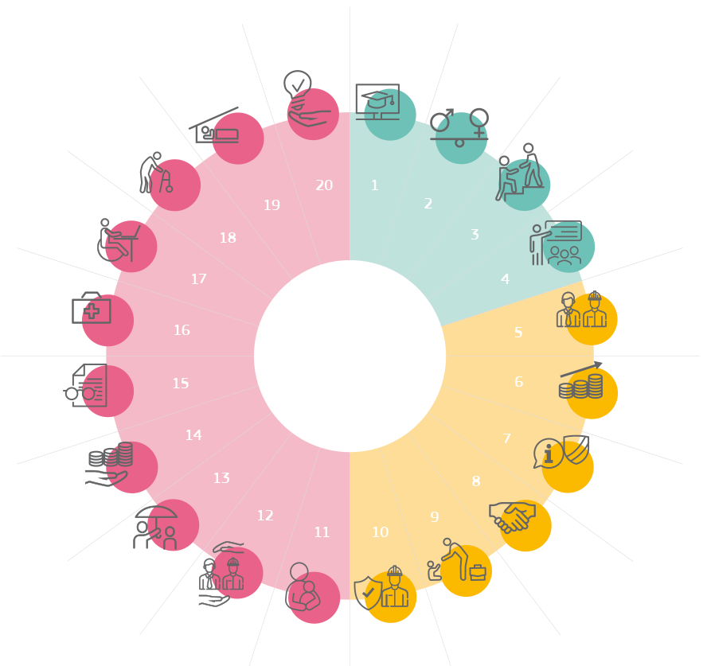
Access to essential services
Education, training and life-long learning
Housing and assistance for the homeless
Gender equality
Long-term care
Equal opportunities
Inclusion of people with disabilities
Active support to employment
Healthcare
Secure and adaptable employment
European Pillar of Social Rights
Old-age income and pensions
Wages
Information about employment conditions and protection in case of dismissals
Healthy, safe and well-adapted work environment and data protection
Minimum income
Social dialogue and involvement of workers
Unemployment benefits
Work-life balance
Social protection
Childcare and support to children

Slide 6
10. Healthy, safe and well-adapted work environment and data protection (Chapter I: Equal opportunities and access to the labour market)
Workers have the right to a high level of protection of their health and safety at work. Workers have the right to a working environment adapted to their professional needs and which enables them to prolong their participation in the labour market. Workers have the right to have their personal data protected in the employment context.
Related Commission action: EU strategic framework on health and safety at work 2021-2027, Communication and proposal to better protect people from asbestos
27. 04. 2023 Skopje
Károly György Seminar on Trade unions and International Labour Standards

Slide 7
EU Pillar of Social Rights Action Plan
The EPSR Action Plan was adopted on 4 March 2021
Outlining concrete actions to further implement the principles of the EPSR Action Plan
Porto Social Summit in May 2021: Porto Social Commitment signed by PT PCY, COM, EP and social partners
➔ Joint effort to consolidate the commitment already made with the EPSR
27. 04. 2023 Skopje
Károly György Seminar on Trade unions and International Labour Standards

Slide 8
EPSR Action Plan – OSH related actions
2021 - new EU OSH Strategy Framework
2022 - in consultation of social partners legal proposals presented to further reduce workers’ exposure to hazardous chemicals including asbestos
Commission encourages public authorities, social partners to ensure the application and enforcement of existing rules
27. 04. 2023 Skopje
Károly György Seminar on Trade unions and International Labour Standards

Slide 9
EU OSH strategic framework 2021-2027
The Strategic Framework takes a tripartite approach — involving EU institutions, Member States, social partners and other stakeholders — and focuses on three key priorities and actions for improving workers’ health and safety, addressing rapid changes in the economy, demography and work patterns.
Anticipating and managing change in the new world of work (e.g. digital, green and demographic transitions / mental health)
Improving prevention of work-related diseases and accidents (e.g. ‘vision zero’ approach / updated rules on hazardous chemicals / etc.)
Increasing preparedness for possible future health threats (e.g. emergency procedures and guidance for future health crises)
27. 04. 2023 Skopje

Slide 11
The actions in the strategic framework are to be implemented through
strong social dialogue,
a strengthened evidence based policy-making,
improved enforcement and monitoring of existing EU legislation, (iv) awareness-raising, and
mobilising funding to invest into occupational safety and health, including from EU funds
Member States to update their national occupational safety and health strategies to ensure that the new measures reach the workplace
Beyond EU borders - continue playing a leading role in promoting high occupational safety and health standards globally.

Slide 12
Trade union priorities - ETUC
Promote new and improved national OSH strategies / Social partners’ involvement / Support implementation in micro, small and medium-sized enterprises / Enlarge the scope of the EU OSH strategy to self-employed / Enforcement / New work patterns / prevent work-related diseases, accidents, violence and harassment / Improve statistical data collection and OSH evidence base / strengthen international cooperation / Mainstream OSH.
Gender perspective given more prominence / Covid-19 pandemic is not only a public health issue but very much an occupational health issue.

Slide 13
ETUC opinion
European Commission has taken on board much of the trade union analysis concerning OSH failures.
ETUC is disappointed that the Commission has remained very limited in the actions proposed.
Welcome the three key priorities
Would have preferred a strategy as compared to a strategic framework - for more political weight to the goals and actions proposed, and ensured their proper follow-up

Slide 14
ETUC - Preventing work-related diseases, accidents and harassment
ETUC welcomes the "vision zero" on work-related accidents - including gender focus - all work-related accidents and diseases.
be more proactive – focusing on risk prevention
abide to the principle of prevention
through consultation, social dialogue
underpinned by strong regulation and enforcement.
fight against workplace violence and harassment - in line with the ILO Convention 190 on violence and harassment in the world of work, which covers all work-related violence and harassment.

Slide 15
ETUC - Preventing work-related diseases - cancer
Strategy Framework not ambitious enough in combating work related cancer.
Currently only 27 such carcinogens are subject to limits, bad limit values
A risk based approach should be adopted to set limit values for carcinogens, not a methodology that considers the protection of workers as a cost.
Asbestos: the Strategic Framework only speaks of a revised limit value. The ETUC considers it imperative that the asbestos directive in modernised thoroughly, as this would protect workers better.

Slide 16
ETUC - MSD / Psyco Social Risks
Musculoskeletal Disorders – EC approach not ambitious enough. ETUC calls for an EU Directive on work-related MSDs
PSR - the main reason that motivates enterprises to manage OSH is fulfilling the legal obligation. PSR in the MSs’ legislation varies significantly
Strategy Framework propose only guidance on psychosocial risks
European Commission asks the social partners to take action and update existing agreements relating to psychosocial risks. The autonomous framework agreement on workrelated stress – 2004 - incomplete implementation
Gender dimension should be taken across the development of OSH strategies to prevent occupational stress, starting from the design of the risk assessment.

Slide 17
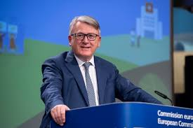
Trade unions – right to disconnect
‘Right to disconnect’ should be an EU-wide fundamental right – European Parliament
EU directive on the right to disconnect
„a worker’s right to be able to disengageform work and refrain from engaging in work-related electronic communication such as emails or other messages during non- work hours
Work organisation / management
Need to put in place measures to prevent
„Why should some workers in Europa have this right and not others. We really have to work on that”
The framework aims to address these changes to the way we work to ensure that everyone is protected – all of the time”

Slide 18
ETUC - New work patterns
„Need to modernise and simplify EU OSH rules in the context of the green and digital transitions” – The narrative of the “better regulation agenda” must not debilitate the European OSH acquis by identifying as an obstacle for business to grow and operate more freely in the market.
Commission: „need to enact new OSH Directives in the field of digitalisation” - ETUC calls for OSH to be integrated into this legislation. (example: Artificial Intelligence Act does not deal with the use of AI as a measure of control and surveillance of workers)
Self-employed, platform workers must be covered by OSH acquis.

Slide 19
ETUC - Enforcement
Member States to step up on enforcement.
1 labour inspector per 10 000 workers
Need strengthening the sanctioning mechanisms.
Role of trade union workplace health and safety representatives should be strengthened.
Social partners should be properly involved in designing and implementing sound health and safety measures
Dedicated working party of ACSH on enforcement
unless enforcement is set as a priority, it will not be possible to achieve the pursued vision zero on work related accidents and diseases

Slide 20
EU OSH Strategy Framework – National policies
EC calls on MS to update and draw up their national OSH strategies in line with the strategic framework – in cooperation with social partners
2023 OSH summit - stocktaking of progress and assessment of adaptation
Process of national level evaluation – trade union involvement !
- Trade union involvement in the EU-OSHA national Focal Point work

Slide 21
ETUC Congress Action programme (draft) - OSH
2.3. Safeguarding Occupational Health and Safety
State of Play and Challenges
High – unacceptable –number of work-related accidents and illnesses
Increasing range of challenges. Growing precariousness in employment
Climate change
Work related stress
Violence and harrasment at work
Carcinogenes – cancer
Notes:
2.3.1. In the EU there are 12 fatal work-related accidents per day in the EU, despite some improvement in the total number of occupational diseases, accidents and casualties; these are still far too many. Work-related cancer due to exposure to hazardous substances is responsible for 53% of all work-related deaths, amounting to 100.000 workers passing away per year. Furthermore, traditional hazards remain on a high level. In June 2021, the European Commission presented its Strategic framework on health and safety at work.
2.3.1. In the EU there are 12 fatal work-related accidents per day in the EU, despite some improvement in the total number of occupational diseases, accidents and casualties; these are still far too many. Work-related cancer due to exposure to hazardous substances is responsible for 53% of all work-related deaths, amounting to 100.000 workers passing away per year. Furthermore, traditional hazards remain on a high level. In June 2021, the European Commission presented its Strategic framework on health and safety at work.
2.3.4. Work-related stress and psychosocial health issues accounts for more than half of all working days lost in the EU and affects female workers to a greater extent; in addition there is a growing number of workers in need of protection because they are subject to online harassment and shaming.
2.3.5. Workers, particularly women, face work-related violence, either from the employer, third parties and even co-workers. The duty of care of employers includes putting in place measurements for ensuring a workplace free of harassment and violence.
2.3.6. There are at least 23 dangerous carcinogens that workers are exposed to that still need to be addressed as a priority. Arduous and strenuous work is still a major OHS problem and the reason for physical pain, musculoskeletal disorders, reduced employability and early retirement for millions of workers in the EU.
2.3.3. Climate change –including extreme temperatures, growing exposure to UV-radiation and weather events – is also increasing risks for working people affecting their physical and mental health, and sometimes causing their death.

Slide 22
ETUC Congress Action programme (draft) - OSH
Actions 1 - The ETUC will:
Continue working to achieve Zero Deaths by 2030, by bringing to the forefront the realities of work-related deaths and occupational illnesses. - Cooperation with all stakeholders. - Particular attention to the safety and health of migrants on construction sites, including undocumented migrants, and including the right to decent housing;
Mainstream the gender dimension in the field of occupational safety and health;
Advocate for the revision of EU legislation on OSH to better protect workers against new and long-standing risks, like MSDs Work for extension of the scope of the Framework Directive and the individual directives to domestic servants, currently exclude;
Address psychosocial risks, including online harassment and shaming, at work through a European Directive that creates the conditions for trade union action against growing risks with an organisational and collective approach that e.g. takes into account staffing levels;

Slide 23
ETUC Congress Action programme (draft) - OSH
Actions 2 - The ETUC will:
Work to improve the REACH regulation in the light of providing better protection of workers against the exposure to chemical substances and nanomaterials;
Move towards EU legislation that establishes the temperature limits for people to be able to work outdoors in order to prevent injuries and accidents at work.
Support the development or re-establishment of dedicated OSH instances with dedicated resources for workers’ representatives and trade unions in the workplace, respectful of national models, to support, defend and enforce OSH in the workplace.
Support the implementation of the CMRD (Carcinogen, Mutagen and Reprotoxic Directive) and its revisions to include new BOELs on CMR substances while supporting alternative risk-free substances and protect from poly-exposure.
Build on the recognition of ILO Conventions on OSH as fundamental principles to support trade unions’ campaign for their swift ratification at national level and their actions dedicated to OSH.

Slide 24
111. International Labour Conference
Items placed on the agenda by the Conference or the Governing Body:
Proposed Convention and Recommendation concerning the partial revision of 15 international labour instruments following the inclusion of a safe and healthy working environment in the ILO’s framework of fundamental principles and rights at work

Slide 25
Trade unions – using EU OSH Strategy Framework:
Build in / prioritize OSH into union policies – in together with sectoral unions
Capacity building measures to empower workplace unions to deal with OSH
Involvement in OSH policy setting – participate in national OSH structures
Active role in national strategy setting and application / monitoring
Bring OSH issues out from workplace – out to the public
Open up to non-traditional groups of employment
But first of all: thematise / build capacity in unions for OSH !

