Slide 1
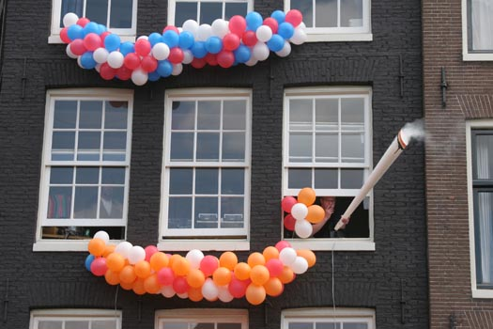
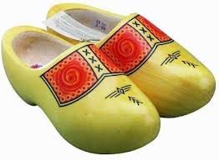
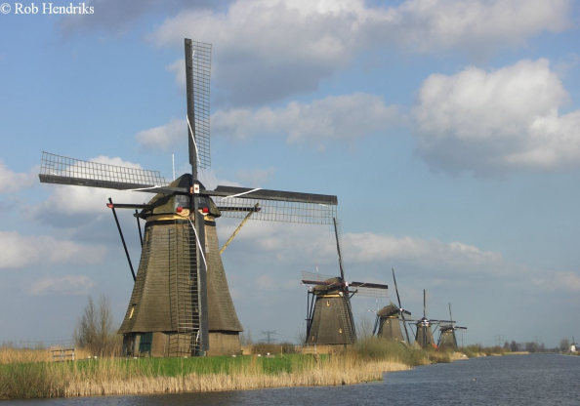
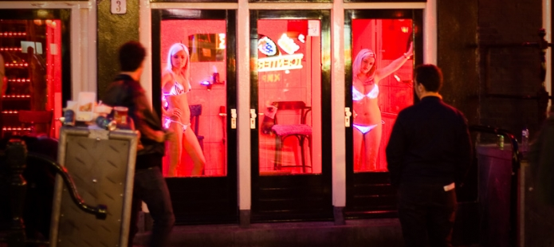
Welcome to the Netherlands!
Holland in a nutshell The Netherlands…Zeedijk Amsterdam…windmills…tulips…coffee shops…..a King…

Slide 2
The Netherlands….Europe's paradise for workers??
3000 workers die preliminary due to an occupational disease and long-term exposure of unhealthy working conditions.
Around 90 workers die every year because of an accident at work.
More then 220.000 accidents happens each year where workers are badly injured.
Some 30.000 workers will ‘catch’ an occupational disease every year.
We are top scorer on amounts of workers who have to face a total ‘burnout’
We are ‘leading’ on exposure to aggression and violence at the workplace as well as stress and high work pressure at work
Unannounced inspections do not exist in the Netherlands
Part of prevention is having a well organized Labour Inspectorate!
200 H&S inspectors for almost 8 million workers is not enough…

Slide 3
Young and united FNV union in the Netherlands their action in the news: stop youth wages above 18 years. Young workers they are being undressed

Slide 4
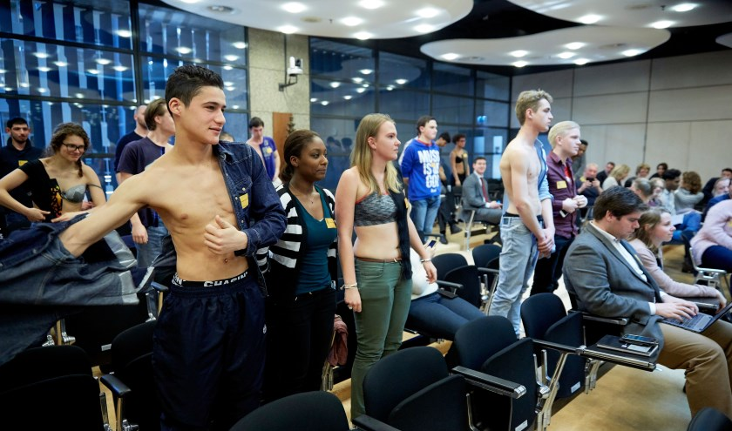
Young and united FNV Union Youht wages are criminal!

Slide 5
A minimum wage for young people was demanded!
You can’t buy a half glass of beer: youth wages are half wages for adult work!

Slide 6
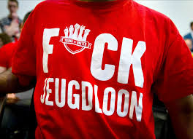
Youth wages are unfair.

Slide 7
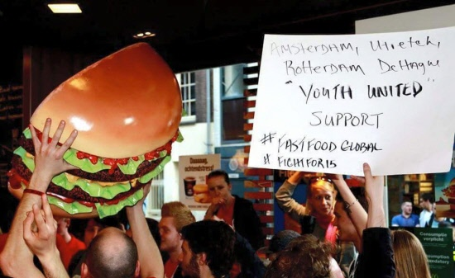
Half hamburgers do not exist: half waves sadly do!

Slide 8
Since July 2017: minimum wages in the Netherlands, thanks to the Unions
Tabel: minimun wage per month, week , day (bruto bedragen per 1 juli 2017)
Leeftijd | Per month | Per week | Per day
22 jaar en ouder | € 1.565,40 | € 361,25 | € 72,25
21 jaar | € 1.330,60 | € 307,05 | € 61,41
20 jaar | € 1.095,80 | € 252,90 | € 50,58
19 jaar | € 860,95 | € 198,70 | € 39,74
18 jaar | € 743,55 | € 171,60 | € 34,32
17 jaar | € 618,35 | € 142,70 | € 28,54
16 jaar | € 540,05 | € 124,65 | € 24,93
15 jaar | € 469,60 | € 108,40 | € 21,68
.

Slide 9
More wages….but better health and safety conditions?
Suddenly most young people ( between 18 en 21 years) receive 2 Euroos extra per hour!
Most accidents occur with young people, often during temporarely work in summertime. Young people are wounded during Tullip picking or driving a forklift truck
Stagiares/interns are ever worse off: they often have to work long days for nothing.

Slide 10
Something about Labour inspections
In de Netherlands we have 1 labour inspector for 30.000 workers
In total: 200 labour inspectors form the Government
Change that a company is visited by the Labour inspector is once in 30 years!
Even the employers federations think we need more inspectors

Slide 11
But we talk and talk with employers and governments: In the members states as well as in Europe
In the Netherlands we have strong dialoques with Government and Employers on:
National level, sector level and company level
We have a Social Economic Council where we formulate H & S advices for the Minister of social affairs
Just like in Europe….there we have also dialoques :
In the Adisory Committee on Safety and Health in Luxembourg where all Member states discuss on H & S ( 28 members from union’s side, 28 members from employers side and 28 members from Governments).
Here we dicuss and make advices ( Opinions) for the EU Commission. At het moment 6 EU directives are in an updating proces and also the CM Directive will be adapted.

