Slide 1
PERC OHS Western Balkan virtual meeting
ILO Centenary Declaration & ILO OSH Framework
The ILO Centenary Declaration
ILO Promotional framework for occupational safety and health
6 November 2020
Time 10:00hs
Speaker: Victor Hugo Ricco

Slide 2

1) ILO Centenary Declaration
for the Future of Work
A ROADMAP FOR A
HUMAN-CENTRED FUTURE

Slide 3

The ILO Centenary Declaration “marks an historic opportunity
to open a door to a brighter future for people around
the world.”
António Guterres
UN Secretary-General
Notes:
Adopted by the Centenary International Labour Conference in June 2019, the ILO Centenary Declaration for the Future of Work represents a significant milestone for the Organization, that sets out priorities for the ILO and its member States as it enters its second century.
In the words of UN Secretary-General António Guterres, the Declaration proposes a shift in the paradigm of how we look at development, and an historic opportunity to open a door to a brighter future for people around the world.

Slide 4
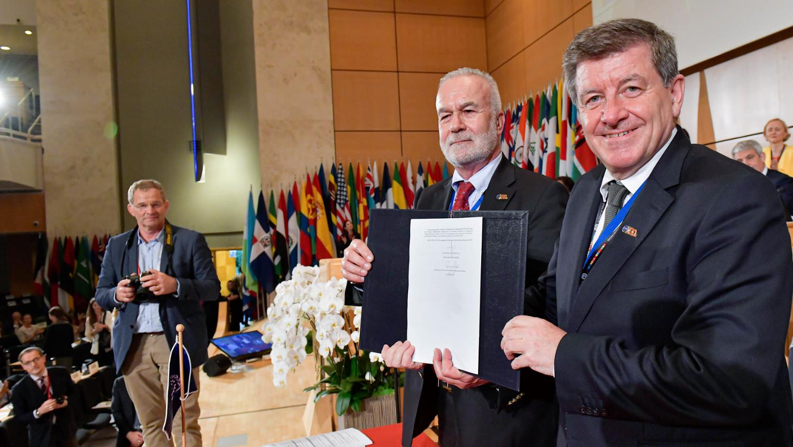
The ILO must carry forward in its
second century
with unrelenting vigour its constitutional mandate for
social justice.
Centenary Declaration
"
Notes:
The Centenary Declaration reaffirms the ILO’s social justice mandate and provides a framework for the Organization to carry forward its constitutional mandate for social justice.
The Declaration builds on other notable declarations in ILO’s history, notably the Declaration of Philadelphia (1944); the ILO Declaration on Fundamental Principles and Rights at Work (1998); and the Declaration on Social Justice for a Fair Globalization (2008).

Slide 5
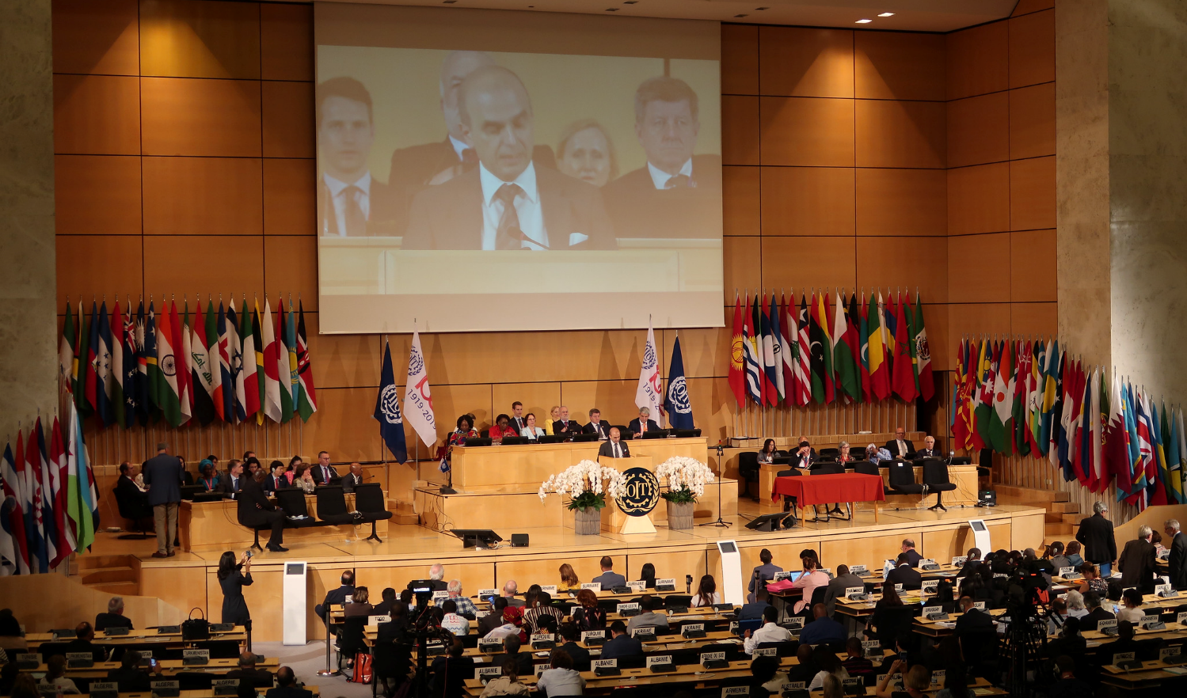
CENTENARY DECLARATION
A commitment to shape a better future of work
Adopted by the Centenary Labour Conference (June 2019)
Recognizes the transformational changes in world of work
Calls for a human-centred approach to the future of work
Reaffirms the ILO’s social justice mandate.
Provides guidance for the ILO’s priorities and programme.
Represents a crucial call to action for the ILO and its member States.
Notes:
The Centenary Declaration was adopted by Governments', employers’ and workers’ representatives of ILO member States at the historic International Labour Conference in June 2019.
It situates the organization in the context of the profound, transformational changes which are taking place in the world of work.
The Declaration differentiates the ILO from other bodies focusing on the future of work by calling for a human-centred approach, that ensures that people are at the heart of, and are the beneficiaries of, economic and social policies.
It reaffirms the ILO’s social justice mandate in all its dimensions, echoing the vision of the ILO’s founders.
And it provides guidance for the ILO’s priorities and programme as it enters a new phase of its history.
Recognizing that the ILO does not act in isolation, and that global challenges require concerted international action, the Declaration represents a crucial statement of intent and call to action for member States and a commitment to multilateral cooperation.

Slide 6
CENTENARY DECLARATION
Background and timeline
2013 Director-General proposes Centenary Initiatives
2015 Centenary Initiative on the Future of Work
2016-2017 National dialogues
2019 Report of the Global Commission on the Future of Work
2019 International Labour Conference adopts Declaration
Centenary Initiative
National dialogues
Global Commission
International Labour Conference
Notes:
The Centenary Declaration is the culmination of years of work within the framework of the ILO’s Future of Work initiative launched in 2015, following the proposals made by the Director-General in 2013.
Over a period of two years, ILO member States held a series of more than 100 tripartite national and regional dialogues.
Together, these dialogues produced a wealth of information and insights and an expression of priorities from countries at all levels of development.
The outcomes of these dialogues informed the work of the Global Commission on the Future of Work, which launched its report in early 2019. The Commission was chaired by two heads of government and made up of people from very diverse backgrounds and areas of expertise, and its groundbreaking report set out a human-centred agenda for the future of work.
The Global Commission’s recommendations, in turn, provided the foundation for the Centenary Declaration for the Future of Work, which, after often difficult debate, was unanimously adopted at the Centenary International Labour Conference.

Slide 7

CENTENARY DECLARATION
Transformative change in the world of work
"
  The world of work
  is experiencing transformative change, driven by technological innovations, demographic shifts, climate change
  and globalization.
Notes:
The ILO marks its Centenary at a time of transformative change in the world of work.
The drivers of this change are the impact of technology, which represents both enormous risks and opportunities for the world of work.
Demographic shifts are experienced in very diverse ways across the globe, with a growing youth population in Africa, for example, and ageing populations in other regions.
Climate change is having a major impact in all member States, and there is an urgent need to prepare for a just energy transition and the related new skills.
Globalization is not a new phenomenon, but the growth of largely unregulated borderless work in the digital economy, for example, has profound impacts on the nature of employment relationships and the future of work.

Slide 8

CENTENARY DECLARATION
Realizing the founding vision of the ILO
"
  Moved by the imperative of social justice…to reinvigorate the Organization and shape
  a future of work that realizes its founding vision.
Notes:
The Declaration reaffirms the imperative of social justice that gave birth to the ILO one hundred years ago, and the conviction that it lies within the reach of the governments, employers and workers of the world to reinvigorate the Organization and shape a future of work that realizes its founding vision.
The Declaration positions the ILO as the leading global organization for the future of work.

Slide 9

CENTENARY DECLARATION
Shaping the future of work
"
  A human-centred approach puts workers’ rights and the needs, aspirations and rights of all people at the heart of economic, social and environmental policies.
Notes:
In response to the transformation of the world of work, the Declaration calls for a human-centred approach to the future of work.
In line with the report of the Global Commission on the Future of Work, a human-centred approach puts workers’ rights and the needs, aspirations and rights of all people at the heart of economic, social and environmental policies.

Slide 10
CENTENARY DECLARATION
A human-centred approach
The approach focuses on three priorities for action:
Increasing investment in people’s capabilities,
Increasing investment in the institutions of work, and
Increasing investment in decent and sustainable work.
Notes:
The Centenary Declaration provides a basis for a human-centred approach to the future of work with decent work for all.
A human-centred approach to the future of work focuses on three priority areas for action.
Increasing investment in people’s capabilities.
Increasing investment in the institutions of work, and
Increasing investment in decent and sustainable work for all people.

Slide 11
CENTENARY DECLARATION
An agenda and priorities for the ILO
Strengthened constituent capacity and mechanisms of social dialogue.
Robust international labour standards and effective supervision.
Harnessing economic, social and environmental transformations.
Enabling entrepreneurship and sustainable enterprises.
Enabling effective lifelong learning to facilitate access to and transitions in labour market.
Transformative agenda on gender equality.
Effective protection for all workers.
Comprehensive and sustainable social protection for all.
Safe and healthy working conditions are fundamental to decent work.
Committing to a world of work free from violence and harassment;
Notes:
The Declaration also provides a framework for the ILO’s Programme of Work and identifies a number of priority areas for ILO action. These priorities will shape an ambitious programme of work for the Organization as it enters its new century.
Tripartism is at the heart of the ILO’s mandate, and there is a need to strengthen the capacity and representation of unions and employers’ organizations.
The ILO is a standard-setting organization. The ILO is committed to upgrading its work in this area, and ensuring that all standards are robust and up-to-date, with greater levels of ratification and effective supervision and compliance.
We need to fine new ways of harnessing the economic, social and environmental transformations, to ensure the human-centred approach in all policy areas.
And we need to ensure that we support and build effective and sustainable enterprises and new business models that generate decent work and productive employment.
The ILO will enhance its capacity to advise on lifelong learning, ensuring that the need for new skills is anticipated, and that training and education are matched to the new forms of work that are emerging.
The ILO has always promoted gender equality and will give priority to a transformative agenda for change.
The effective protection workers needs to go beyond traditional employment relationships, looking at all forms of work including informal work and the new forms of digital working relationships.
Finally, building on the strong ILO profile in this area, the ILO will strengthen its commitment to building the essential protection of all workers that are essential for social coherence and stability.

Slide 12
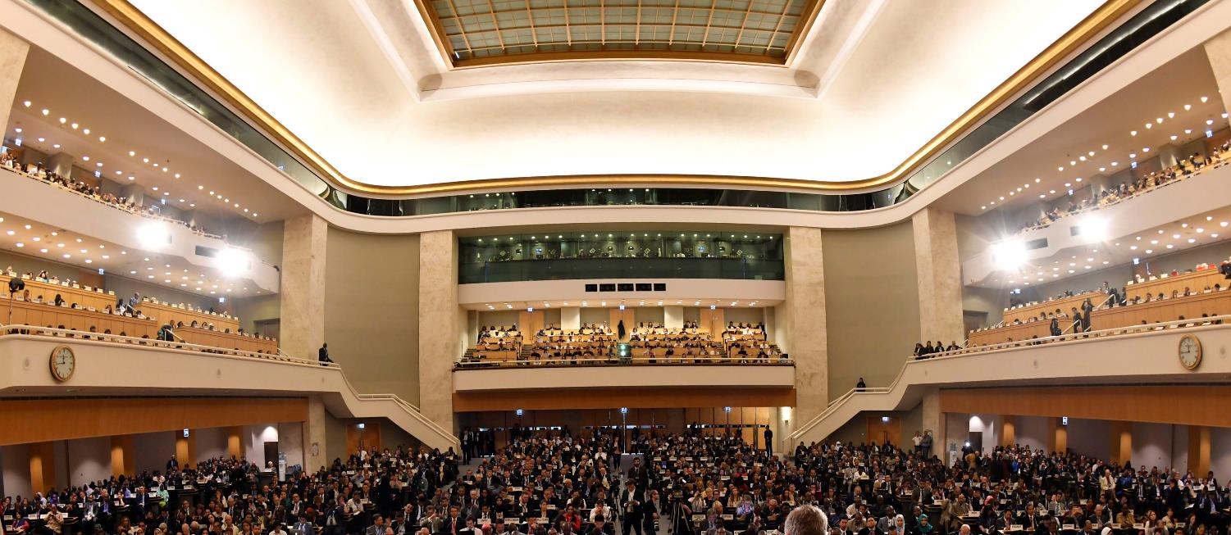
CENTENARY DECLARATION
A call to member States and social partners
Ensuring all people benefit from the changing world of work.
Ensure the continued relevance of the employment relationship.
Ensure adequate protection for all workers.
Promoting sustained, inclusive and sustainable economic growth, full employment and decent work.
Notes:
The Declaration calls upon all constituents to work individually and collectively, and with the support of the ILO, to further develop its human-centred approach to the future of work, with attention to a number of priority areas.
The Declaration calls upon member States and social partners to ensure that people benefit from the changes in the global economy.
It upholds the need for clear definitions in employment relationships, with adequate protections for all workers, regardless of their employment status.
The Declaration calls for greater cohesion across all policy areas.

Slide 13

CENTENARY DECLARATION
A roadmap for the future of the ILO
On the basis of its constitutional mandate, the ILO must take an important role
in the multilateral system in pursuit of its human-centred approach to the future of work.
Notes:
Finally, the Declaration reaffirms the need for the ILO to provide services to its member States and social partners in pursuit of its human-centred approach.
The ILO will remain committed to effective development cooperation and policy advice around the world.
The ILO will maintain the highest levels of statistical, research and knowledge management capacities and expertise to inform its work.
Finally, the Declaration calls upon the ILO to take an important role in the multilateral system, by reinforcing its cooperation and coordination, and building formal institutional arrangements with other organizations to promote policy coherence.

Slide 14
2) ILO Promotional framework for occupational safety and health- Key instruments on occupational safety and health
Promotional Framework for Occupational Safety and Health Convention, 2006 (No. 187)
As an instrument setting out a promotional framework, this Convention is designed to provide for coherent and systematic treatment of occupational safety and health issues and to promote recognition of existing Conventions on occupational safety and health. The Convention is aimed at establishing and implementing coherent national policies on occupational safety and health through dialogue between government, workers’ and employers’ organizations and to promote a national preventive safety and health culture.
Occupational Safety and Health Convention, 1981 (No. 155) and its Protocol of 2002
The convention provides for the adoption of a coherent national occupational safety and health policy, as well as action to be taken by governments and within enterprises to promote occupational safety and health and to improve working conditions. This policy shall be developed by taking into consideration national conditions and practice. The Protocol calls for the establishment and the periodic review of requirements and procedures for the recording and notification of occupational accidents and diseases, and for the publication of related annual statistics.
Occupational Health Services Convention, 1985 (No. 161)
This convention provides for the establishment of enterprise-level occupational health services which are entrusted with essentially preventive functions and which are responsible for advising the employer, the workers and their representatives in the enterprise on maintaining a safe and healthy working environment.

Slide 15
Protection in specific branches of activity
Up-to-date instrument
C120 - Hygiene (Commerce and Offices) Convention, 1964 (No. 120)
R120 - Hygiene (Commerce and Offices) Recommendation, 1964 (No. 120)
C167 - Safety and Health in Construction Convention, 1988 (No. 167)
R175 - Safety and Health in Construction Recommendation, 1988 (No. 175)
C176 - Safety and Health in Mines Convention, 1995 (No. 176)
R183 - Safety and Health in Mines Recommendation, 1995 (No. 183)
C184 - Safety and Health in Agriculture Convention, 2001 (No. 184)
R192 - Safety and Health in Agriculture Recommendation, 2001 (No. 192)

Slide 16
Occupational Safety and Health (OSH) - ILO Convention 155:
Applies to all workplaces and all employees (though with flexibility);
Emphasizes continuous improvement;
Outlines responsibilities, duties and rights of stakeholders;
Deals with issues such as policy and consultations with social partners, legislation, advice & enforcement, designers & manufacturers, training, employers’ responsibilities, workers’ duties and rights, bilateral cooperation;
Highlights universal principles on OSH (e.g. prevention, “so far as is reasonably practicable”, cooperation, hierarchy of protection, right to remove in case of imminent danger and to be protected, but with duty to inform).

Slide 17
Occupational Safety and Health (OSH) - ILO Convention 155:
calls for the formulation, implementation and periodical review of a national policy
  design, testing, choice, substitution, installation, arrangement, use and maintenance of the material elements of work
  relationships of the material elements of work and persons who carry out or supervise the work
  training in the adequate levels of safety and health
  communication and cooperation at all levels
  protection of workers and their representatives from disciplinary measures as a result of actions in conformity with the Convention
  definition of responsibilities of public authorities, employers, workers and others
  Implementation through legislation and enforcement by a system of inspection with adequate penalties for legal violations
  Include OSH in education and training

Slide 18
Occupational Safety and Health (OSH) - ILO Convention 155:
National authorities shall ensure:
  determination of conditions concerning design, construction and layout of undertakings, commencement of operations, major alterations, safety of technical equipment
  determination of work processes and substances/ agents the exposure to which is to be prohibited, limited or subdue to authorization
  procedures for notification of work accidents and occupational diseases
  production and publication of statistics
Obligations beyond the responsibility of employers:
  All who design, manufacture, import, provide or transfer machinery, equipment or
  substances for occupational use
    duty of care
    information and instructions
    be aware of scientific and technical progress

Slide 19
Occupational Safety and Health (OSH) - ILO Convention 155:
Collaboration with workers and their representatives
  Information on the measures undertaken
  appropriate training
  right to enquire the employer and to be consulted on all aspects of OSH associated with their work
Protection of workers (Articles 13/ 19)
A worker who has removed himself from a work situation which he has reasonable justification to believe presents an imminent and serious danger to his life or health shall be protected from undue consequences in accordance with national conditions and practice.
The worker will report to his supervisor any situation he believes presents an imminent and serious danger to his life or health.
The employer cannot require workers to return to this work situation

Slide 20
Occupational Health Services ILO Convention 161
Sets principles concerning the services entrusted with preventive functions and responsible for advising the employer, workers and their representatives on:
  requirements for establishing and maintaining a safe and healthy work environment
  adaptation of work to the capabilities of workers

Slide 21
Occupational Health Services ILO Convention 161
  Formulation, implementation and review of national policy
  Development of occupational health services for all workers and sectors
  Organization for a single undertaking or common to several undertakings
  May be organized by:
    concerned undertakings (internal services)
    public authorities
    social security institutions
    bodies authorised by the competent authority
  Full professional independence of the personnel
  Surveillance of workers’ health shall involve no loss of earnings, be free of charge and take place during working hours

Slide 22
Promotional framework for Occupational Safety and Health ILO Convention 187
  Aims for the development of a national policy, system and programme
  The national policy should refer to the principles of:
    assessment of occupational risks
    combating risks at source
    information, consultation and training

Slide 23
Promotional framework for Occupational Safety and Health ILO Convention 187
National system
Legal framework
Competent authorities
Compliance mechanisms
Cooperation with workers at workplace level
National tripartite advisory body
Information and advisory services
Occupational health services
Research
Collection and analysis of data
Collaboration with insurance of social security
schemes
Support mechanisms for SME and informal economy
National programme

Slide 24
Promotional framework for Occupational Safety and Health ILO Convention 187
NATIONAL OSH POLICY
NATIONAL OSH SYSTEMS
Available infrastructure
and resources
NATIONAL OSH PROFILE
Inventory and analysis of
situation and resources
NATIONAL OSH SITUATION
Occupational accidents
and diseases
NATIONAL OSH PROGRAMMES
What we want/can do
REVIEW
Impacts & achievements
Strategic planning
Goals and priorities
Operative planning
Formulation, implementation,
evaluation of activities

Slide 25
In light of the pandemic……
Some OSH rights and responsibilities according to ILO standards

Slide 26
Employers’ roles and responsibilities
    Ensure that, so far as is reasonably practicable, the workplaces, machinery, equipment and processes under their control are safe and without risk to health.
    Ensure that, so far as is reasonably practicable, the chemical, physical and biological substances and agents under their control are without risk to health when the appropriate measures of protection are taken.
    Provide, where necessary, adequate protective clothing and protective equipment (at no cost to workers)
    Provide, where necessary, for measures to deal with emergencies and accidents, including adequate first-aid arrangements.
    Ensure that workers and their representatives are consulted, informed, and trained on OSH
    Occupational Safety and Health Convention (No. 155) and Recommendation (No. 164)

Slide 27
Workers’ rights and responsibilities
    Right to remove themselves from a work situation which they have reasonable justification to believe presents an imminent and serious danger to their life or health, without undue consequences
    Right to receive adequate information and training on OSH
    Right to enquire into (and to be consulted on) all aspects of OSH associated with their work
    Duty to co-operate with the employer in the field of OSH (e.g. comply with OSH instructions and procedures; use PPE correctly; report to supervisor hazardous situation; etc.)
Occupational Safety and Health Convention (No. 155) and Recommendation (No. 164)

Slide 28
Protecting workers from the risk of contagion during an outbreak
Assessment of the risk of contagion at work
    Probability to be exposed to the risk of contagion, taking into account the characteristic of the infectious disease (i.e., transmission patterns) and the possibility that workers may encounter infectious persons or may be exposed to contaminated environments or materials (e.g., laboratory samples, waste) in the course of their duties
    Severity of the resulting health outcomes, taking into account individual affecting factors (including age, underlying diseases and health conditions), as well as the measures available to control the impact of the infection

Slide 29

Emergency response workers
    Health care workers
    Laboratory personnel
    Death care workers
    Emergency transport workers
    Cleaners and waste management workers in health-care and emergency facilities
    Others (e.g. police officers, civil protection personnel, military personnel, fire fighters)

Slide 30
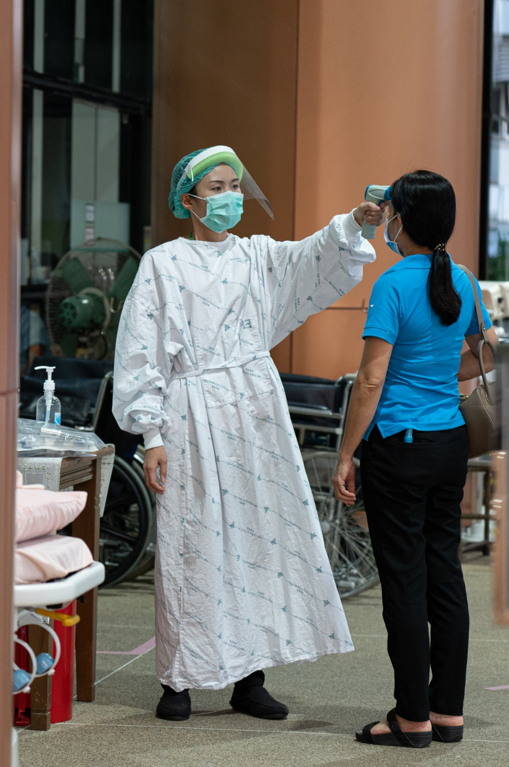
Emergency response workers
Risk of contagion
    Contact with infectious patients and co-workers
    Contact with infectious blood, tissue and bodily fluids
    Contact with bodies of persons who have died from highly infectious diseases
    Contact with contaminated materials, surfaces and environments
    Medical equipment and personal protective equipment (PPE) not properly used, cleaned or disinfected

Slide 31

Emergency response workers
Examples of measures to prevent contagion
    Environmental and engineering controls aiming at reducing the spread of pathogens and the contamination of surfaces and objects (physical distance between patients and health-care /emergency workers; ventilated isolation rooms; etc.)
    Administrative measures aiming to prevent risky behaviour (infection prevention and control (IPC) procedures; OSH training; health monitoring and surveillance; etc.)
    Appropriate PPE and training on how to put on, remove, and dispose of them

Slide 32


Workers in essential activities
    Workers who interact with potentially infectious individuals (e.g., workers in shops and supermarkets, banks, schools, delivery services, restaurants, sports and tourist facilities, etc.)
    Workers in high-density work, due to the proximity with other workers in semiconfined settings (e.g., factories, call centers, open space offices, etc.)

Slide 33
Examples of measures to prevent contagion
    Physical distance (e.g., introducing working shifts; using phone calls and virtual meetings; etc.)
    Hygiene (e.g. providing hand disinfectants; promoting good respiratory hygiene at the workplace; etc.)
    Cleaning (e.g. regularly cleaning and disinfecting the surfaces of desks, workstations and working objects; regularly disinfecting common areas; etc).
    Training and communication (e.g. on the preventive measures adopted; on their right to remove themselves from a work situation that poses an imminent and serious danger for life or health, etc.)
    Personal protective equipment (PPE).
    Response (e.g., arranging for isolation of any person who develops symptoms at the work site and adequately disinfecting the work site; providing health surveillance of persons who have been in close contact with the infected worker).

Slide 34
Workers in the emergency response and in essential services
Common psychosocial factors
    Fear of being infected at work and then passing on the disease to families
    Lack of access to PPE and support
    Working in environments with low capacity to apply optimal OSH measures
    Increased workload (reduction in staff, work longer and consecutive shifts)
    Reduced rest periods
    Increased violence and harassment (both physical and psychological)
    Increased social stigma and discrimination (because of a perceived link with a disease)
    Increased fatigue and stress
    Negatively impact mental health and well-being
    Increase the risk of work injuries and accidents

Slide 35
    IMPORTANT TO CONSIDER…..
    Good communication and up-to-date information
    Multidisciplinary sessions to identify concerns and to work together on strategies to solve problems
    Checklist to assess personal strengths and limitations, and recognize signs of stress and burnout
    Buddy system to provide psychological support and monitor stress and burnout
    Regulated rest periods for taking sufficient rest breaks during the work day
    Opportunities to promote physical health (e.g., exercise, healthy eating habits)
    Psychological support for workers to share fears and worries confidentially
    Role-modelling (managers/supervisors conduct themselves in ways that show how to mitigate stress)
    Campaigns to reduce stigma
    Participatory techniques which can promote dialogue, innovative solutions and positive changes in attitude

Slide 36
Social dialogue on OSH in times of a pandemic
Employers and their organizations
    Collaborate with government to shape policy measures that are conducive for business resilience and sustainability
    Observe advice/guidance provided by public authorities
    Communicate critical information to workers
    review or draw up a business continuity plan
    Identify and mitigate risks of contagion to workers
    Promote workplace hygiene
Workers and their organizations
    Participate in decision-making and policy responses to epidemics
    Actively cooperate with employers in the implementation of the preventive and protective measures.
    Strictly follow the workplace hygiene practices and adopt a responsible behaviours

Slide 37
Thanks a lot.
Victor Hugo Ricco.

