Slide 1
SEE Trade Union Economic Experts’ Meeting
“The impact of the Covid pandemic and conflict in Ukraine on the employment and economies of the Western Balkans; Inflation and wages – trade union activities”
11 – 12 May 2022, IGALO, Montenegro.
Energy crisis, energy growth and green economy.
Bruno S. Sergi
ETUI and University of Messina

Slide 2
The energy sector is the source of around three‐quarters of greenhouse gas emissions today and holds the key to averting the worst effects of climate change.
The energy mix
“Net-Zero” workforce

Slide 3
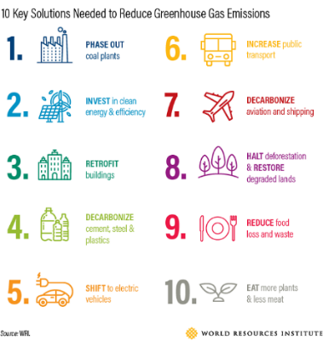
What’s next?
This calls for nothing less than a complete transformation of how we produce, transport, and consume energy.
The global economy – transportation, electricity, industry, agriculture, and commercial and residential buildings – needs to be transformed to get to net zero.

Slide 4
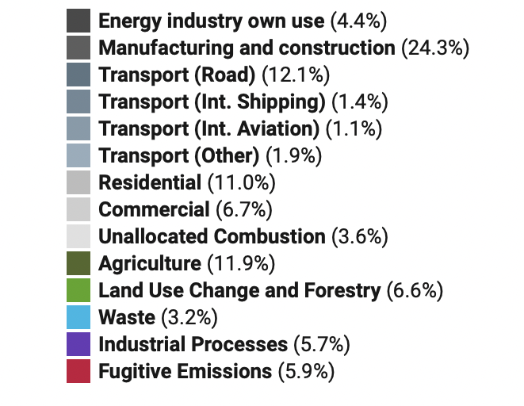
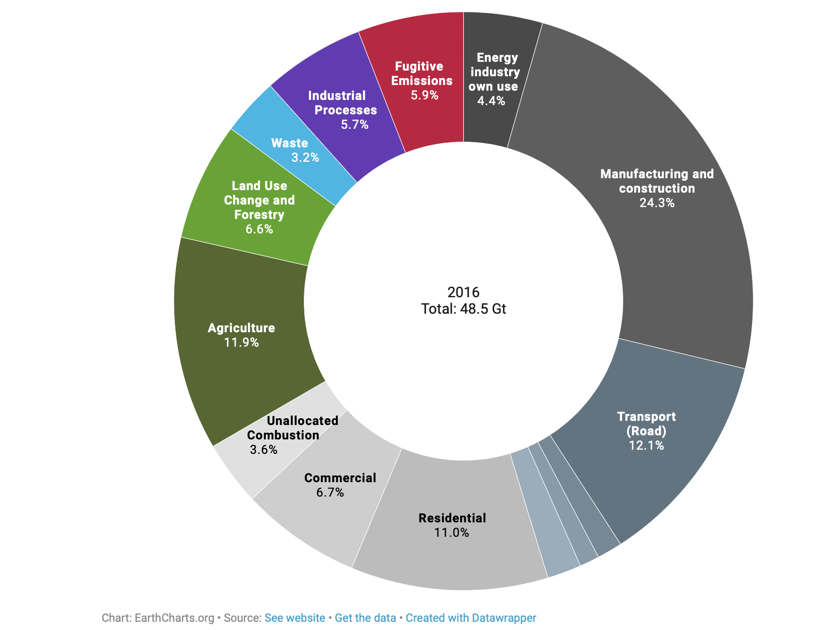
Global GHG Emissions by Sector

Slide 5
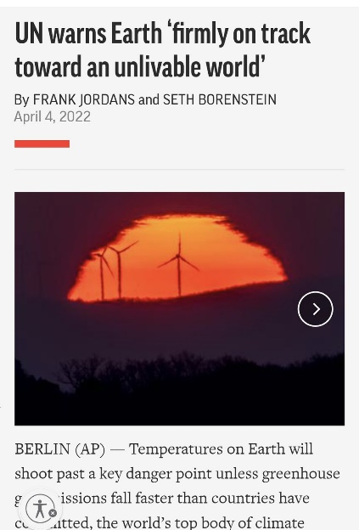
Towards a key danger point!
UN warns Earth is “firmly on track toward an unlivable world.”
Long-term projections indicate that climate change and increasing environmental degradation will have far-reaching political, social, and economic consequences.
U.N. Secretary-General Antonio Guterres said on April 4^{th,} reported by the Intergovernmental Panel on Climate Change, revealed “a litany of broken climate promises” by governments and corporations, accusing them of stoking global warming by tight-fitting to harmful fossil fuels.

Slide 6
What is net-zero? Global warming stops!
The term means that any greenhouse gas emissions are balanced by an equal amount being taken out of the atmosphere.
The Paris Climate Agreement (COP21) created goals to limit the increase in global temperatures to well below 2.0°C (3.6°F) above pre-industrial levels and to aim to curb the temperature increase to 1.5°C (2.7°F). To do this, global greenhouse gas emissions need to be cut in half by 2030 and reach “net zero” by 2050 for the 1.5°C degree target.

Slide 7
However, we are missing net zero targets
At COP26 (Glasgow, 2021), almost 140 countries committed to net zero emissions sometime around midcentury.
There is still a large gap between global mitigation ambition and policy action on climate change. Greenhouse gas emissions need to be cut by one-quarter to one-half by 2030 to be consistent with limiting warming to 1.5 to 2 degrees Celsius.

Slide 8
What is net-zero? What will our societies look like in a decade’s time?
Simply, to cut our society’s carbon emission footprints.
Saudi Arabia’s energy minister:
The net-zero goal is being undermined by the rising demand for oil and gas!
Net zero does not mean cherry-picking; net-zero doesn’t mean zero oil!

Slide 9
Does the debate hang in the balance?
Recent debates:
Kyiv has halted Russian gas shipments through the key hub;
Colombia has to choose between energy security and the environment (Colombia has put in place a temporary ban on fracking in 2018) – note that Colombia has the resources to be self-sufficient;
Globally: Will resetting the energy mix take people to the streets in opposition to fracking operations?

Slide 10
A perfect storm of factors! Profits and cash flow to another record high in 2022!
LNG – quickly shifted from buyer to seller market!!
Germany (big differences) vs Qatar (and the US and Australia):
“length of the contract and reselling”
Landlocked countries in SEE?

Slide 11
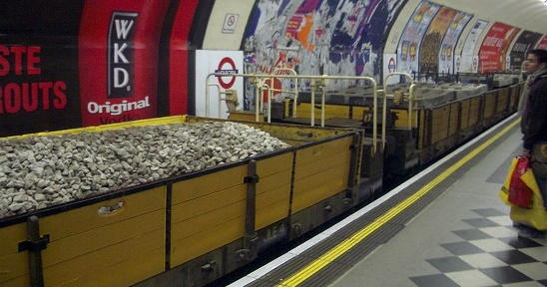
Consequences for the Net Zero strategy
Recent energy prices have intensified the debate over Europe’s carbon plan.
European nations are rethinking the role of natural gas in their transition away from coal-fired energy and avoiding dependence on Russian fuels.
Poland plans to have its first nuclear plant operating in 2033.
London Subway transporting coal on Mar 6th, 2022

Slide 12
The key milestones planned according to the International Energy Agency

Slide 13
4 April 2022. Working Group III: Monday 4 April: Summary for policymakers
The Intergovernmental Panel on Climate Change (IPPC) is working on the Sixth Assessment Report, which consists of three Working Group contributions and a Synthesis Report (Autumn 2022).
The global temperature will stabilise when carbon dioxide emissions reach net zero. For 1.5°C (2.7°F), this means achieving net-zero carbon dioxide emissions globally in the early 2050s; for 2°C (3.6°F), it is in the early 2070s.
In 2010-2019, average annual global greenhouse gas emissions were at their highest levels in human history, but the rate of growth has slowed.

Slide 14
4 April 2022. Working Group III: Monday 4 April: Summary for policymakers
Without immediate and deep emissions reductions across all sectors, limiting global warming to 1.5°C is beyond reach: this requires global greenhouse gas emissions to peak before 2025 at the latest and be reduced by 43% by 2030.
Limiting warming to around 2°C (3.6°F) still requires global greenhouse gas emissions to peak before 2025 at the latest and be reduced by a quarter by 2030.

Slide 15
Saturday, April 16:
Climate change: Key UN finding widely misinterpreted - BBC News
“In the document, researchers wrote that greenhouse gases are projected to peak "at the latest before 2025 …… This implies that carbon could increase for another three years and the world could still avoid dangerous warming ………………….. This will take a herculean effort, with carbon emissions needing to shrink by 43% by the end of this decade to stay under this threshold of danger.”
"When you read the text as it's laid out, it does give the impression that you've got to 2025 which I think is a very unfortunate outcome ………..It's an unfortunate choice of wording. That is, unfortunately, going to potentially have some rather negative consequences.” Glen Peters, from the Centre for International Climate Research in Oslo, and an IPCC lead author.
This led to a lengthy debate during the two-week long approval session between the scientists and government officials over the exact words to use. "There were many discussions about whether words such as "now" or "immediately" can be used," said Dr Byers, an IPCC contributing author from the International Institute for Applied Systems Analysis.

Slide 16
Saturday, April 16:
Climate change: Key UN finding widely misinterpreted - BBC News
This worries observers who argue that giving countries the impression that emissions can continue to grow until 2025 would be a disaster for the world.
"We definitely don't have the luxury of letting emissions grow for yet another three years," said Kaisa Kosonen from Greenpeace.
"We have eight years to nearly halve global emissions. That's an enormous task, but still doable, as the IPCC has just reminded us - but if people now start chasing emissions peak by 2025 as some kind of benchmark, we don't have a chance."

Slide 17
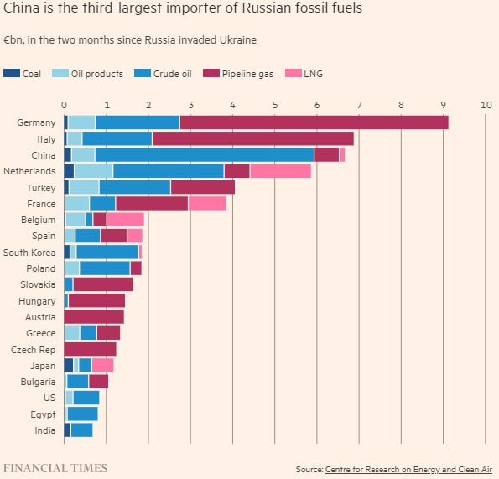
Russian natural gas exports by destination (according to Gazprom, bcm:
 | 1Q2021 | 1Q2020 | 2020 | 2019
China | 2,601 | 0,715 | 4,101 | 0,328
Germany | 15,541 | 11,658 | 45,844 | 53,502
Italy | 4,613 | 4,069 | 20,799 | 22,100
Turkey | 7,762 | 3,757 | 16,399 | 15,510
France | 3,243 | 2,785 | 12,388 | 14,072
Finland | 0,757 | 0,453 | 1,609 | 2,457
Austria | 2,965 | 3,060 | 13,215 | 14,196
Greece | 0,848 | 0,687 | 3,019 | 2,413
Netherlands | 2,606 | 2,804 | 11,809 | 8,506
Switzerland | 0,099 | 0,070 | 0,280 | 0,268
Denmark | 0,439 | 0,358 | 1,845 | 1,670
United Kingdom | 1,484 | 1,504 | 6,026 | 10,321
Belgium | 0,637 | 0,666 | 2,499 | 2,417
Total Western Europe and Turkey | 40,994 | 31,871 | 135,732 | 147,432
Hungary | 1,805 | 1,238 | 8,637 | 10,522
Poland | 2,448 | 2,066 | 9,668 | 9,734
Slovakia | 1,406 | 1,753 | 8,624 | 6,409
Czech Republic | 0,744 | 0,840 | 5,013 | 8,061
Romania | 0,599 | 0,315 | 0,962 | 0,994
Bulgaria | 0,725 | 0,476 | 2,287 | 2,387
Serbia | 0,737 | 0,430 | 1,346 | 2,135
Croatia | 0,288 | 0,411 | 1,840 | 2,821
Slovenia | 0,130 | 0,056 | 0,407 | 0,336
Bosnia and Herzegovina | 0,091 | 0,088 | 0,214 | 0,236
Macedonia | 0,024 | 0,082 | 0,137 | 0,296
Total Central Europe | 8,997 | 7,755 | 39,135 | 43,931
Total Europe and Turkey* | 51,374 | 40,034 | 177,315 | 192,558

Slide 18
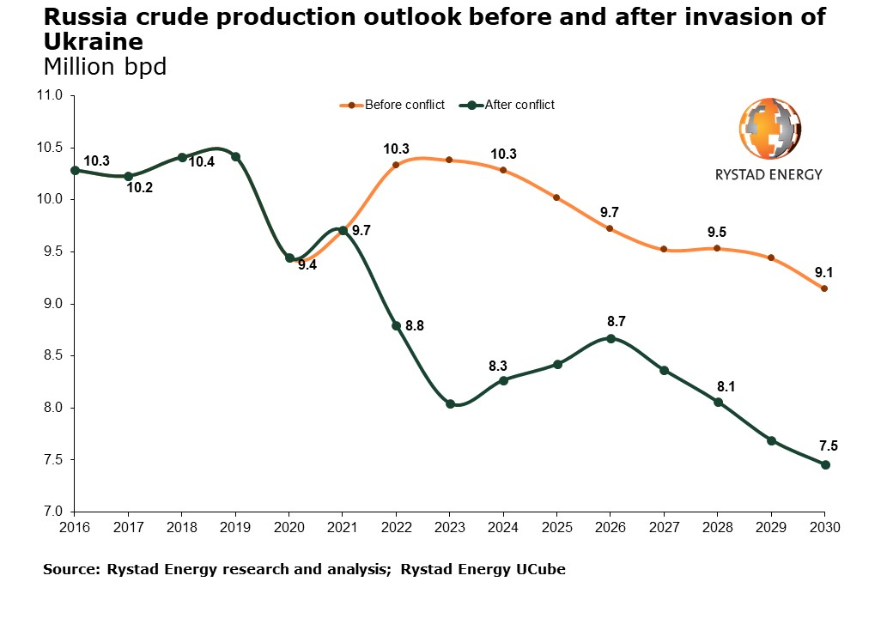

Slide 19
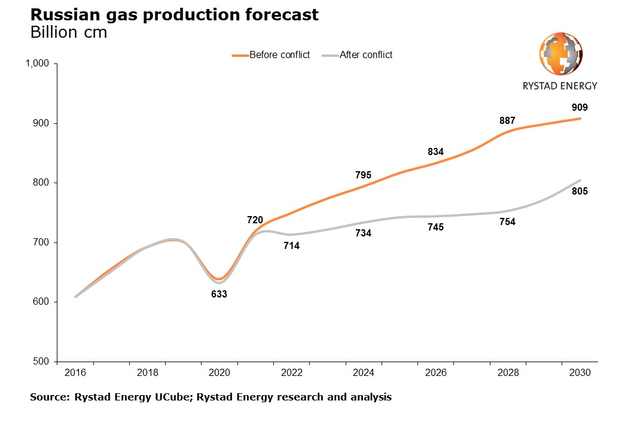

Slide 20
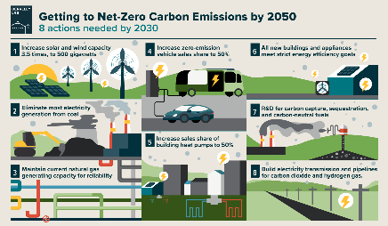
Key Issues to the Net-Zero Standard framework
Most of the global reductions in CO2 emissions through 2030 in our pathway come from technologies readily available today.
According to the International Energy Agency, all the technologies needed to achieve the necessary deep cuts in global emissions by 2030 already exist.
However, innovation efforts must occur with further progress to bring these new technologies to market in time.
To set near-term science-based targets:
  5-10 year emission reduction targets in line with 1.5°C pathways.
To set long-term science-based targets:
  Target to reduce emissions to a residual level in line with 1.5°C scenarios by 2050.

Slide 21
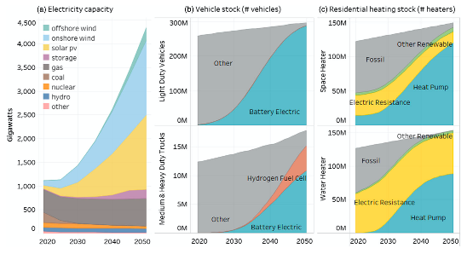
In the least-cost scenario, to achieve net-zero emissions of CO2 by 2050, wind, solar, and battery storage capacity will have to increase several-fold.
Vehicles will need to be mostly electric, powered either by batteries or fuel cells (middle charts).
Residential space and water heaters will also need to be electrified, powered by heat pumps or electric heaters (right charts).

Slide 22
Reaching net zero by 2050 requires further rapid deployment of available technologies and the widespread use of technologies on the market.
Clean energy innovation must accelerate rapidly, with governments putting R&D, building infrastructure, and demonstration and deployment at the core of energy and climate policy.
Source: https://iea.blob.core.windows.net/assets/deebef5d-0c34-4539-9d0c-10b13d840027/NetZeroby2050-ARoadmapfortheGlobalEnergySector_CORR.pdf

Slide 23
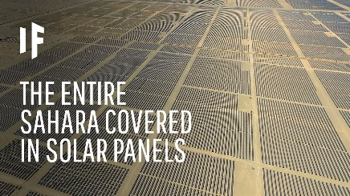
What would happen if we covered the Sahara Desert with solar panels?
The Sahara Desert is one of the most exposed places on Earth to the sun’s rays. So, the idea is that if we could gather all that energy.
According to scientists, solar panels covering a surface of around 335km² would be enough to power the world – (Sarah Desert = 9 mill km²).
https://www.youtube.com/watch?v=62ASvupr8Zg

Slide 24
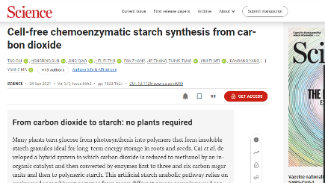
Other exciting technologies are on the horizon.
The University of Texas at Austin researchers have created a new sodium-based battery material. Sodium a matter, abundant and easy to mine, is a cheaper and more environmentally friendly replacement for lithium-based battery technology.
https://news.utexas.edu/2021/12/06/sodium-based-material-yields-stable-alternative-to-lithium-ion-batteries/
Researchers at an institute under the Chinese Academy of Sciences have developed a way to synthesize starch from carbon dioxide much quicker than plants can naturally, potentially cutting emissions and reducing the amount of farmland needed for starch crops.
https://www.youtube.com/watch?v=C2u6KIA5uPo

Slide 25
But …….. who is looking at the whole picture of this transformation?"
Carlos Tavares, CEO of Stellantis: "We will have a shortage of batteries around 2025 or 2026 …… And if there is no shortage of batteries, there will be a significant dependence of the Western world on Asia."
Battery supply challenges would fuel a big problem: keeping cars affordable in the transition to electric models would be an issue for manufacturers' margins in a "Darwinian era for the industry ……. Those who are unable to transform will be in trouble".
The supply of raw materials, including those needed to make lighter chassis for cars weighed down by batteries, will create problems. "Everyone will bring electric vehicles to market …. Where is the charging infrastructure? What are the geopolitical risks of procuring those raw materials?” Tavares said.

Slide 26
Let’s drive markets to adopt environmentally sustainable products and services and how to develop their skills and choose environmentally sustainable careers.

Slide 27
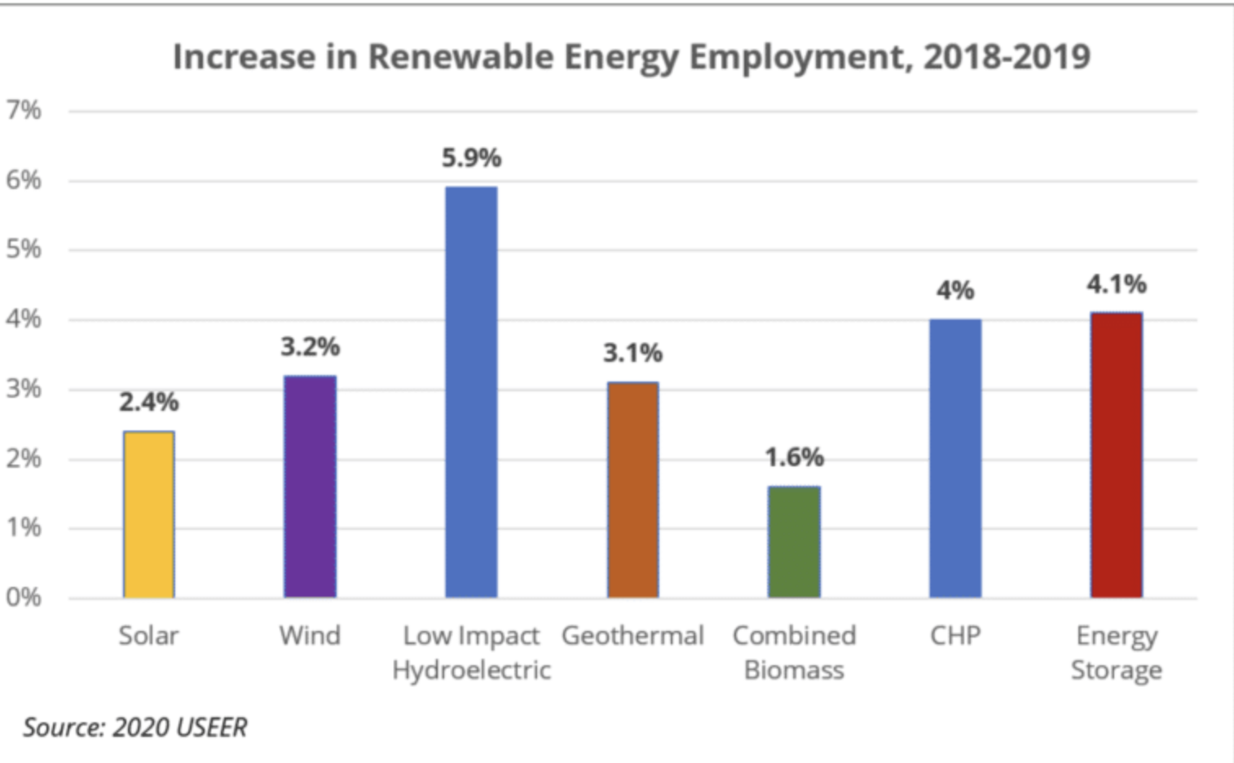
Assembling a large skilled “Net Zero Jobs” workforce.
Decarbonization won’t happen at the necessary speed and scale without assembling a large skilled workforce.
Even before the pandemic, the demand for green skills was particularly acute in the energy industry.

Slide 28
WEF identified the in-demand skills for green jobs.
Science skills: key roles will include environmental scientists, biologists, hydrologists, and biochemists. People in these jobs will monitor, manage and protect natural resources, including land and valuable water supplies.
Architectural and planning skills: Buildings will become more energy-efficient, with fewer resources used to construct and operate them. Architects and planners will design these buildings to comply with environmental regulations and client demands for green spaces.
Green engineering and tech skills: Today’s young people will be tomorrow’s green engineers, helping design and maintain solar panels, wind turbines, low emissions vehicles, and other green economy technology.
Source: https://www.weforum.org/agenda/2021/08/these-are-the-skills-young-people-will-need-for-the-green-jobs-of-the-future/

Slide 29
WEF identified the skills for green job
Agriculture skills: As farming and food supply becomes more sustainable, there’ll be a growing number of green jobs in areas such as organic farming, urban farming, and precision agriculture. This involves using data to measure and improve farming efficiency.
Environmental justice skills: Workers in this field will operate at the intersection of human rights and environmental rights. They will gain legal, social, and historical awareness to ensure humanity does not repeat past mistakes, which led to racial and social injustice and poor environmental and social health.
Systems skills: workers who can design, operate and monitor a wide range of systems. They’ll need to assess systems against performance indicators and optimise and improve system operations. They’ll need skills in macroeconomics to build sustainability into long-term infrastructure projects.
Source: https://www.weforum.org/agenda/2021/08/these-are-the-skills-young-people-will-need-for-the-green-jobs-of-the-future/

Slide 30
The EU and green jobs
Climate neutrality requires a massive financial commitment to emerging green sectors and jobs in all sectors where skills gaps need to be addressed.
The European Green Deal to create 487,000 new jobs in the EU in the construction sector by 2030. Of these, nearly 70% will go to workers with manual and non-manual skills, who usually have a background of vocational education and training (VET).
The EU supports transforming VET systems to make them sit well with the green transition. An example is Erasmus + funding helps establish Centers of Professional Excellence, where local partners develop "ecosystems of skills", contributing to regional development.
Greenovet, the platform for VET excellence for green innovation; Eplug, the platform for urban greening and 3Loe, professional excellence in the green economy.
The Pact for Skills: a forum where partners discuss current and future skills needs and acts as an intermediary between the supply and demand for talent.
600+ organisations have helped equip 6 million people with the right skills, and that's just the beginning. The EU goal for 2030 is to reach 60% of adults in the EU who participate in training each year.

Slide 31
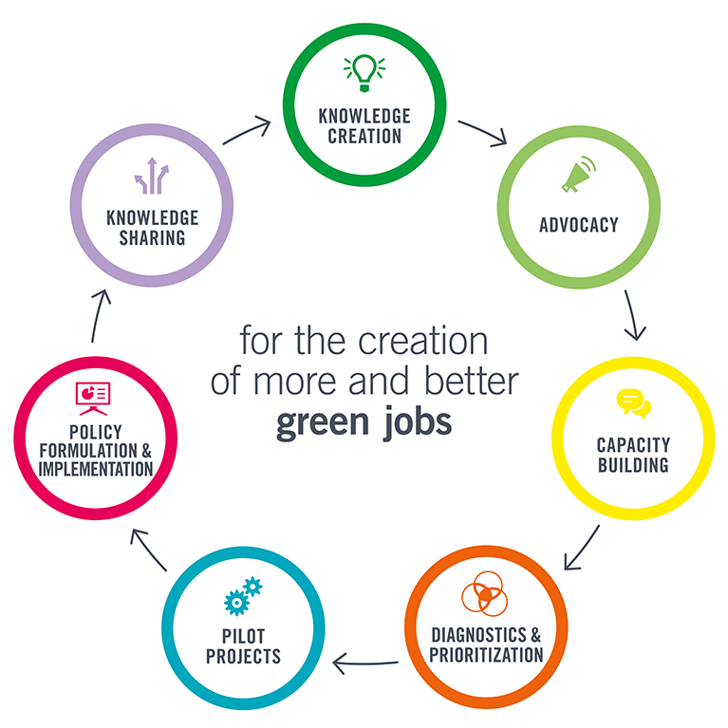
The International Labor Organization's Green Jobs Program.
The Green Jobs Program has progressively assisted over 30 countries by building relevant ILO expertise and tools in dedicated work areas to combat climate change.
https://www.ilo.org/global/topics/green-jobs/areas-of-work/lang--en/index.htm

Slide 32
Thank you very much!
Bruno S. Sergi

