Slide 1
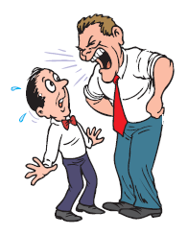
The PERC Regional Meeting
“Trade union approaches and strategic opportunities in OHS:
Challenges in providing a safer and healthier work environment for workers in the Balkan region countries”
3 – 5 October 2018, Montenegro, IGALO
Stress and Psychosocial Risks at Work
Ivan Majer (Slovakia)

Slide 2
Stress is a phenomenon of modern times.
People can suffer from stress in their personal life and they meet it in their work as well.
Why to deal with psychosocial aspects at work?
Legal duty
Social sense (culture)
Health protection of work force
Economic interest of employer
Wellbeing and welfare, satisfaction and motivation of employees encouradge a productivity, quality, effectiveness, creativity, devotion to the company
The employer is responsible for every aspect of workplace health and safety, including psychosocial risks.

Slide 3
Legal framework
Basis:
Framework Directive 89/391/EEC on the introduction of measures to encourage improvements in the safety and health of workers
Art. 5/1
The employer shall have a duty to ensure the safety and health of workers in every aspect related to the work...
Art. 6/2
General principles of prevention:
(g) developing a coherent overall prevention policy which covers technology, organization of work, working conditions, social relationships and the influence of factors related to the working environment;

Slide 4
This project is funded
by the European Union
Work-related stress – a major issue
Stress is the second most reported work-related health problem
Stress affects nearly one in four EU workers
Studies suggest that between 50% and 60% of all lost working days are related to it
The number of people suffering from WRS is likely to increase.
The economic cost of work-related stress (WRS) in the EU-15 was around EUR 20,000 million (2002)

Slide 5
This project is funded
by the European Union
What can cause stress – (stress factors)
Stress occurs when the perceived pressure exceeds your perceived ability to cope
Excessive workload
Exposure to physical hazards
Luck of personal control – not understanding roles and responsibilities, inadequate instructions
Inagequate support from managers and co-workers
Poor relationships, conflicts, bad personal relations, violence and harassment
Inadequate communication, not involved in change management, little participation in making decisions
What training workers need to perform their tasks.

Slide 6
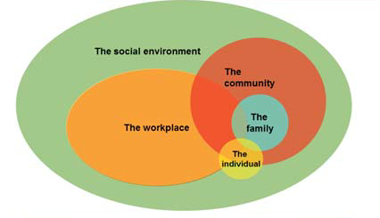
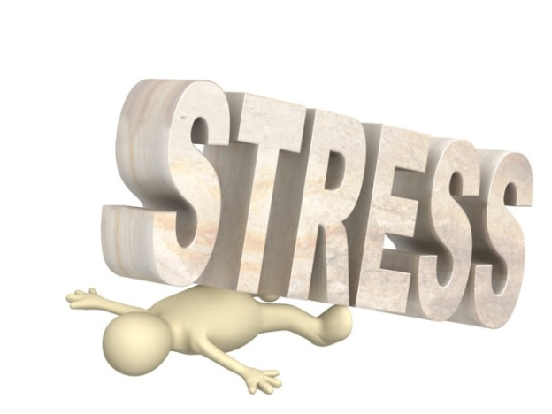
This project is funded
by the European Union
Interactions of different influences

Slide 7
Strategy of motivation
PYRAMID OF NEEDS
Self- actualisation
SELF-ESTEEM
Status, challenges
Abraham Harold M a s l o w
SOCIAL NEEDS
Belonging, trust, welfare
SAFETY, SECURITY
Stabil job, shelter, health, morality
PHYSIOLOGICAL NEEDS
Food, water, warmth, salary

Slide 8
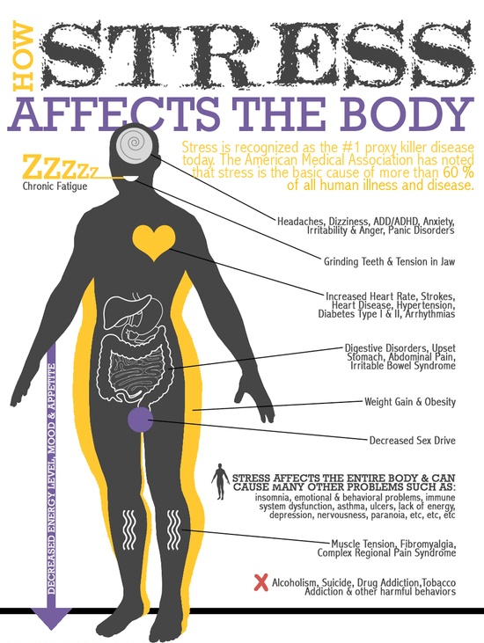
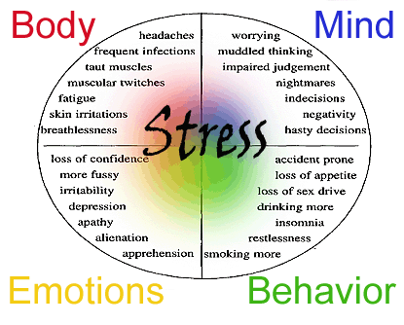
This project is funded
by the European Union
Symptoms of work-related stress
High blood pressure, heard disease, mental illness, burnout, cancer, suicidal behavior
The stress is a basic cause of more then 60% of all humean ilnesses and deseases

Slide 9
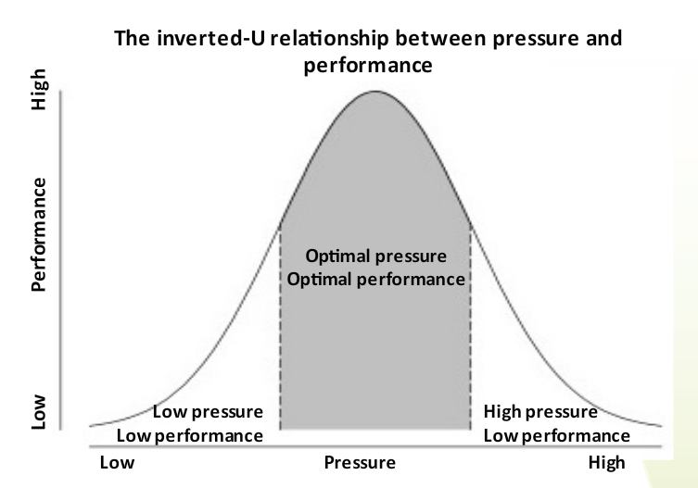
This project is funded
by the European Union
„Good“ and „bad“ work load
Stress is not the same as pressure
People work better with som (but not too much) pressure

Slide 10
What are psychosocial risks at work?
HUMAN RELATIONS
STRESS
HARRASMENT
SHIFT WORK
VIOLENCE
MOBBING
STIGMA-TISATION
WORK LOAD
BOSSING
INSTABIL JOB
FATIGUE

Slide 11
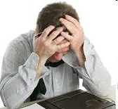
Focus on human relations,
Experiences show that people are able to bear discomfort and stress, resulting from unsuitable working conditions and acting of physical and chemical harmful factors much easier, than traumas from poor human relations!
Discomfort and stress may decrease working performances by 30 to 50%
These issues shall be openly discussed

Slide 12
This project is funded
by the European Union
How to prevent psychosicial risks?
There are similar methods for all risks – RISK ASSESSMENT.
RA for stress involves the same basic principles and processes as for other occupational risks
Different methods are available. But for most businesses, a straight forward five-step approach works well:
Identify the hazards and those at risk
Evaluate and prioritise the risks
Decide on preventive action
Take action
Monitor and review

Slide 13
This project is funded
by the European Union
RA – obligation of employer
and right for employees
It is essential that employees are consulted and involved in the process of RA – it is more emergent at assessing stress and other psychosocial aspects than concerning other risks
Employees know their problems, know the workplace, they are the ones who will have to implement any changes
Participation of employees is essential mainly during the first step of procedure –
Identification of hazards and those at risk
It is not possible to determine from the situation alone the amount of stress it may cause

Slide 14
Step 1: Identification of hazards and those at risk
This project is funded
by the European Union
Factors to look out for in relation to stress include:
Workplaces and activities with excessive workload
Exposure to physical hazards
Identification of situation with mental load
Level of control that workers have in carrying out their work
Whether workers understand their roles, tasks
Relationships (vertical and horizontal); behavior of people
Possible cases of mobbing, violence, harassment
Communication and support from colleagues and managers
What training workers need to perform their tasks

Slide 15
Step 1: Identification of hazards and those at risk
This project is funded
by the European Union
We are all vulnerable, depending on the pressure we are under at any given time
The following factors may help to determine who or which groups of workers are most at risk:
Absenteeism, high staff turnover, aggressive communication, accidents, psychosocial problems, health problems and complaints from workers etc
Particular attention should be paid to groups of workers who may be at increased risk, e.g. workers with disabilities, migrant workers, young and older workers.

Slide 16
This project is funded
by the European Union
Step 2: Evaluate and prioritise risks
Step 3: Decide on preventive action
Representatives of employees should evaluate is the measures are meaningful.
Effective measures in preventing WRS also include:
Minimising physical risks
Allowing workers to take part in decisions that affect them
Matching workloads to the capabilities and resources of each worker
Designing tasks to be stimulating
Defining work roles and responsibilities clearly
Providing opportunities for social interaction, and
Avoiding ambiguity in matters of job security and career development.
Representatives of employees shall
be informed on adopted measures

Slide 17
This project is funded
by the European Union
Methods to deal with
psychosocial risks
Dialogue with employer and a workers’ representatives
Interviews with individual employees
Group conversation with employees
Training of employees on psychosocial risks at work
Cooperation with labour inspection, complains in case of problems
Encourage employees to solve their psychosocial problems
Mapping of opinions, questionnaires
Observations at the worksite
Hot line

Slide 18
The final notice
Quality of (working) life
Are people satisfied at work?
Are people happy at work?
What can be helpful?
What are the barriers?
How to be happy from work?
How to reach satisfaction?
Satisfied and motivated employee is a warranty of productivity and quality of work, s/he is warranty of company prosperity

Slide 19
Thank you for your attention
PERC Regional Meeting, October 2018, Montenegro, IGALO

