Slide 1
SEE-NIS OSH network: ITUC/PERC ILO ACTRAV meeting
Chisinau, 20-21 March 2024
Victor Hugo Ricco
ACTRAV

Slide 2
Objectives of the presentation
Provide a brief overview of the ILO ILS System and the ROLE YOU CAN PLAY IN IT.
Describe OSH as FPRW and the supervisory mechanisms

Slide 3
ILO standard setting system
Adoption of International Labour Standards
Supervision of their application
ILO two added values in the UN family. ILS and social dialogue.
TU can participate in the decision of the standard setting, in the élaboration of it (text), the promotion of its ratification in the case of C and P, the promotion of full implementation in law and practice and in the SUPERVISION of the application of that standard.

Slide 4
International Labour Standards:
CONVENTIONS:
International treaties open to ratification by Member States.
When ratified, are legally binding.
If not ratified, source of inspiration for domestic law.
Total:191
MAKE THE MATHS….. 2 YEARS PER STANDARD….. IMPORTANCE OF THE DOUBLE ILC STANDARD SETTING….
RECOMMENDATIONS:
Not open to ratification; not legally binding.
Can complement Conventions or be adopted alone.
Provide guidelines for national policy and action.
Total: 208.
PROTOCOLS:
They need to be ratified.
They relate to a specific convention
Total so far: 6.

Slide 5
Fundamental + Protocol to C 29 | Governance or Priority
C029 - Forced Labour Convention, 1930 181 P29 60 | C081 - Labour Inspection Convention, 1947
C087 - Freedom of Association and Protection of the Right to Organise Convention, 1948 158 | C122 - Employment Policy Convention, 1964
C098 - Right to Organise and Collective Bargaining Convention, 1949 168 | C129 - Labour Inspection (Agriculture) Convention, 1969
C100 - Equal Remuneration Convention, 1951 174 | C144 - Tripartite Consultation (International Labour Standards) Convention, 1976
C105 - Abolition of Forced Labour Convention, 1957 178
C111 - Discrimination (Employment and Occupation) Convention, 1958 175
C138 - Minimum Age Convention, 1973 176
C182 - Worst Forms of Child Labour Convention, 1999 187
C155 - OSH Convention, 1985 80
C187 - Promotional Framework for OSH Convention, 2006 62

Slide 6
In light of the upcoming 2 OSH related standard setting (biohazards and chemicals) its important to know the characteristics of ILS
TRIPARTISM: The 3 constituents work together on an equal footing for the adoption of the ILS.
MINIMUM PROTECTION: The ILO ILS fixes a minimum level of protection.
UNIVERSALITY: The standards are set at the world level. NO RESERVATIONS ALLOWED
FLEXIBILITY: The ILO takes into account the needs of all ILO member States in the process of adopting the standards.
In the white report for Biological Hazards Standard Setting, there are many options for this flexibility….

Slide 7
Adoption of ILS
Problem identified (by any constituent)
⇩
Item put on the ILC Agenda (by GB)
⇩
Item discussed at the ILC
- twice: DOUBLE DISCUSSION
- once: SINGLE DISCUSSION
⇩
Instrument adopted with a 2/3 majority of delegates present at the ILC
White Report
Brown Report
- Office prepares reports
- Workers, employers and governments
provide inputs and discuss

Slide 8
Ratification of Conventions
By ratifying a Convention or a Protocol, an ILO member state commits to:
give effect, both in law and in practice, to the provisions of a Convention and
accept international supervision

Slide 9
A safe and healthy working environment as a fundamental principle and right at work
The International Labour Conference (ILC) in June 2022 decided to amend the ILO Declaration on Fundamental Principles and Rights at Work
“A safe and healthy working environment” is included as a fifth category of fundamental principle and right at work (FPRW)
The Occupational Safety and Health Convention, 1981 (No. 155) and the Promotional Framework for Occupational Safety and Health Convention, 2006 (No. 187) are considered as fundamental Conventions
Protocol to Convention 155, P155 yet not formally mentioned as FPRW will have to be reported with the convention every 3 years.
The relevant recommendations accompanying these conventions, R 164 (to C 155) and R 197 (to C 187) play a vital role in understanding the expected conduct towards the obligations deriving from these conventions.
Consequential amendments are to be made to the different ILS, Declarations such as ILO Declaration on Social Justice for a Fair Globalization, etc…

Slide 10
The implications of this historical decision
All ILO Member States have now an obligation arising from the very fact of membership in the Organization to respect, to promote and to realize, in good faith and in accordance with the Constitution, the fundamental right to a safe and healthy working environment, whether or not they have ratified the relevant Conventions.
How the ILO helps countries to achieve the full realization of the fundamental principles and rights at work? Annual follow-up concerning non-ratified fundamental conventions governments can indicate what measures they have taken organizations of employers and workers can voice their views on progress made Global reports objective picture of the global and regional situations and trends and serve to determine priorities for action Technical cooperation projects addressing identifiable needs and strengthening local capacities to translate the FPRW into practice

Slide 11
ILO Declaration on FPRW as amended “2. (…) all Members, even if they have not ratified the Conventions in question, have an obligation, arising from the very fact of membership in the Organization, to respect, to promote and to realize, in good faith and in accordance with the Constitution, the principles concerning the fundamental rights which are the subject of those Conventions, namely: (a) freedom of association and the effective recognition of the right to collective bargaining; (b) the elimination of all forms of forced or compulsory labour; (c) the effective abolition of child labour; (d) the elimination of discrimination in respect of employment and occupation; and (e) a safe and healthy working environment

Slide 12
More implications
Reporting cycle every 3 years instead of 6. Starting in 2024 (G-N), 2025 (A-F) and 2026 (O-Z) French alphabet.
Vocation to universal ratification. So far only C 182 has that status.
Annual reporting on the ways this category of fundamental rights is being protected (Starting from 2024 onwards)
There will have to be included in the RID in the ILC on FPRW.
The technical cooperation will have a strong role to play.
Convention 155 has a protocol on statistics on occupational accidents and diseases.

Slide 13
1. Conventions No. 155 and No. 187 – Why these two?
Complementary roles and responsibilities
Progressive realization
Prevention
Consultation and participation
Conventions that focus on the governance of OSH at national and workplace level – they serve as the basis for the safety and health measures provided for in other specific OSH instruments.
Both contain the relevant principles and rights to ensure a safe and healthy working environment.
Contain provisions of general scope covering all branches of activity and all workers, regardless of the type of hazards
Call for progressive and sustained improvements towards the provision of safe and healthy working environments

Slide 14
The core principles of Conventions No. 155 and No. 187
Set out
Set out the general principles for the establishment of a systems approach for the management of occupational safety and health.
Promote
Promote a preventive approach to OSH
Emphasize
Emphasize the participation of employers and workers, through express provisions on consultation and co-operation in the decision-making process

Slide 15
The Occupational Safety and Health Convention, 1985 (No. 155)

Slide 16
National policy on occupational safety, occupational health and the working environment
Formulated, implemented and periodically reviewed in consultation with the most representative organizations of employers and workers.
Aims at preventing accidents and injuries to health arising out of, linked with or occurring in the course of work, by minimizing, so far as is reasonably practicable, the hazards in the working environment.
Shall indicate the functions and responsibilities of public authorities, employers, workers and others, taking into account the complementary character of such responsibilities and national conditions and practice.
Articles 4 and 6
Covering the following main spheres of action
Design, testing, choice, substitution, installation, arrangement, use and maintenance of the material elements of work
Relationships between the material elements of work and the workers, and the adaptation of work to the physical and mental capacities of the workers
Training, qualifications and motivations in the achievement of adequate levels of OSH
Communication and co-operation at the levels of the working group and the undertaking and at all other appropriate levels up to and including the national level
The protection of workers and their representatives from disciplinary measures
Article 5

Slide 17
The Promotional Framework for Occupational Safety and Health Convention, 2006 (No. 187)

Slide 18
The core Convention187 in a nutshell
National POLICY
Based on the principles defined in Convention No. 155.
National SYSTEM
Refers to the infrastructure which provides the main framework for implementing the national policy and national programmes on safety and health at work.
National PROGRAM
Promotes the development of a national preventative safety and health culture.
Promotes a safe and healthy working environment

Slide 19
Opportunities for TU action. Social dialogue / Consultation.
C 155 | C 187
Art 1. Exclusion of branchs/sectors. | Art 2. National Policy. Measures to ratify other OSH ILO Conventions.
Art.2 Exclusion of category of workers | Art 3. National Policy.
Art 4. Formulation, implementation and review of the National Policy. | Art 4. National System.
Art 8. How to put in practice art 4. | Art 5 National Programme.
Art 15. Coordination internally.
Art 19. Information for workers relevant to OSH.
Recommendation 197. - IV. NATIONAL PROFILE
13. Members should prepare and regularly update a national profile which summarizes the existing situation on occupational safety and health and the progress made towards achieving a safe and healthy working environment. The profile should be used as a basis for formulating and reviewing the national programme.

Slide 20
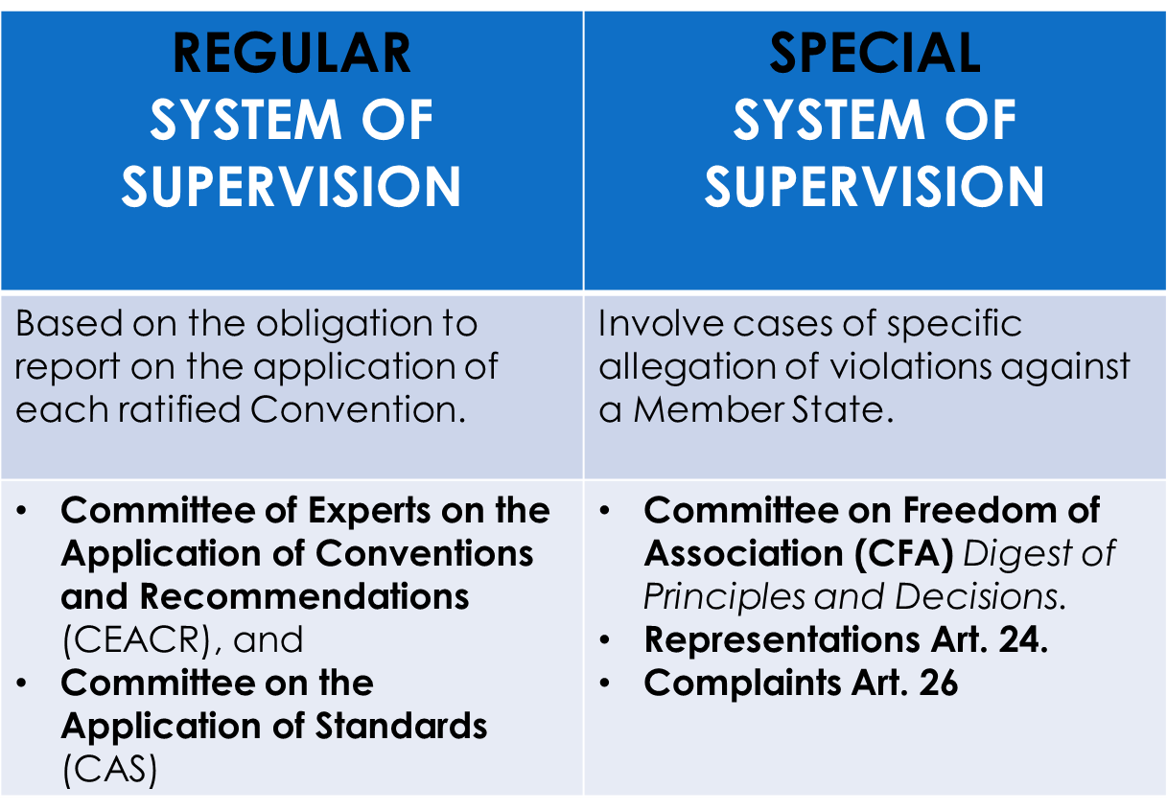
What are the ILO Supervisory Mechanism?

Slide 21
ILS regular supervisory process
Governments submit
reports
1st June – 1st September
Social partners may
comment
INTERNATIONAL LABOUR OFFICE
November
&
December
COMMITTEE OF EXPERTS ON THE APPLICATION OF
CONVENTIONS AND RECOMMENDATIONS
Examines reports, comments and related in formation
Direct requests
sent to the government and available online
for the social partners
February
Observations
published in the CEACR’s Report
March
TRIPARTITE CONFERENCE COMMITTEE ON THE APPLICATION STANDARDS
Examines the CEACR’s report and discuss a selection of cases
Presentation of the Report to the
INTERNATIONAL LABOUR CONFERENCE
and adoption in plenary
June

Slide 22
Examination on the application of ratified conventions
Constitutional obligation (art 22)
Examines Government reports and comments from social partners on implementation in law and practice
Reporting cycle :
3 years for the 10 Fundamental + P29 and the 4 Governance Conventions (since 2012)
6 years for the technical conventions.
Standards initiative being discussed at the GB.
Makes 2 types of comments
Observations
Direct requests

Slide 23
Country | Reporting Cycle C155 | Reporting Cycle C 187
Albania | 2025 | 2025
Armenia | Not ratified yet | Not ratified yet
Azerbaijan | First report 2025. Ojo exclusions…. | Not ratified yet
Bosnia and Hersegovina | 2025 | 2025
Georgia | Not ratified yet | Not ratified yet
Kazakhstan | 2024 | 2024
Moldova | 2024 | 2024
Montenegro | 2024 | 2024
North Macedonia | 2024 | 2024
Serbia | 2026 | 2026
Tajikistan | 2026 | Not ratified yet
Ukraine | 2026 | Not ratified yet
Uzbekistan | Not ratified yet | 2021 not done- 2024 done

Slide 24
Country | Comments presented by Workers Organizations C155 | Comments presented by Workers Organisations C 187
Albania | NO COMMENTS EVER | NO COMMENTS EVER
Armenia | Not ratified yet | Not ratified yet
Azerbaijan | First report 2025. Ojo exclusions…. | Not ratified yet
Bosnia and Hersegovina | Once in 2015 | NO COMMENTS EVER
Georgia | Not ratified yet | Not ratified yet
Kazakhstan | NO COMMENTS EVER | NO COMMENTS EVER
Moldova | NO COMMENTS EVER | NO COMMENTS EVER
Montenegro | NO COMMENTS EVER | NO COMMENTS EVER
North Macedonia | NO COMMENTS EVER | NO COMMENTS EVER
Serbia | Last year 2023 | Last year 2023
Tajikistan | NO COMMENTS EVER | NO COMMENTS EVER
Ukraine | Last year 2023 | Not ratified yet
Uzbekistan | Not ratified yet | NO COMMENTS EVER

Slide 25
CEACR
Seize the possibility of provide comments on law and practice on ratified conventions and protocols.
If C 144 is ratified, demand the formal participation.
Present the facts in a detailed manner with all evidence included in order to allow the experts to understand and act in consequence. In many Observations they quote the information received.
Seek support on the comments ( i.e. ETUC, ITUC)
It is better to have one comment signed by many organizations than different comments that could be confuse on the facts.
Have the reporting cycle of your country in order to be prepared to send comments in each ratified convention before Sept 1 each year.
Make a calendar of deadlines (GS 28 Feb for Gov, 30 June for Social partners; 1 Sept for regular reporting cycle, etc..)
Use previous language used by the ILO Supervisory Mechanisms with regards to the violation alleged and even better if there is linked to the country in case.
Follow up on the Observations and Direct Requests.

Slide 26
Acknowledging the limited scope of Anthrax Prevention Recommendation, 1919 (No. 3) and the absence of coverage for other biological hazards, the SRM TWG, during its third meeting in 2017, recommended revising the Recommendation through an instrument addressing all biological hazards and publishing technical guidelines on biological hazards. In line with this, the 331st Governing Body (GB.331/LILS/2) requested the Office to prepare proposals for a potential standard-setting item on biologicalhazards.
International labour standards….. Robust and effective …. Several revisions. SRM

Slide 27
Then Chemicals 2027 - 2028
So, after some discussions…… The standard setting preparation…. Experts meeting, then the 2 years discussion…….

Slide 28
Victor Hugo Ricco. ACTRAV

