Slide 1

SEE-NIS OSH network: ITUC/PERC ILO ACTRAV meeting
Chisinau, 20-21 March 2024

Slide 2

ILC. 112 / Report IV (2): "Protection against biological hazards in the working environment"

Slide 3
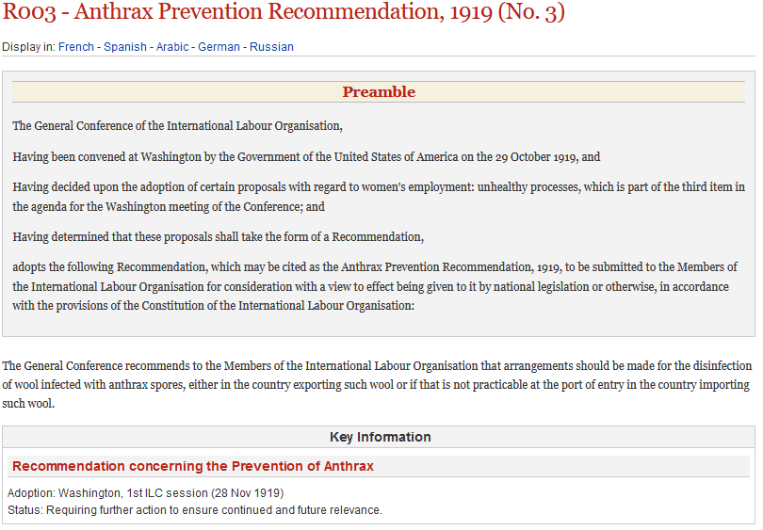
The need for a normative instrument(s)
Acknowledging the limited scope of Anthrax Prevention Recommendation, 1919 (No. 3) and the absence of coverage for other biological hazards, the SRM TWG, during its third meeting in 2017, recommended revising the Recommendation through an instrument addressing all biological hazards and publishing technical guidelines on biological hazards. In line with this, the 331st Governing Body (GB.331/LILS/2) requested the Office to prepare proposals for a potential standard-setting item on biological hazards.

Slide 4
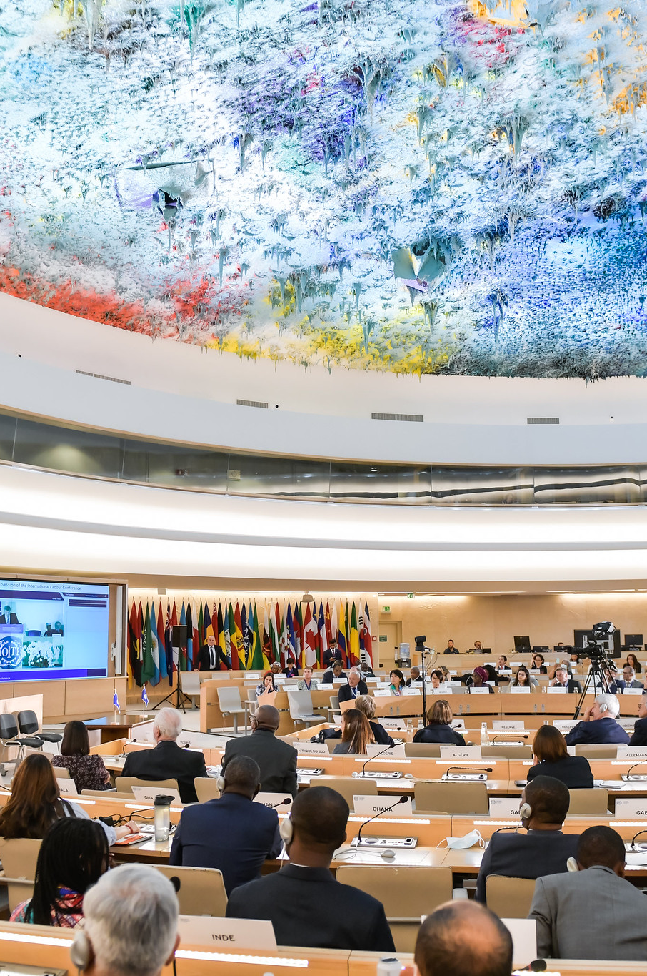
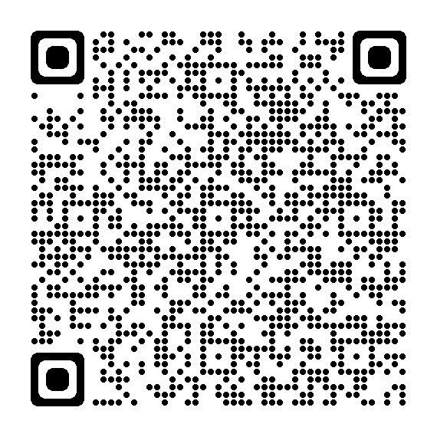
ILO Technical guidelines on biological hazards in the working environment
Key principles to manage biological hazards in the working environment
Adopted by the 346th GB Session
In line with International Labour Standards but NOT legally binding
Technical basis for the normative International Labour Conference discussion (2024–25)

Slide 5

The objective of the Technical Guidelines on Biological Hazards adopted by the 346th Session of ILO’s Governing Body in November 2022 (GB.346/INS/17/3) is to provide governments, employers, workers, and their organizations with key principles for the effective management of biological hazards in the working environment, in line with ILO standards and principles.
The guidelines were drafted by a group of international specialists and were adopted by a tripartite meeting of experts from different countries that met in Geneva from 20 to 24 June 2022.

Slide 6
Standard setting process of double discussion…
Suggestions from governments, workers, employers, Office, UN Agencies, etc.
Governing Body
Participation in the tripartite GB discussion
I Office Report (White) with questionnaire.
Governments
Trade unions can comment the White Rieport Questionnaire
II Office Report (Yellow)
Governments
Advocacy time for TU to influence the first set of discussions
ILC Committee. First Discussion….
Participation in the ILC Discussion..
III Office Report(Brown)
Governments
Trade unions can participate in replying to the Brown Report.
IV Office Report (Blue) Two reports. One showcasing replies to the Brown Report and another one with the Zero draft for the ILS to be discussed and set.
Governments
Consultation
ILC Committee. Second Discussion
Participation
ILC Plenary Session. Voting. Adoption
Voting….

Slide 7
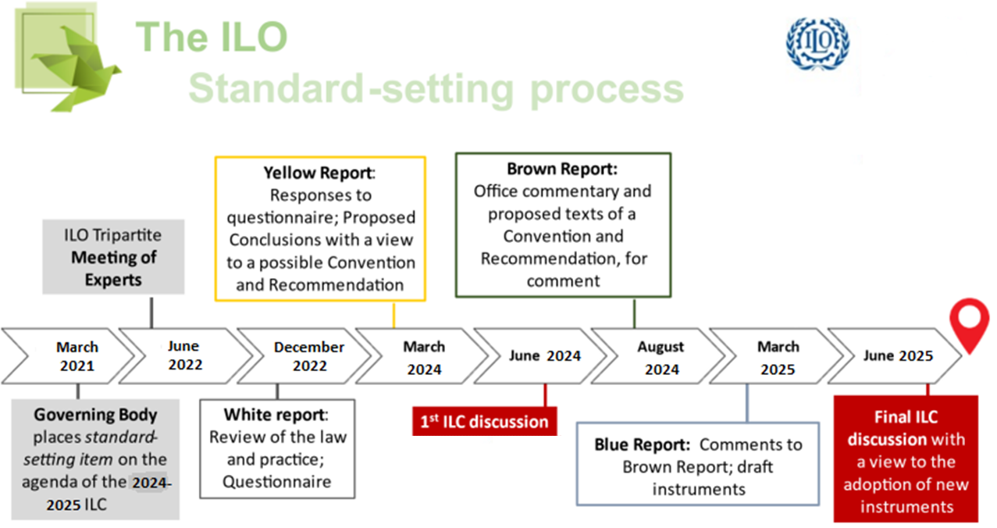



Slide 8
The Governing Body mandated the Office to place this item on the agenda of the 112th and 113th Sessions (2024–25) of the International Labour Conference (standard-setting – double discussion). The Office prepared a preliminary “white” Report IV (1) setting out the law and practice in different countries, together with a questionnaire, which was transmitted to Member States in December 2022. Despite the 31 July deadline and given the initial low number of responses and several requests for extending the period coming from governments, responses were accepted up to 24th October 2023. Report IV(2) “yellow report” based on these responses was published in February 2024.
If, after the first discussion, the Conference deems the question suitable for a Convention and/or Recommendation and places it on the agenda of the 2025 ILC, the Office, based on the first discussion, will prepare a “brown” report within two months, limiting the scope of the discussion to the results of the First ILC Discussion, and placing questions or situations so to received suggestions.
Governments will then be asked to state within three months, following consultation, whether they have any proposed amendments or comments. Finally, the Office will prepare the “blue” report at least three months before the second Conference discussion.

Slide 9
Contents of the report
Abbreviations
Introduction
Replies received and comments.
General observations
Replies received by each of the constituents to each of the questions presented in the White Report and after each, the Office makes comments replying to some of the concerns and suggesting language.
Proposed Conclusions with suggested language for a Conventions and a Recommendation.
Appendix
Report IV (2) aims to inform the first ILC discussion presenting Proposed Conclusions in the form of a Convention and a Recommendation for the Conference’s consideration, based on the diverse replies and comments. Deliberations will offer further insights into the interests and concerns of constituents, setting the stage for subsequent refinements.

Slide 10
Replies and comments on the questionnaire
with more than 8,700 comments….
231 questionnaires received
Constituents actively engaged:
87 governments,
50 employers' organizations, and
94 workers' organizations contributed their insights.
The list of replies is displayed in tabular form in the appendix to the report.

Slide 11
The Proposed Conclusions
( paragraph number)
Form of the instruments (1-2)
Proposed Conclusions with a view to a Convention
    Preamble (3)
    Definition and scope (4-9)
    National Policy (10-12)
    Preventive and protective measures (13-16)
    Occupational health and occupational health services (17)
    Data collection, recording and notification of occupational diseases and accidents (18-19)
    Employment injury benefits (20)
    Enforcement of laws and regulations (21-23)
    Duties and responsibilities of employers (24-28)
    Rights and duties of workers and their representatives (29-31)
    Methods of application (32)
C. Proposed Conclusions with a view to a Recommendation
    Preamble (33)
    Preventive and protective measures (34-37)
    Recording of occupational diseases (38)
    Employment injury benefits (39)
    Enforcement of laws and regulations (40-41)
    Duties and responsibilities of employers (42-43)
    The Recommendation supersedes the Anthrax Prevention Recommendation, 1919 (No. 3) (44)

Slide 12
The majority favour a Convention and a Recommendation (32/83 governments, employers 2/43, workers 64/92), but certain governments (25/83) and most employers’ organizations (29 of 43), expressed a preference for a non-binding Recommendation.
However, if you add up any type of binding instrument is clear majority over non-binding, except for employers:
Binding: G 50/83, E (6/43), W (82/92)
Non-binding: G 25/83, E (29/43), W (2/92)
Despite broad consensus on many aspects, the Yellow Report raises several sensitive and controversial questions warranting further discussion.
These include defining "biological hazards" and "biological agents," regulatory approaches, and potential overlaps with existing provisions in other International Labour Standards (ILS) and public health regulations.

Slide 13
General Observations
All workers’ organizations and overwhelming majority of governments and employers’ organizations are in favour of adopting an instrument(s).
The majority favour a Convention and a Recommendation, but certain governments and most employers’ organizations, prefer a Recommendation arguing existing ILS regulate all hazards.
Despite major support, respondents provided numerous comments concerning the scope of the instrument(s) and the definition of “biological hazards”, which is based on the Technical Guidelines.
The concept of "precautionary measures" triggered discussions, with most governments and all workers’ organizations supporting the development of guidelines on precautionary measures.
Concerns were raised about potential overlaps with public health authorities and the WHO. The Office proposes consultations with WHO (art. 47 of the ILC Standing Orders).

Slide 14


Victor Hugo Ricco. ACTRAV

