Slide 1
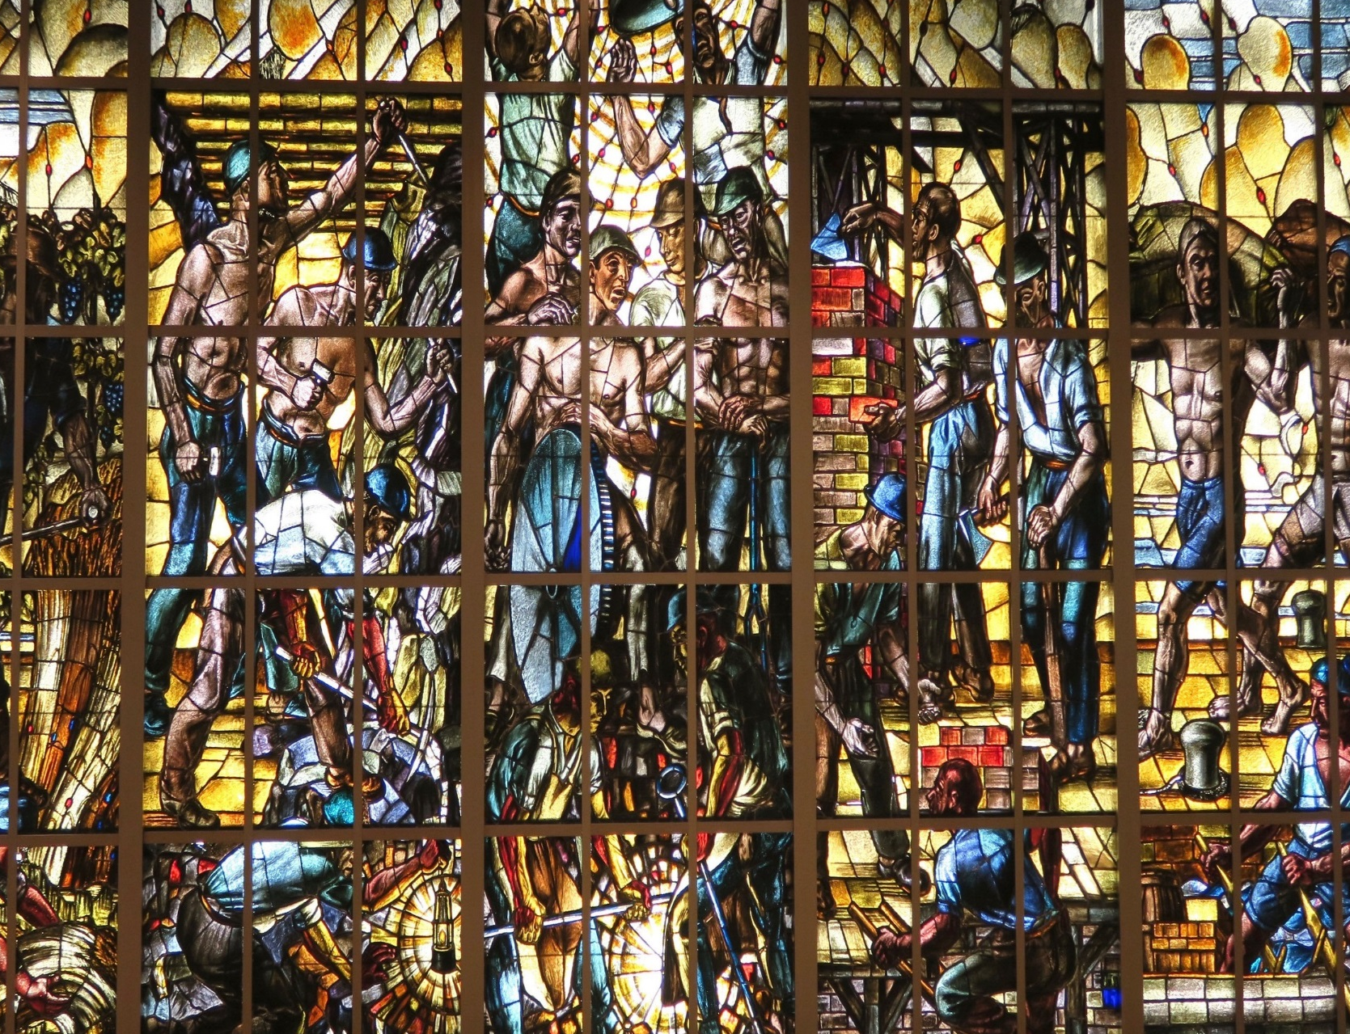
Roles of Trade Unions in Promoting OSH policies and Employment Injury Benefits
Seminar on Trade unions and International Labour Standards
For the Western Balkans Trade Unions
28 April 2023
Kenichi Hirose
Senior Social Protection Specialist
ILO Decent Work Technical Support Team for Central and Eastern Europe
Email: hirose@ilo.org

Slide 2
Social Dialogue and OSH
OSH is a joint commitment between the government, employers and workers
Employers’ responsibility for ensuring a safe and healthy working environment
Workers’ duty to cooperate in the implementation of the OSH programme; and in respecting and applying procedures and protective measures
Joint health and safety committees, an effective mechanism for workers’ participation in OSH management at the workplace level

Slide 3
ILO Promotional Framework for Occupational Safety and Health Convention, 2006 (No. 187)
Article 1 (d).
A national preventative safety and health culture refers to a culture in which the right to a safe and healthy working environment is respected at all levels, where government, employers and workers actively participate in securing a safe and healthy working environment through a system of defined rights, responsibilities and duties, and where the principle of prevention is accorded the highest priority.

Slide 4
THE ROLE OF WORKERS
At national level:
Participate through their organizations in national tripartite bodies
At workplace level:
Cooperate with employers and participate in joint OSH committees
Follow safety and health instructions and procedures
Report any work related accident or injury and any hazardous situation
Request and participate in OSH training and awareness-raising activities

Slide 5
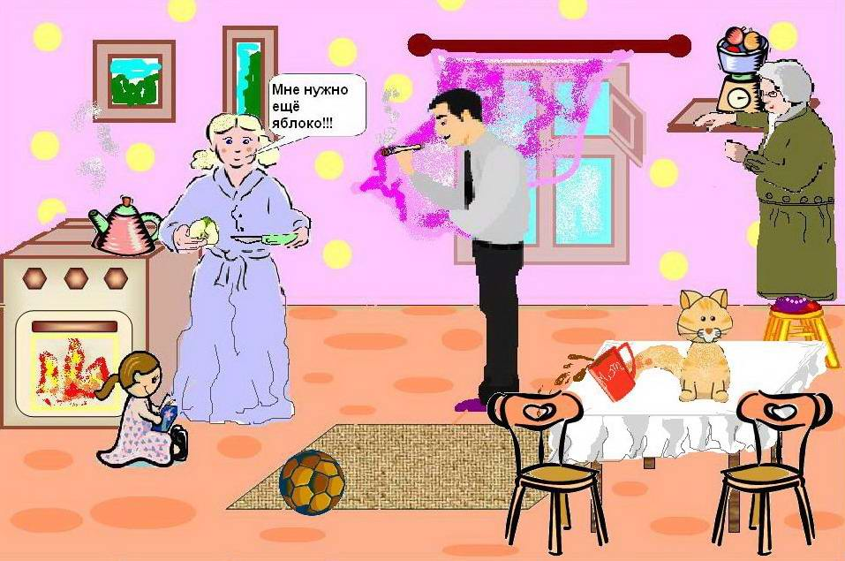
Exercise in risk assessment:
Where are hazards and how serious the damages?
P.2.1

Slide 6
Example: Caught in conveyor belt

Slide 7
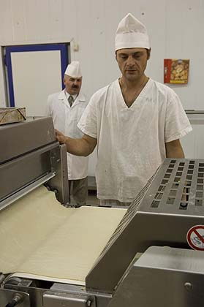
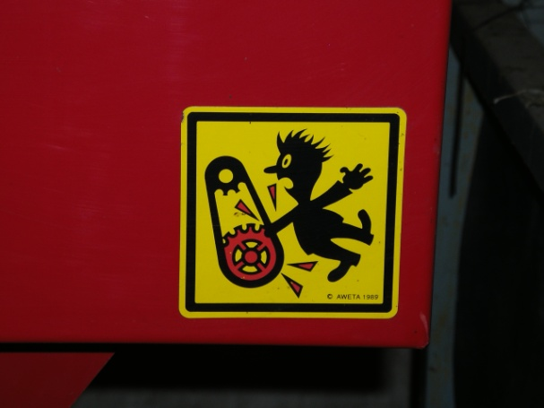
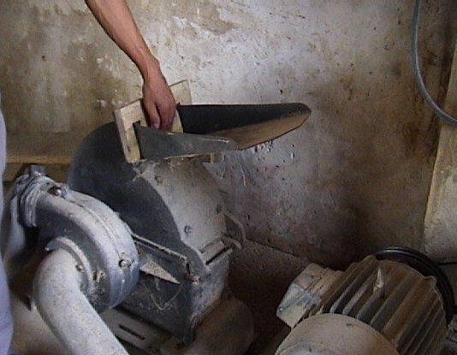
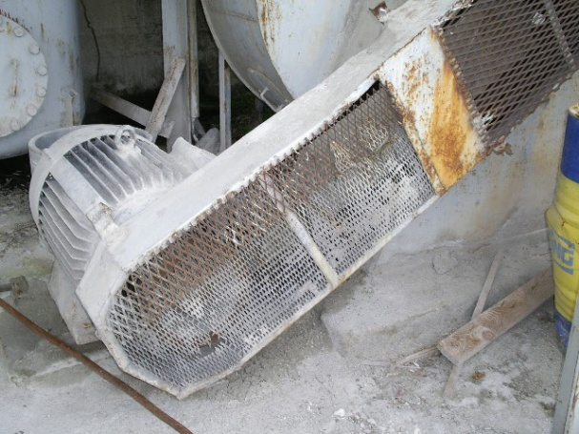
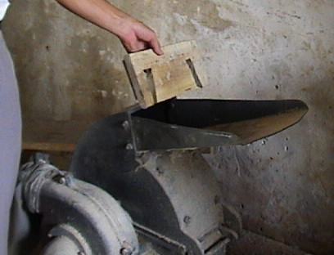
Example: Productive machine safety

Slide 8
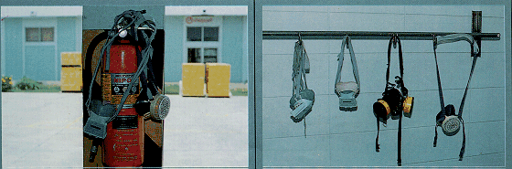
Example: Materials handling and storage
Before
After

Slide 9
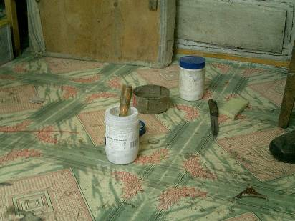
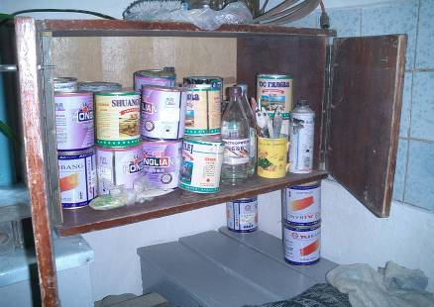
Example: Protection against hazardous substances
Before
After

Slide 10
THE ROLE OF SOCIAL SECURITY
Provide medical care and cash compensation for work accidents and occupational diseases
Provide rehabilitation to facilitate the return to work after injuries or diseases
Promote workplace safety and health as prevention
Ensure recording and reporting of data on occupational accidents and diseases

Slide 11
Risk management approach to employment injury
Two complementary approaches to prevent and respond work accidents and occupational diseases:
Proactive approach (OSH programmes)
=> Focus on Prevention and Enforcement
Reactive approach (Employment Injury Benefits)
=> Focus on Treatment, Compensation and Rehabilitation

Slide 12
Basic structure of employment injury benefits schemes
Most widely adopted branch of social security (174 countries out of 177)
Compensations for employment injury are made without attribution of fault, as opposed to lawsuit under Common Law
Funding is employers’ legal responsibility
Benefits comprise medical care and cash benefits
Benefit level is higher than health insurance or general disability benefits

Slide 13
Employment injury benefits
Medical care and hospital treatment (Morbid condition)
Temporary incapacity for work
Permanent disability (Total or partial loss of earning capacity)
Death benefit for the survivors (including funeral grant)

Slide 14
ILO Conventions on Employment Injury Benefits
C.102 (1952), Social Security (Minimum Standards) Convention [64 ratifications] (also R.202)
C.121 (1964), Employment Injury Benefits Convention [24 ratifications] (also R.121)

Slide 15
Risks covered by C.102
1 | Sickness
2 | Maternity
3 | Employment injury
4 | Unemployment
5 | Invalidity
6 | Old-age
7 | Death
8 | Medical care
9 | Family benefits
Cash sickness benefits Paid sick leave
Cash maternity benefits Paid maternity leave
Workers’ compensation Employment injury benefits
Unemployment insurance Employment service
Invalidity allowance (lump sums) Invalidity pensions
Provident funds, Ret. allowance Old-age pensions
Survivors’ pensions Funeral benefits
Health insurance (curative care) Health promotion, prevention, rehab.
Child allowances Family allowances

Slide 16
Ratification of C.102 by branch and C.121
COUNTRY | DATE OF RATIFICATION OF C.102 | BRANCH
 |  | MEDICAL CARE | SICKNESS | UNEMPLOYMENT | OLD AGE | EMPLOYMENT INJURY | FAMILY | MATERNITY | INVALIDITY | SURVIVORS'
Albania | 18/01/2006 | √ | √ | √ | √ | √ |  | √ | √ | √
Bosnia and Herzegovina | 02/06/1993 | √ | √ | √ | √ | (C.121) |  | √ |  | √
Montenegro | 03/06/2006 | √ | √ | √ | √ | (C.121) |  | √ |  | √
North Macedonia | 17/11/1991 | √ | √ | √ | √ | (C.121) |  | √ |  | √
Serbia | 24/11/2000 | √ | √ | √ | √ | (C.121) |  | √ |  | √

Slide 17
International standards on employment injury benefits: principles
Schemes must be financed by employers as a continuation of the responsibility for workplace safety
Eligibility for benefits may not be subject to the length of employment or payment of contributions (even day 1)
Medical and cash benefits should be provided throughout the contingency
Cash benefits for permanent disability and survivorship should be paid in the form of periodical payments (pensions). Amounts should be reviewed following substantial increase in the cost of living.
The costs of the benefits and administration should be financed collectively by contributions or taxes.

Slide 18
International standards on periodical payments for standard beneficiaries married with 2 children
        (As a % of previous earnings)
 | C.102 Minimum Standards | C.121 (cf. C.128) | R.121 (cf. R.131)
Temporary incapacity for work | 50 | 60 | 66.7
Total loss of earning capacity | 50 | 60 | 66.7
Survivorship due to empl. injury | 40 | 50 | 66.7
Cf. Sickness | 45 | 60 | 66.7
Cf. Invalidity | 40 | 50 | 60
Cf. Survivorship | 40 | 45 | 55

Slide 19
Scope for improvement
Payment of rehabilitation (medical and vocational) and commuting accidents
Cover self-employed workers, farmers and workers in the informal economy
Tackle the under-reporting of work accidents and occupational diseases
Closer link with prevention (OSH)
From employers’ liability to social insurance system

Slide 20
Group work - Instruction
    Form a small group
    Nominate the rapporteur
    Read the statements (next slide), and discuss:
              Share your views (Is this common in your country?, Do you agree or disagree?)
              What are the underlying problems/issues?
              What can Trade Unions do to improve?
    Feedback at the plenary

Slide 21
Group work – Questions
    An employer says “I provide protective equipment and training, but my workers do not wear or attend trainings. A large part of accidents occur due to the fault of workers.”
    A worker says “I would rather get more salary payment than my employer spending money for safety.”
    An employer says “OSH interventions are costly, they interrupt the flow of work activity, and regulations impose a non-productive investment.” Likewise, “Labour inspection should be minimized if not abolished.”
    In your country, does the EI system cover (a) accidents during commutation and (b) costs of rehabilitation? If not, why?
    A worker had an accident at work but does not want to report and claim paid sick leave because if she does so her employer may terminate her employment. (Similar situation between main and sub contractors).
    Do work-related injuries and diseases diagnosed properly by the doctors? Is the national register of occupational diseases functional in your country?

Slide 22
Thank you for your attention
For further information, please visit our webpage at
www.ilo.org/global/topics/safety-and-health-at-work
www.ilo.org/budapest

Slide 23
Comments for BiH, North Macedonia, Montenegro and Serbia
These countries have no specific scheme to cover work accidents and occupational diseases. In the current system, these contingencies are covered by PIO fund (for cash benefits) and health insurance fund (medical benefits).
The benefit level is the same as non-work related cases
A question: is employers’ responsibility recognized?
The way ahead:
  Review the benefit and financing structure
  Study the organizational arrangements:
    Establish a separate fund for employment injury insurance. (premium system, administrative capacity)
    Amendments within the current organizational framework

Slide 24
Comments for Kosovo
Temporary incapacity are provided to employees directly from employers.
20 days ordinary sick leave with 100 percent salary
90 days work-related sick leave with 70 percent salary (after 10 days of waiting period).
Pensions are provided by the general budget. Pensions are payable for 100 percent disability. The amount pension is 100 euro. The benefit level is the same as non-work related cases.
Health care services are provided by the public health system and patients are asked to make out-of-pocket payments.

Slide 25
Questions for the participants
Q1. In your country, are employment injury (EI) benefits (workers compensation) paid directly by individual employers or by a social insurance scheme? In the first case, has there been any attempt to introduce a social insurance scheme?
Q2. Explain how you enforce the Law on EI benefits to small and medium enterprises. Are there any problems?
Q3. In your country, are permanent invalidity benefits paid in lump-sum or in pensions? In the first case, please explain why.
Q4. In your country, does the EI system cover (a) accidents during commutation and (b) costs of rehabilitation? If not, why?
Q5. Explain how your EI system coordinate with MOL (labour inspectorate and OSH authorities). Does your EI system contribute to preventative activities (e.g. safety campaign, training)?
Q6. Explain how work accidents and occupational diseases are reported in your country. Any problems?

Slide 26
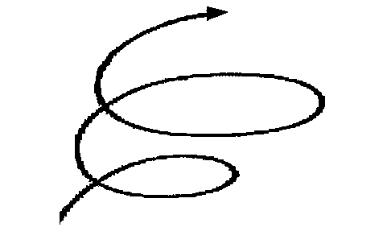
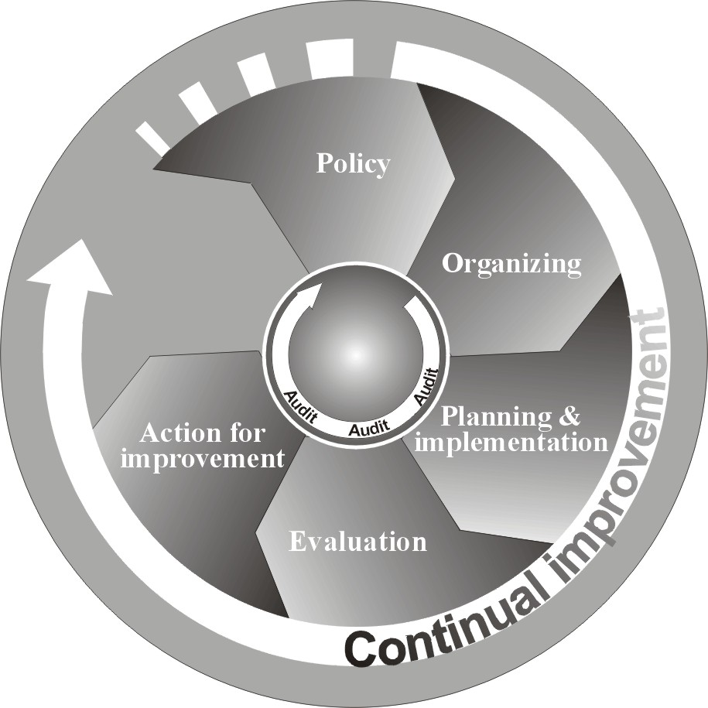
Continual improvement of OSH performance by PDCA cycle
Act
Plan
Do
Check
Act
Plan
Do
Check

Slide 27
Collection and analysis of OSH data
Reliable and consistent OSH statistics are the basis for the policy development as well as for monitoring and evaluation.
However, there is little incentive for reporting accidents and diseases. The enforcement mechanism for reporting is generally weak.
An effective reporting system should be a part of national legal framework. Protocol of 2002 to the Occupational Safety and Health Convention (No. 155, 1981) stresses the need to strengthen recording and notification procedures of occupational accidents and diseases.
Employment injury schemes have the role of reporting accidents and supplying statistics to the OSH authority.

Slide 28
Business Case for OSH (direct & indirect)
Improved productivity
Savings through better plant maintenance
Reduced absenteeism
Improved worker retention
Reduced compensation claims and accident insurance
Corporate image enhanced (CSR, RBC)
Improved client / supplier relationships
Higher worker morale, motivation and concentration at work
Source ILO GB Paper 295/ESP/3, March 2006

Slide 29
Comparison of premium rating methods
1. Uniform rating
2. Differential rating
3. Experience rating
Enterprises

Slide 30
Remarks on the experience rating system
Under the experience rating system (the “bonus-malus” premium system), the contribution rate is adjusted within certain range according to an enterprise’s claims experience.
The rates provide for a more equitable distribution of the charges but there will be less insurance element (pooling of risk) and each establishment would pay its own accident costs.
Supporters claim that this system provides an incentive for employers to reduce the number of employment injuries and to reduce lost time due to work injuries by implementing OSH measures.
Opponents argue that experience rating compromises the collective solidarity in social security financing. It incurs higher administrative costs. Without proper monitoring and enforcement, this system encourages employers’ under-reporting.
If higher administrative costs can be offset by a reduction in the total cost of injuries, then the experience rating system can be considered appropriate.

