Slide 1

Global wage report 2016/17
Wage inequality in the workplace
Mariko Ouchi
ILO-Budapest
ouchi@ilo.org

Slide 2

Some preliminary remarks
The 2008 ILO Declaration on Social Justice for a Fair Globalisation calls for policies “designed to ensure a just share of the fruits of progress to all, and a minimum living wage to all employed and in need of such protection”
Wages are a key source of income: they often represent 70% to 80% of total income for households with at least one member in the labour force.
Wages have an important effect on the economy: They have a direct impact on competitiveness, consumption and aggregate demand.
In many countries, wage trends have become a political issue, changing the “nature of political discussion”.

Slide 3





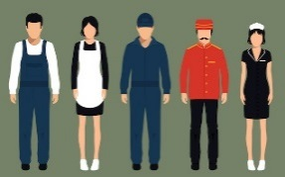



Outline
Part I: Major Trends in Wages
Global trends
Wages, productivity and labour shares
Part II: Wage Inequality in the Workplace
The extent of wage inequality
Within & between enterprises
Gender pay gaps
Part III: Summary & Conclusion

Slide 4
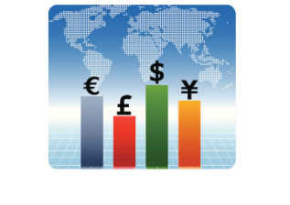


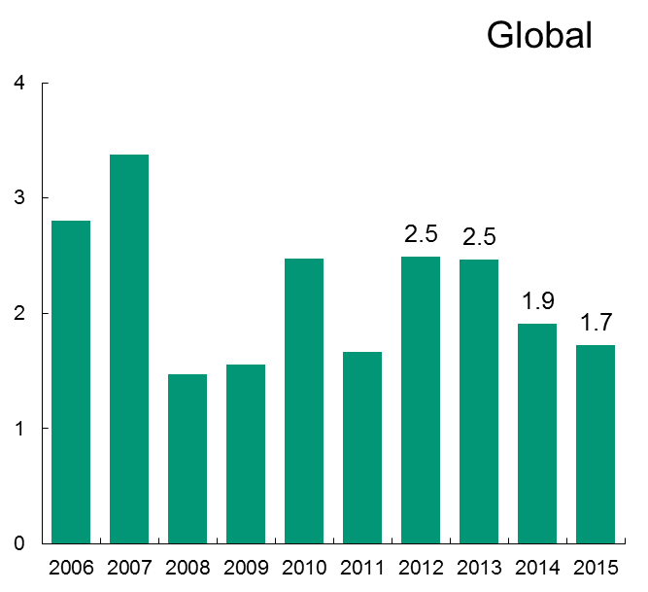
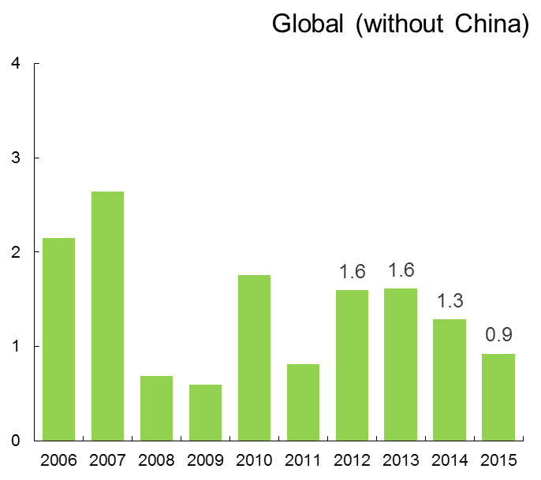
Global wage growth has decelerated since 2012
Annual average global real wage growth (2006-15)
Weighted average; data from ILO global wage database,
%

Slide 5
Wage growth has increased in developed countries; but declined in emerging economies
Annual average real wage growth in the G20 (2006-15)
Weighted average; data from ILO global wage database,
%

Slide 6

Real wage growth in Moldova is steady
Nominal monthly average wage (2010-14)
Data from national statistics office;
Moldovan Leu (MDL)
Real wage growth (2010-14)
Calculated by ILO, based on nominal wage data from National statistics office & IMF cpi
%

Slide 7

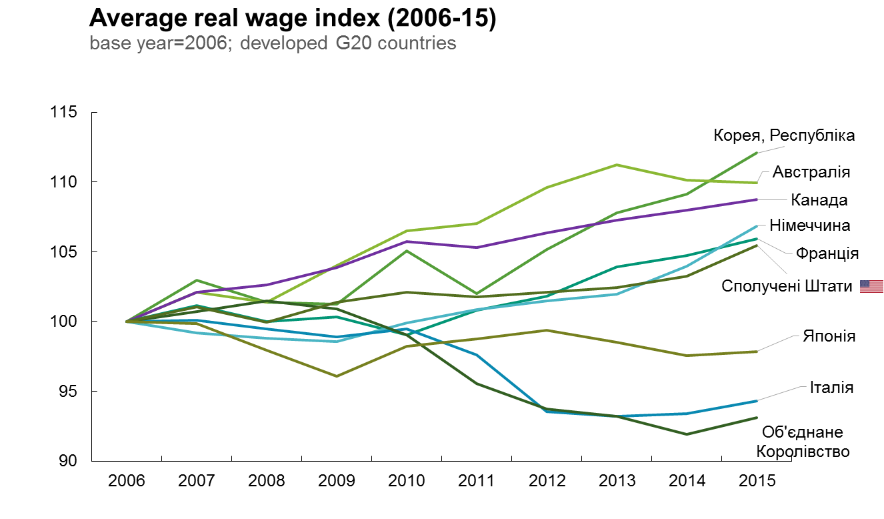
In the last 10 years, real wage gaps have opened up between developed countries

Slide 8

… and also between emerging economies
Notes:
The figure shows that among developed G20 economies real average wages have increased most rapidly for South Korea, Australia and Canada. In fact, all countries except for Japan, Italy and the United Kingdom show positive real wage growth. In the case of the UK, real wages in 2015 stand at about 93% the value of wages in 2006.

Slide 9

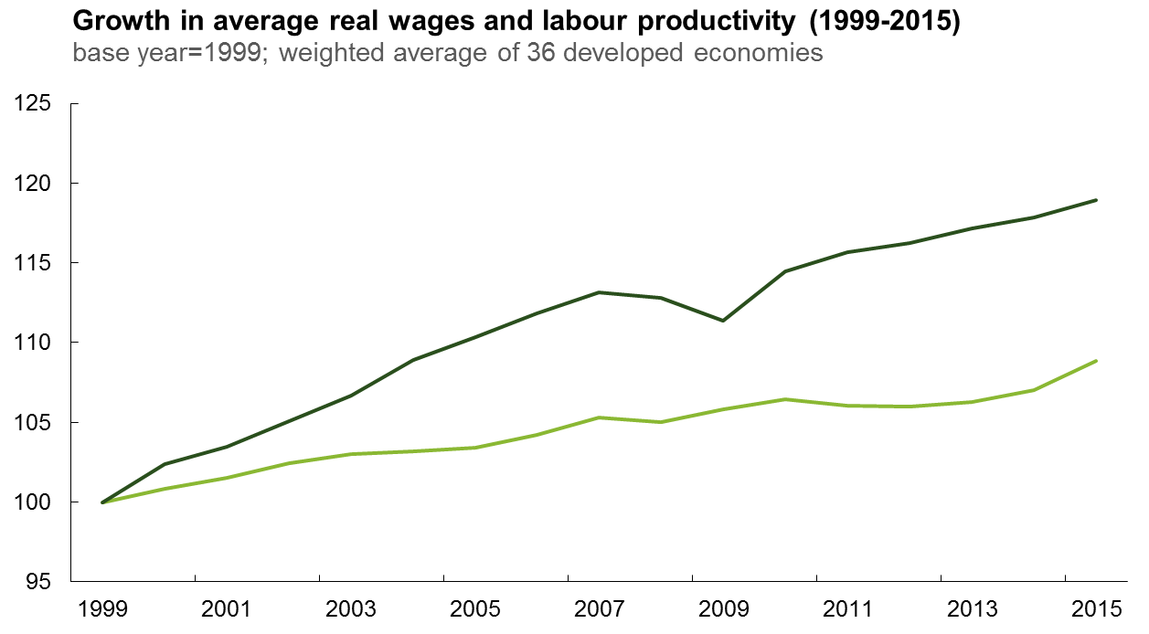
In developed countries, real wages growth has lagged behind the growth of labour productivity
Labour productivity
10ps
2x
5ps
7ps
Wage

Slide 10
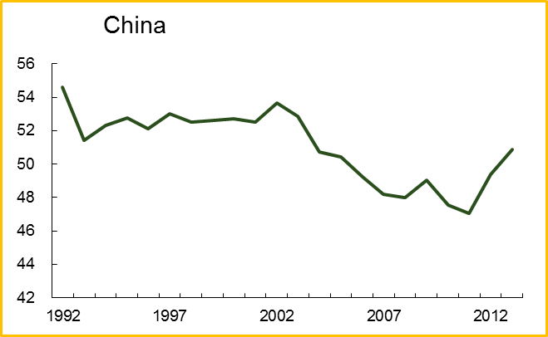
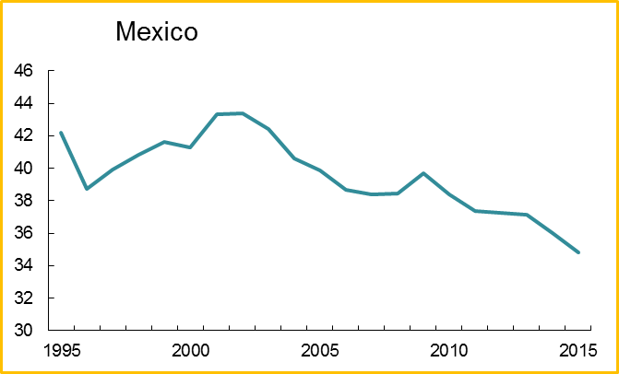
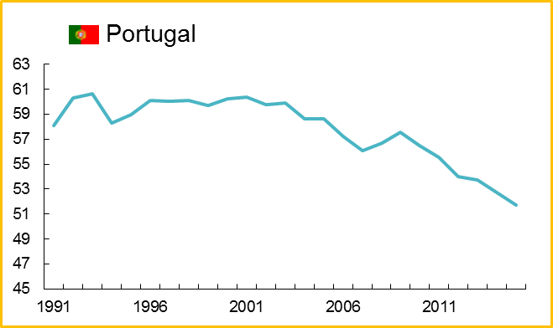
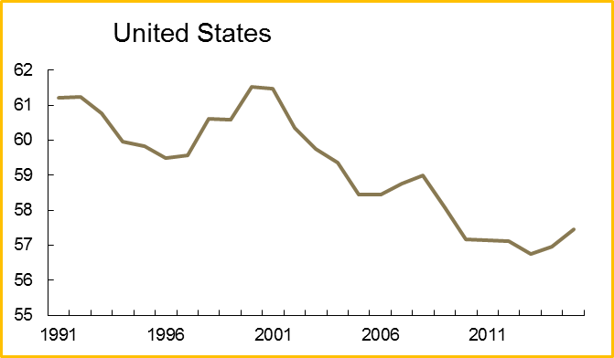
… and there has been a global decline in labour income shares
Adjusted labour income share, %
Note: China data is unadjusted

Slide 11

But in Moldova, growth trends of wage and productivity are synchronized…
Moldova total labour income share (2000-14)
Data from ILO global wage database
Moldova wage vs productivity (2006-14)
Calculation based on ILO wage database
Index
Wage
Productivity

Slide 12
In conclusion …
Emerging
economies
  Some emerging economies have performed well in terms of average wage growth, but the pace of convergence is slowing down
Developed
economies
  Wage growth has been slow in many developed economies, lagging overall behind productivity growth
Coordination
Coordination of wage policies should take into account the relationship between wages & productivity, and labour income shares.

Slide 13
Outline
Part I: Major Trends in Wages
Global trends
Wages, productivity and labour shares
Part II: Wage Inequality in the Workplace
The extent of wage inequality
Within & between enterprises
Gender pay gaps
Part III: Summary & Conclusion

Slide 14

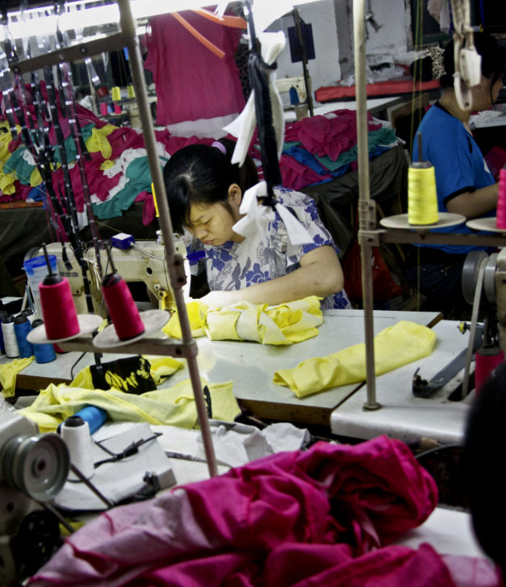
Motivation and Data Sources
Motivation for Part II
Data sources for Part II
  Excessive inequality is bad for economic growth; It reduces social mobility and creates divisions within society.
  For Europe, we use EMPLOYER-EMPLOYEE matched data (Structure of Earnings Survey, Eurostat).
  22 Countries, 2002 to 2010, 22 million wage employees from about 1.1 million enterprises
  For Emerging & Low income Economies, such data is not available. Instead, we used labour & household surveys & enterprise level surveys
  Debate has mostly focused on the characteristics of workers, and the effects of technology and globalization. A new literature looks at the role of the workplace.

Slide 15

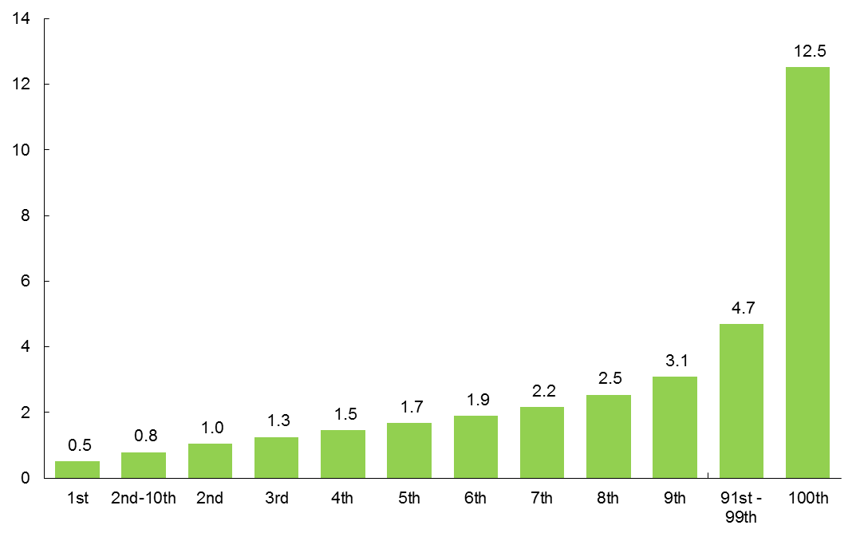
Wage inequality increases sharply at the top
Gross monthly wage of employee (2010)
Weighted average by centile; data from 22 European economies,
Euro (thousand)
7.4x

Slide 16
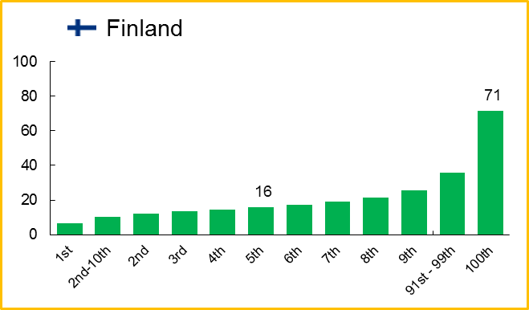
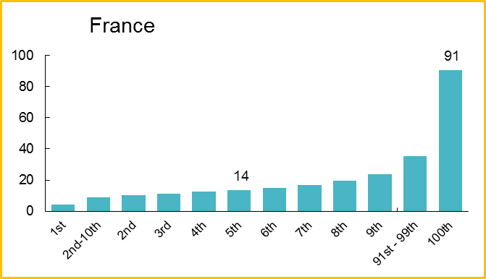
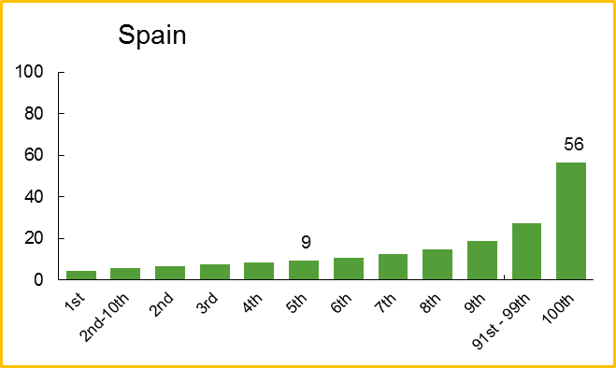
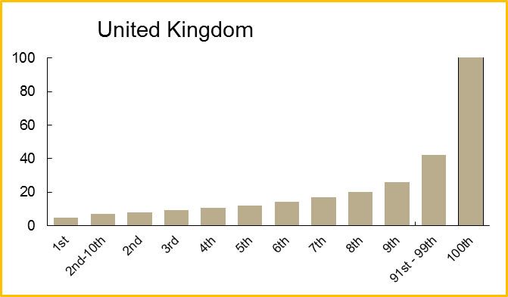
There are differences across countries; some have much lower wages inequality
Gross hourly wage of employee (2010)
Weighted average by centile; data from 22 European economies,
Euro
4.4x
6.5x
160
13.3x
6.2x
12

Slide 17
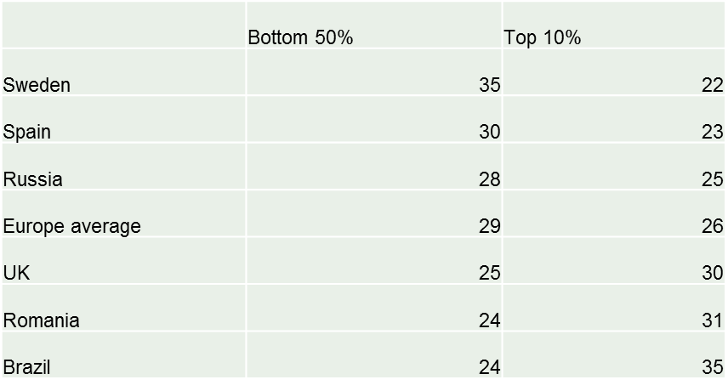
Top decile of highest-paid employees earns as much as the bottom 50% of the population
Real gross monthly wage share of employee (2010)
Weighted average; data from 22 European economies,
%
3.6%
D90

Slide 18

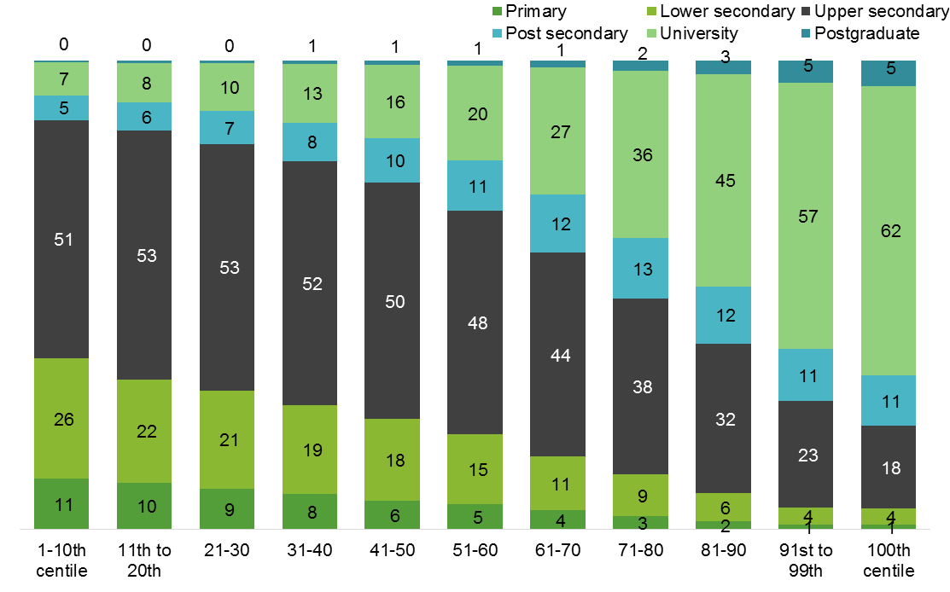
Education is correlated with wage levels, but does not explain everything
Education of wage employee (2010)
Weighted average by centile; data from 22 European economies,
%
Having college degree does not help you move to top 1%

Slide 19
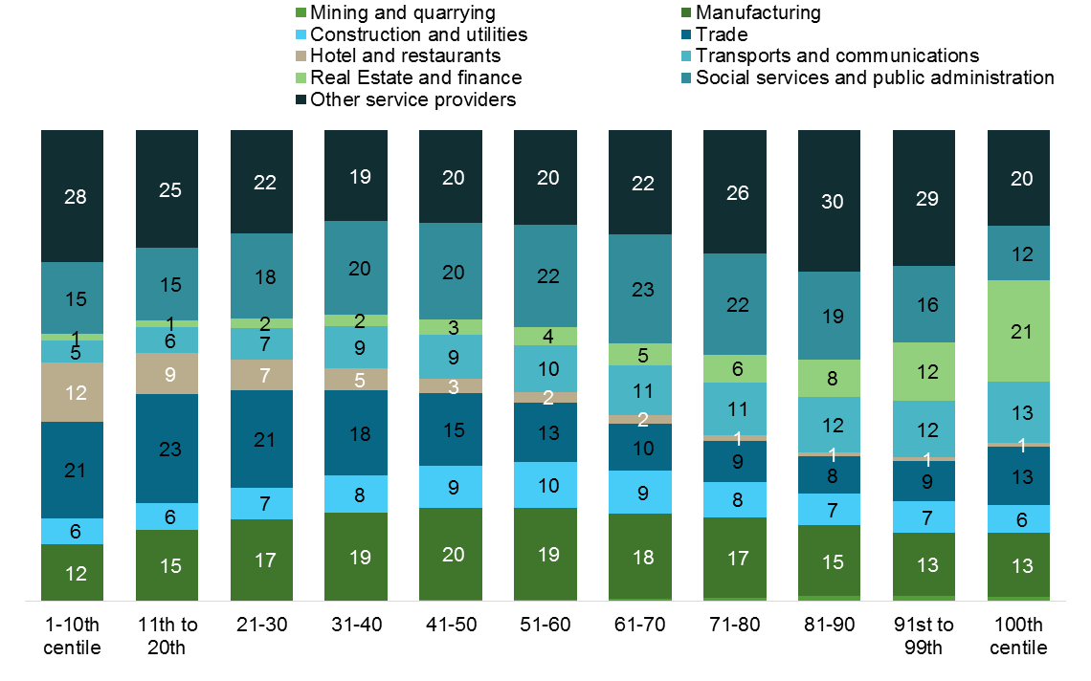
Economic sector and other factors also play a role
Economic sector of wage employee (2010)
Weighted average by centile; data from 22 European economies,
%
1 in 5 top 1% wage earner work in Real estate and Finance

Slide 20



Next, we therefore bring enterprises into the analysis
Between enterprises
Within enterprises
According to recent research, increases in inequality are due in part to growing difference in productivity and wages between enterprises
But what about inequality within enterprises? Let us also consider what is going on within enterprises

Slide 21

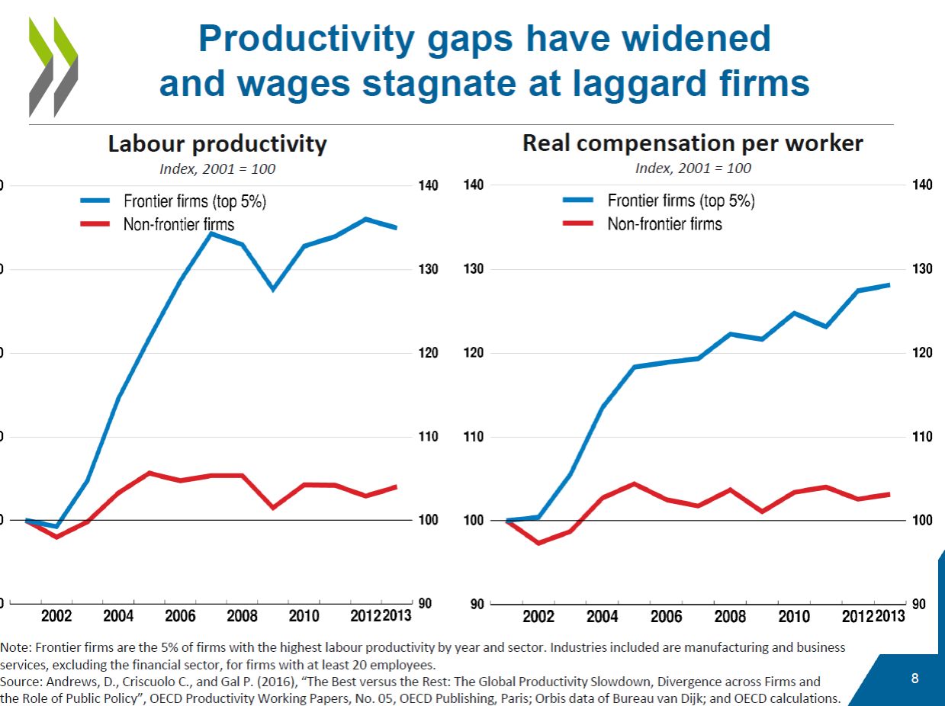
Inequality between enterprises
A recent chart from the OECD

Slide 22


Inequality within enterprises
About 80% of employees earn less than the average wage in their enterprises
Wage inequality is much higher among enterprises that pay high average wages
A few workers in a few enterprises earn extremely high wages

Slide 23
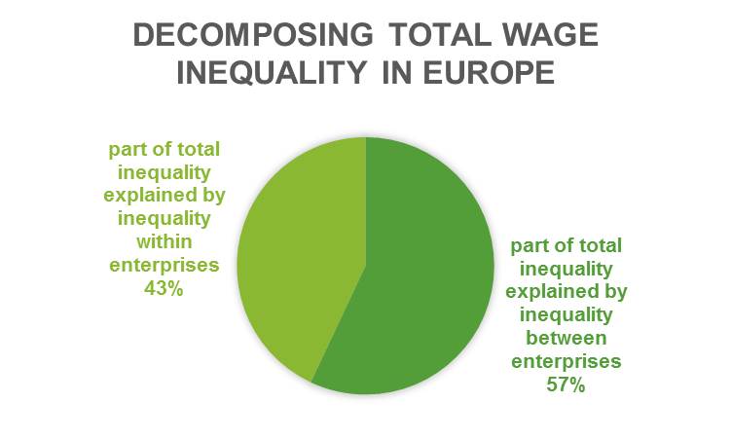
Decompose total variance in wages as the sum of the “within” and “between”
Average hourly wages of individuals & enterprises (2010)
Wage variance; data from 22 European economies,
% of total
Within-enterprise inequality is as nearly important as between- establishments inequality

Slide 24
Countries with more “between” inequality also have more “within” inequality
Decomposition of variance (2010)
Average hourly wage; data from 22 European economies
s² (ln)

Slide 25
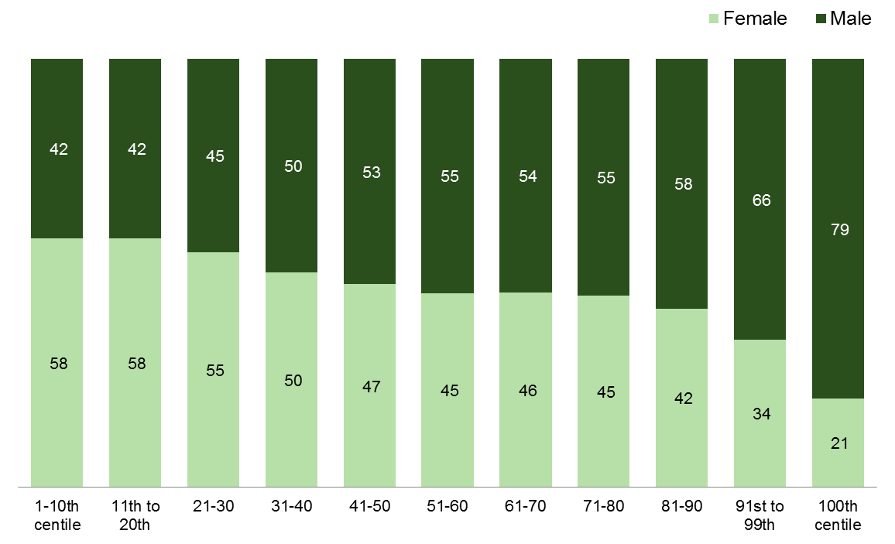
Fewer women in top deciles; more woman in low-pay
Gender of wage employee (2010)
Weighted average by centile; data from 22 European economies,
%
4x
1.4x

Slide 26
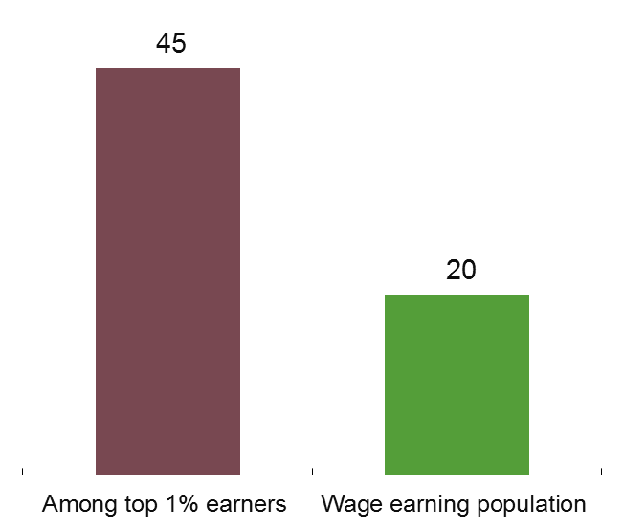
Gender wage gap is even wider among top 1% of wage employees
Gender of wage employee (2010)
Ratio of female to male hourly earnings among total population; data from 22 European economies,
%

Slide 27
Outline
Part I: Major Trends in Wages
Global trends
Wages, productivity and labour shares
Part II: Wage Inequality in the Workplace
The extent of wage inequality
Within & between enterprises
Gender pay gaps
Part III: Summary & Conclusion

Slide 28
Proposing country-specific measures to reduce excessive wage inequality
1
Productivity growth for sustainable enterprises
    No necessary trade-off between growth and inequality
    ILO Conclusions concerning the promotion of sustainable enterprises
Minimum wages & collective bargaining
Government
Trade Union
Employer
Sustainable Wage Policies
Gender & other pay gaps
    Top salaries

Slide 29

Proposing country-specific measures to reduce excessive wage inequality
1
Productivity growth for sustainable enterprises
Minimum wages & collective bargaining
    The need for institutions
    How to design sustainable wage policies?
Government
Trade Union
Employer
Sustainable Wage Policies
Gender & other pay gaps
    Top salaries

Slide 30

Proposing country-specific measures to reduce excessive wage inequality
1
Productivity growth for sustainable enterprises
Minimum wages & collective bargaining
Government
Trade Union
Employer
Sustainable Wage Policies
    Regulation or self-regulation?
    Transparency and shareholder “say over pay”
    Top salaries
Gender & other pay gaps

Slide 31
Proposing country-specific measures to reduce excessive wage inequality
1
Productivity growth for sustainable enterprises
Minimum wages & collective bargaining
Government
Trade Union
Employer
Sustainable Wage Policies
    Equal pay legislation
    Job evaluations
Gender & other pay gaps
    Top salaries

Slide 32
THANK YOU FOR YOUR ATTENTION!
For further information on Global Wage Report or research conducted by the ILO wage group, please refer to:
Global Wage Report 2016/17
http://www.ilo.org/global/research/global-reports/global-wage-report/2016/WCMS_537846/lang--en/index.htm
Minimum Wage Guide & Other Publications http://www.ilo.org/global/topics/wages/publications/lang--en/index.htm

