Slide 1
Gender pay gap and pension differences in Serbia
Vilnius, Lithuania
September 25-26, 2019

Slide 2
 | No women | No unemployed women | No employed women | No educated women | salaries | business | Mean salaries | Min salaries
SER |  |  |  |  |  |  | 490 e | 230 e-255 e
MN |  | 17 %total58% | 43,8% |  | < 13,9 % | 25% | 511 e | 222e
Mean pension | Min pension
210 | <100
289 | 128

Slide 3
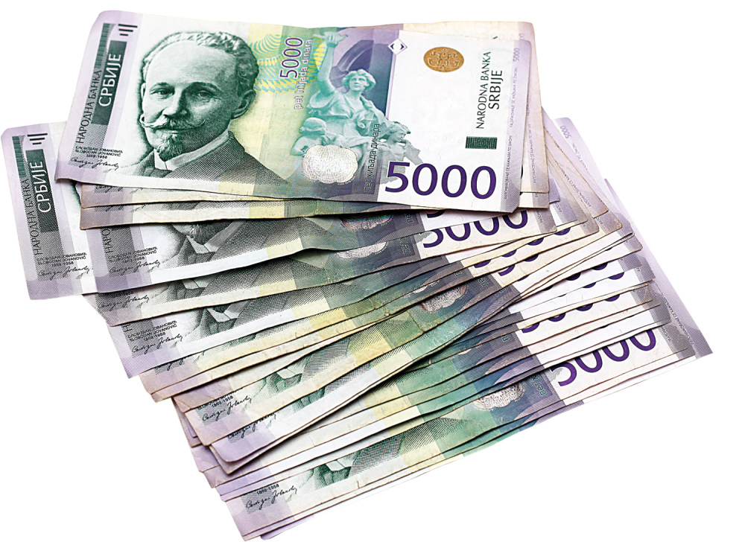
Women in Serbia earn about 16% less than men (16.3% is the European average)
women in Serbia have to work an additional 40 days a year to earn as much as men with the same characteristics in the labor market

Slide 5
Women make up the majority of the workforce in the lower paid professions - health, education, social work, textile, hospitality and so-called. assisting professions.
Men are more often in managerial positions, more often in specializations and training and less in sick leave - both maternity leave and those taken because of childhood illnesses. So we come to the pay gap between men and women. Due to the fertile period and child-rearing, women are more likely to 'drop out' of the career race and this ultimately affects the level of earnings ”-

Slide 7
Wage inequalities between regions and between genders in Serbia are enormous. Employees in the Belgrade region, for example, receive as much as 51 percent higher salaries than employees in central Serbia.
By far the biggest difference is at the level of the highly educated.
Men employed with a college diploma received an average of 750 e in March, and women 570 e difference of as much as 37 5%.
The smallest difference is for employees with secondary education - “only” 26%.

Slide 8
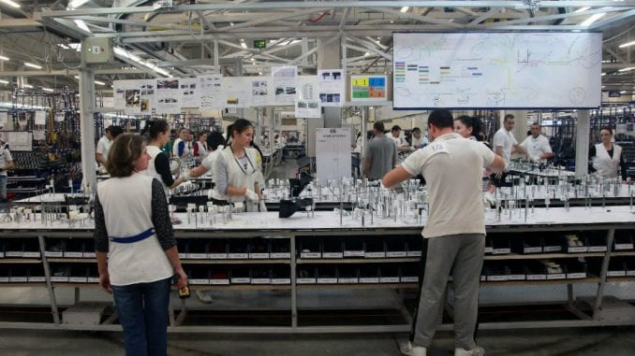
Thus, the average salary of graduates is 640 e , while the average salaries of employees with high school are 400 e, while workers with lower education receive another 100 e less

Slide 9
The largest gap of 10.1% is among men and women between the ages of 40 and 49
9.3% is the difference in the category of those who are 30 to 39 years old
while the smallest wage gap among the over-60s is just 0.3%.
the smallest pay gap is among administration officials - 3%.
In the IT sector, female developers in the same positions as their male counterparts are paid up to € 400 less.
On average, women made more money than men on a yearly basis only in the fields of transport, real estate and services, while in all other men they were better paid
Salaries in the public and public sector are transparent and regulated by law, there is no law that obliges private companies.

Slide 10
Women in Serbia more qualified than men (more graduates and PhDs)
Compared to men who spend 10 hours a week on housework, women spend an additional 22 hours a week doing homework after work. With the pay gap that exists, women would have to work 40 days longer to reach the men's earnings

Slide 11
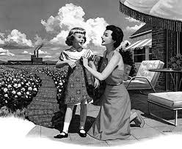
We have 350,000 women between the ages of 25 and 54 who are not working. The reason for not looking for work is most often about caring for family members

Slide 13
PENSIONS

Slide 14
Men in Serbia retire at the age of 65 with a minimum of 15 years of service
Women with 62 years of age and a minimum of 15 years of service.
The age limit for women is gradually rising every year, so it should be equal to that for men in 2032, since women would also need 65 years to retire.

Slide 15
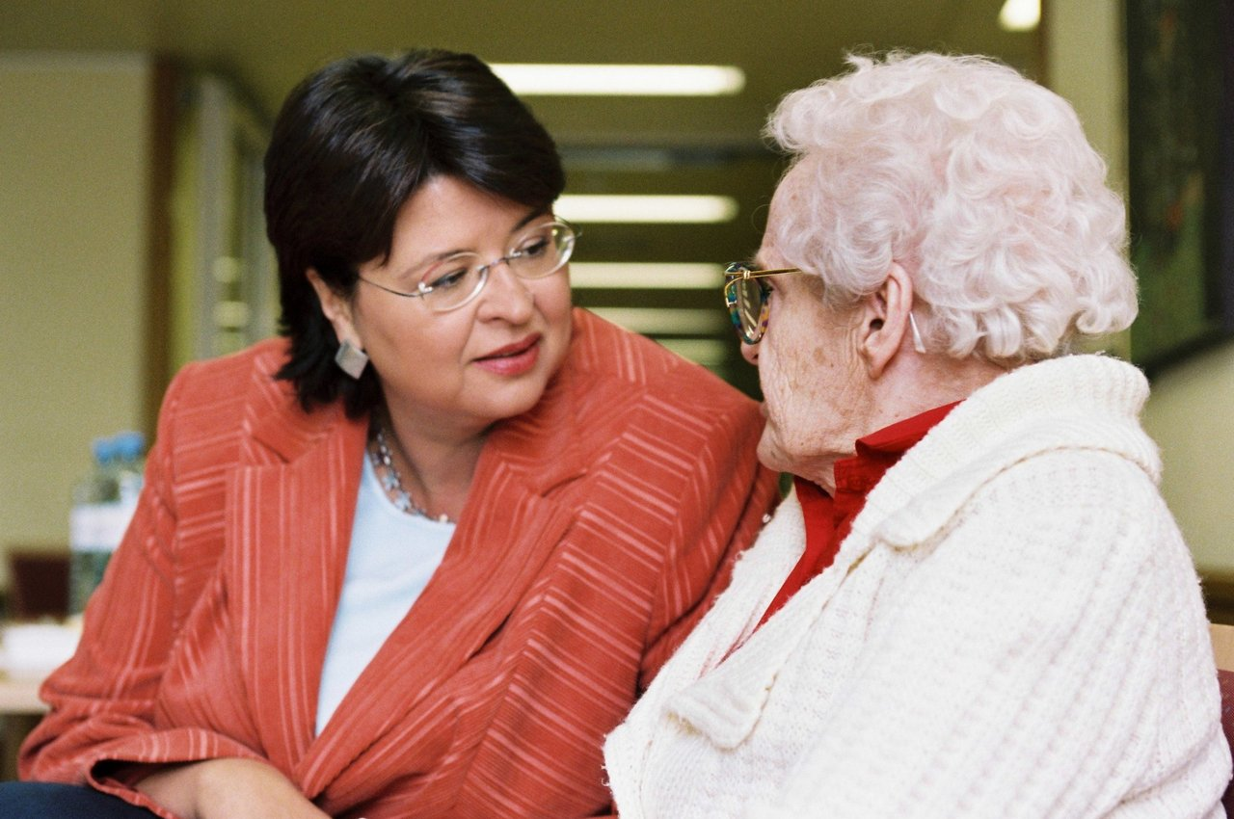

Slide 16
And when they retire, women are at a disadvantage - their pensions are between 280 e and 300 e and in this range 21 percent are retired
58 percent of men receive pensions between 300 and 350 e.

Slide 18
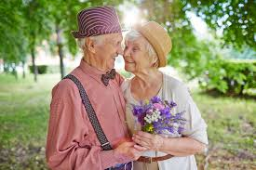
The minimum pension is the minimum amount that one can receive as an old-age pensioner and is currently just above 120 e. It is higher than the pension of someone who has minimum pension requirements (only 15 years of service with the lowest paid contributions), to ensure that all retirees are above a certain level of income

Slide 20
Thank you for your attention !!!
Section of Women INDEPENDENCE Serbia

